Slide 1
Anorexia, Nausea, and Vomiting in Palliative Care
Bree Johnston, MD MPH FACP
Director Palliative Care at PeaceHealth

Slide 2
Learning Objectives
By the end of this talk, the learner should be able to:
  Identify anorexia as a common source of distress for both patients and caregivers
  Discuss the importance of framing and exploring meaning when dealing with patients with anorexia
  Discuss the prevalence of anorexia, nausea, and vomiting among patients with serious illness
  Discuss the evidence for various pharmacologic approaches to anorexia, nausea, and vomiting
  Discuss nonpharmacologic approaches to anorexia, nausea, and vomiting

Slide 3
Anorexia is common in palliative care Patients
Anorexia occurs in about ¼ of palliative care patients (not all have anorexia-cachexia)
  Anorexia = poor appetite
Anorexia-cachexia affects > 50% of cancer patients
  Anorexia = poor appetite
  Cachexia = catabolic state
Inui A, “Cancer Anorexia‐Cachexia Syndrome: Current Issues in Management and Research.” Cancer J Clin 2002; 52:72‐91

Slide 4
Cachexia
Complex metabolic syndrome associated with:
  underlying illness
  loss of muscle
  with or without loss of fat
Anorexia, inflammation, insulin resistance, and increased muscle protein breakdown are frequently associated with cachexia.
Not starvation

Slide 5
Couch M, et al. “Cancer Cachexia Syndrome in Head and Neck Cancer Patients: Part 1. Diagnosis, Impact on Quality of Life and Survival,
and Treatment.” Head and Neck 2007; 401‐11.

Slide 6
Anorexia-Cachexia occurs in…
Cancer
Heart Failure: Cardiac Cachexia
Frailty/sarcopenia
COPD
ESRD
Dialysis
Anker SD and Sharma R. J Cardiolology The syndrome of cardiac cachexia. 2002
Morley JE, Anker SD and von Haehling s. Prevalence, incidence, and clinical impact of sarcopenia: facts, numbers, and epidemiology- update 2014. J Cachexia Sarcopenia Muscle. 2014

Slide 7
Consequence of Anorexia-cachexia for patients & families
Associated with increased morbidity/mortality
Can limit treatment options
Increases fear and anxiety
Self image disturbance
Contributes to conflict among caregivers and family

Slide 8

Love, Death, and Spaghetti
The New York Times Theresa Brown April 11, 2015
Bianca Bagnerelli

Slide 9
The Importance of Empathizing, Reframing, and Exploring Meaning
It is important to reframe from “Mom is starving to death (and therefore I can fix it if I can just get her to eat)” to…….
Take 2 minutes to explore ways to reframe with the people sitting around you
Then share ideas

Slide 10
Approaches - I
Explore potentially contributing factors
  Treat underlying disease when possible
  Nausea/vomiting
  Dry mouth
  Thrush
  Constipation/diarrhea
  Depression
  Altered taste

Slide 11
Approaches - II
Multidisciplinary
Frequent small meals and snacks
Focus on calories more than “healthy” foods
  Anything that tastes good
Address patient /family fears, conflicts, concerns

Slide 12
Treatment Goals for Anorexia-Cachexia
Prolong survival
Improve quality of life
  Improve performance status
  Reduce fatigue
  Improve pleasure associated with eating
  Increase lean body mass
  Reduce family conflict
Increase treatment options

Slide 13
Nutritional Supplementaion
Evidence only for pre-cachexia
Grade A evidence for intensive dietary counseling with food plus or minus oral nutritional supplements in preventing therapy-associated weight loss
No evidence for parenteral nutrition in advanced cancer
European Society of Parenteral and Enteral Nutrition (ESPEN)

Slide 14
The Evidence for Pharmacologic Treatments
Most trials are small, low quality
Difficult to generalize
Bottom line: No great treatments at this time
Lots of ideas and theories

Slide 15
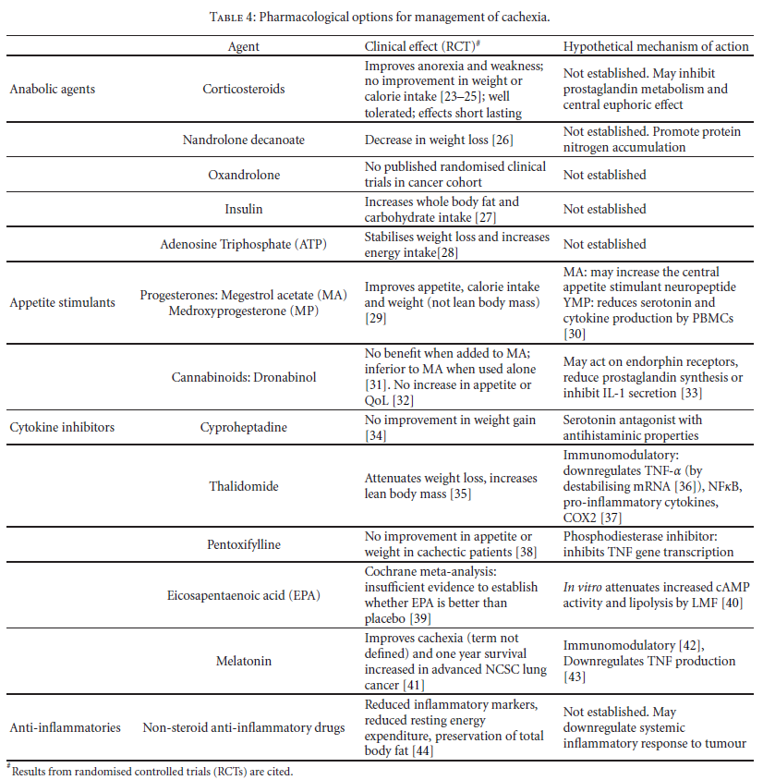
Donohoe et al 2011

Slide 16
Donohoe et al 2011

Slide 17
Megestrol Acetate (Megace)
The Evidence
Cochrane review 2013
  Megestrol acetate is associated with
    Improved appetite
    Slight weight gain
    Increased edema
    Thromboembolism
    Increased risk of death
Ruiz‐Garcia 2013, Maltoni 2001 Ann Oncology, Ruiz‐García 2002 Med Clin, Pascual López 2004 J Pain Symptom Manage, Lesniak 2008 Pol Arch Med

Slide 18
Marinol and Cannabionoids
The Evidence
Small RCT of dronabinol in AIDS associated anorexia
  88 patients, 2.5 mg dronabinol 2X daily versus placebo
  Increased appetite (P < 0.05), decreased nausea (P = 0.05)
  Trend toward improved mood and less weight loss, but not statistically significant
  Sides effects were mild- moderate and included euphoria, dizziness, and thinking abnormalities
There are many anecdotal reports of efficacy, but little high quality evidence
Chemotherapy associated nausea and vomiting
  THC and not cannabis
Bottom Line: Evidence weak but often worth a trial
          Wilkinson 2014

Slide 19
Olanzapine for CA related Cachexia?
Used for anorexia nervosa
Causes weight gain in patients using it for schizophrenia
Can be useful with nausea/vomiting
RCT for cancer associated cachexia (20mg daily) negative
  Small study, poor quality
    Naing et al 2015
Side effects: Somnolence, prolonged QTc, EPS, high expense
BOTTOM LINE: Would try only in setting of nausea/vomiting AND anorexia

Slide 20
Mirtazipine
Very weak evidence for efficacy with cachexia
Would use it preferentially in patients who have depression and cancer associated cachexia
Riechelmann RP et al 2010

Slide 21
Herbs proposed as beneficial
Ginseng
C. rhizome
Radix astragali
TJ-48, TJ-41, PHY906
Rikkunshito
No robust evidence for any
Cheng et al 2012

Slide 22
Bottom Line
Therapies for Anorexia-cachexia are disappointing
  Counseling and reframing probably our most important intervention
  Early, not late, nutritional interventions may help
  TPN rarely indicated, increases burdens and complications
  Trial of cannabinoids (no great evidence)
  Mirtazipine if depression exists
  Consider olanzapine if N/V present
  Megestrol acetate increases mortality, other steroids might be considered if other indications for them
  Neutraceuticals and herbs?

Slide 23
Nausea and Vomiting
Prevalence
Will not be discussing chemotherapy associated N/V
Will also not discuss associated issues of bowel obstruction, retching, regurgitation
Approaches

Slide 24
Prevalence of N/V in advanced illness
Most literature on advanced cancer
Can also be present in cirrhosis, ESRD, heart failure, CAD, AIDS
Nausea and vomiting are distinct, although often presented together
Nausea and vomiting present in 16-68% of patients with advanced illness
  Less common than pain, SOB, fatigue
  Glare et al 2011

Slide 25
Nausea and Vomiting
Three Approaches to N/V
  Pathophysiologically based treatments based on mechanism of nausea
  Empiric treatments based on evidence
  Treatments based on side effects

Slide 26
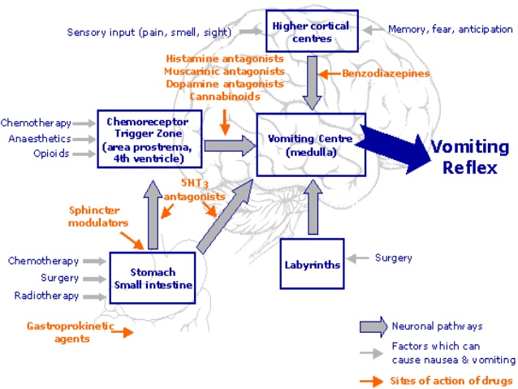

Slide 27
Drug | Dopamine Antagonist | Hista-mine Antagonist | Acetyl- choline Antagonist | Serotonin 2 Antagonist | Serotonin other Antagonist | PNK-1 Antagonist | Other
Chlorpromazine | ++ | ++ | +
Haloperidol | +++
Levomapromazine | ++ | +++ | ++ | +++
Olanzapine | ++ | +++ | ++ | +++ | ++
Metoclopramide | ++ |  |  |  | +/++ (high dose only)
Ondansetron |  |  |  |  | +++
Prochlorperazine | ++ | +
Promethazine | + | +++ | ++
Aprepitant |  |  |  |  |  | +++
Dexamethasone |  |  |  |  |  |  | Steroid receptors Local inflammation
Cannabinoids |  |  |  |  |  |  | Cannabinoid receptors

Slide 28
Causes | Examples | Mediators | Potential Drugs for specific Causes | Examples of drugs
Gastric stasis | GI cancer, opioids, diabetic | Dopamine | Dopamine antagonist (in GI tract) | Metoclopromide Haloperidol, prochlorperazine (less active on D2 receptors in GI tract, more active in CTZ) Olanzapine
 |  | Serotonin | Serotonin antagonists | Ondansetron Metoclopromide (high dose only) Olanzapine
 |  | Prokinetic agents |  | Metoclopromoide, cisapride, domperidone
Bowel obstruction | Colon Cancer | Dopamine | Dopamine antagonist | Haloperidol
 |  | Serotonin | Serotonin antagonists | Ondansetron (5HT3) High dose metoclopromide (5HT3) Mirtazipine (5HT3) Olanzapine
 |  | Multiple | Anti-secretory drugs | Octreotide Anticcholinergic drugs (scopolamine, hyoscyamine)
 |  | Inflammation | Anti-inflammatory drugs | Steroids
Biochemical | Drugs, Anorexia/ cachexia | Dopamine, Serotonin | Dopamine antagonist Serotonin antagonists (active in the CTZ) | Haloperidol, prochlorperazine, olanzapine
Raised ICP | CNS tumors | ? | Steroids | Dexamethasone
Anxiety | Anticipitory nausea | Cerebral cortex GABA | Benzos | Ativan
Vestibular | Motion sickness | Histamine, acetylcholine
 |  |  | Anticholinergics, histamine antagonists | Diphenhydramine, promethazine, olanzapine

Slide 29
Does the Pathophysiologic Approach Work?
No evidence that it is superior to empiric selection of agent
Glare et al 2011

Slide 30
Nausea/Vomiting in advanced CA
Not related to chemotherapy
Therapies with Level B1 Evidence (moderate)
  Medications found to be effective as anti-emetics
  Chlorpromazine
  Metoclopromide (continuously infused or high dose)
  Levomapromazine
  Olanzapine
  Prochlorpherazine
  Thiethylperazine
  Octreotide (bowel obstruction)
  Corticosteroids (bowel obstruction)
  Davis et al. J Pain Symp Man 2010

Slide 31
Nausea/Vomiting in Advanced CA
Not related to chemotherapy
Therapies with Level B2 Evidence (low quality)
  Perphenazine
  Haloperidol
  Risperidone
  Mirtazipine
  Diphenhydramine
  Ondansetron
  Cannabinoids
  Various anti-emetic cocktails
  Davis et al. J Pain Symp Man 2010

Slide 32
Side Effects of Common Anti-emetics
Drug | Sedation | EPS | Anti- cholinergic | Delirium | Orthostasis | Other
Cannabinoids |  |  |  | + |  | Paranoia, cardiac stress
Chlorpromazine | ++++ | +++ | +++ |  | ++++
Haloperidol | + | ++++ | + |  | + | Black box Prolonged QTc
Metoclopromide |  | ++ |  | ++ |  | Parkinsonism
Ondansetron |  |  |  |  |  | Headache
Olanzapine | ++ | ++ | ++ | + | ++ | Weight gain Prolonged QTc Expensive
Perphenazine |  |  | +++ | +++
Promethazine | +++ | ++ | +++ | +++ |  | Resp. Depression

Slide 33
Costs of common Anti-Emetics & Appetite Stimulants
Nabilone 60 – 1 mg tablets ~$16,000
Marinol 60 - 2.5 mg tablets ~$580
Olanzapine 30 - 5 mg tablets ~$400
Aprepitant 1 – 125 mg tablet ~$400
Ondansetron 120 – 4 mg tablets ~ $100
Megestrol acetate 120 – 40 mg tablets ~$80
Promethazine 120 – 12.5 mg tablets ~$80
Metoclopromide 120 – 5 mg tablets ~$60
Prochlorperazine 60 – 10 mg tablets ~$60
Dexamethasone 60 – 4 mg tablets ~$20
Haloperidol 60 - 1 mg tablets ~$20

Slide 34
Putting it all together
One single obvious cause of nausea -> consider pathophysiologically directed therapy
Otherwise, empiric therapy considering side effect profile and cost

Slide 35
Principles
Scheduled (not prn) anti-emetics if nausea/vomiting are moderate or severe
Ondansetron as backbone due to its low side effect profile
  Start with 4mg 4 times daily
  Increase to 8 if symptoms not controlled and no side effects
  D/c if not effective -> go to second line
Choose second agent based on data/side effect profile/mechanism of action

Slide 36
Examples
Elderly patient with dementia and multi-morbidity, on morphine for pain/SOB
  Ondansetron as backbone
  Low dose haloperidol (0.5mg Q 6)
Young patient with glioblastoma
  Ondansetron as backbone
  Dexamethasone
Ovarian cancer in diabetic with multiple complications including gastroparesis
  Ondansetron as backbone
  Metoclopromide

Slide 37
Summary
Anorexia-cachexia
  Address psychosocial concerns
  Reframe
  No great treatments
    Consider cannabinoids, mirtazipine, olanzapine
Nausea-vomiting
  Consider pathophysiology
  Choose agent based on pathophysiology, evidence, and side effect profile

Slide 38
Thank you
Questions?
bjohnston@peacehealth.org

