Slide 1
Shoreline Master Programs: A hindrance or a help to kelp conservation in Puget Sound?
Katherine Conroy (1), Daniel Tonnes (2), Max Calloway (3), Nicole Naar (4), Kalloway Page (6), Steve Copps (2), Betsy Peabody (5)
(1) Stony Brook University, Stony Brook, NY (2) National Marine Fisheries Service, West Coast Region (3) Washington Department of Natural Resources (4) Washington Sea Grant (5) Puget Sound Restoration Fund (6) University of Washington, Seattle, WA (current Pacific Shellfish Institute)
Notes:
The State of Washington adopted the Shoreline Management Act in November 1972 to provide a management and protection framework for the state’s shorelines. To implement the framework, the Act calls for each jurisdiction to develop a Shoreline Master Program (SMP) that outlines plans to: (1) balance and integrate interests of local citizens; (2) address shoreline conditions; (3) consider and influence planning regulations for adjacent lands; and (4) classify shoreline segments into environmental designations. Each SMP must strive for no net loss of ecological function while still promoting the public use and development of county and city shorelines, using the “best available science” to issue specific guidelines.

Slide 2
Background: Kelp
22 native species of kelp found in Puget Sound
Important foundation species which provides:
Habitat
Refuge
Foraging Grounds
Possible kelp loss varies by region
Increased ocean temperature
Fishing related changes to nearshore food webs
Increased nutrients from human actions
Increased turbidity and movement of sediment in the water column
Notes:
The waters of Washington State are home to one of the most diverse assemblages of kelps in the world, with 22 native species found in Puget Sound. Kelp provides numerous ecosystem services including habitat, refuge, and foraging grounds for invertebrate and vertebrate communities including ESA listed Rockfish.
However, local declines have been identified through anecdotal accounts as well as published studies. While specific kelp declines often vary by region, generally, kelp loss is associated with increased ocean temperatures, fishing related changes to nearshore food webs, increased nutrient input, and increased turbidity and sediment transport

Slide 3
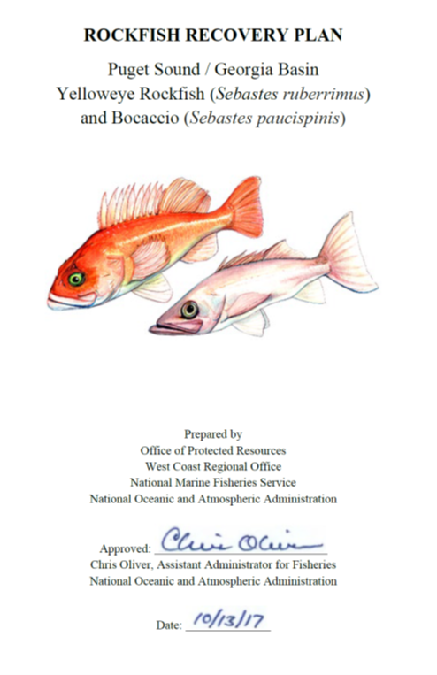
Motivation for research
2014 critical habitat for rockfish was designated along the nearshore of Puget Sound
Overlapping in areas that could or have supported kelp
Rockfish recovery plan identified the conservation and recovery for kelp as priority
Restoration of bull kelp underway
bull kelp enhancement is a novel activity in Puget Sound
encountered uncertainty and delays related to permitting
Notes:
In 2014, critical habitat, was identified along the nearshore of Puget Sound. Ooverlapping with those areas were areas that could or have supported kelp. With this information, the Rockfish recover plan identified the recovery of kelp habitat as a priority for the over all recovery of Rockfish. Various organizations attempted to address the recovery of kelp habitat. However, this proved be be no easy feat. Puget Sound restoration fund attempted to begin kelp restoration projects, and due to it being a novel activity, faced obstacles to obtaining the correct permits. They were trying to navigate a system that was not set up to support kelp restoration.

Slide 4
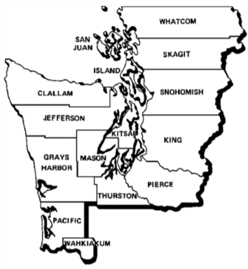
Shoreline Master Programs
November 1972: Washington State adopted the Shoreline Management Act
management and protection framework for the state’s shorelines
Each jurisdiction must:
balance and integrate interests of local citizens
address shoreline conditions
consider and influence planning regulations for adjacent lands
classify shoreline segments into environmental designations
Each SMP must strive for no net loss of ecological function
Use the “best available science”
Photo credit: Department of Ecology
Notes:
Washington State adopted the Shoreline Management act in November of 1972 to provide management and protection framework for the states shorelines. In accordance with the SMP, each jurisdiction must:
Balance and integrate interest of local citizens
Address shorelines conditions
Consider and influence planning regulations for adjacent lands
Classify shoreline segments into environmental designations
Additionally, each SMP must strive a no net loss in ecological function while still promoting public use, and they must use best available science when issuing their guidelines.
Picture Source:https://ecology.wa.gov/Water-Shorelines/Shoreline-coastal-management/Coastal-zone-management#gallery

Slide 5
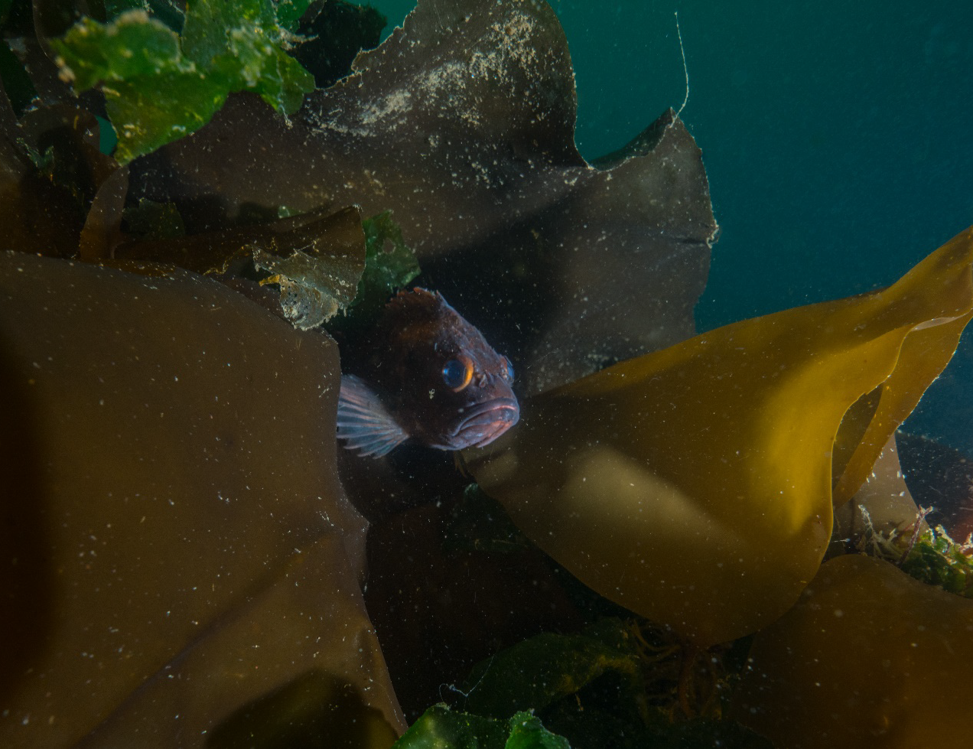
Purpose of Analysis
1. Understand policy specific to Shoreline Master Programs (SMPs) and kelp recovery
2. Identify SMP policy obstacles and opportunities for kelp restoration
Hypothesis:
~More floating and understory kelp canopy would have higher protection scores
~Less floating and understory kelp would have higher restoration scores.
Notes:
This research analyzes Washington State SMPs in 45 jurisdictions along Puget Sound, to identify opportunities and barriers to kelp recovery projects.
We hypothesized that SMPs in counties with more floating and understory kelp canopy would have higher Protection scores, reflecting the need to protect existing habitat. Conversely, we predicted that SMPs in counties with less floating and understory kelp would have higher Restoration scores, indicating an intention to recover potentially lost kelp habitat.

Slide 6
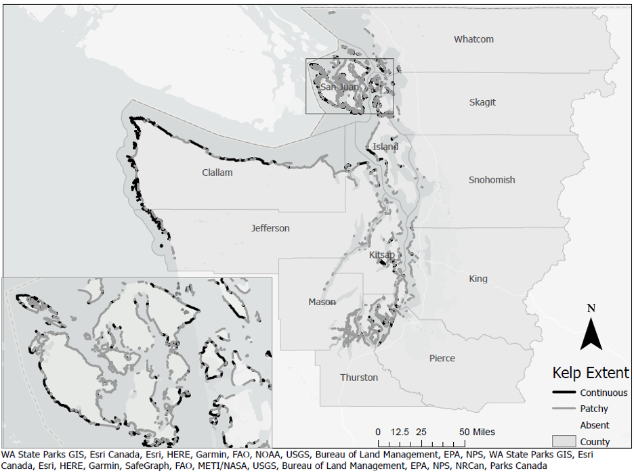
Methods
Study site
12 counties and 33 municipalities which border the saltwater shorelines of Puget Sound and Strait of Juan de Fuca
July 2018: the SMPs were collected from each county, city or the Department of Ecology webpage
Notes:
We conducted a content analysis of 12 counties and 33 municipalities which bordered the saltwater shorlines of Puget Sound and the Strait of Juan de Fuca. The research was conducted in July of 2018. we used the most up to date SMP during that summer. If a SMP was being amended, we used the draft if it was almost finished, or the latest final draft in the event we couldn’t find the amended document.

Slide 7
Methods
Key Word
Kelp
Macroalgae
Buffer Area
Critical Saltwater Habitat
Fish and Wildlife Habitat
Critical Areas
Non-Commercial Aquaculture Restoration Aquaculture
Conducted a keyword search of each SMP
Ex: macroalgae is used interchangeably with kelp
“critical saltwater habitat,” “fish and wildlife habitat,” and “critical areas” all include kelp forest within their definitions
Notes:
After a preliminary search of several SMPs, keywords were chosen to understand which terms best captured how kelp protection and restoration were addressed within each document. We consulted the Washington State Department of Ecology, SMP handbook, the SMP definition, and the RCW to identify keywords that used kelp within their definition, or related words and phrases.

Slide 8
Methods
Category | Criteria | Score and Description
Protection score | Buffer for kelp | 0 - No mention
 |  | 1 - Implicit mention (i.e. critical habitat, critical saltwater habitat, fish and wildlife habitat mention of Critical Habitat, Fish and Wildlife Area, Critical Saltwater Habitat)
 |  | 2 - Explicit mention
 | Kelp identified in General Regulations | 0 - No mention
 |  | 1 - Implicit mention (i.e. critical areas, critical saltwater habitat, fish and wildlife habitat)
 |  | 2 - Explicit mention
Restoration score | Restoration Plan within SMP | 0 - No
 |  | 1 - yes
 | Restoration of Kelp | 0 - No mention
 |  | 1 - Implicit mention
 |  | 2- Explicit mention
 | Conservation aquaculture or restoration aquaculture | 0 - No mention
 |  | 1 - Yes, but no mention of kelp
 |  | 2 - Yes, with implicit mention of kelp
 |  | 3 - Yes, with explicit mention of kelp
Content analysis modeled after Ballinger and Dodds, (2020).
Scored relative protection and restorations scores based off of criteria
Notes:
Our content analysis was modeled after the Ballinger and Dodds research in 2020. we scored each SMP based
we scored each SMP’s relative protection of kelp based on the two Protection Criteria– the presence of a buffer for kelp as well as if kelp was identified within the general regulations. We also scored each SMP based on its treatment of restoration based on the three Restoration Criteria– If the SMP had a restoration plan, if so, does the restoration plan mention kelp? And if the SMP had mention of conservation aquaculture/restoration aquaculture.

Slide 9
Compared 12 county SMPs to linear extent of kelp
Obtained from aerial surveys between 1994 and 2000
Notes:
We compared the scores of the 12 county SMPs to the linear extent of understory and floating kelp within their jurisdictional boundaries. We used GIS data from the ShoreZone inventory. The ShoreZone inventory was conducted using shoreline aerial surveys between 1994 and 2000. Although the kelp abundance data is several decades old, it is the only comprehensive inventory of kelp across all of the assessed county-level SMPs, has been used in federal Critical Habitat designation, and was available for many of the SMPs as they were developed or updated.

Slide 10
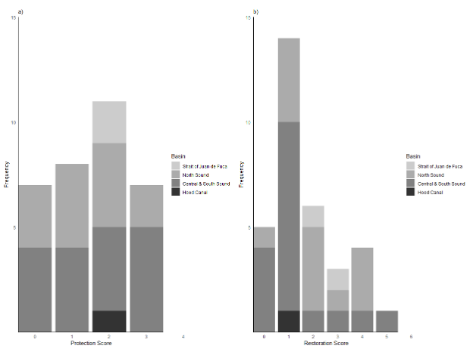
Results
Low protection scores
of the 45 scored SMPs, 20 (44%) had a score of 0 or 1
None received the maximum score of 4
Low restoration scores
26 (57%) receiving a score of zero or one,
one SMP, Bainbridge, received a score of 5
None received score of 6.
Notes:
Our evaluation revealed generally low protection scores for kelp within the SMPs. Of the 45 scored, 20 (44%) had a score of zero or one, with no county receiving the maximum score of four.
Restoration measures within the SMPs were similarly low, with 26 (57%) receiving a score of zero or one, and only one SMP, Bainbridge, receiving a score of 5 and no SMPs receiving the best scores of 6.

Slide 11
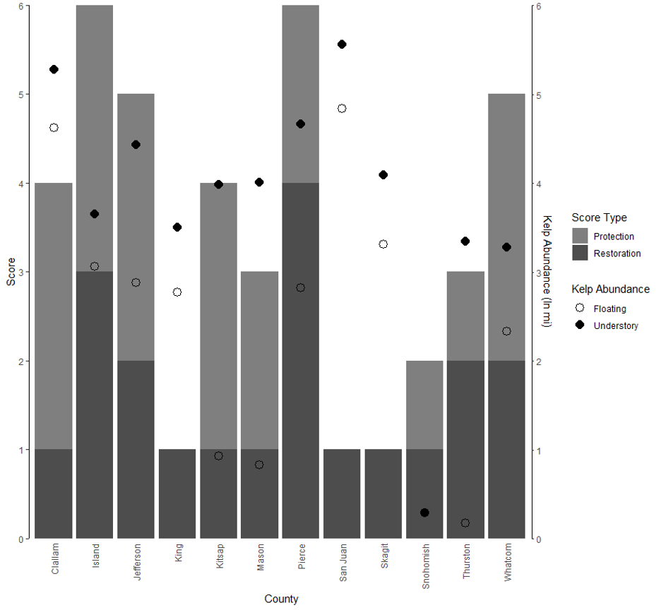
No association between linear extent of floating kelp and the protection scores for county SMPs.
Notes:
When comparing the protection and restoration scores for the 12 counties against the abundance levels for kelp, there was no association between the two.

Slide 12
Best Available Science…
SMP content likely reflect watershed restoration planning priorities from the late 1990s and early 2000s.
The Chinook salmon ESA listing in 1998 initiated a watershed-based approach to recovery planning termed the Shared Strategy for Puget Sound.
many local counties participated in and led the development of regionally-specific watershed recovery plans
No restoration numbers targeted for nearshore environment or kelp habitat
Few published research on the importance of kelp habitat to salmon
Relative lack of “best available science” may have contributed to policy inertia reflected in the SMPs
Notes:
Our results likely reflect watershed restoration planning priorities from the late 1990s and early 2000s. The 1998 Chinook salmon ESA listing initiated a watershed-based approach to recovery and many local counties participated in and led the development of watershed recovery plans. The Plan included targets for freshwater and estuary habitats. However, it did not targets for the marine nearshore environment, nor for kelp habitat
This oversight in the Chinook Recovery plan likely stems from relatively little documentation of kelp loss and few published research on the importance of kelp habitat to salmon. Unfortunately, the relative lack of “best available science” related to kelp during this time may have generated the policy inertia reflected in later SMP

Slide 13
Legislative win
The Puget Sound Restoration Fund worked with Washington State Legislature on Senate Bill 5404, passed in 2018:
Amended the Fish Habitat Enhancement Hydraulic Permit Approval to include fish habitat enhancement projects to include native kelp, eelgrass beds and native oysters. This streamlines SMP permitting!
This policy reflects growing consensus that nearshore kelp habitats are vital for salmon, rockfish and other biota
Photo credit: Puget Sound Restoration Fund
Notes:
However, already, since this research has been conducted, steps have been made to ease the process for kelp habitat restoration. In 2018 the Puget Sound Restoratiom Fund worked with the Washington State legislature on Senate Bill 5404 to amend the HPA rule concerning Fish Habitat Enhancement. The rule now includes marine nearshore habitat restoration activities within the exemption process for shoreline development. Senate Bill 5404 expanded the definition of fish habitat enhancement projects under to include “[r]estoration of native kelp and eelgrass beds and restoring native oysters.”
This policy change reflects the growing scientific consensus that nearshore kelp habitats in Puget Sound are diminishing, yet are vital for salmon, rockfish and other species.
Photo credit: Puget sound restoration fund

Slide 14
Moving Forward
Washington Department of Natural Resources has already used this research to work with local jurisdictions to improve kelp conservation
We expect that updated SMPs better reflect habitat protection and restoration priorities
Notes:
Although most SMPs do not currently reflect this updated science and policy, the Washington Department of Natural Resources has used this research to work with local jurisdictions to improve kelp conservation. Moving forward, we hope to continue to see updated SMPs better reflect these habitat protection and restoration priorities within local jurisdictions

