Slide 1
Building with Nature: Blue Green System for Solving Urban Growth and Climate Changes in Canada
Eva Li
City of Vancouver
4/26/2022

Slide 2
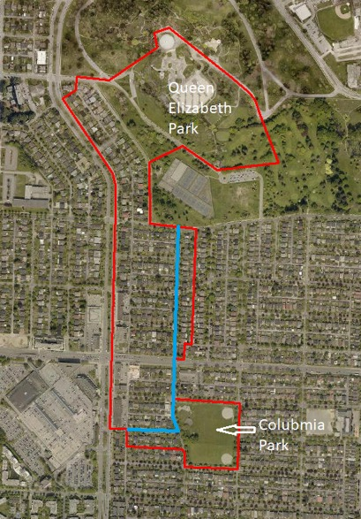
Project Overview
Location:
Cambie Corridor, Vancouver
Alberta St & 43rd Ave
Columbia Park
Scope:
Concept Design
Master Plan
Multi-Phased Engagement
Oakridge
Town
Centre
Columbia Park
Notes:
Mandy:
Before I talk about the project scope, I want to emphasize that the Alberta St. Blue-green system and Columbia Park Renewal should be treated as a single, seamless integrated project and our aim is for the end user, to experience it that way as well.
As a high level overview, the Master Plan and Preliminary Design for the project will be developed through several phases of work. This includes:
Carrying out Background and Analysis: This includes a context analysis, open space needs assessment, reviewing any relevant information or technical studies already completed by the City, completing a survey, arborist report and precedent studies to help provide a comprehensive picture of the existing conditions which ultimately inform the next phase which is:
Developing the design concepts - The Consultant team will develop up to three preliminary design concepts for the project area which includes the street re-design and transportation assessment of AB St from 37-45th Ave and 43rd Ave; Columbia Park and the interface between them
We are looking at how these concepts will address sustainability and climate change through the landscape architecture, biodiversity and water management as well as provide opportunities for placemaking through public space, interpretive signage and integrated place-based public art.
The options will be evaluated through a tool the City has developed and a class C cost estimate for the preferred concept
Also looking phasing plan for future development and implementation
Eva- Rainwater Management Plan and Engagement
The consultant will develop a rainwater management plan for the study area
The plan will include developing district scale rainwater management solutions. (the city envision the solutions to integrate both green and grey system: using targeted sewer separation and re-alignment to deliver rainwater to district-scale GRI in public right-of-way along Alberta St and a water management feature in Columbia Park)
We hope that the best outcome of the rainwater management plan: is to “limit the future combined storm and sanitary flows from the study area to the existing capacity of the downstream combined sewer trunk. In this way, we can postpone the downstream trunk upgrading project.
Engagement will be three phases
Incluidng outreach program, skateholder notificaiton, stake hlder group meeint, online feedback platform, video illustration, and openh ouses.
Due to covid, the 1st round of engagement in the summer will be online and mail outs
For 2 and 3 round of engagement, depending on the pandemic situation, we may consider on site open house events with pop up interactive stations
Alberta St. Blue Green System and Columbia Park Renewal to be treated as a single project for master plan and preliminary design
Up to (3) preliminary design concepts of Columbia Park and Alberta St Blue-Green System, options evaluation
Street re-design and transportation assessment of Alberta St (37th to 45th Ave) and 43rd Ave
Interface between the park and the Alberta street.
Opportunities for public space, interpretive signage and integrated place-based public art
Class C cost estimate for the preferred concept
Phasing plan
EVA:
This project is unique in several ways. it is a first district scale blue-green system implementation project, major demonstration project that provides innovative approach in water management, street design and urban planning.
Traditionally, the water was managed in a way that it can NOT cross property line. Private site water are managed on site, ROW water managed with in the Road, and park manage its own water. For the first time, the city and Park board decides to blur the property line, respect natural hydrology and have an innovated way of managing water to meet servicing need and combat climate change.
As the current City bylaws do not allow for overland flow across property lines that is separating public and private lands, the Consultant will identify innovative alternatives for delivering rainwater from private properties to the district scale GRI in the public right-of-way and park space
Through this project, we hope to prove that holistic water management concept may work. It will inspire future city planning, park planning and rainwater management.
Lastly, we want to use this project opportunity for continuous learning on grey-green infrastructure (their cost, performance, Operation & Maintenance)
MANDY:
We are look this to be a showcase project demonstrating how we can implement innovative ideas for Vancouver and work toward greater collaboration with the City and Park board
The project site is also first segment of realizing one of the larger strategic bold moves outlined in VanPlay (VanPlay is the City’s Parks and Recreation services MP) where there is a vision to connect open space, habitat and recreation services from Little Mountain (Queen Elizabeth Park) to the Big River (Fraser River)
We also want the project to be a demonstration project or example where the solutions can be measured, replicable, scalable and inspire other areas of the city to deploy these strategies
Finally, we hope the ideas and concepts from this project will result in multiple net social, community, economic and environmental benefits
This project is also an opportunity to move forward the City and Park Board’s reconciliation values in a collaborative approach to celebrate water, protect and improve water quality, naturalize watersheds, and connect park spaces.
Celebrate the water cycle, focus on place making and provide net social and environmental benefits
Minimize ongoing operation and maintenance inputs
Includes a water management feature that is coordinate with Alberta Street design and is
a surface feature/clear visible expression of water (natural or architectural)
floodable (storage/overland flow path for large events)
based on principles of natural watershed management
Co-benefit (environment, community, resiliency, cost effective, crime prevention)

Slide 3
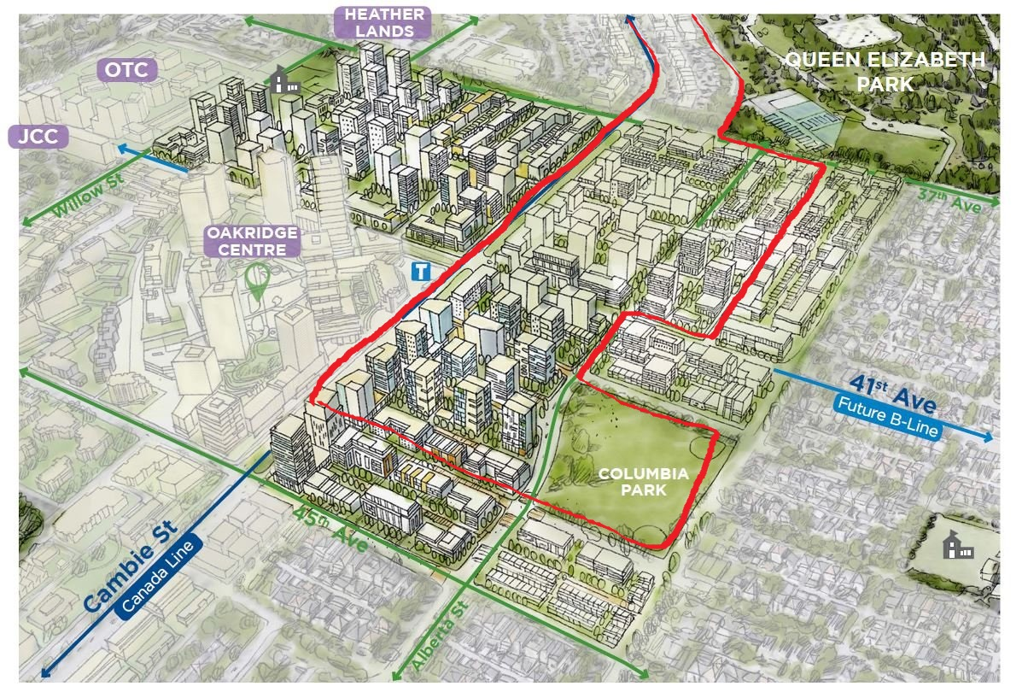
Growth and Densification
Alberta St

Slide 4
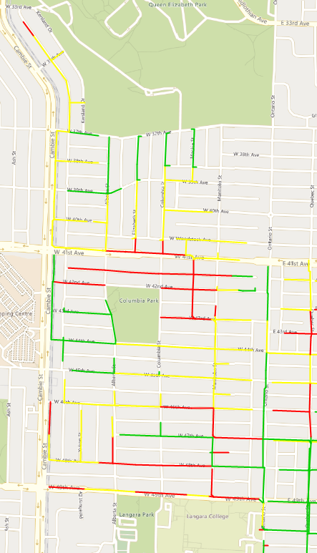
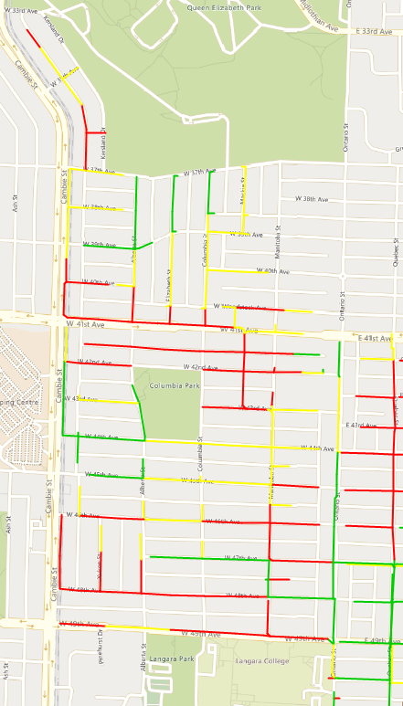
Mandatory Utility Infrastructure Upgrades
Existing Condition
Year 2050 with Climate Change

Slide 5
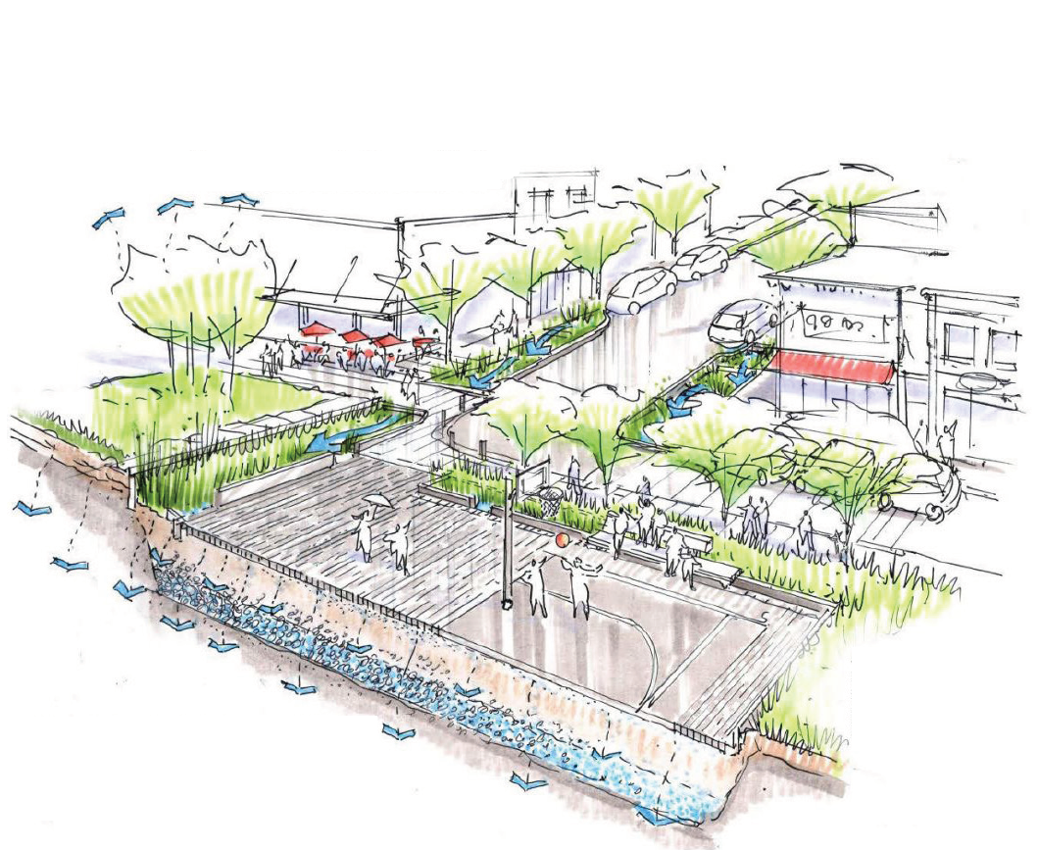
Blue-Green System - Concept
Working definition:
Network of connected park-like streets that manage water and land in a way that is inspired by nature and designed to replicate natural functions and provide ecosystem services. “

Slide 6
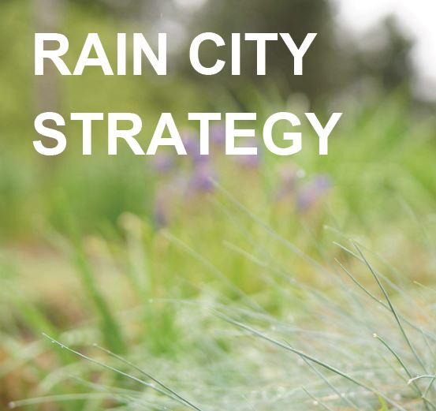
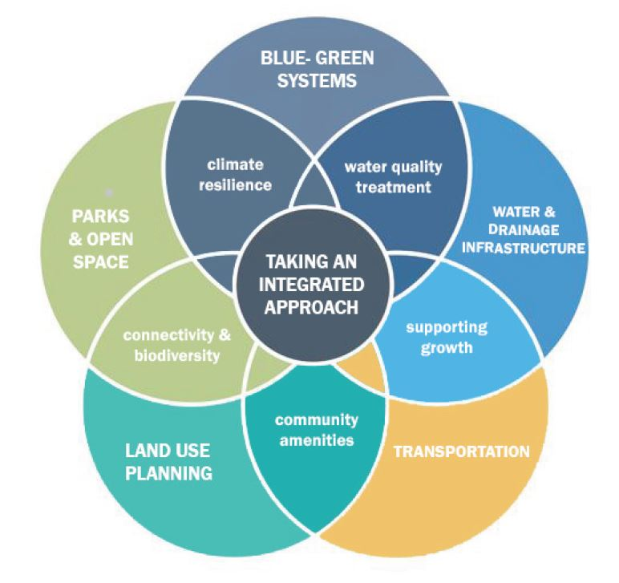
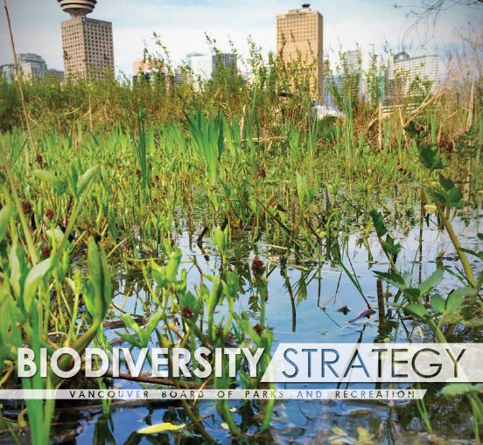
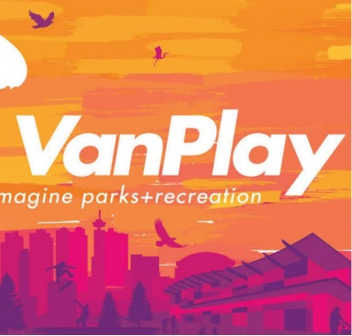
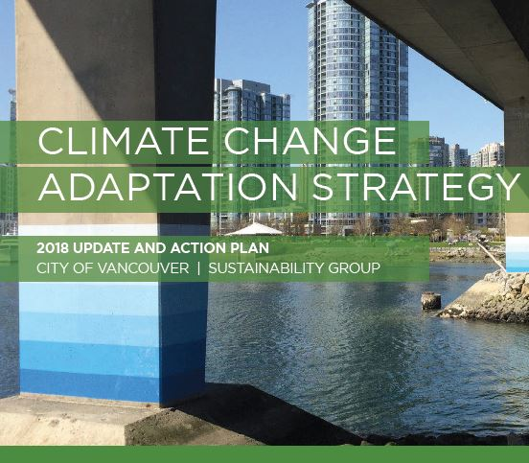
Integrated Planning
Notes:
Alignment of overlapping work programs
Shift away from an “us vs. them” mindset toward a collaborative working relationship
. It also bring potential for significant cost-savings, efficiency in the processes, and multiple co-benefits through project delivery

Slide 7
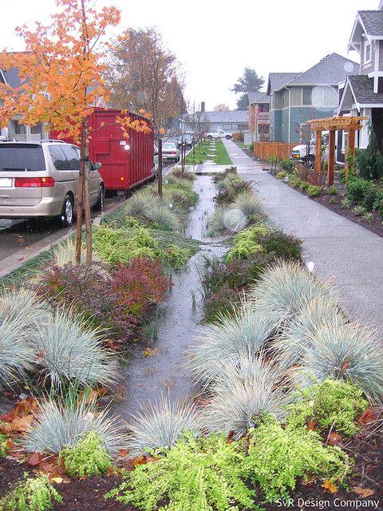
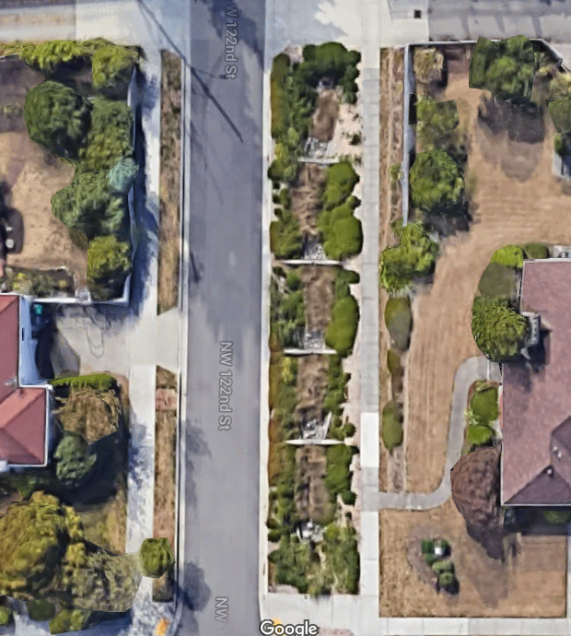
How Does Blue Green System Work
Function during heavy rainfall
Venema Creek Natural Drainage System (Seattle, WA)
High Point Neighbourhood (Seattle, WA)
Notes:
that use soil, plants, trees and parts of the street to management and treat rainwater more like nature. Unlike traditional approach of installing bigger pipes, blue green system treats rainwater that would otherwise overwhelm the City’s overburdened pipe system at its source. It allows rainwater to be filtered through the soil, cleaned of street contaminants and absorbed into the ground or returned to the atmosphere through evaporation.

Slide 8
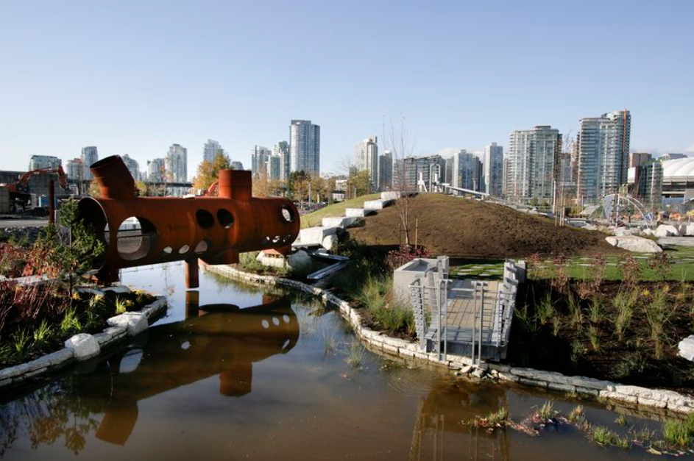
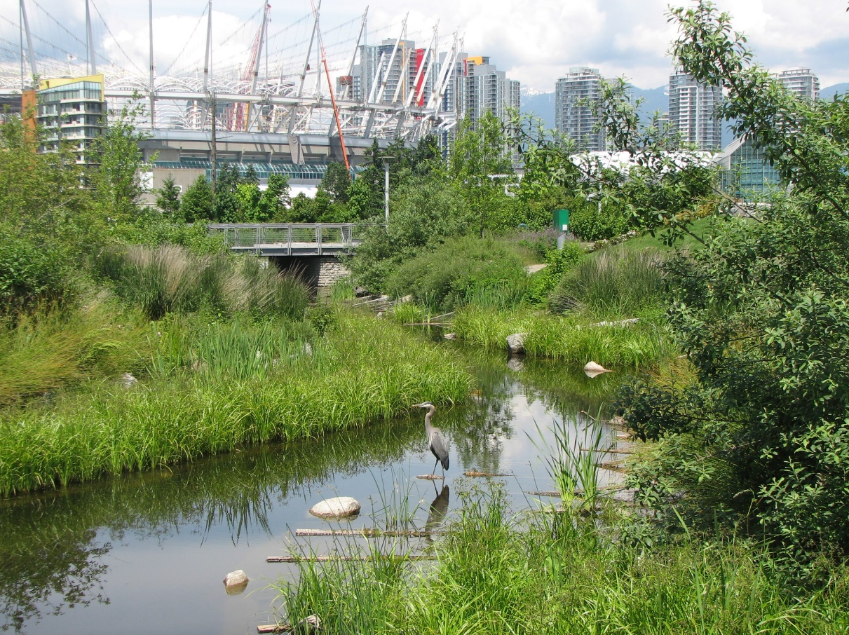
Wetland System in the Park
Hinge Park (Vancouver, BC)

Slide 9
What it might look like?

Slide 10
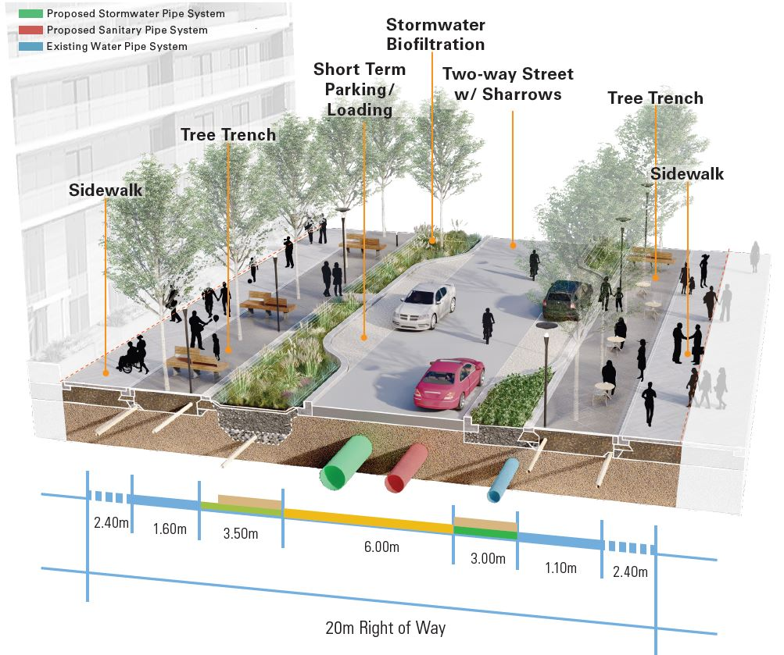
Alberta St – Concept 1
Two Way Traffic with Parking

Slide 11
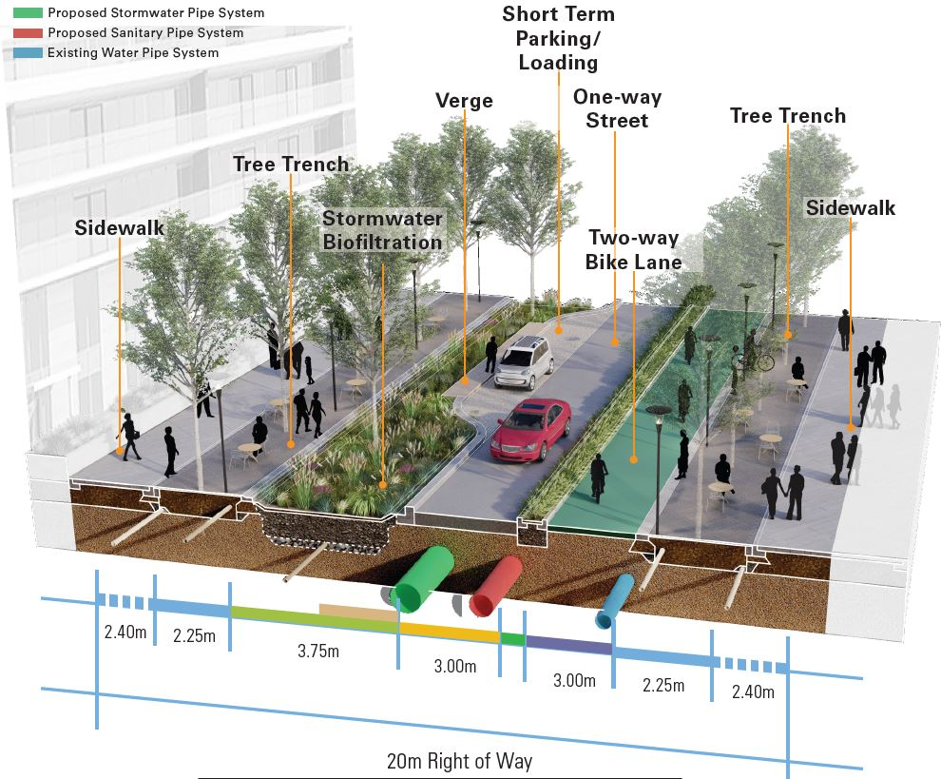
Alberta St – Concept 2
One Way Traffic with Limited Parking

Slide 12
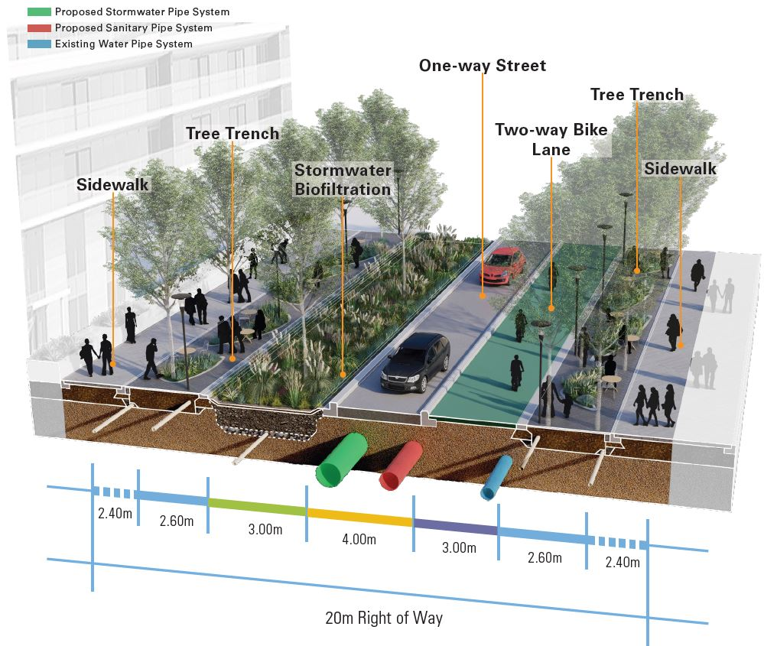
Alberta St – Concept 3
Diverging One Way with Carless Blocks with No Parking

Slide 13
Columbia Park – Concept 1
Active Play

Slide 14
Columbia Park – Concept 2
Flexible Play

Slide 15
Columbia Park – Concept 3
Nature Play
Notes:
Natural area: are an important part of this project and help to meeting large city wide goals an dsrategies towards a thriving urban ecosystem. By providing multiple cobenift for people and wildlife, natural areas help to support the health and well being of the entire community. For this project, natural raeas refers to
Naturally managed areas including pollinator meadow that prioritize native plants
Habitat for birds, pollinators and amphibians
Seasonal ponds and wetlands
Urban forest enhancements
GI to improve water quality
A full natural experience with some areas reserved for nature only,

Slide 16
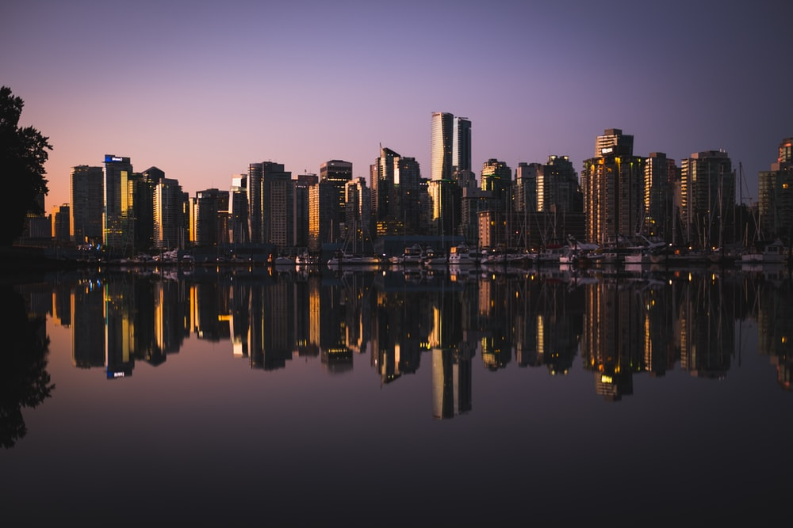
Thank you!

