Slide 1
Assessing Sources of Polybrominated Diphenyl Ether (PBDE) Flame Retardants Impacting Juvenile Chinook Salmon in the Snohomish River Watershed
Alex Gipe¹, Dr. Will Hobbs¹, Sandra O’Neill²
¹ Washington State Dept. of Ecology
² Washington State Dept. of Fish and Wildlife

Slide 2
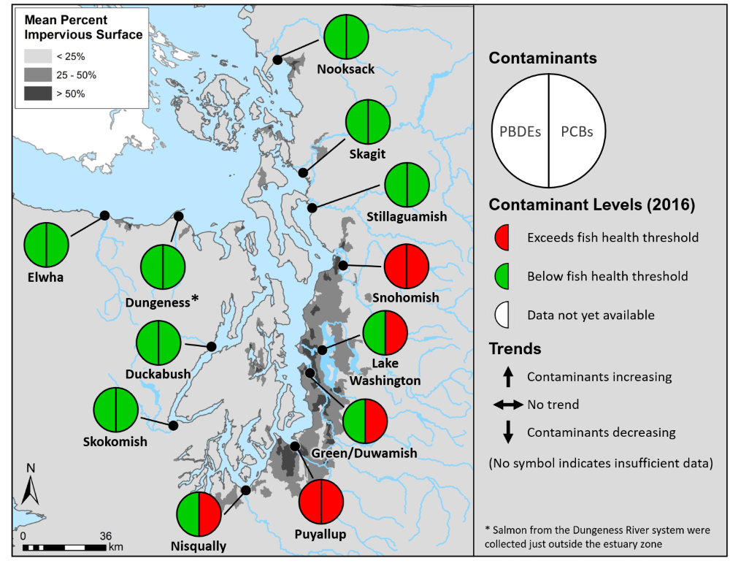
Toxics in Juvenile Chinook Program
Partnership between WA Dept. of Ecology & Dept. of Fish & Wildlife
Goal
Assess and prioritize potential sources of toxics that may be impacting the health of out migrating juvenile Chinook
Objectives:
Assess the spatial distribution of toxics in migratory rivers
Assess the vectors, or pathways of toxics

Slide 3
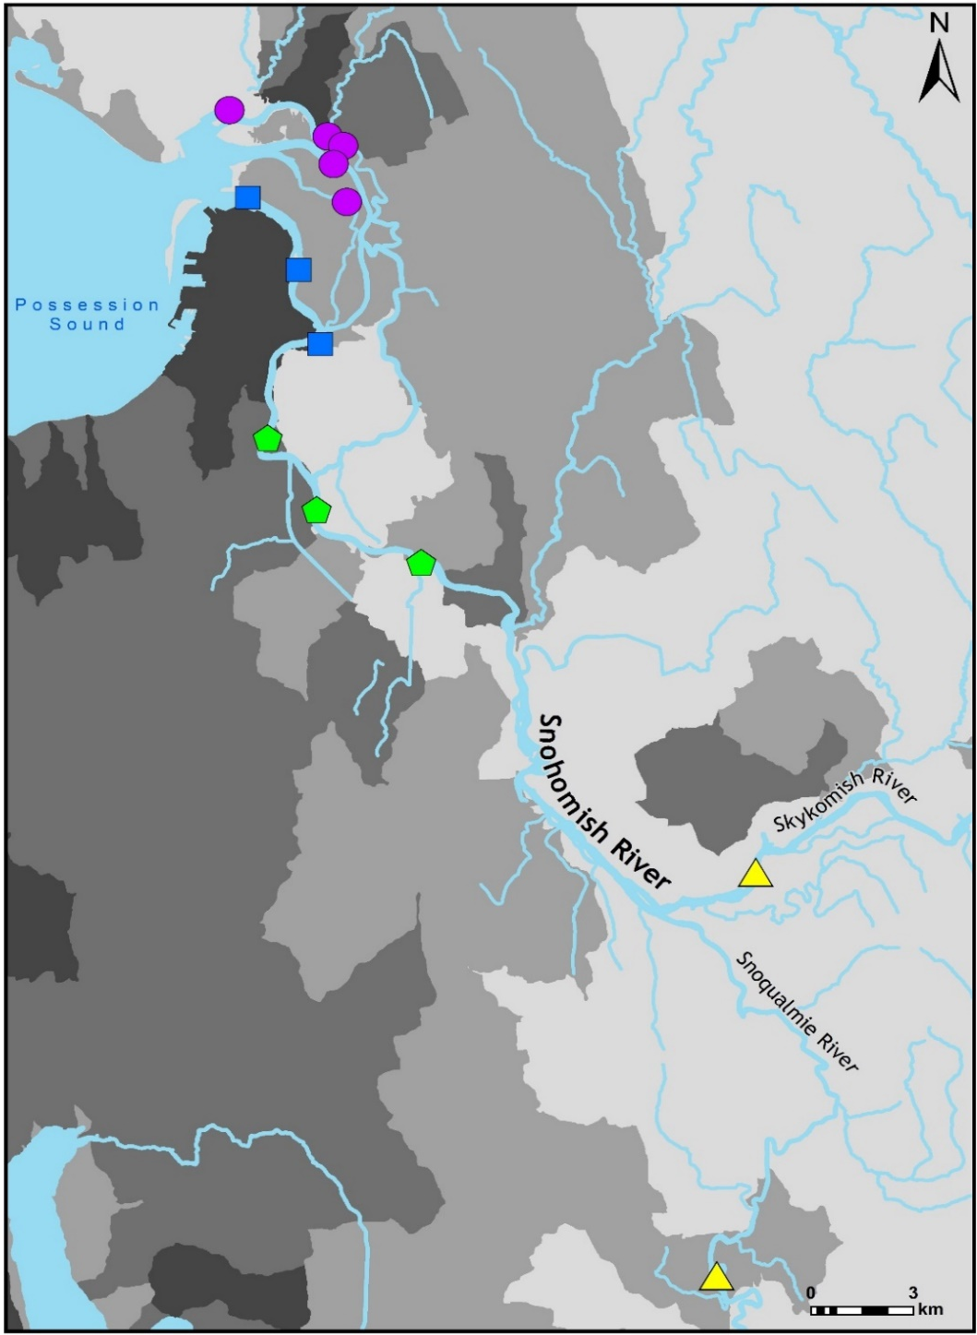
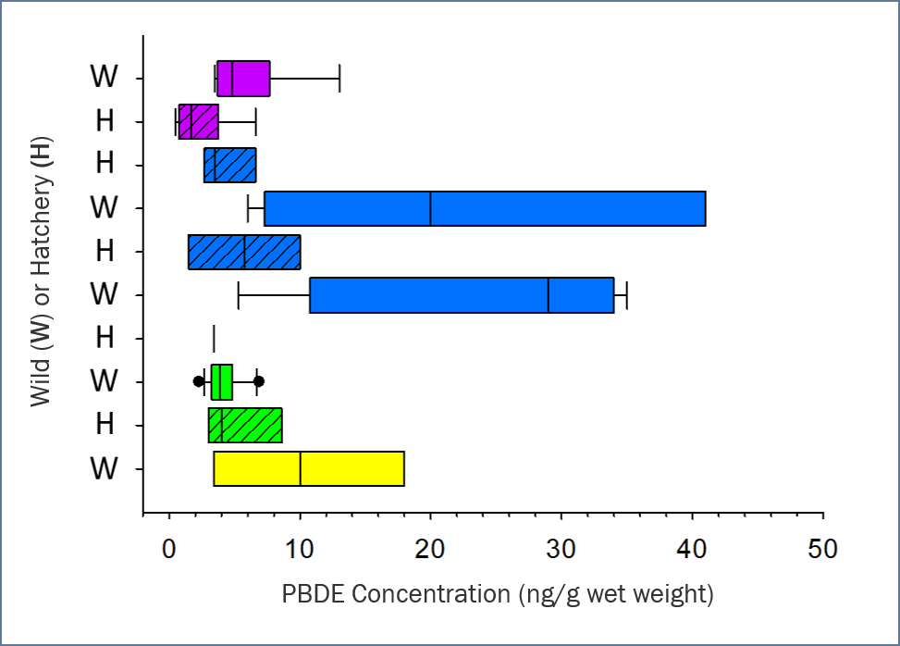
Toxics in Snohomish Watershed
Juvenile Chinook PBDE Tissue Concentration
Outside
Mainstem
Lower
Delta
Upper
Delta
Outside
Mainstem
Only WILD fish in the Lower Delta exceeded critical tissue level
Carey et al. 2019

Slide 4
Snohomish Watershed
Made up of Snohomish, Snoqualmie, Skykomish Rivers
Runs from Cascades to Possession Sound
Hosts populations of threatened Chinook
Extensive restoration of tidal marshlands in Snohomish estuary to restore habitat

Slide 5
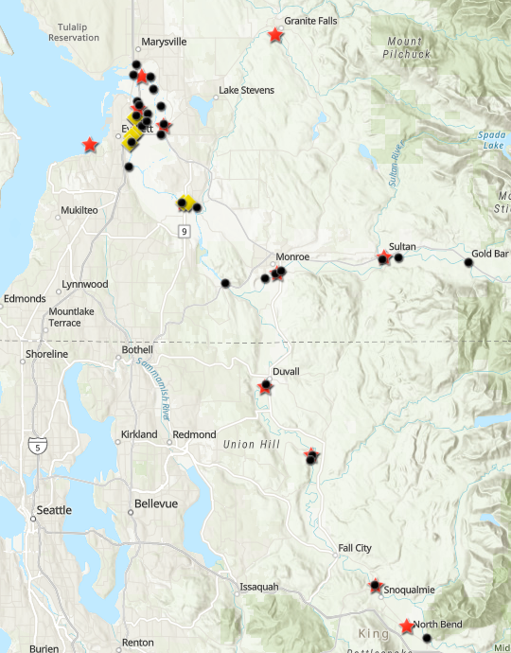
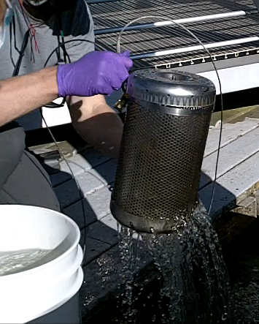
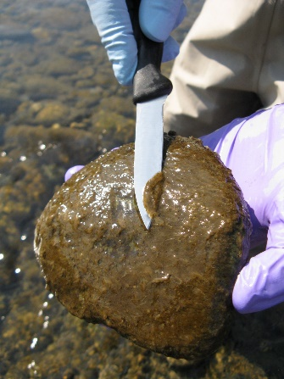
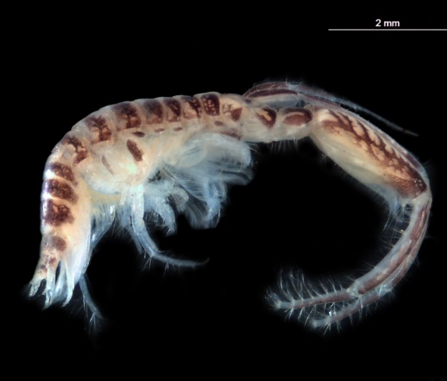
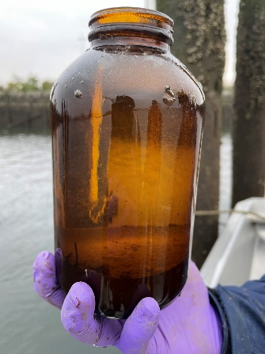
PBDE Source assessment
Sampled Snohomish, Skykomish, Snoqualmie Rivers
Sampled 29 sites from 2019-2021
4 Sampling events: 1 high flow, 3 low flow
Analyzed for 36 PBDE congeners
Sampling Methods
Passive Sampler
Biofilms
Sediments
Invertebrates
Sampling Methods
Sample Site
WWTP Outfall
CSO
Notes:
Please Explain what each of the sampling methods represents (fix notes below for accuracy!):
Passive Sampling – deployed for 30 days; due to low concentrations in water, need to represent a longer time frame
Biofilms – solids, material available for bugs to eat
Sediments – bedded sediments are where bugs/critters live and take up pollutants; suspended solids represent material moving in the water column that is not soluble (and often where our hydrophobic or higher molecular weight PBTs are found)
Invertebrates – the food that the juveniles are eating; trying to figure out if PBDEs are taken up by gills (Water) or by prey (invertebrates), as this would point to different solutions/actions necessary to control the pollutant.

Slide 6
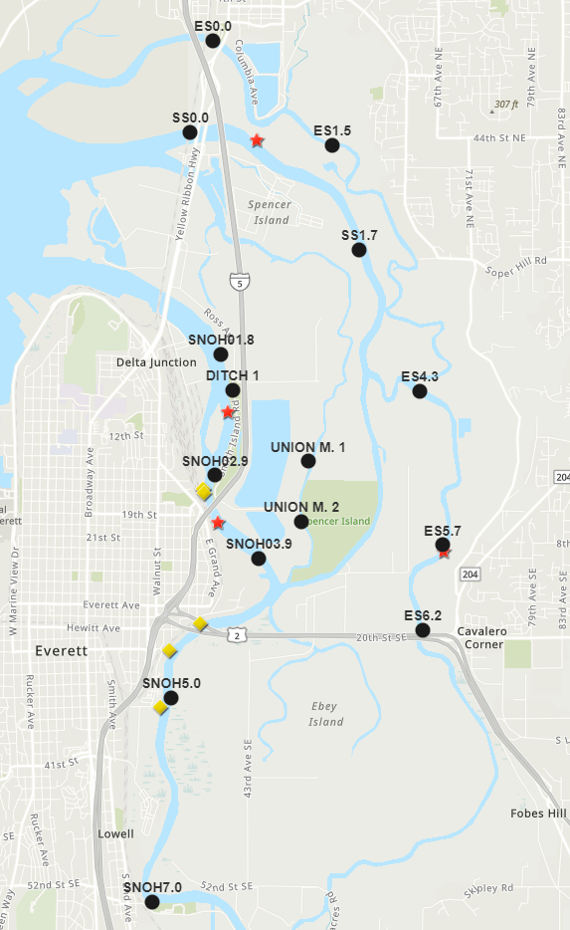
Lower Mainstem
Upper Mainstem
Sloughs
Sample Site
WWTP Outfall
CSO
Notes:
Note that deca-BDE is generally not found in water.

Slide 7
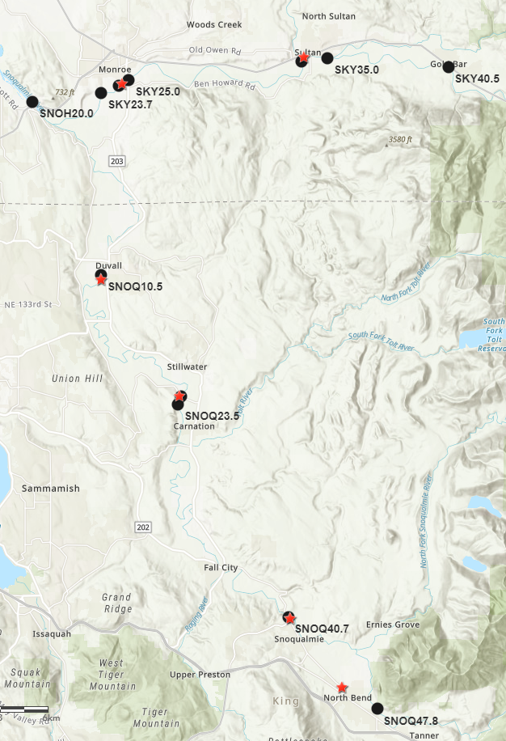
2019-2021 Total PBDE Water Concentration in Skykomish & Snoqualmie Rivers
Snoqualmie
SKY34.5
SKY24.5
SKY34.5
SKY24.5
SNOQ23.0
SNOQ23.0
Sample Site
WWTP Outfall
CSO

Slide 8
Fall 2019 PBDE Homolog Proportions in water
Tetra and Penta dominate homologs
BDE47/99 & BDE99/100
Lesser amounts of Hexa, BDE-153/154
All major components of industrial PBDE mixes

Slide 9
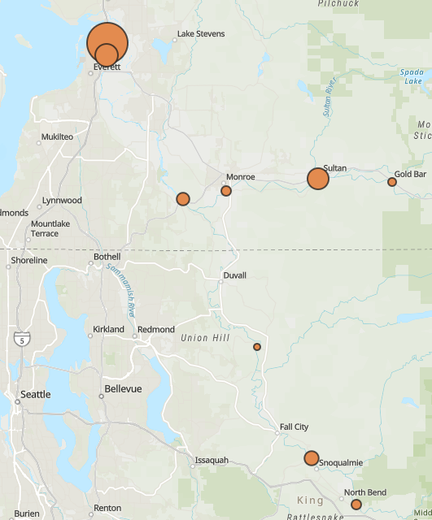
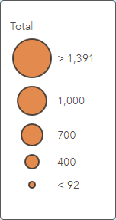
PBDEs in Biofilms
SNOH01.8
Collected during 2019 low flow event
Highest concentrations located in mainstem of Snohomish
Elevated concentrations near city of Sultan and Snoqualmie
SNOH02.9
SKY34.5
SKY40.5
Lower Mainstem
SKY24.5
SKY34.5
SNOH20.0
Skykomish
Snoqualmie
Total PBDE (pg/g)
SNOQ23.0
SNOQ40.7
SNOQ47.8
Notes:
Biofilms were collected throughout the Snohomish, Skykomish, and Snoqualmie Rivers.
Heat map shows concentrations of total PBDEs in Biofilms and Bar chart shows concentrations and proportions of PBDE homologs
Highest concentrations located in main stem of estuary, Dagmar & Langus rowing dock.
Elevated concentration at the city of Sultan and Snoqualmie sites.
BDE-209 is dominate congener in Biofilms, represents 35 to 70% of the total PBDE concentration.
Nona, Penta, and Tetra-BDE homologs were other major homolog measure similar to water and sediment samples

Slide 10
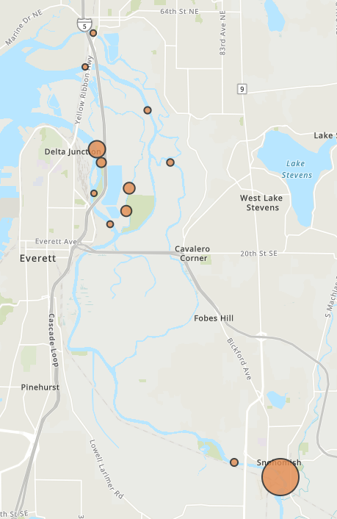
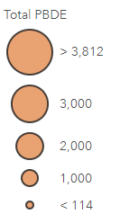
PBDEs in Bottom Sediments
ES0.0
Concentration Range from 115 to 3800 pg/g
Highest concentrations at SNOH01.8 & 13
Union slough elevated compared to other sloughs
Dominated by BDE-209
SS0.0
SS1.7
SNOH01.8
DITCH 1
ES4.3
SNOH02.9
Union M. 1
Union M. 2
SNOH03.9
Total PBDE (pg/g)
SNOH12.0
SNOH13.0
Notes:
RM: In the Puget Sound area, we tend to consider bottom sediment contamination representative of historical releases, and generally managed under state and federal cleanup laws – MTCA/SMS and/or Superfund. We also tend to think of bottom sediment as generally staying in place in areas of net deposition.

Slide 11
PBDEs in Suspended Sediments
Similar concentrations from RM1.8 up to RM7
BDE-209 dominate
Demonstrates suspended particulates contain high concentrations of PBDEs
Notes:
RM: We tend to think of suspended sediments as the solids that are discharged, but they are also from erosive forces (like high flows) and, in the estuary, from the mixing/churning caused by routine salt-wedge movement due to tidal conditions.

Slide 12
Invertebrates
Snohomish Estuary Site 1
4/27/21
5/12/21
6/25/21
8/17/21
9/19/19
Corophium spinicorne
No Data
No Data
No Data
Snohomish Estuary Site 2
Higher concentrations found in main stem vs. Ebey slough
Dominated by Tetra & Penta BDEs (47 & 99)
Main stem inverts. concentration trended lower over sampling events
Similar concentrations in Aug/Sept 2019 & 2021 samples
No Data
Ebey Slough Mouth
Qwuloolt
No Data
No Data

Slide 13
PBDEs Across the Environment
ppt = parts per trillion
*Preliminary Data
Notes:
We are waiting on new data from fish obtained from the Tulalip Tribe so that we have some nearly simultaneous/synoptic results for comparison.
Collected fish from estuary, sloughs and river near Monroe, for WDFW study
Results pending

Slide 14
Summary
PBDE concentrations in the lower main stem are consistently elevated
Sloughs throughout estuary do not show elevated PBDE concentrations
PBDE concentrations directly downstream of Monroe and Sultan WWTP outfalls are elevated during low flow events
Invertebrates collected in the main stem have higher concentrations than those collected in Ebey slough
PBDEs accumulate in sediments, biofilms, and biota
Invertebrates, fish tissue, and water: mostly BDE-47 & 99
Mostly BDE-209 in sediments
WWTP outfalls are a direct input of PBDEs into the Snohomish Watershed

Slide 15
Next Steps (2022)
Follow up high flow sampling (spring)
Concentrated around Snohomish mainstem
Passive samplers and suspend sediments
Invertebrate time series study
February through August/September
Monthly sampling at RM 2.9
Comparative samples collected at RM 7.0
Paired with suspended sediment sampling
2022 low flow sampling
Targeting period with no WWTP discharge to lower mainstem
Publish Results

Slide 16
Questions
Contact Alex Gipe, WA Dept. of Ecology
agip461@ECY.WA.GOV

