Slide 1
The Time for Reparations from Washington State Is Now! As Non-Human Persons, Orcas Deserve Justice
Dr. Alexandrea Safiq
Salish Sea Ecosystem Conference 2022
Ethics & Southern Resident Killer Whale Recovery 1

Slide 2
Intentionality
Photo Credit: Center for Biological Diversity
Notes:
This was one of the most difficult talks that I’ve written, in part because of my own lived experiences as well as my orientation to feel things deeply. I want to bring some intentionality to this space and say that: It is not my intention to trigger or shock anyone. My intention is, however, to speak openly, honestly, and candidly about the injustices that orca have experienced in the past and propose a new way forward grounded in justice.

Slide 3
Generational Inheritance
We cannot change the past, but we can take responsibility for the legacy we have inherited and make a more just future.
Photo Credit: EPA website

Slide 4
Background & History of WA Orca Harvest

Slide 5
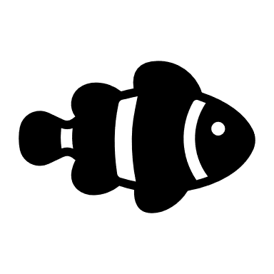
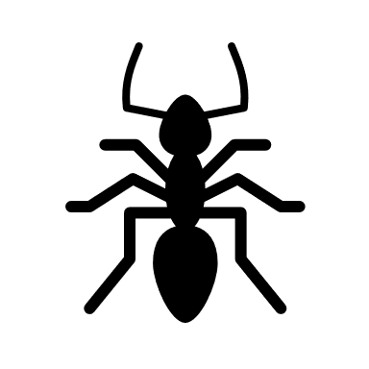
Wildlife Value Orientations
Pluralistic
Mutualism
Domination
Notes:
Ecosophy
Ecosophies of mutualism and domination/utilitarianism
Laws and regulations follow the predominate culture
- Lack of federal regulation around orca (and marine mammal harvest)
- Connecting to a domination cultural perspective around wildlife (WVO’s)

Slide 7
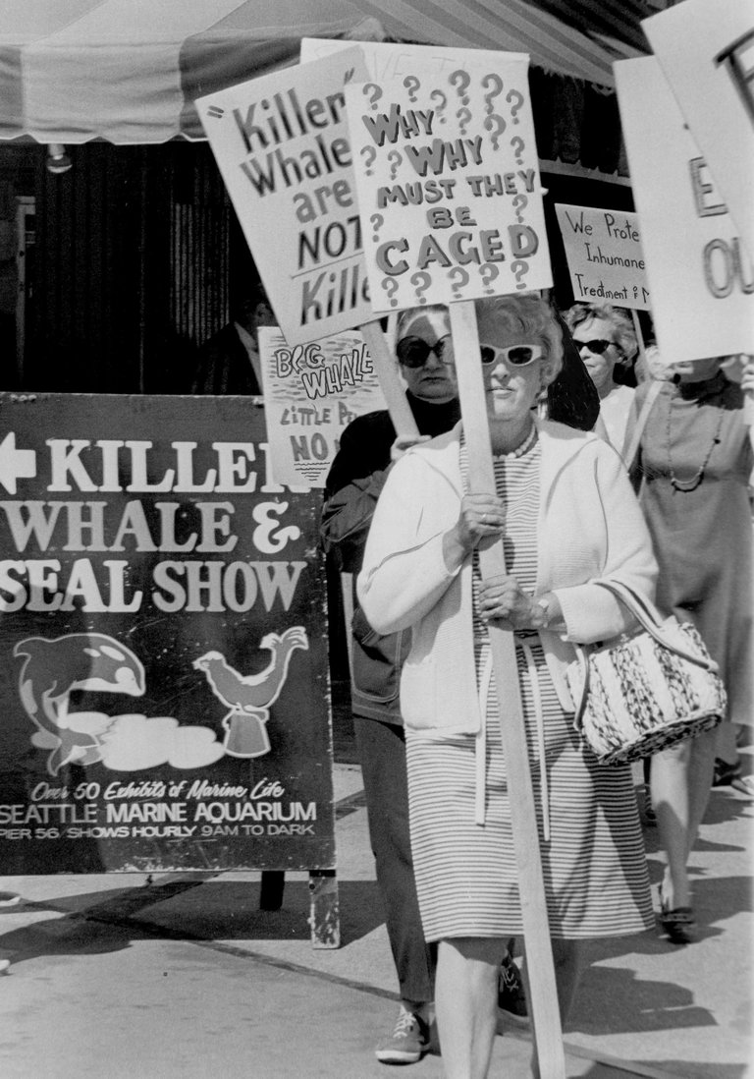
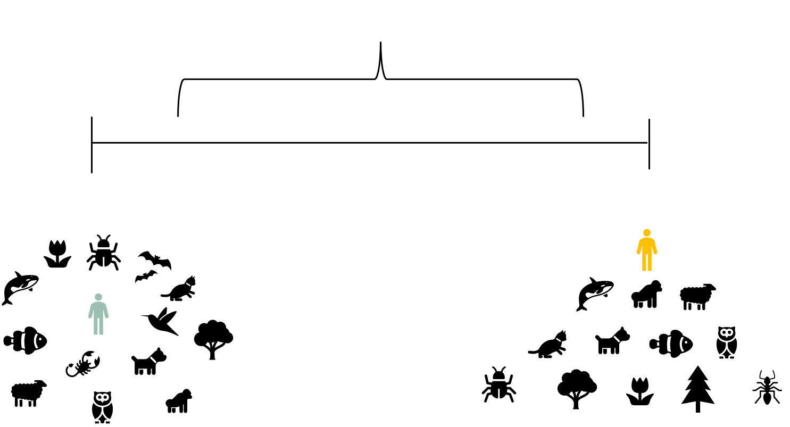
Photo (left) Credit: (Richard S. Heyza / The Seattle Times)

Slide 8
Non-Human Rights
Animal Welfare

Slide 9
Photo Credit:
Robin W. Baird/Cascadia Research Collective

Slide 10
Environmental Justice
Animal Rights
Civil Rights Framework
Non-Human
Rights
Environmental Ethics
Notes:
Frame Bridging / Frame Aligning

Slide 11
Practically Speaking, What Does Frame Aligning / Bridging Look Like?
Re-writing existing laws and regulations to use language that affirms personhood for orca
Proposing new laws and regulations that explicitly re-define orca as non-human persons

Slide 12
Possible Examples of Reparations
Habeas corpus (The Great Writ)
Bringing home Sk’aliCh’elh-tenaut (aka Tokitae / colonially known as Lolita)
Following the work and advice from the Lummi tribe (SacredSea.org)
Salmon
Notes:
common law courts must recognize our nonhuman animal clients as legal persons with the fundamental right to bodily liberty protected by the writ of habeas corpus and then order their release to a sanctuary where this right will be respected to the greatest extent possible.

Slide 13
Generational Inheritance
We cannot change the past, but we can take responsibility for the legacy we have inherited and make a more just future.
Photo Credit: EPA website

