Slide 1
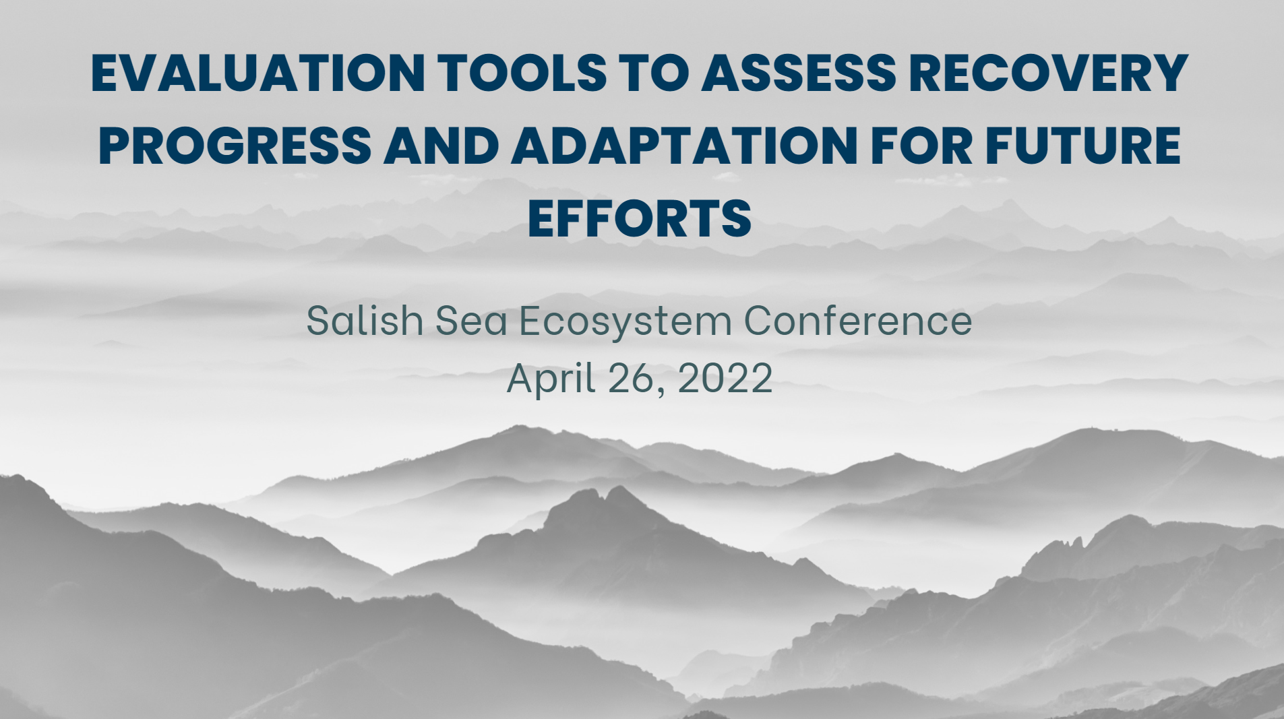

Slide 2
Session Overview
Introduction to the panel
Presentations
Discussion and Q&A

Slide 3
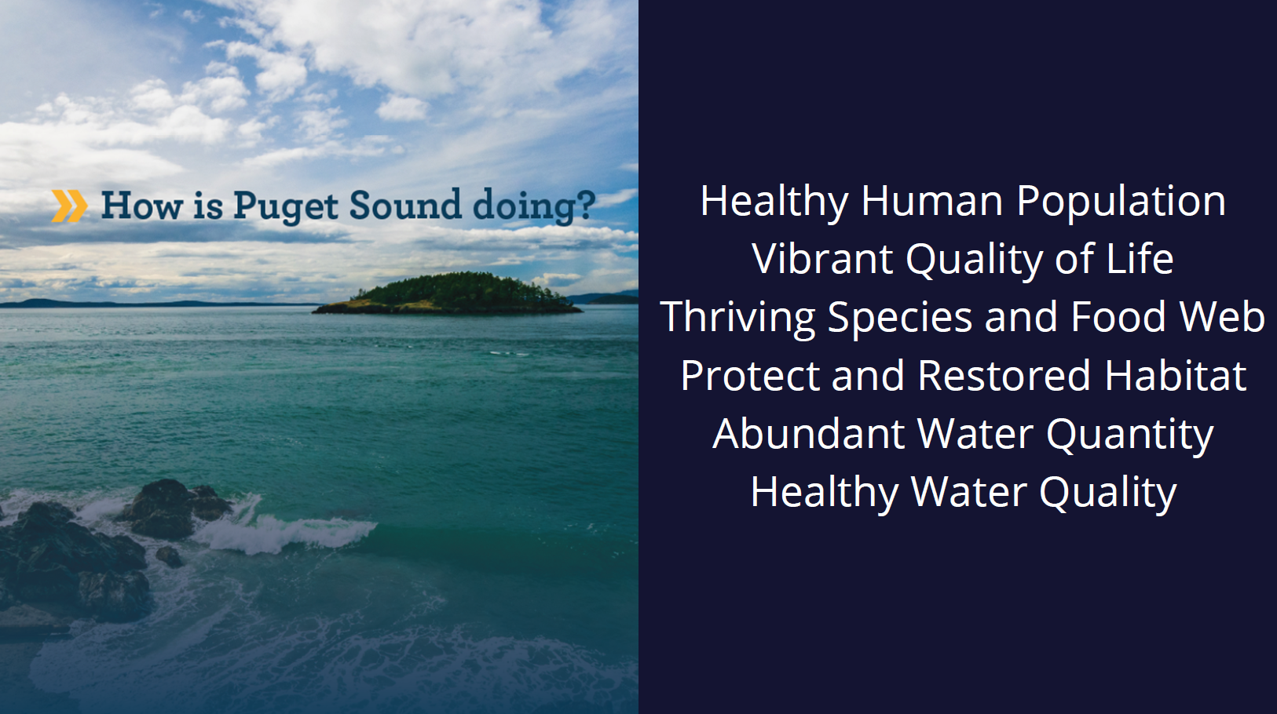

Slide 4
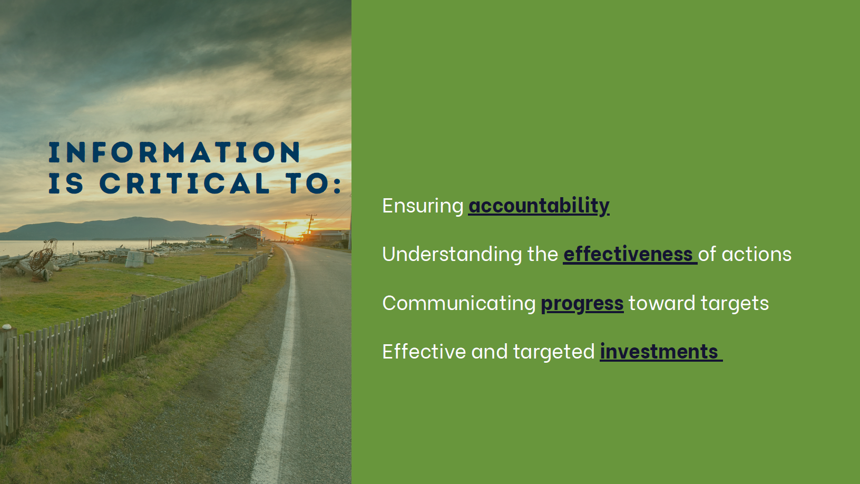

Slide 5
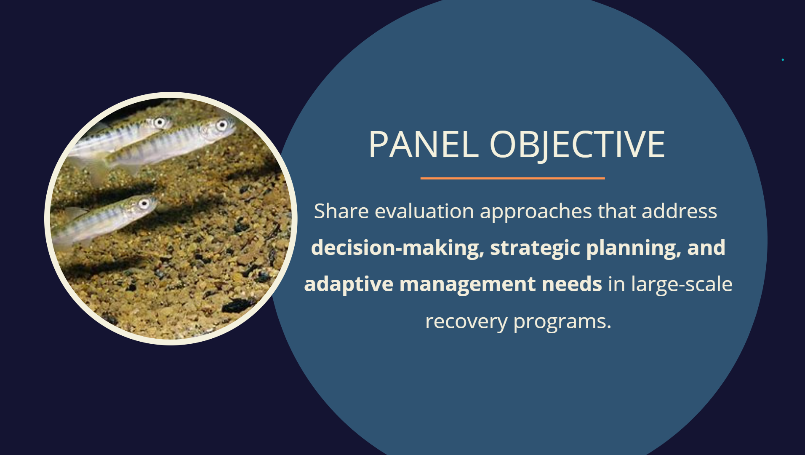

Slide 6
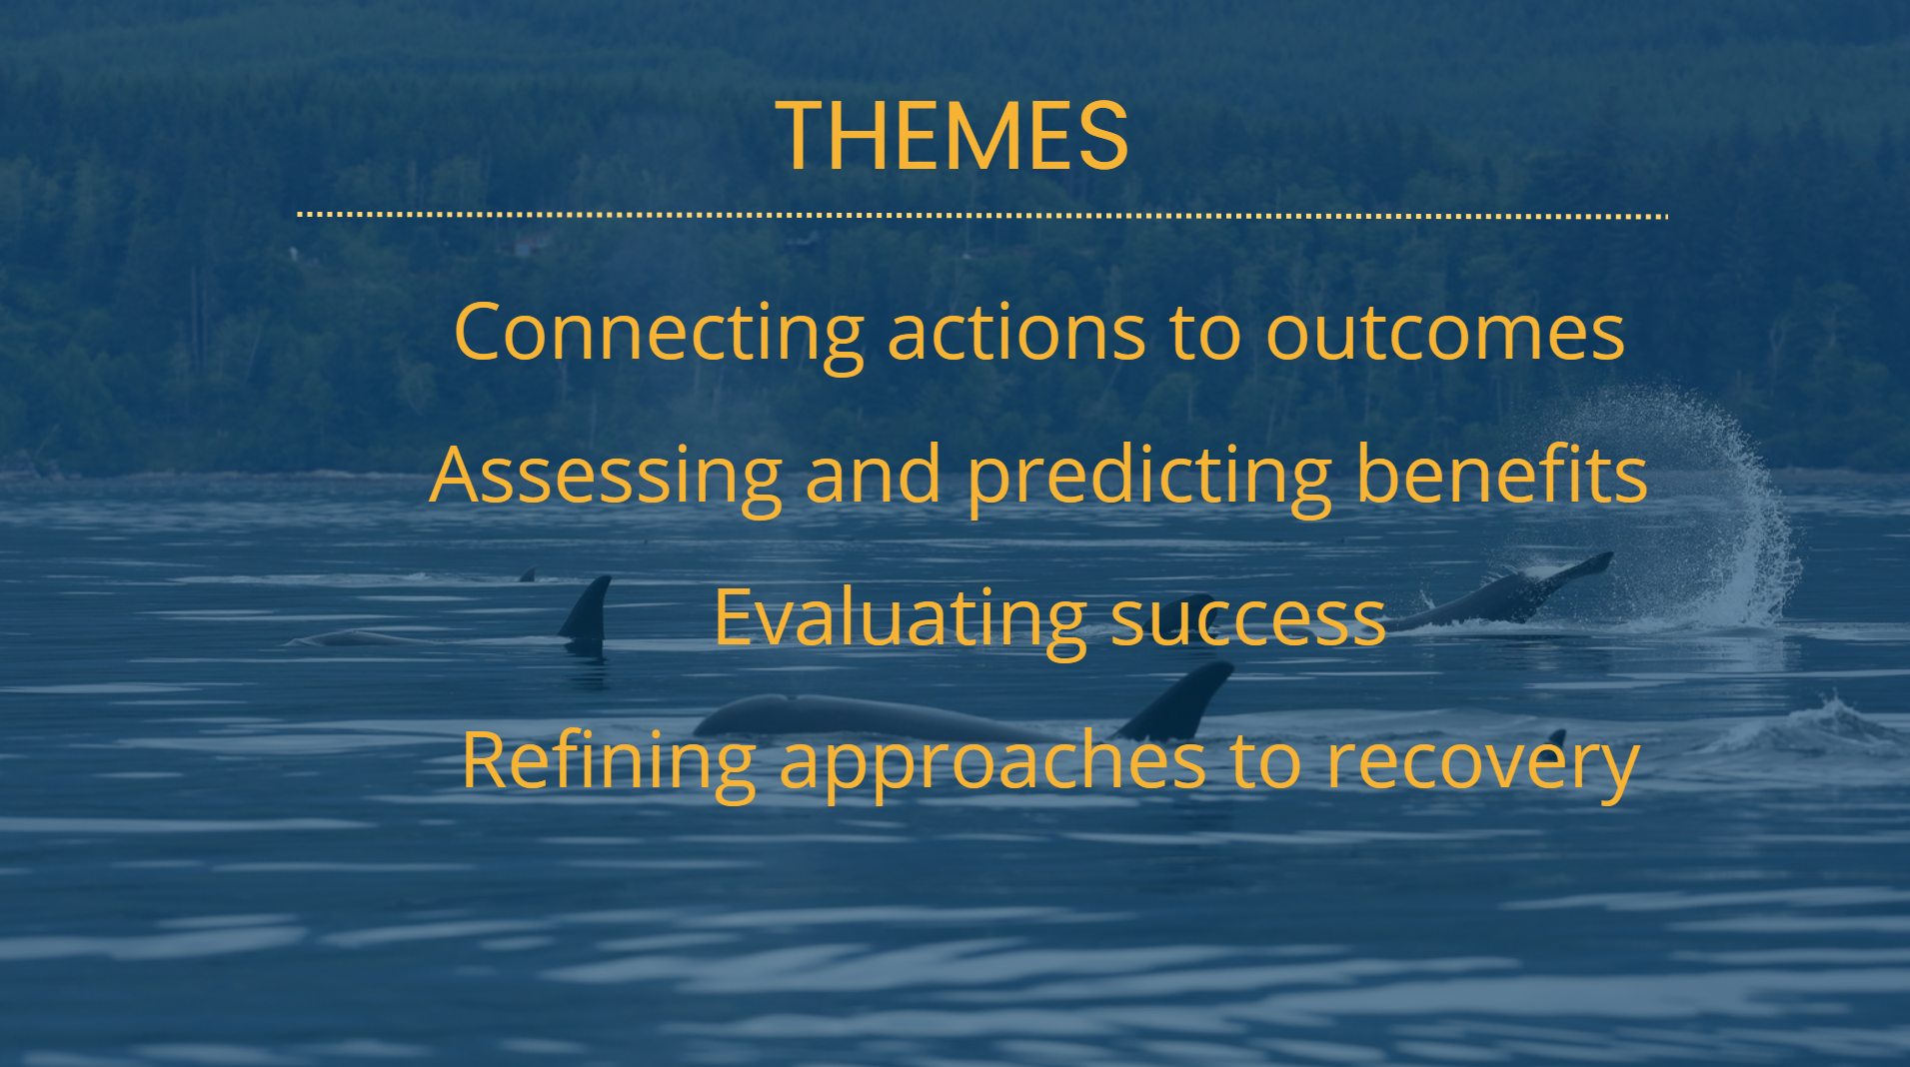

Slide 7
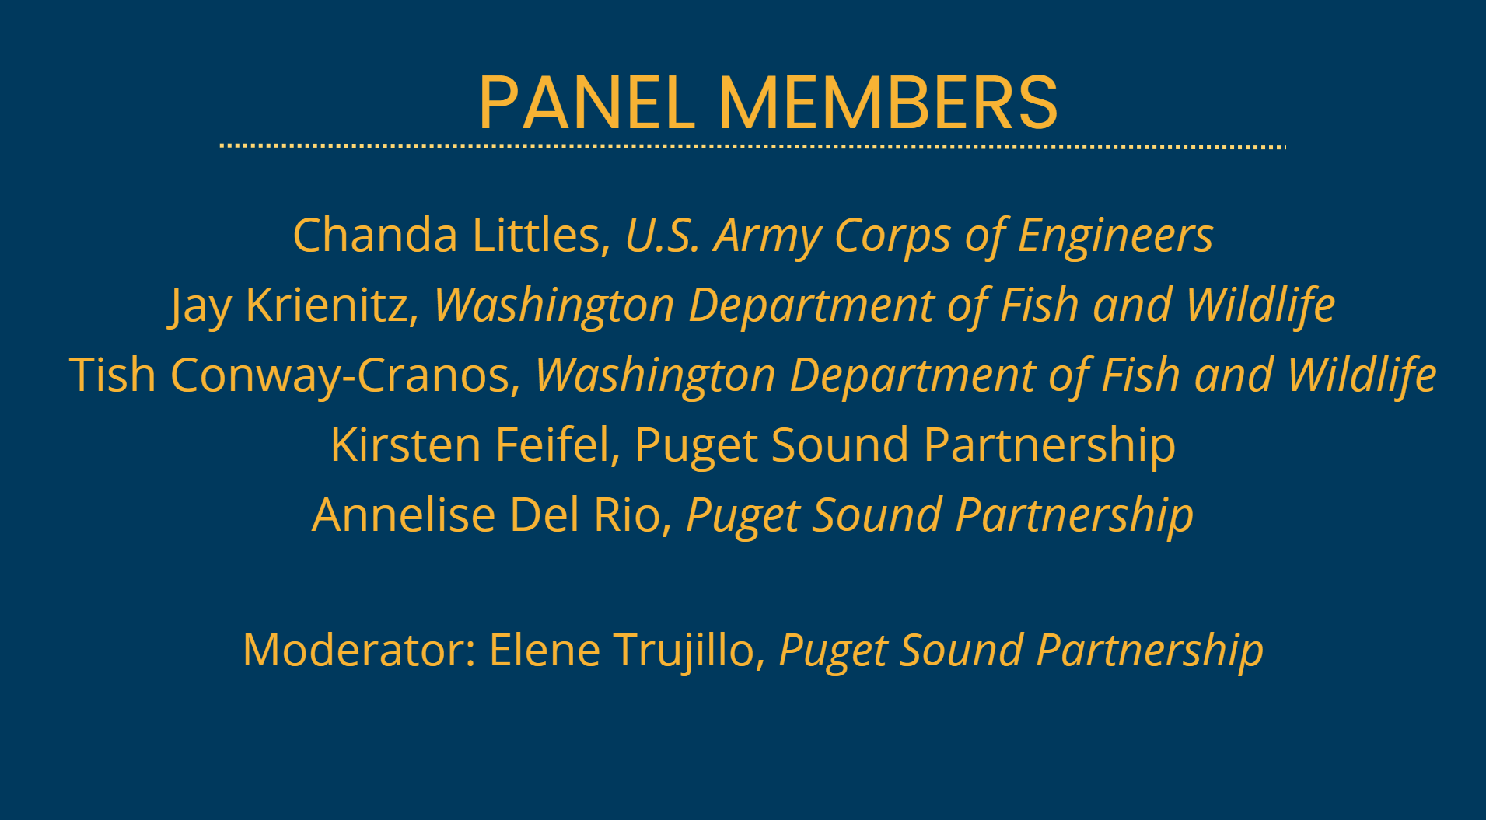

Slide 8
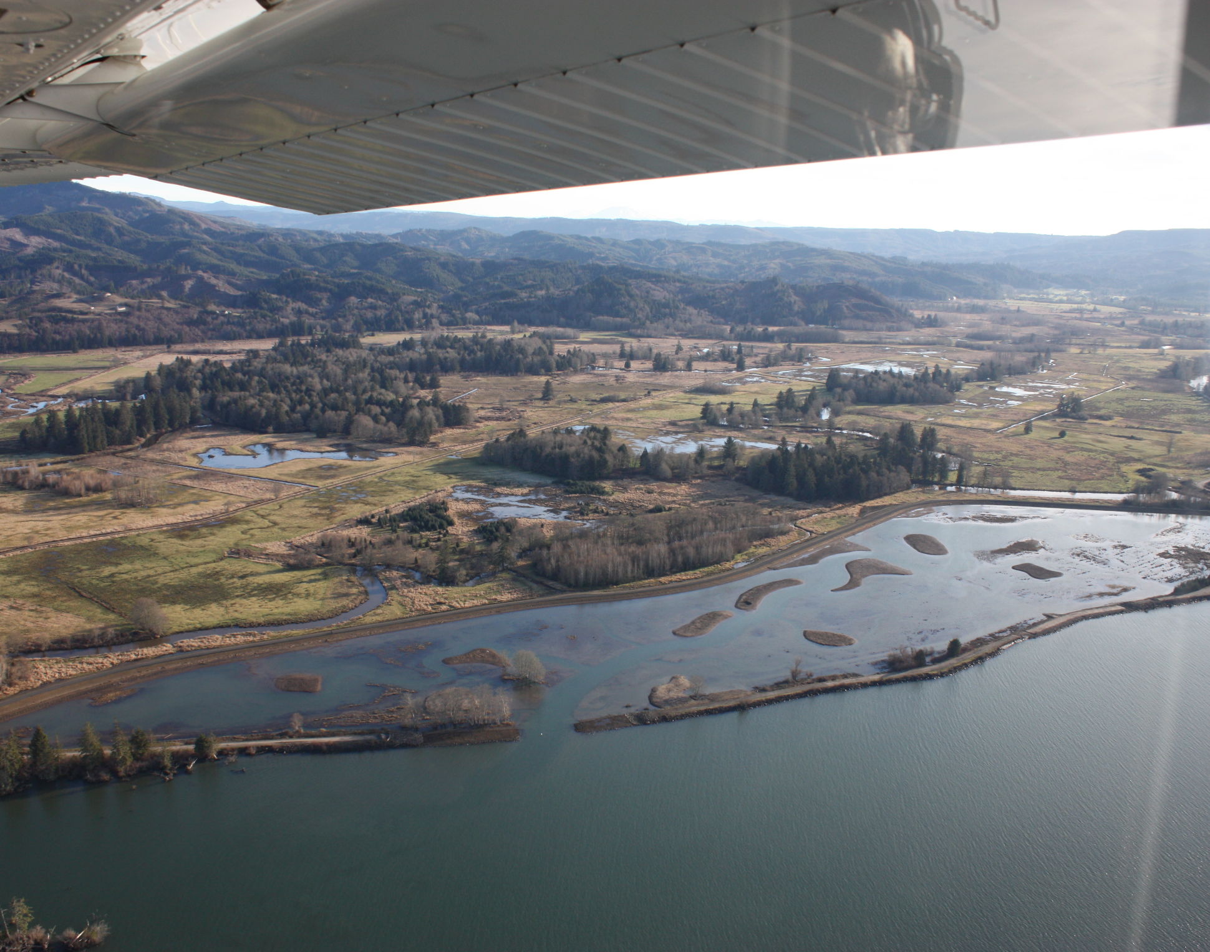
Columbia Estuary Ecosystem Restoration Program (CEERP) Adaptive Management
C. Littles, J. Karnezis, K. Blauvelt, A. Creason, H. Diefenderfer, G. Johnson, L. Krasnow, P. Trask
Steamboat Slough at Julia Butler NWR, Photo courtesy of Light Hawk Conservation Flying

Slide 9
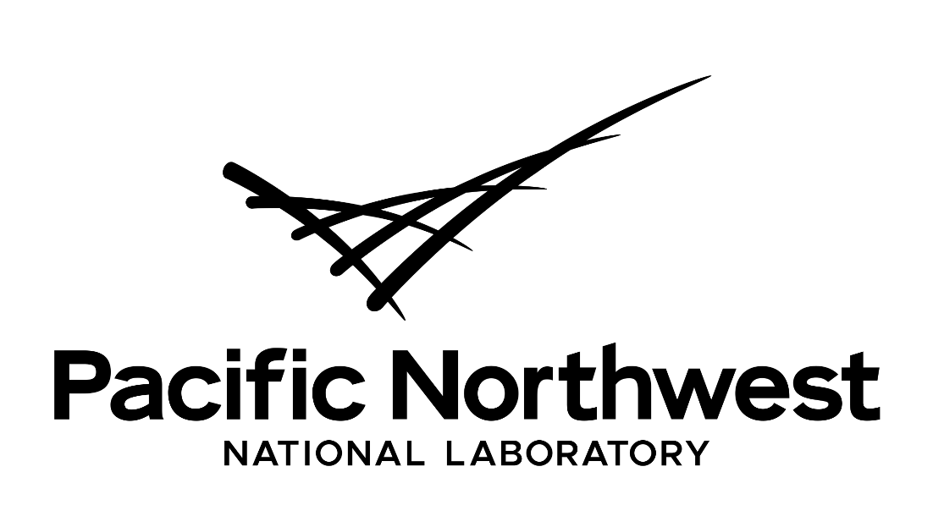




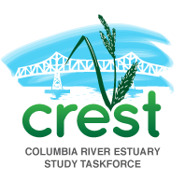


ACKNOWLEDGEMENTS
Multiple agencies support CEERP’s adaptive management

Slide 10
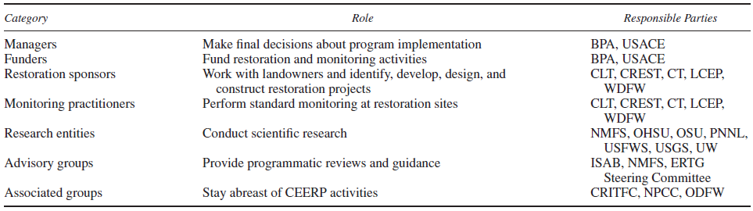
CEERP Overview
CEERP was established as a restoration program to aid in the recovery of ESA-listed salmonids, which also addresses uncertainties about the roles of different estuarine habitats
The program is supported by multiple entities collaborating to achieve positive outcomes
Ebberts et al. 2017, Table 2

Slide 11
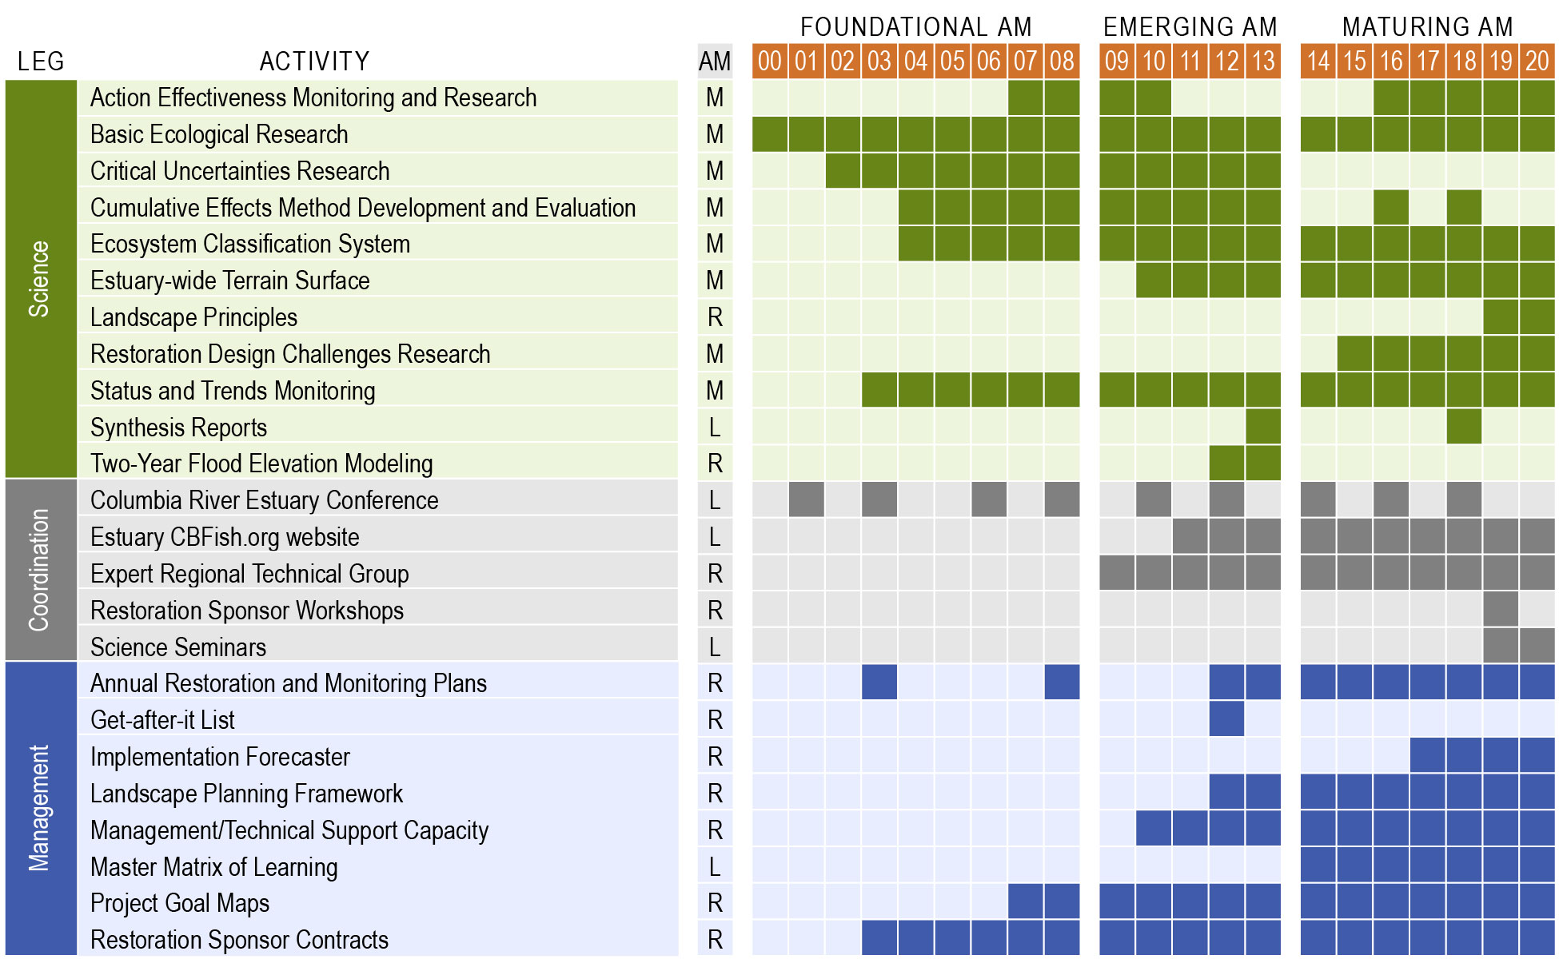
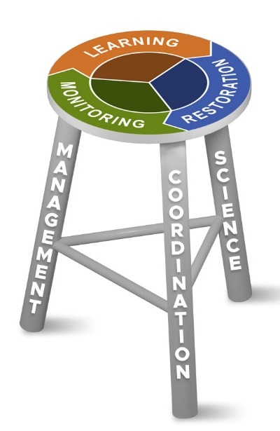
Adaptive Management in Practice

Slide 12
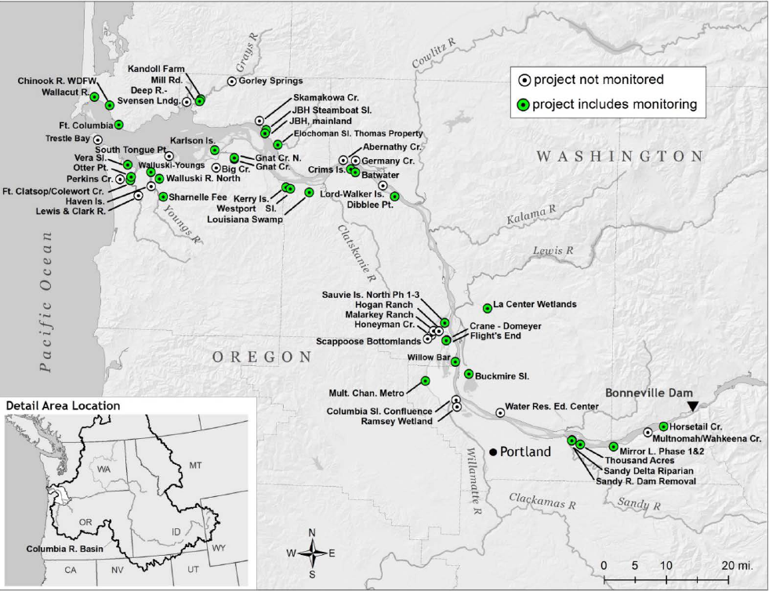
77 restoration projects implemented between 2004 and 2021
NOTE: “monitoring” refers to action effectiveness and may include research on critical uncertainties

Slide 13
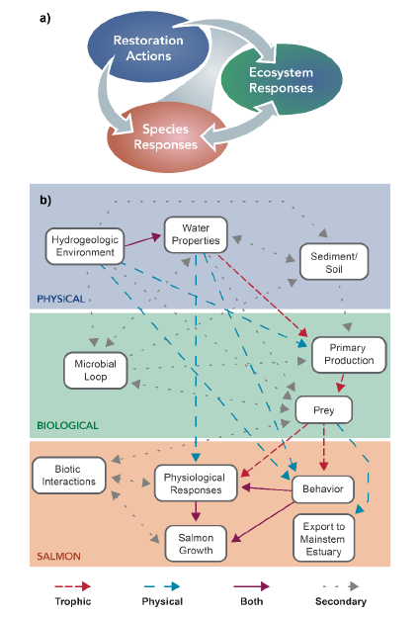
CEERP Restoration Cumulative Effects
general organizing model; and
ecosystem model distinguishing trophic and physical relationships for direct and indirect effects of restoration on juvenile salmon.
(Diefenderfer et al. 2016)
These models helped conceptualize the cumulative effects of CEERP restoration actions using an evidence-based evaluation (EBE) of all the lines of evidence from the suite of restoration projects implemented

Slide 14
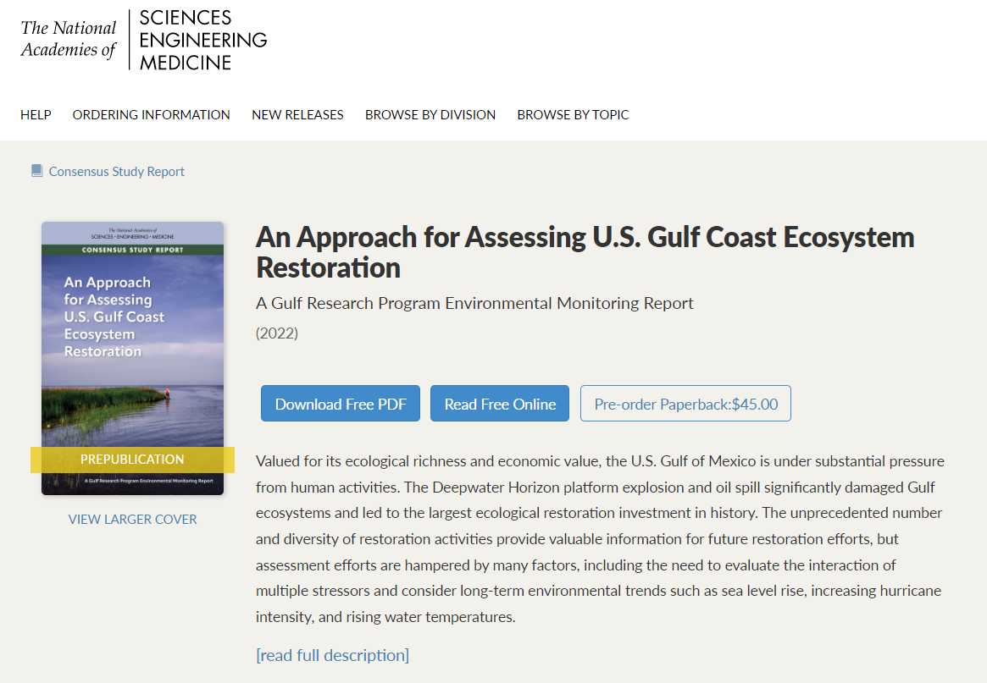
https://nap.nationalacademies.org/catalog/26335/an-approach-for-assessing-us-gulf-coast-ecosystem-restoration-a

Slide 15
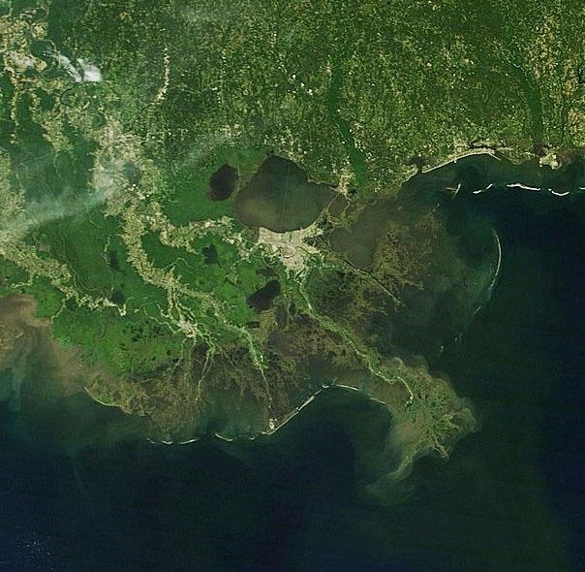
Current Scientific Progress Towards Assessing Cumulative Effects
Cumulative effects of restoration are the additive, synergistic, and antagonistic effects of all restoration activities occurring within a defined setting (e.g., a watershed).
Approaches for Assessing Cumulative Effects of Restoration include:
Developing conceptual models and hypotheses
Evaluating antagonistic and synergistic effects
Constructing Multiple Lines of Evidence
Image: USGS
Notes:
LM: Cumulative effects of restoration, where they may occur, are typically one of three types:
Additive – being the sum of the total – 1+1+1 = 3
Synergistic – greater than the sum of the total 1+1+1 = 4,5, 6…like where oyster reefs facilitate seagrass and /or shoreline protection
Antagonistic – less than the sum of the total 1+1+1 = 2,1, 0…
Synergistic and antagonistic effects can be either positive or negative. For example, depending on interactions restoration projects can reduce nitrogen inputs or increase them. Good or bad depending on objective
The committee explored a number of approaches for assessing cumulative restoration impacts that might be applicable in the GoM. This is one the aspects of our work that I am most proud of, we did not just identify problems we developed ways and means of addressing those problems and perhaps solving them

Slide 16
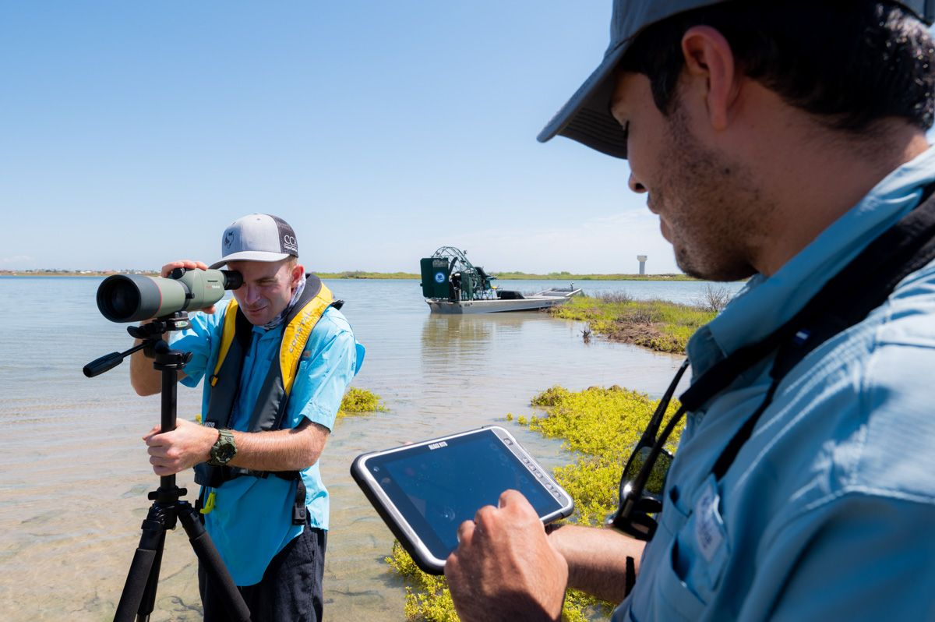
Moving Forward: Program-level Adaptive Management
Environmental background trends, especially those associated with climate change, are exhibiting higher variability over time; thus, past restoration practices that were successful may no longer be adequate.
Employing adaptive management techniques allows restoration program managers to update practices, based on periodic review of monitoring data and progress toward programmatic goals.
Image: HRI
Notes:
LM: Environmental background trends, especially those associated with climate change, are exhibiting higher variability over time—and in turn, restoration practices that have been successful in the past may no longer be adequate to compensate for the effects of anticipated changes in these background trends.
Adaptive management techniques can provide restoration program managers with the ability to revisit and update large-scale restoration and /or programmatic strategies.
However, successful implementation of adaptive management in Gulf restoration has been limited; This lack of success is not isolated to the Gulf, but examples of successful implementation do exist.

Slide 17
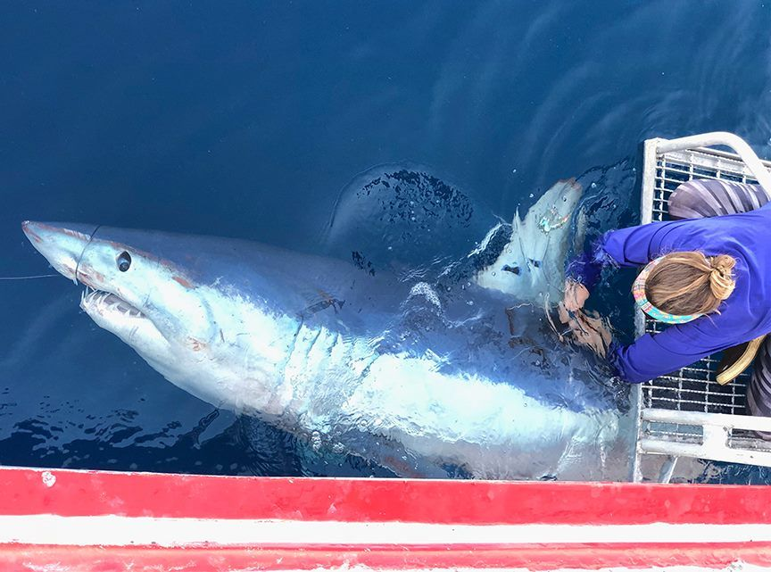
Moving Forward: Synthesis
Synthesis efforts are urgently needed to determine whether the many localized restoration efforts have collectively improved coastal and estuarine ecosystems across the Gulf.
A comprehensive monitoring database is needed for synthesis activities, yet current data collection in the Gulf remains insufficient for regional or Gulf-wide synthesis.
Image: HRI
Notes:
LM: Synthesis efforts are needed to determine if and how localized restoration efforts may have collectively generated measurably improved coastal and estuarine ecosystems across the GoM region.
In addition, such analyses provide a mechanism for adjusting future efforts to produce better restoration outcomes. The synthesis framework makes it possible to address difficult and complex environmental questions, providing answers that lead to increased understanding of coastal and estuarine system dynamics and, ultimately, better management decisions.
Synthesis at scales relevant to programmatic management is also needed in the Gulf because of strong and concerning trends in both chronic stressors, like sea level rise or tropicalization and acute stressors, like hurricanes or floods that can, directly and indirectly, strongly influence the success of restoration projects at all scales.
A comprehensive monitoring database is needed for synthesis activities. Current data collection in the GoM is often inadequate for regional or Gulf-wide synthesis. Inconsistencies in the types of variables and techniques used in monitoring programs adds to that difficulty.
There is a lack of centralized data management, storage, and access across the many restoration projects and funding for long-term monitoring efforts is difficult to obtain.
Without serious synthesis efforts it seems unlikely that we can quantitatively determine whether, and to what degree, GoM habitats and ecosystems have improved because of our actions.

Slide 18
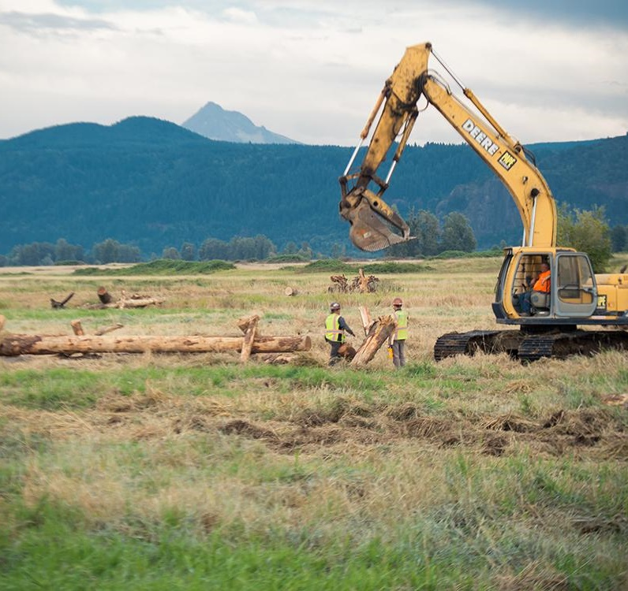
“Adapting the Program”
Support strategic collaborations between CEERP practitioners
Increase emphasis on climate-smart restoration projects
Improve the system for tracking the flow (and retention) of institutional knowledge
Enhance opportunities for pilot studies that may address emerging uncertainties
Maximize stakeholder engagement and community outreach
Apply predictive models to better leverage data collected at the project and program scale
Steigerwald floodplain reconnection, Photo credit LCEP

Slide 19
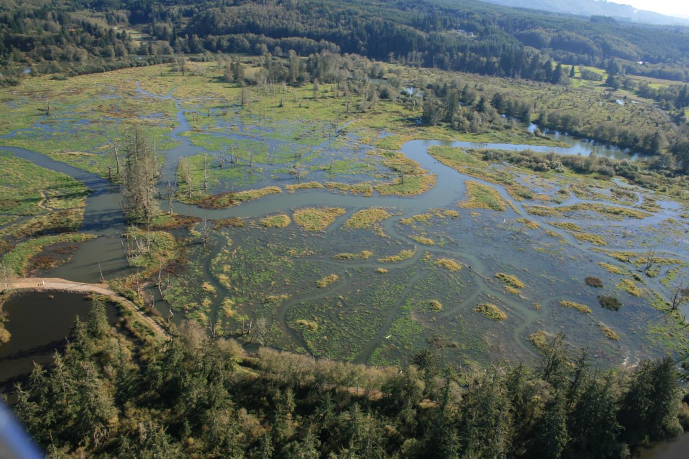
LINKS OF INTEREST
CEERP documents and related work:
https://www.cbfish.org/EstuaryAction.mvc/Index
Littles et al. 2022 CEERP adaptive management:
https://onlinelibrary.wiley.com/doi/epdf/10.1111/rec.13634
Diefenderfer et al. 2016 CEERP cumulative effects analysis:
https://esajournals.onlinelibrary.wiley.com/doi/full/10.1002/ecs2.1242?scrollTo=references
Assessment of restoration effectiveness in Gulf of Mexico (see Chapter 3):
https://nap.nationalacademies.org/catalog/26335/an-approach-for-assessing-us-gulf-coast-ecosystem-restoration-a?utm_source=Gulf+Research+Program+Updates&utm_campaign=7935778324-EMAIL_CAMPAIGN_2022_03_30_03_28&utm_medium=email&utm_term=0_367e0eb01a-7935778324-257655061

Slide 20
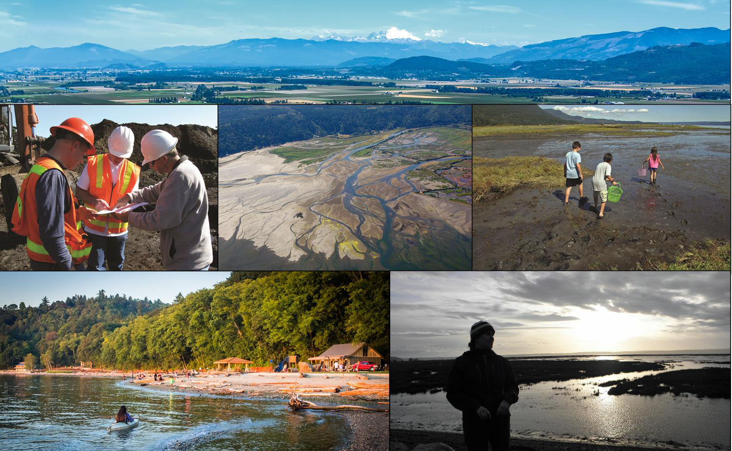


WDFW’s Estuary and Salmon Restoration Program: Restoration science and adaptive and management in Puget Sound
Tish Conway-Cranos
Jay Krienitz
Estuary and Salmon Restoration Program
Washington Department of Fish and Wildlife
Salish Sea Ecosystem Conference
Adaptive Management Panel
April, 2022

Slide 21
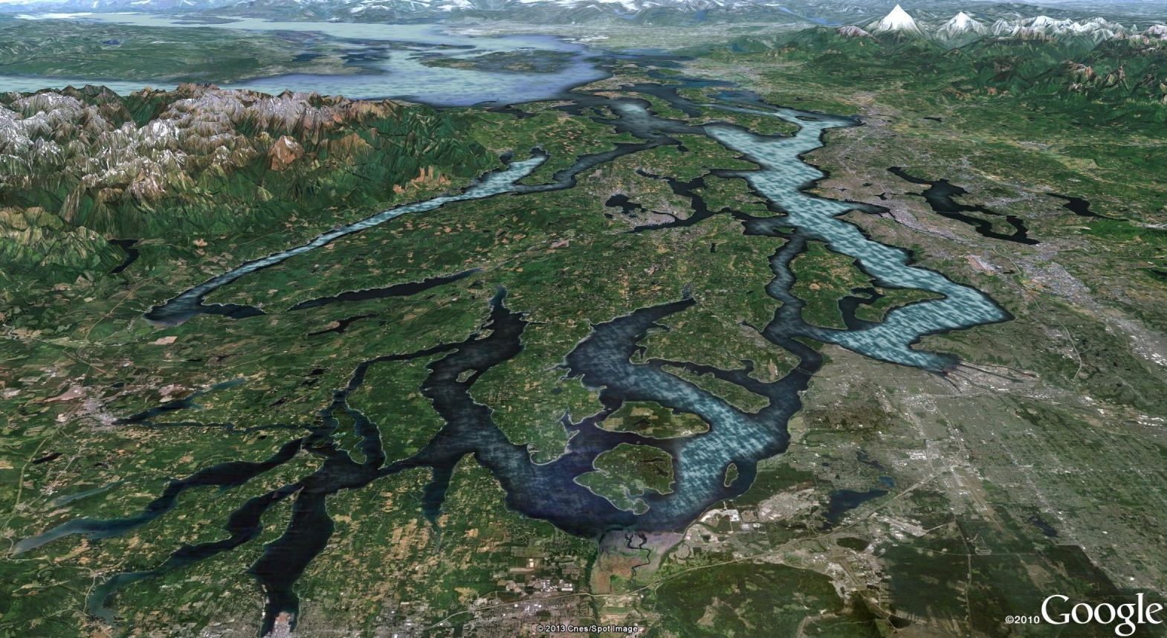
Puget Sound
Seattle
Tacoma
Olympia
Notes:
Puget sound is a complex and dynamic place comprised of multiple ecosystems ranging from alpine to estuarine to marine. This diverse landscape is one of the features that makes this region so biologically rich, but it also poses potential management challenges
Shoreline is clearly degraded in different ways across the landscape – what is the best way to approach restoring it?

Slide 22
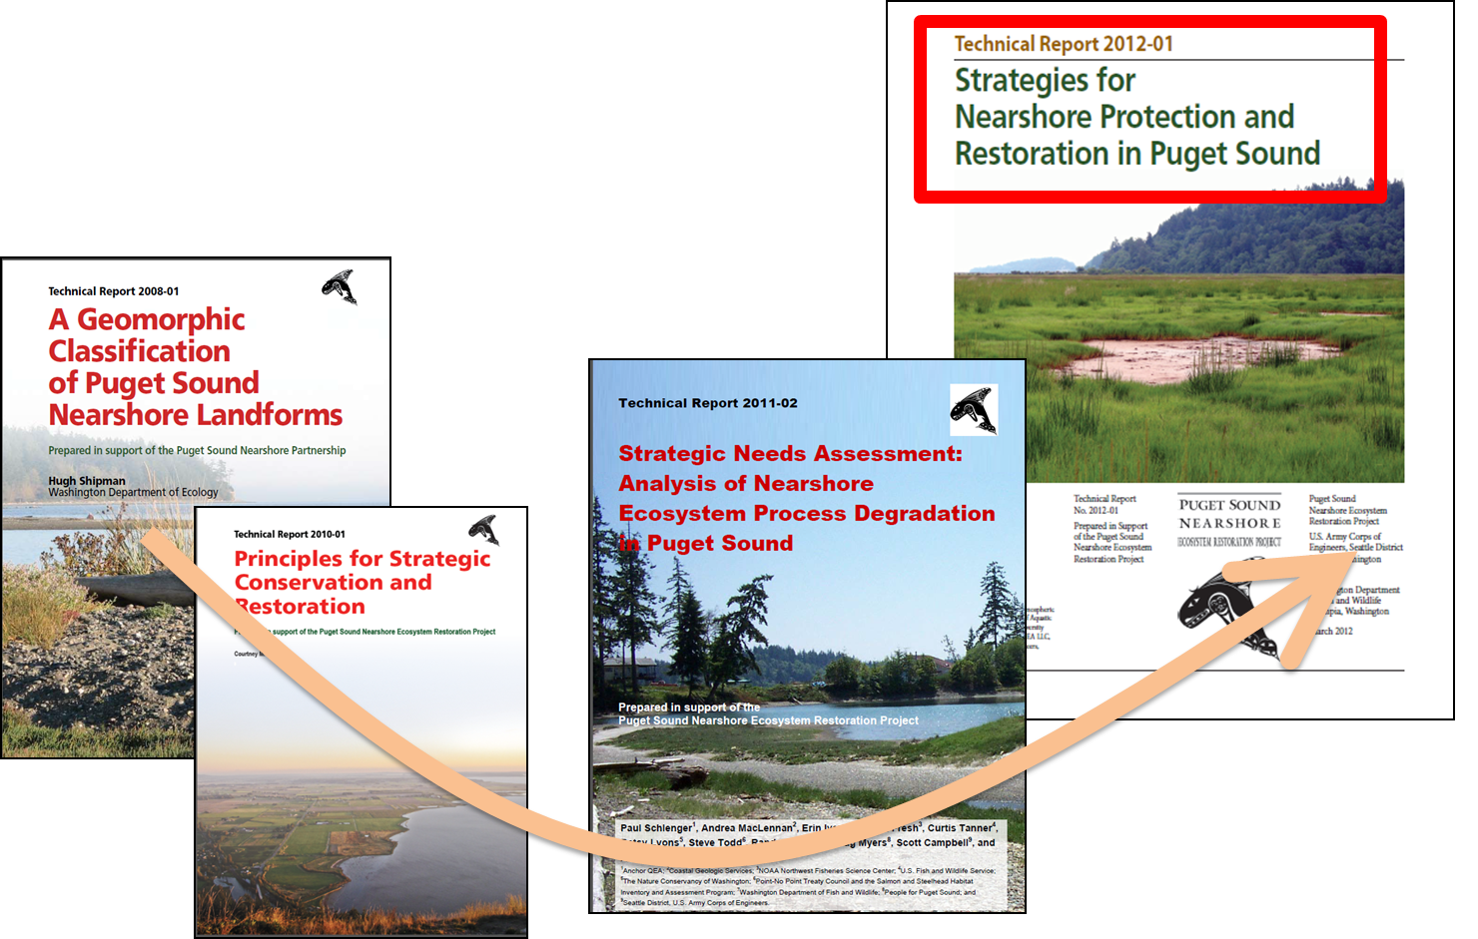

The Puget Sound Nearshore Ecosystem Restoration Project (PSNERP)
Feasibility Report and new Congressional Approval for 12 Projects
Estuary and Salmon Restoration Program

Slide 23
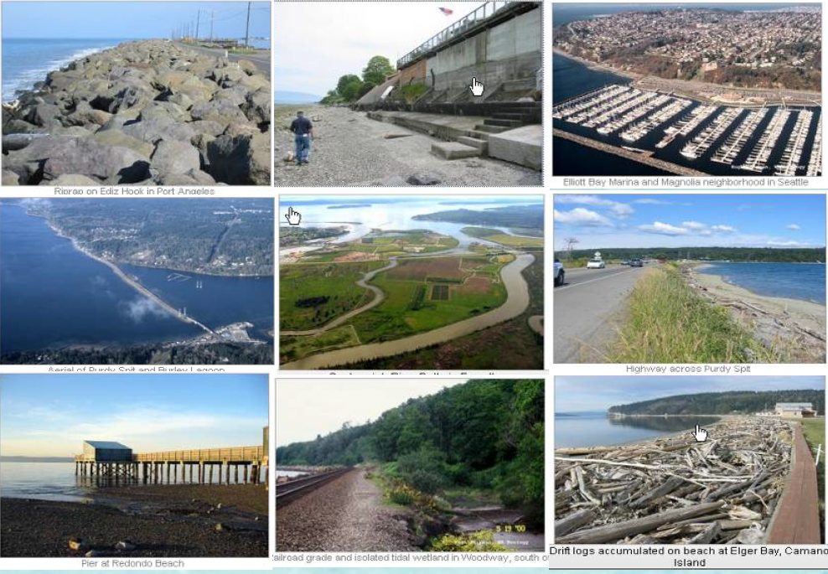
Wetland loss and shoreline degradation in Puget Sound
~75% of large river delta tidal wetlands are diked and filled
~1/3 of beaches are armored
Simenstad et al. 2011 Historic change and impairment of Puget Sound Shorelines
Notes:
Our conceptual model tells us that it is the natural processes such as (tidal flow, sediment transport, nutrient exchange) that create the structure of the nearshore (how it works and what it looks like) and this in turn provides functions or ecosystem goods and services that are valuable to society.
An understanding and appreciation for this Conceptual Model is fundamental to how our program works.
Unless we are able to protect and restore these underlying natural processes, other complementary habitat restoration projects such as salmon recovery may not be sustainable over time and with climate change.

Slide 24
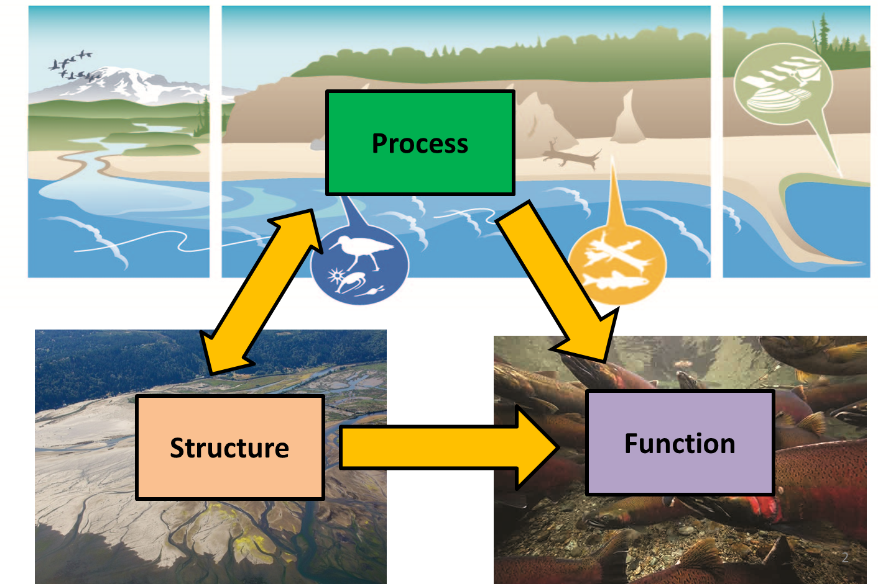
Process-Based Restoration
Recognizes link between ecological processes, the structure they create on the landscape, and the ecosystem functions linked to that structure.
Challenging! Processes are dynamic and structure and function take time to develop. (Learning Program)
Strong focus of PSNERP on landscape attributes (Structure) as indicators of both Process and Function (both current and historic)
Goetz et al. 2004
Simenstad et al. 2006
Grenier 2010
Notes:
The fundamental conceptual model of our program recognizes the integral link between ecological processes such as tidal flow, sediment delivery and nutrient exchange, the structure they create on the landscape, and the ecosystem functions that are linked to that structure.
Our goal is to conduct restoration that targets the process being impacted so that structure and function will follow
For example: This approach to restoration contrasts from an approach that starts with a target species, asks the question: what does that species need? And then tries to create that. This approach starts with the processes that are impaired and seeks to alleviate the source of the impairment. Because of the relationship between process, structure and function, we expect to see a more fully functioning restoring ecosystem when processes and landscape connectivity are considered.

Slide 25
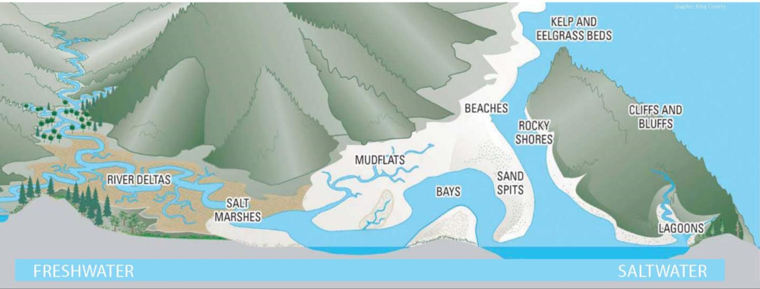
What processes do we care about?
Solar incidence
Detritus import and export
Freshwater input
Erosion
Sediment transport
Sediment transport
Exchange of aquatic organisms
Channel migration and formation
Accretion
Sediment input
Erosion
Tidal flow
Accretion
Detritus import and export
Sediment input
What processes maintain this physical landscape?
Notes:
This is a depiction of a functioning nearshore ecosystem, with diverse, interconnected habitats.

Slide 26
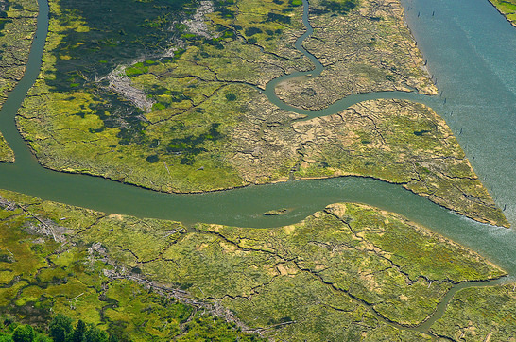

Estuary and Salmon Restoration Program
Founded on scientific principles of PSNERP
90%
Process-based restoration in Puget Sound

Slide 27
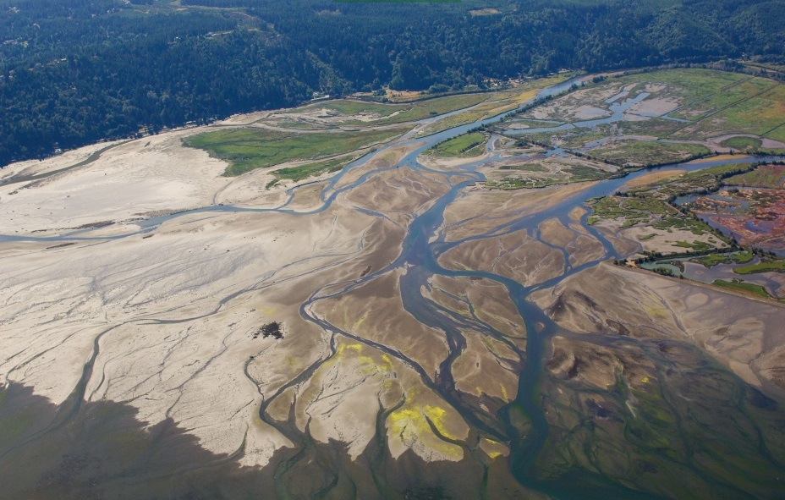

Restoration project Example: Skokomish Estuary
Sponsor: Skokomish Tribe & Mason Conservation District
Total: 1,179 acres / 377 tidal acres $3.7 Million in ESRP Funding
Notes:
Mike

Slide 28
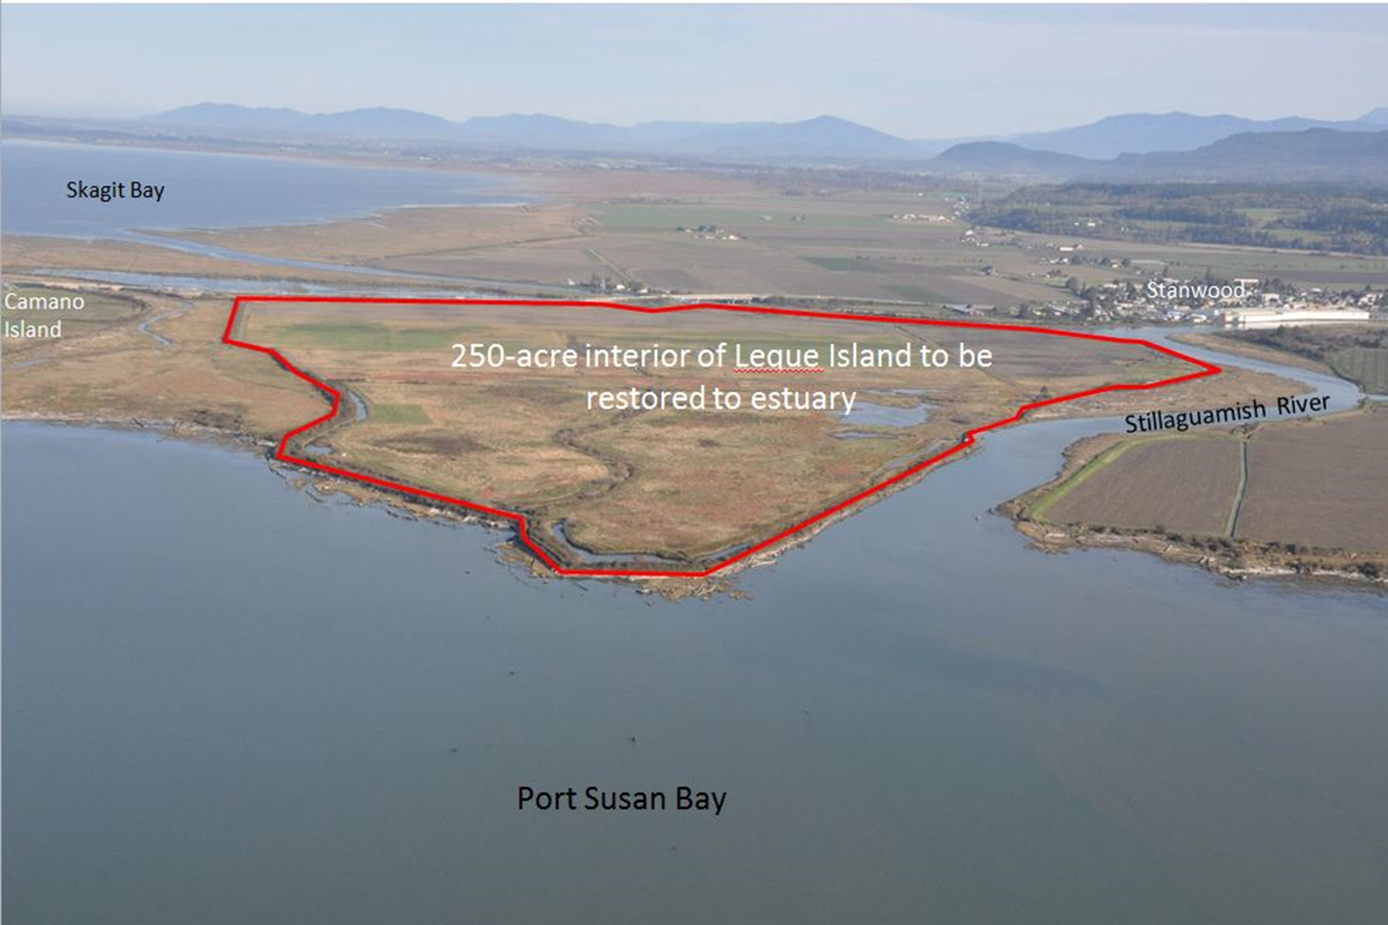
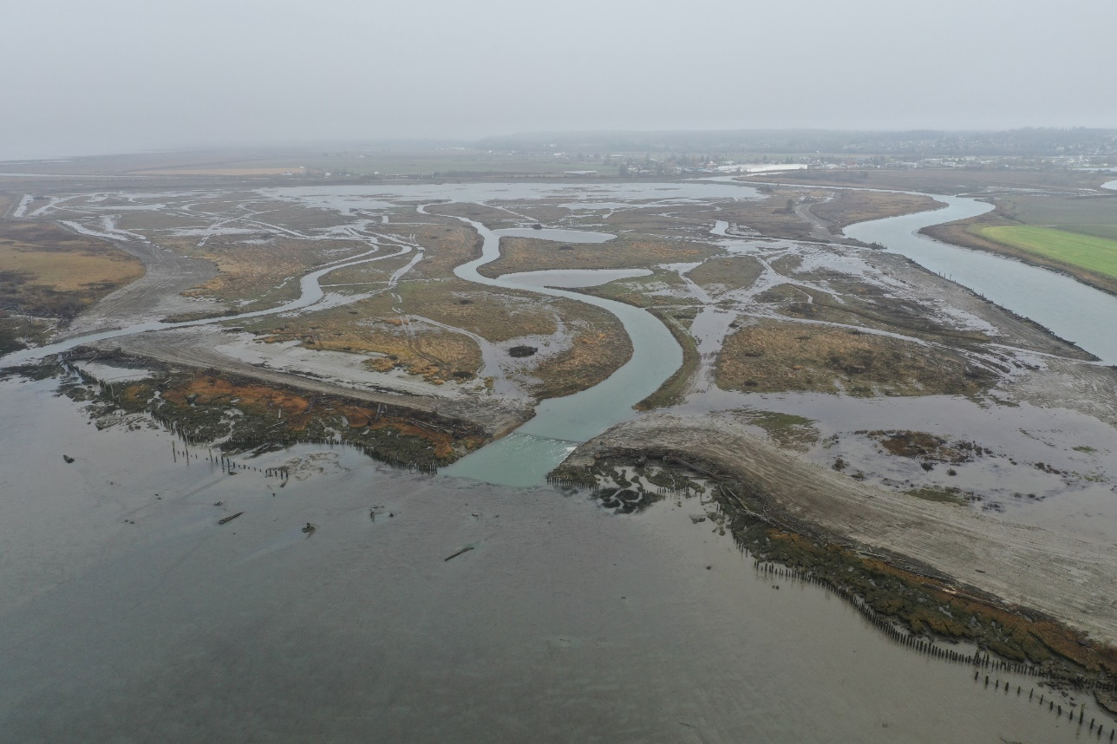
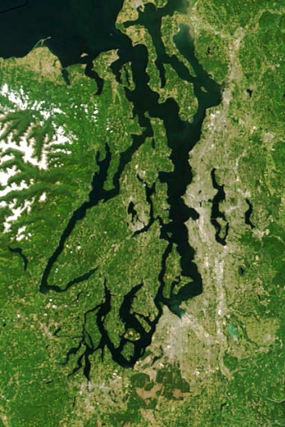

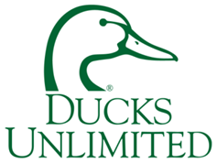
Restoration project Example: Leque Island Restoration
Restored to tides in October 2019

Slide 29
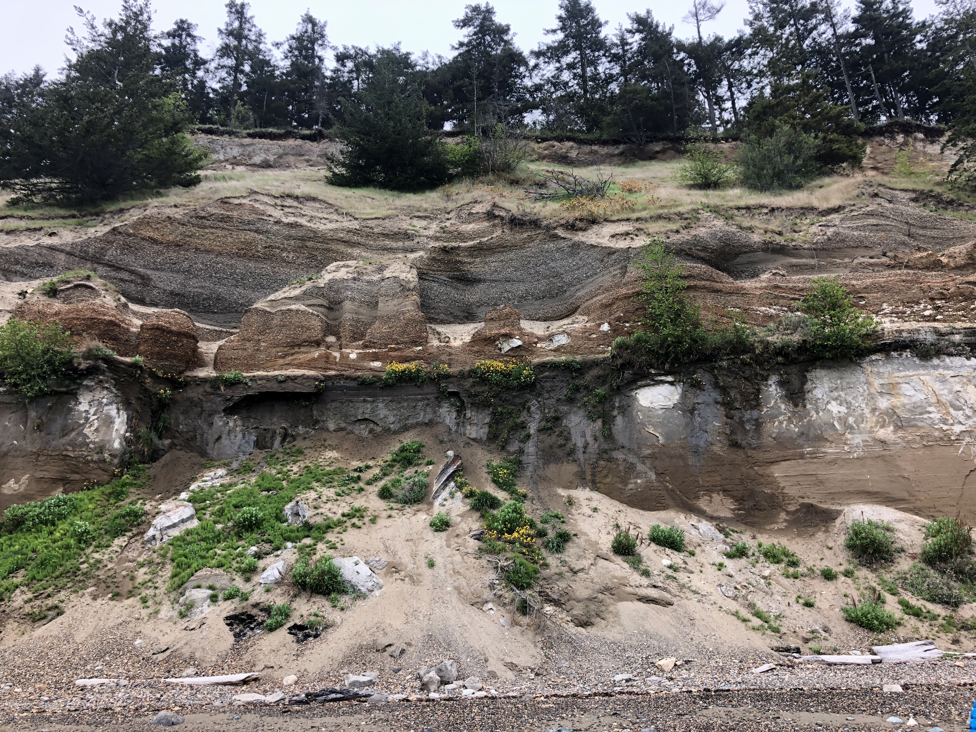
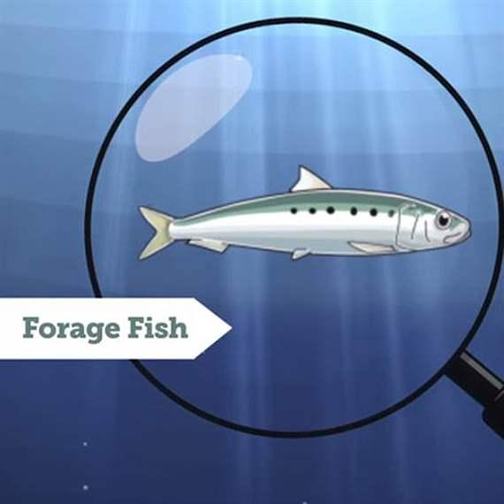
Project Example: Kelly's Point
ESRP request $400,000
Match: $976,555
27 acres
3,150 feet of feeder bluff including exceptional
Notes:
Maynard Point, Discovery Bay

Slide 30
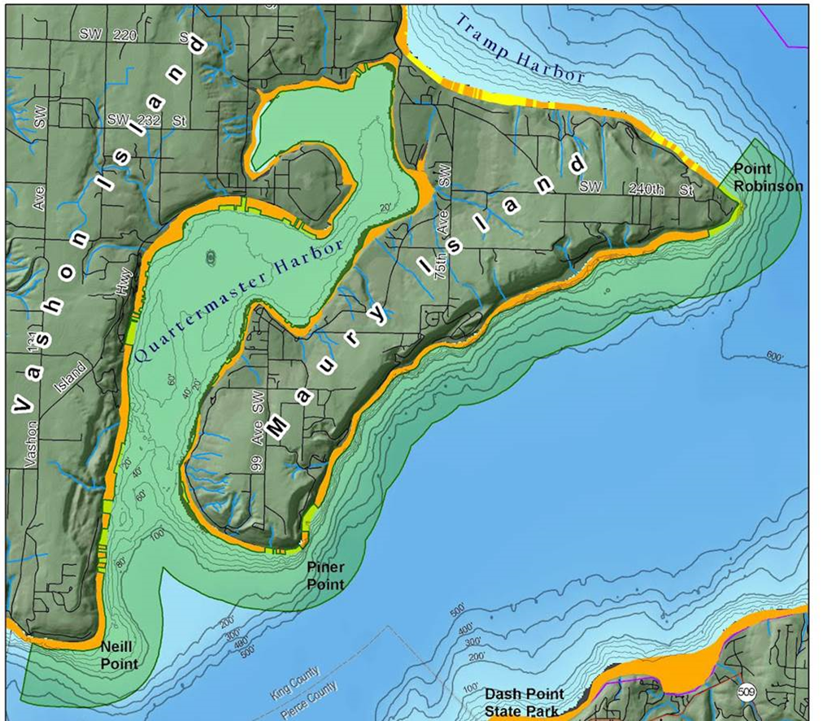
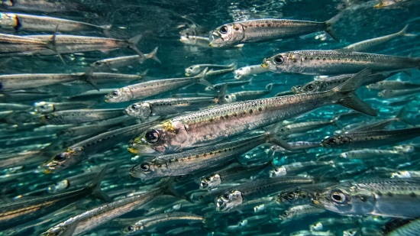
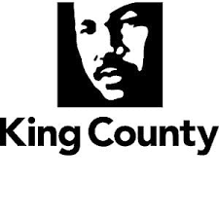
Restoration project Example: Maury Island Aquatic Reserve
ESRP Award 1: $1,586,712
ESRP Award 2: $1,645,600
ESRP Rank 5- 3: $1,121,000

Slide 31
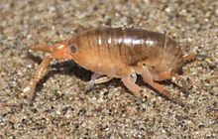
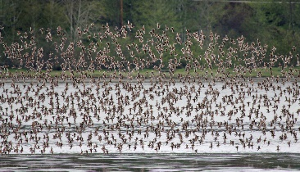
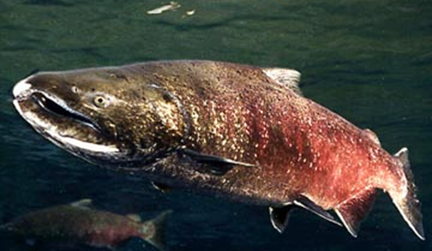
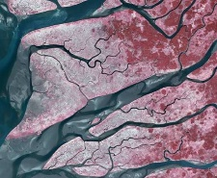
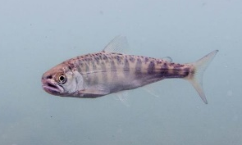
Estuary and Salmon Restoration Program
Founded on scientific principles of PSNERP
90%
10%
Process-based restoration in Puget Sound
Research projects to inform restoration

Slide 32
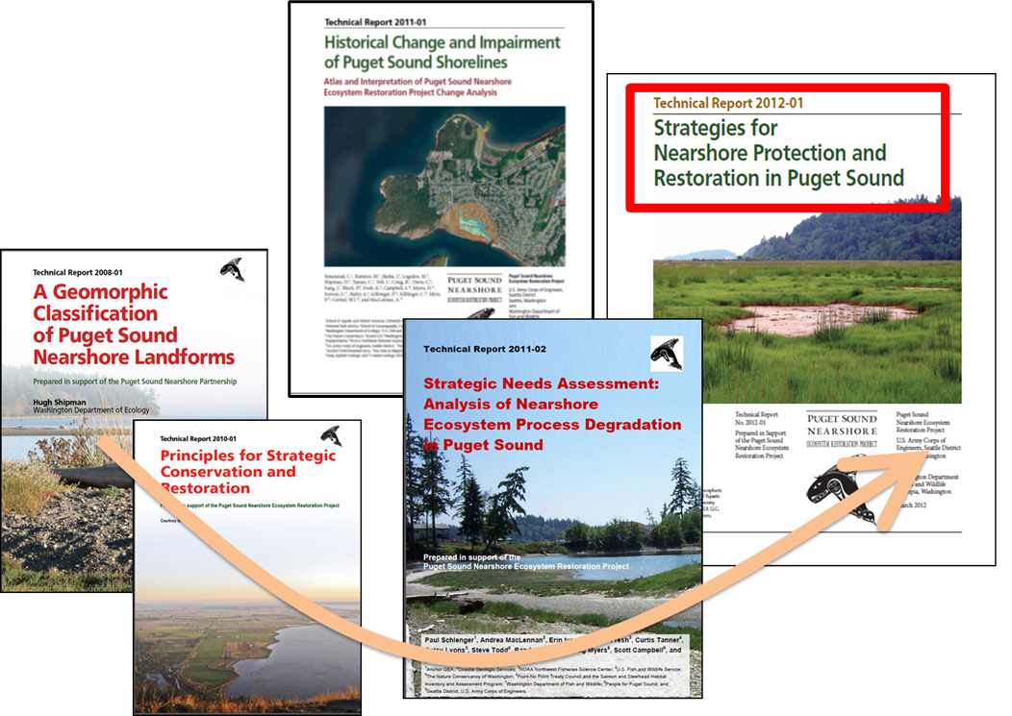
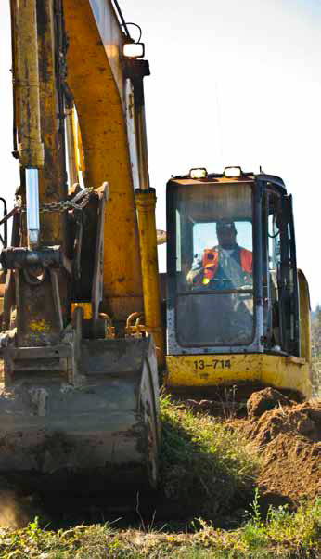
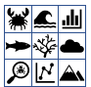
Linking research to restoration planning and implementation
Learning Projects
Restoration Actions
Ecosystem response
Planning Tools
ESRP Learning Program
Predictive Models
Notes:
Field investigations of ecosystem response to restoration actions
Prioritization to maximize ecosystem benefits relative to potential costs
Predictive models of ecosystem processes (e.g., channel development, sediment transport, vegetation development)

Slide 33
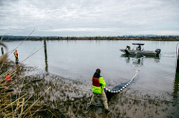
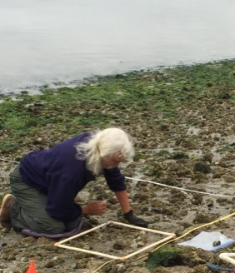
Adaptive Management Cycle
Learn
Ecosystem response
Tools
Models
Communication
Implement
Reassess
Incorporation into restoration projects
Notes:
This as a process that can/should always be improved upon.

Slide 34
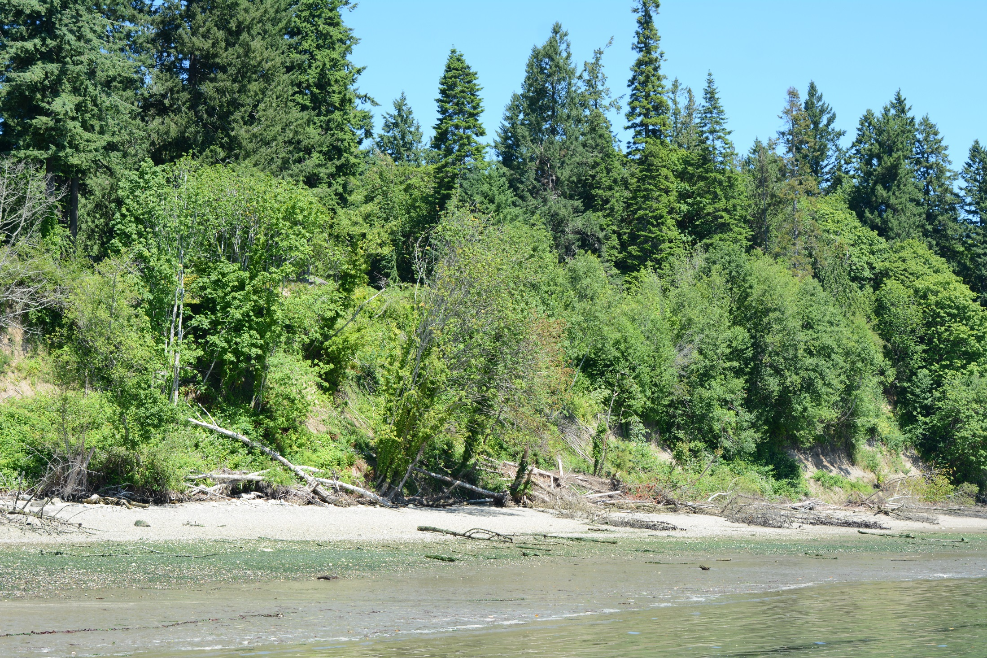






Learning project Example: Edgewater Beach
Ecosystem responses to restoration
Sediment transport
Beach wrack
Beach profile
Invertebrate community
Fish and crab community
Dethier et al. 2020 ESRP Report

Slide 35
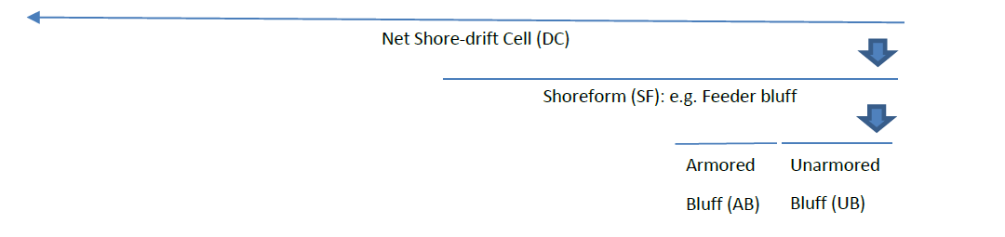
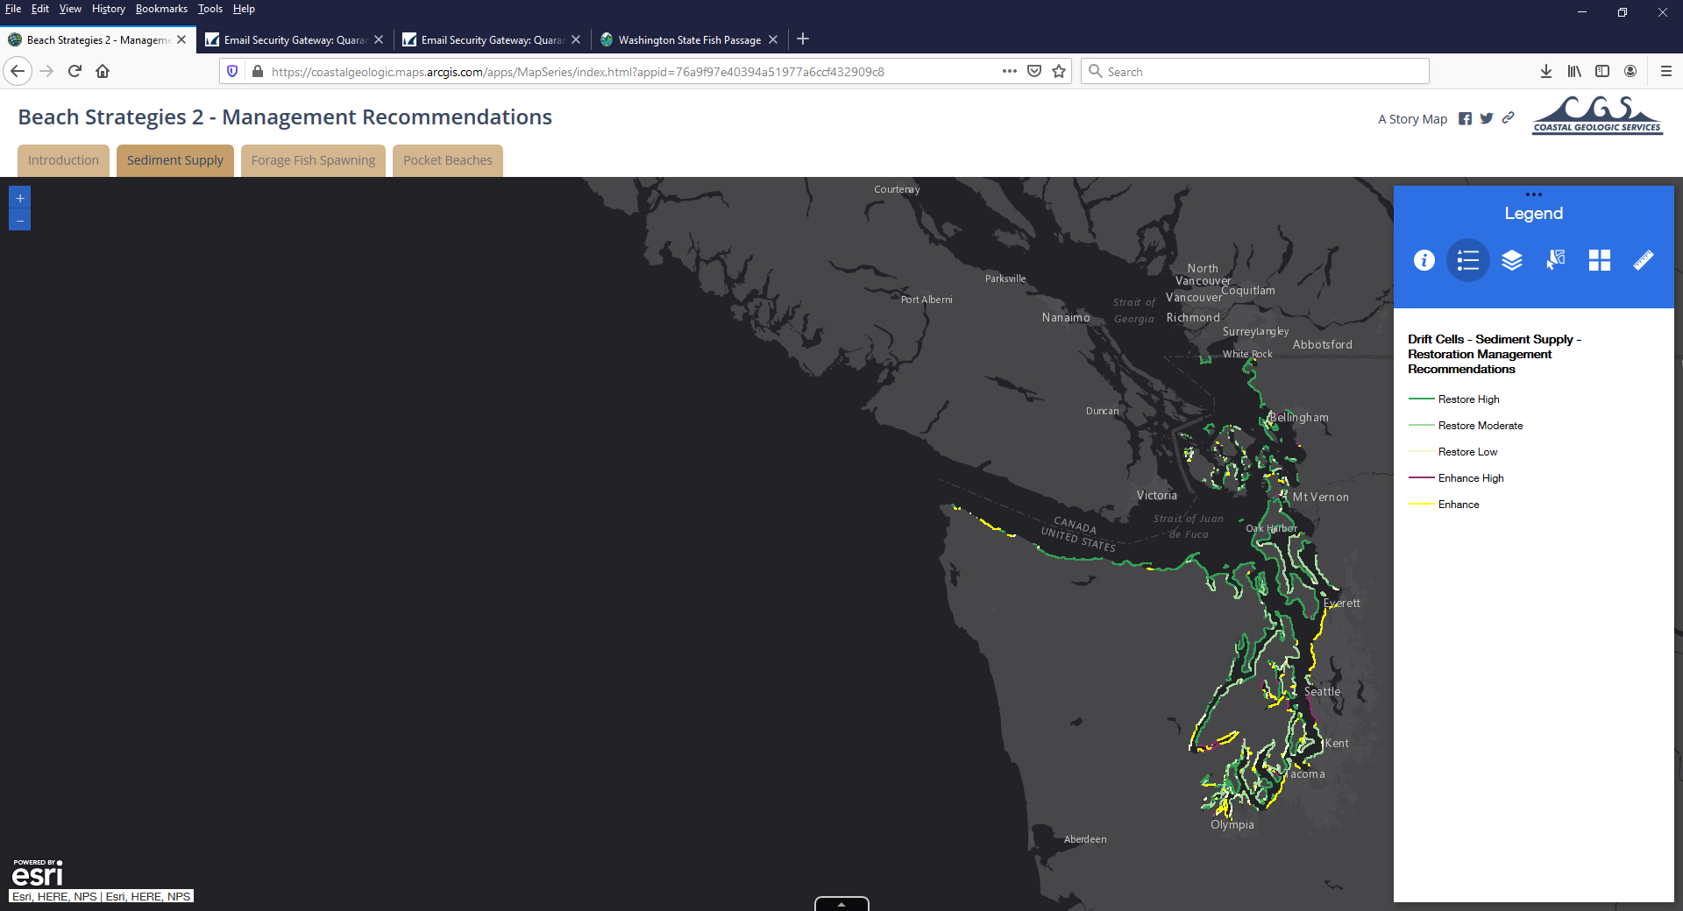

Learning project example: Beach Strategies
Updated spatial data
New derived metrics focusing on sediment dynamics
Online interactive tool (in development)
Armored bluffs
Beach Strategies: Armor, shoreforms, drift cells
https://salishsearestoration.org/wiki/Beach_Strategies_for_Nearshore_Restoration_and_Protection_in_Puget_Sound
CGS 2020 Phase 2 ESRP Report

Slide 36


Learning project example: Scaling tidal geometry with marsh island area for Puget Sound
Measuring relationship between island size and number of channels to inform restoration project design
Hood 2007
Hood 2007 Scaling tidal channel with marsh island area: A tool for habitat restoration, linked to channel formation processes. Water resources research
Hood 2015 Geographic variation in Puget Sound tidal channel planform. Geomorphology.230.98-108
Notes:
Smith Island: An ESRP funded project using ESRP Learning Project product.

Slide 37




Learning project example: Nisqually delta restoration
Colonization by juvenile salmonid prey
Juvenile Chinook access to restored site
Habitat-specific prey energy density
Spatial pattern and quantity of riverine sediment
Ellings et al. 2016
Davis et al. 2017
Woo et al. 2018
Davis et al. 2018 a,b
Grossman, ongoing

Slide 38






Learning project example: Density-Dependent rearing of Chinook in tidal wetlands
Landscape drivers of juvenile Chinook abundance and distribution
Estuary habitat capacity and density-dependence
Growth potential across different habitat types
Long-term datasets
Management recommendations for river deltas considering variation in estuary habitat and natal Chinook populations
Greene et al. 2021 ESRP Report
Notes:
Project led by Correigh Greene in 4 river deltas in Puget Sound, different sizes of estuaries different sizes of Chinook populations
Are juvenile Chinook limited by estuarine habitat capacity?
Analysis to understand use of the estuary in the context of habitat capacity and density-dependence
Greene et al. 2021 – Using a range of deltas to produce results that can be applied across Puget Sound. Connecting habitat restoration to population of fish that could use the delta – not just on site but across the entire delta – proportion of the time when at habitat capacity as a function of annual density of outmigrants. Only possible with long-term monitoring of entire deltas, across different habitat types.
Next step Analysis of estuary restoration over time and Chinook population response

Slide 39
Adaptive Management Cycle
Adaptive Management Cycle: Learning challenges
Learn
Ecosystem response
Tools
Models
Challenges
Complexity of systems
Timeframe: Ecological succession vs. grant cycle
Scaling up from project-level to landscape level insights
Hard to fund monitoring
Approach:
ESRP criteria for targeted research
Importance
Efficiency
Transferability
Policy Impact
Implement
Reassess

Slide 40
Adaptive Management Cycle: Communication Challenges
Learn
Communication
Challenge:
How best to communicate results between researchers and restoration practitioners?
Approach:
Require summary of project and results on Salish Sea Wiki
Webinar series
Nearshore Summit 2021
Implement
Reassess

Slide 41







Connecting Science and Practice: Nearshore Restoration Summit and Synthesis
Summit
Restoration Natural and Social Scientists
Restoration Planners and Practitioners
Proceedings
SRFB March 2021
Item 9
41
41

Slide 42
Adaptive Management Cycle: Implementation challenges
Learn
Challenge:
How best to integrate results of research into new restoration projects?
Approach:
ESRP Restoration criteria and technical review process
Statement of Work negotiation process → incorporation of restoration science
Implement
Reassess

Slide 43
Adaptive Management Cycle
Learn
Ecosystem response
Tools
Models
?
Communication
Implement
Reassess
Incorporation into restoration projects
Notes:
This as a process that can/should always be improved upon.

Slide 44

Thank you!
Want to stay connected? Subscribe to our email listserve!
https://wdfw.wa.gov/species-habitats/habitat-recovery/nearshore/conservation/programs/esrp

Slide 45
Assessing progress at multiple timesteps
Kirsten Feifel

Slide 46
Monitoring, evaluation and adaptive management
Action Agenda Strategy 5: Protect and restore floodplains and estuaries
Vital Signs
“Our vision for the future”
Functional Habitat
Thriving Species and Food Web
Eelgrass habitat
Orcas
Planning framework
Floodplain habitat
Salmon
Estuary habitat
Human Wellbeing
Riparian habitat
Cultural Wellbeing
2022
2050
Notes:
As the Action Agenda has evolved with this update process, so has our system of indicators and targets…

Slide 47
Monitoring, evaluation and adaptive management
Action Agenda Strategy 5: Protect and restore floodplains and estuaries
Needed Actions
“How are we going to get there”
Desired Outcomes
“What do we need to achieve”
Vital Signs
“Our vision for the future”
Incorporate flood risk into the cost of development
Future fragmentation of rivers by structural barriers prevented
Functional Habitat
Thriving Species and Food Web
Enforce regulations for development in floodplains
Conversion of agricultural lands prevented
Eelgrass habitat
Orcas
Planning framework
Complete reach-scale planning
Floodplain habitat
Salmon
Levees, floodgates, and other barriers in floodplains and estuaries removed
Encourage integrated floodplain management
Estuary habitat
Human Wellbeing
Floodplains restored and protected
Riparian habitat
Complete acquisition and restoration projects
Cultural Wellbeing
2022
2050
Monitoring framework
Notes:
As the Action Agenda has evolved with this update process, so has our system of indicators and targets…

Slide 48


Monitoring, evaluation and adaptive management
Action Agenda Strategy 5: Protect and restore floodplains and estuaries
Needed Actions
“How are we going to get there”
Desired Outcomes
“What do we need to achieve”
Vital Signs
“Our vision for the future”
Incorporate flood risk into the cost of development
Future fragmentation of rivers by structural barriers prevented
Functional Habitat
Thriving Species and Food Web
Enforce regulations for development in floodplains
Conversion of agricultural lands prevented
Eelgrass habitat
Orcas
Planning framework
Complete reach-scale planning
Floodplain habitat
Salmon
Levees, floodgates, and other barriers in floodplains and estuaries removed
Encourage integrated floodplain management
Estuary habitat
Human Wellbeing
Floodplains restored and protected
Riparian habitat
Complete acquisition and restoration projects
Cultural Wellbeing
2022
2050
Ongoing Programs tracking
What can programs contribute?
Progress Indicators
What does progress look like?
Vital Sign Indicators
What are the long-term goals?
Puget Sound Nearshore Ecosystem Restoration Project (PSNERP) program
XX acres of floodplain and estuary prevented from development
Eelgrass site status
Chinook salmon abundance
Number of southern resident killer whales
Monitoring framework
Puget Sound Acquisition and Restoration (PSAR) program
XX acres of floodplain and estuary restored or acquired sound-wide
Floodplains by Design (FbD) program
Legend
XX acres of agricultural lands not converted to more intensive uses
SMART target developed
SMART target in development
Notes:
As the Action Agenda has evolved with this update process, so has our system of indicators and targets…

Slide 49
Monitoring, evaluation and adaptive management
Action Agenda Strategy 5: Protect and restore floodplains and estuaries
What progress are we seeing on the ground and why?
What have we accomplished? What hasn’t moved forward?
Is adoption of Integrated Floodplain Management approaches increasing across the region?
Is there evidence that development in floodplains is being disincentivized and is slowing?
Are we seeing the progress we expect to see in achieving gains in functional habitat?
What program barriers have we helped removed?
Are programs successfully accelerating their work?
Evaluation
Ongoing Programs tracking
What can programs contribute?
Progress Indicators
What does progress look like?
Vital Sign Indicators
What are the long-term goals?
Puget Sound Nearshore Ecosystem Restoration Project (PSNERP) program
XX acres of floodplain and estuary prevented from development
Eelgrass site status
Chinook salmon abundance
Number of southern resident killer whales
Monitoring framework
Puget Sound Acquisition and Restoration (PSAR) program
XX acres of floodplain and estuary restored or acquired sound-wide
Floodplains by Design (FbD) program
XX acres of agricultural lands converted to more intensive uses
Notes:
As the Action Agenda has evolved with this update process, so has our system of indicators and targets…

Slide 50
Monitoring, evaluation and adaptive management
Action Agenda Strategy 5: Protect and restore floodplains and estuaries
What else do we need to do or consider in order to support our long-term Puget Sound recovery goals?
What else do we need to do to make progress on protecting and restoring floodplains and estuaries? What has proven most effective?
Adaptive Management
What progress are we seeing on the ground and why?
What have we accomplished? What hasn’t moved forward?
Is adoption of Integrated Floodplain Management approaches increasing across the region?
Is there evidence that development in floodplains is being disincentivized and is slowing?
Are we seeing the progress we expect to see in achieving gains in functional habitat?
What program barriers have we helped removed?
Are programs successfully accelerating their work?
Evaluation
Ongoing Programs tracking
What can programs contribute?
Progress Indicators
What does progress look like?
Vital Sign Indicators
What are the long-term goals?
Puget Sound Nearshore Ecosystem Restoration Project (PSNERP) program
XX acres of floodplain and estuary prevented from development
Eelgrass site status
Chinook salmon abundance
Number of southern resident killer whales
Monitoring framework
Puget Sound Acquisition and Restoration (PSAR) program
XX acres of floodplain and estuary restored or acquired sound-wide
Floodplains by Design (FbD) program
XX acres of agricultural lands converted to more intensive uses
Notes:
As the Action Agenda has evolved with this update process, so has our system of indicators and targets…

Slide 51
Evaluating the Cumulative Effects of Puget Sound Recovery
Salish Sea Ecosystem Conference 2022
Elene Trujillo¹, Annelise Del Rio¹, Gary Johnson², Ron Thom^{1,3}
¹ Puget Sound Partnership
² Pacific Northwest National Laboratory, retired
³ Pacific Northwest National Laboratory, emeritus

Slide 52

Evaluating salmon recovery restoration
Over $215 billion invested in 600+ salmon restoration projects since 1999 in Puget Sound
RCO, PRISM project database

Slide 53

Scales of restoration evaluations
Skagit Delta
Skagit Delta
Skagit Delta
Project scale
Local scale
= example restoration project
Basin or regional scale

Slide 54
Large-scale evaluations needed
“Despite the resources being devoted to measure habitat condition and fish populations there has been comparatively little effort to use existing data to evaluate the effectiveness of habitat restoration actions, especially at large scales such as basin and watershed.”
Factors limiting progress in salmon recovery
(Bilby et al. 2021)
Skagit Delta
Skagit Delta
Skagit Delta
Project scale
Delta scale
= example restoration project
Basin scale

Slide 55
Cumulative effects evaluation framework
Cumulative effects can be defined as “the evaluation of beneficial results of human actions across a landscape”
Comprehensive, evidence-based analysis of implemented recovery actions using multiple sources of existing data
Systematically evaluates cause and effect relationships between recovery actions and ecosystem responses using a causal criteria synthesis
Flexible framework can be applied at larger landscape or regional scales
Notes:
Explain how it’s different from local evaluations, what sets it apart

Slide 56


Cumulative effects modes

Slide 57

Cumulative Effects in the Lower Columbia River Estuary
Documented juvenile salmon benefits produced from restoration actions
Outcomes informed adaptive management of restoration activities in the estuary
Diefenderfer et al. 2016
Ebberts et al. 2017
Notes:
Chanda may talk about this
Could reference Gulf of Mexico report (region wide) compared to our basin wide study

Slide 58

An Approach for Assessing U.S. Gulf Coast Ecosystem Restoration
  How do acute and long-term physical changes affect cumulative effects of restoration actions?
  Will examine synergistic and antagonistic effects, trade-offs, interactions, and feedback
  Recommend adaptive management strategies to address anticipated changes
National Academies of Sciences, Engineering, and Medicine Report, 2022
New York Times

Slide 59
Case Study of Cumulative Effects:
Juvenile Salmonids and Nearshore Habitats in Whidbey Basin
Notes:
Think about how it’s connected to other efforts and salmon recovery needs. Targets, recovery planning,

Slide 60
Case Study
Key Management Questions:
What are the benefits from restoration, conservation, and protection projects and programs on listed salmonid populations in the Whidbey basin in the face of continued impacts?
Post-implementation of salmonid recovery plans (2005), what are the trajectories of juvenile salmon population characteristics and how are they linked to habitat improvements in the Whidbey basin nearshore?

Slide 61
Implementing the evaluation:
Goals of this effort:
  Document juvenile salmonid benefits from nearshore recovery efforts
  Understand salmon recovery progress in the basin
Learning as we go:
  What did we learn from this evaluation process?
  How can the evaluation be applied to other questions and scales?
  How can results be applied to adaptive management or improve decision making?

Slide 62







Applications of a cumulative effects evaluation
Communicate recovery progress towards targets
Provide accountability for funding decisions
Demonstrate benefits of restoration
Identify which actions are effective
Provide context for recovery planning
Inform adaptive management process

Slide 63

Thank you!
Elene Trujillo, Annelise Del Rio, Gary Johnson, Ron Thom
For more information on this on-going work, contact:
Elene.Trujillo@psp.wa.gov or AnneliseDelRio@psp.wa.gov

