Slide 1
Incentivizing Green Infrastructure Equitably
Aaron D. Clark Ph.D.
Stewardship Partners

Slide 2
Outline
Incentives overview
Green Infrastructure overview
Equity
1. Listen first. What we heard
Rebates aren’t accessible for lower income folks (required outlay of cash)
Incentives that don’t pay the whole project cost ensure resources ($, improved service) go where they are needed least.
Outreach that comes from within community is a trusted messenger (under-invested EJ communities have no reason to trust local agencies). Invest in the work of trust building.
2. design and build second. What we’ve done so far
Access loan
Access grant (for existing incentive rebates)
Whole new incentive program model with equity baked in.
3. repeat (keep listening, keep re-designing = adaptive management)
Notes:
Abstract: Incentive-based ecological programs have a checkered history. By providing incentives for voluntary environmental improvement, landowners and communities have the power to choose what changes they want (rather than having changes imposed on them), improvements can occur despite no regulatory requirements, and those changes tend to be enduring because landowner and community buy in leads to better stewardship. However, most incentive programs allocate resources inequitably, funneling public money to improvements in higher income, wealthy and predominantly white communities. But this need not be the case. In 2012 our partners at ECOSS asked community members from several underserved racial and cultural groups in South Seattle what barriers to participation they experienced with Seattle and King County’s RainWise program that pays for rain gardens and cisterns on private property. Two major factors were identified: 1. Financial barriers (e.g. the program doesn’t pay for the whole project cost) and 2. Communication and Engagement barriers (e.g. outreach and messaging was almost always in English). Since 2014, we have developed 3 equity-driven incentive programs and partnered with ECOSS’ multicultural outreach team on outreach to address those barriers. These ongoing programs have reversed the pattern of inequitable public resource allocation such that 75% of funds from these incentives go to limited income landowners and non-profit community organizations. The strategy is simple: 1. pay more where the need is greatest and 2. fund outreach and communication that comes from within communities. We want others to expand, copy and improve on these programs across the Salish Sea region so that environmental improvements are environmentally and socially restorative.

Slide 3
Incentive$
19 incentive programs across the region (US)
More in B.C.

Slide 4
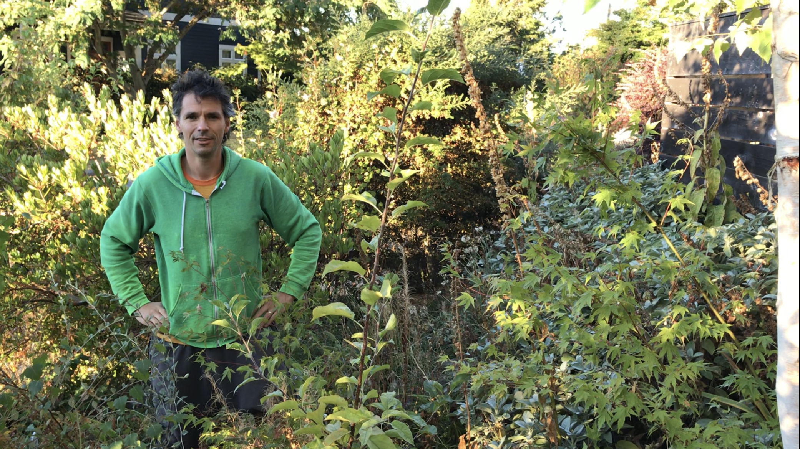
Notes:
Incentives work great
Stewardship Partners mission – Empowering the caretakers of land and water.
Incentives provide
Empowerment
Innovation
Complementary to regulations (carrots and sticks)
Leaders can lead, innovate, and pave the way that laggards must eventually follow, making it easier for regulators to require compliance.

Slide 5
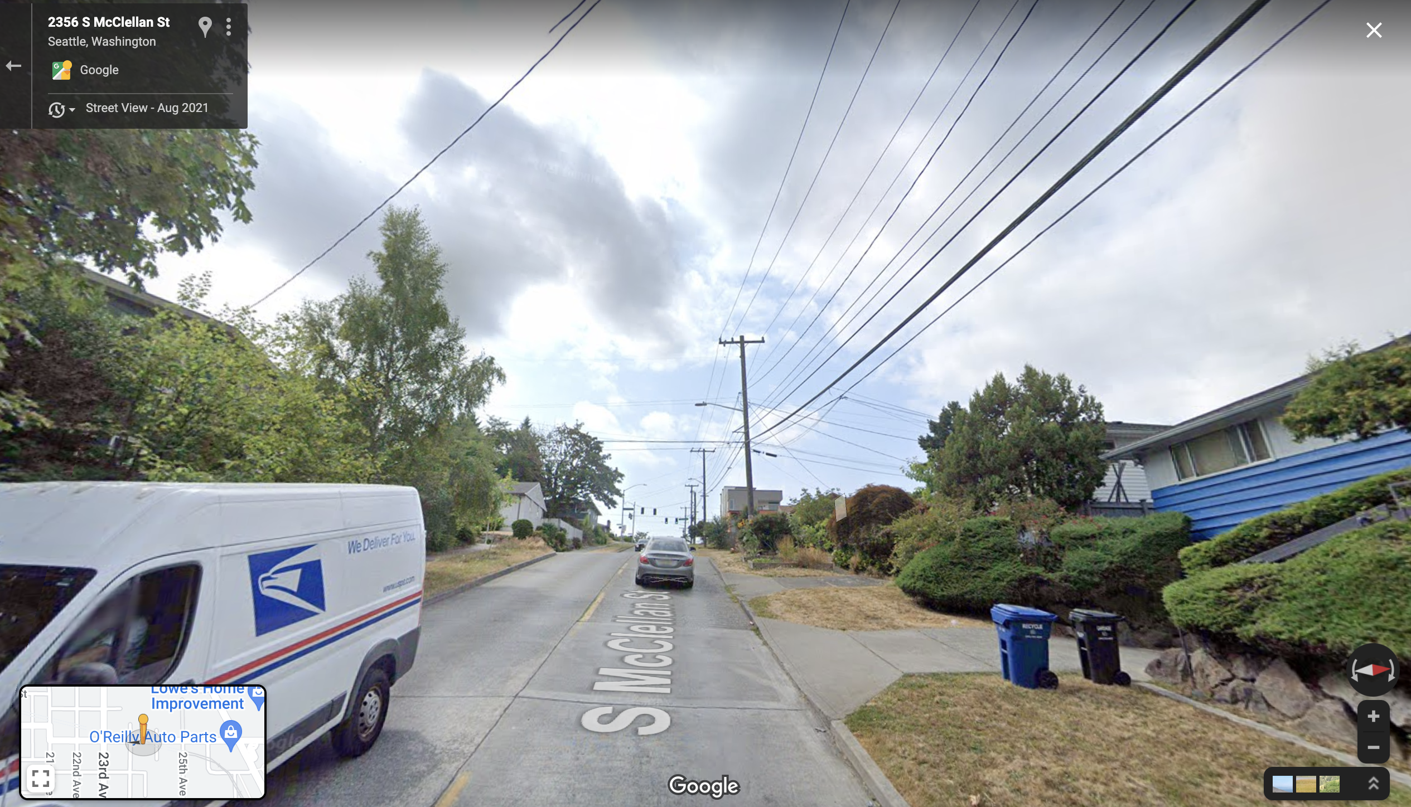
Notes:
So why the checkered past?
The how of incentives is critical and defines who will benefit.

Slide 6
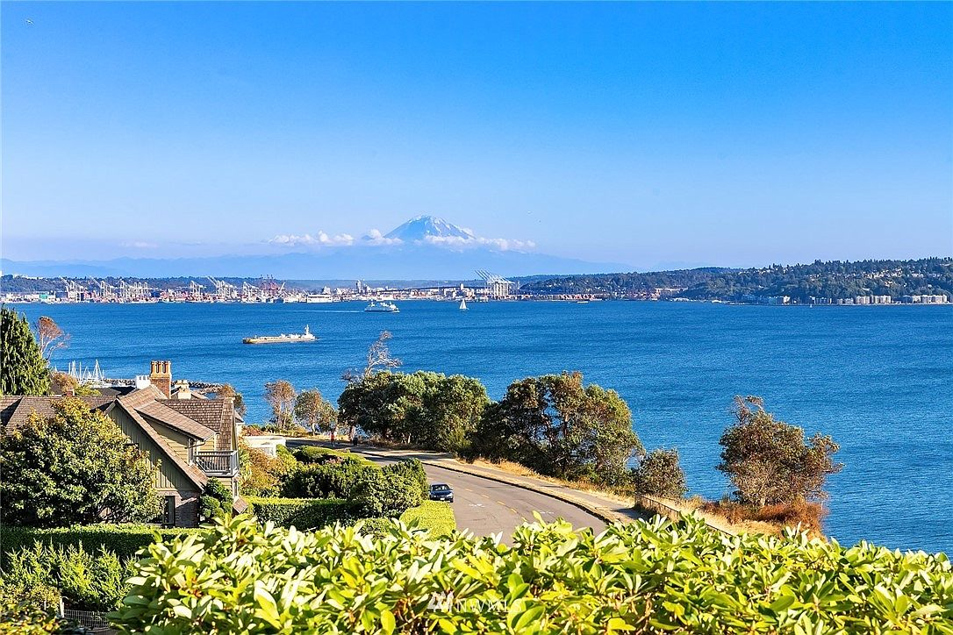

Slide 7
Incentives - overview
Stewardship Partners mission – Empowering the caretakers of land and water.
Incentives provide
Empowerment
Innovation
Complementary to regulations (carrots and sticks)
Leaders can lead, innovate, and pave the way that laggards must eventually follow, making it easier for regulators to require compliance.
So why the checkered past?
The how of incentives is critical and defines who will benefit.

Slide 8
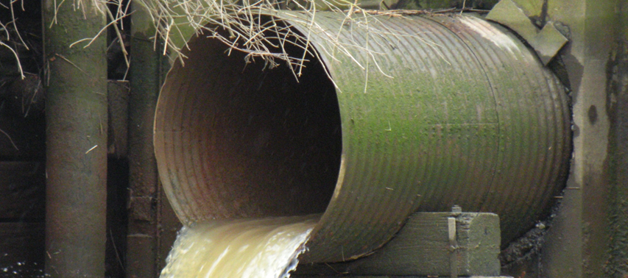
Single Purpose Infrastructure

Slide 9
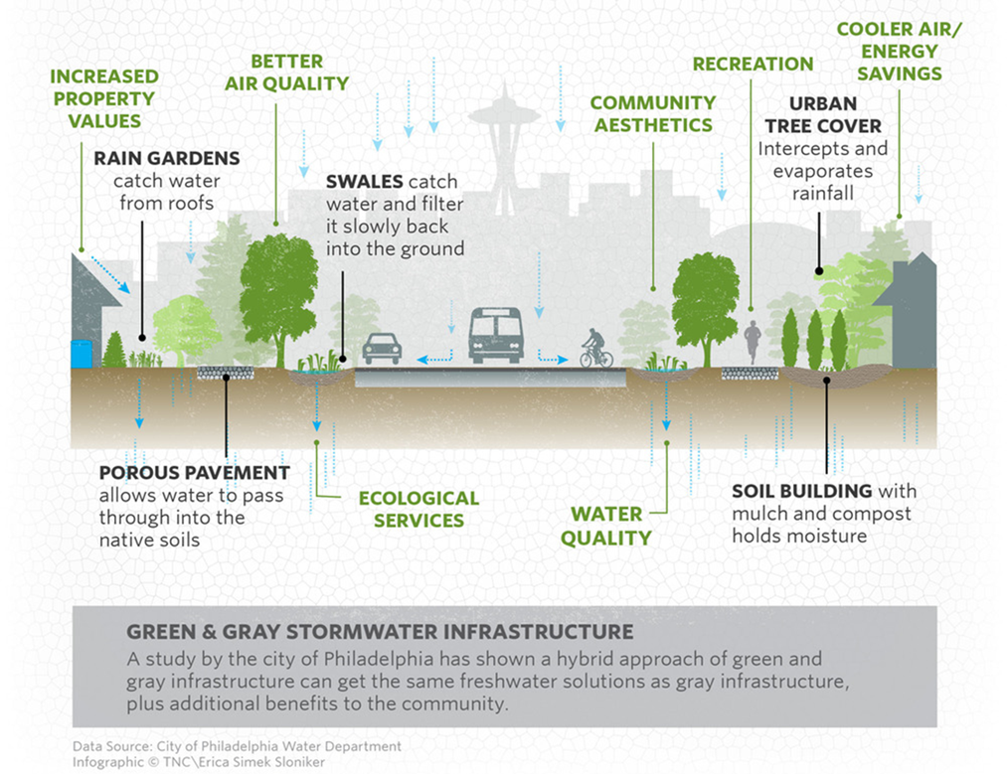
Multi-
Purpose
Infrastructure

Slide 10
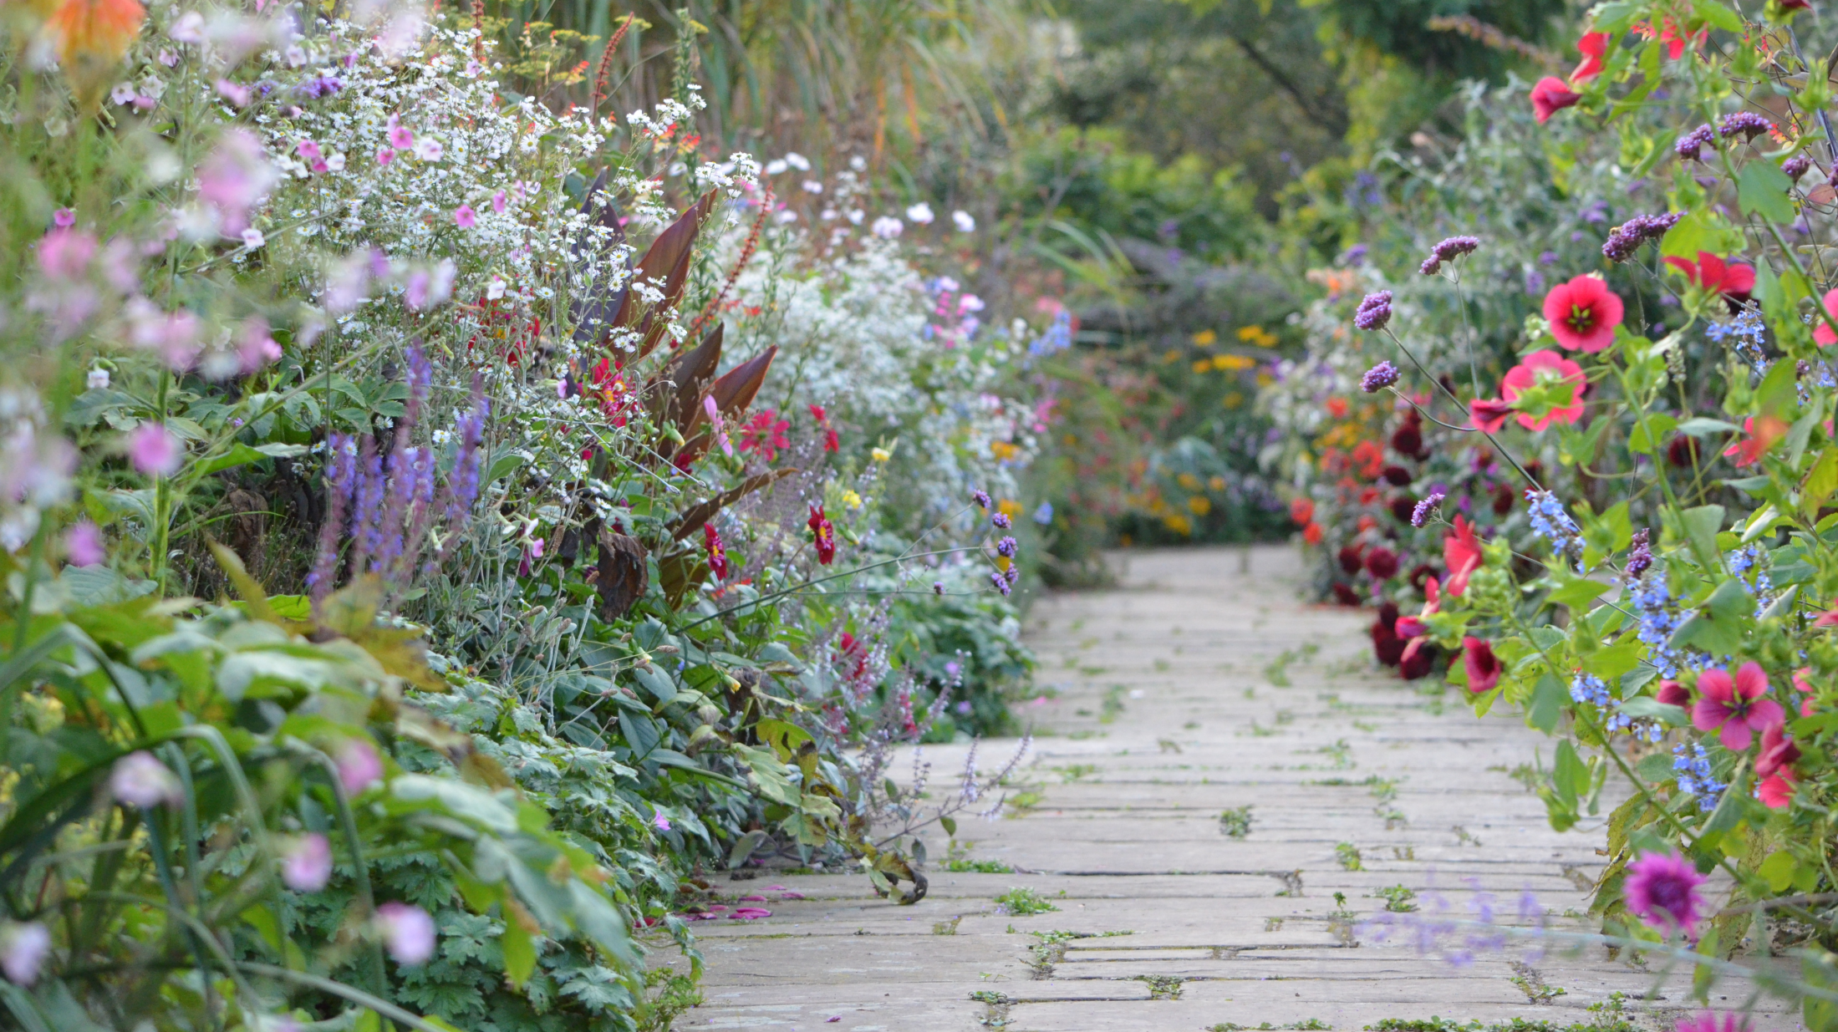
www.homecaprice.com

Slide 11
Green Infrastructure Overview
Stormwater → Green Stormwater Infrastructure
But a tree, garden, park… is not just stormwater infrastructure.
Air quality infrastructure,
Heat island infrastructure
Habitat infrastructure
Human health and mental health infrastructure
Aesthetic infrastructure
Climate and carbon infrastructure
Community infrastructure
Stormwater is a great starting point (and funding source as long as we have the clean water act), but multipurpose infrastructure can/should be funded from multiple pots of money.

Slide 12
Human health/ environmental health are not evenly distributed

Slide 13
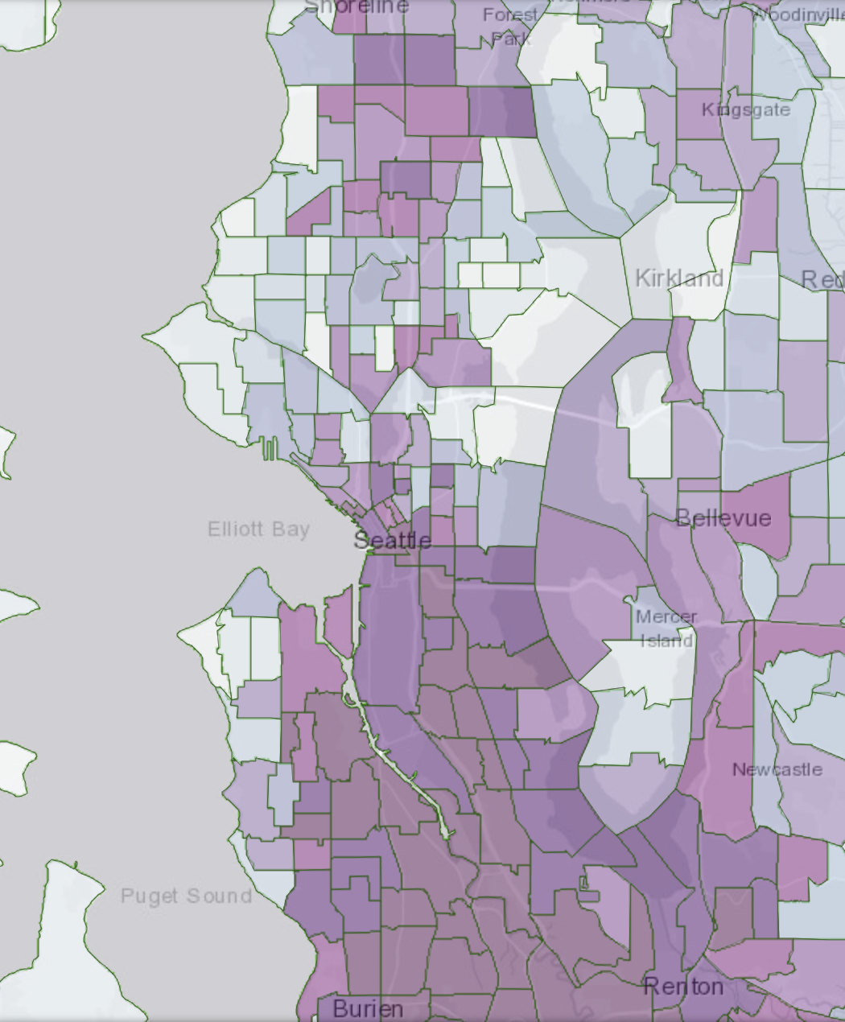
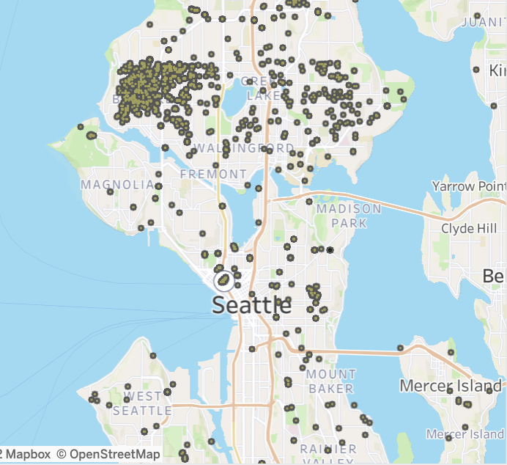
Human health within a single city is uneven, and so are incentivized rain gardens
Sources:
WA health disparities map

Slide 14
Equity and Environmental Justice
Distribution of benefits and harms
Green Infrastructure is a form of ecological and community restoration… healing.
As such, it’s practitioners must heal the deepest wounds first.
Throwing money/medicine into the wind will only ensure it accrues in all the same places it always has with the prevailing winds of our white supremacist, patriarchal, colonial, capitalist systems.
Working against the prevailing winds is harder work.
If we always do what we always did, we will always get what we always got.

Slide 15
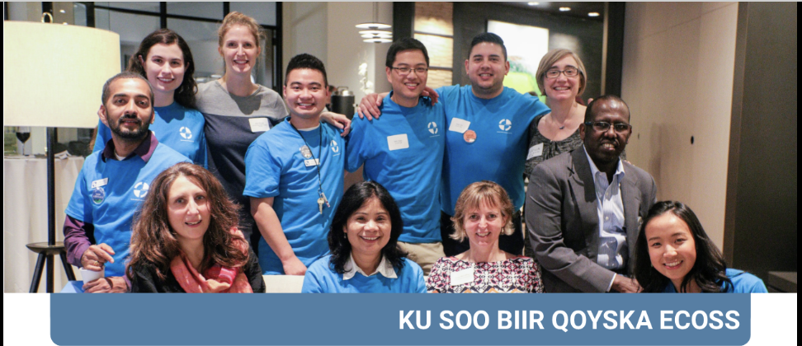
Multi-cultural outreach is vital
Languages/ communities served: Amharic, Chinese, Khmer, Somali, Spanish, Swahili, Tigrinya
Notes:
When listening and learning is your goal, you have to be trusted to hear and understand what is shared.
Context: RainWise rebate for rain gardens and cisterns
Rapidly adopted in wealthier and whiter communities.
ECOSS’ multicultural outreach team contracted by SPU to interview communities in South Seattle and identify their barriers. (trusted messenger, part of the communities engaged)
Barriers:
Outreach and approach didn’t reach communities where they are. Wrong languages, venues, channels.
Too little money (just like powerlines in the 80’s)
Too late (in the process)

Slide 16
The work so far - Listening
Context: RainWise rebate for rain gardens and cisterns
Rapidly adopted in wealthier and whiter communities.
ECOSS’ multicultural outreach team contracted by SPU to interview communities in South Seattle and identify their barriers. (trusted messenger, part of the communities engaged)
Barriers:
Outreach and approach didn’t reach communities where they are. Wrong languages, venues, channels.
Too little money (just like powerlines in the 80’s)
Too late (in the process)

Slide 17
Culturally appropriate and community-based outreach
Photo: Washington Environmental Council

Slide 18
RainWise Access Loan
Add on to existing RainWise incentive program
Provides low-cost financing for up front costs, re-paid by rebate

Slide 19
Supplement to existing incentive program
More money if you have more need (income limited)
Focused outreach to overburdened communities

Slide 20
A whole new incentive program
3x larger grants for income-limited and non-profit applicants

Slide 21
The work so far – Designing & Implementing Solutions
Outreach and communications- fund outreach from within communities. We budget $.50 in community-based outreach for every $1 granted.
Outreach includes translation, working with multicultural installation contractors, and assistance with incentive applications.
Too little $:
RainWise Access Grants- extra $ for anyone with limited income
Too late (in project process)
RainWise Access Loans
Access grants available for up front costs (materials)
All funding to date comes from King County

Slide 22
The work so far – Designing & Implementing Solutions
A whole new incentive program: GSI Minigrants
Opportunity to provide incentives outside of limited RainWise (CSO) basins.
New from the ground up.
Enough vs. too little:
income limited and non-profit applicants (landowners) receive 3x more $.
On-time vs. too late:
NGO small office- processes applications quickly.
Partial funding available up front for materials.
Pre-purchased cisterns

Slide 23
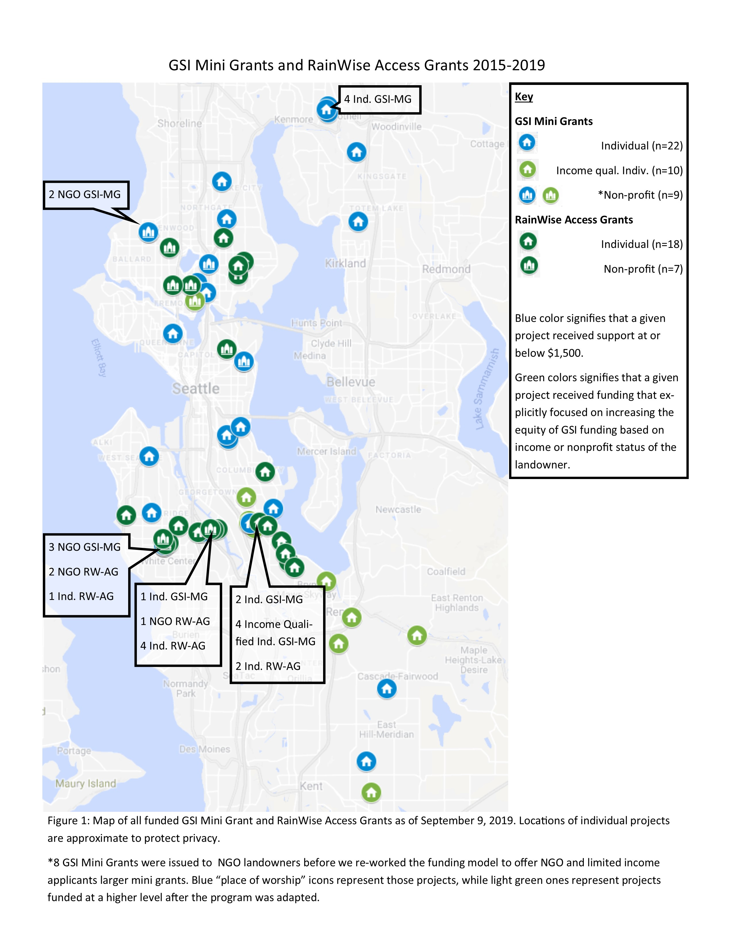
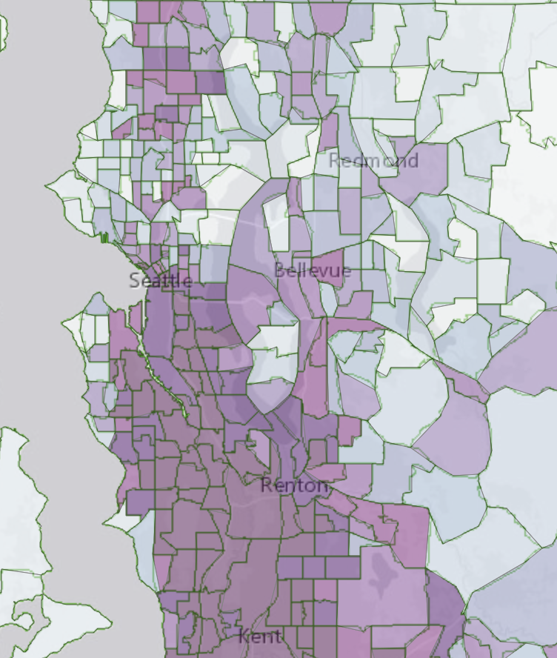
Impact mapping Access Grants & GSI Minigrants

Slide 24
The work so far - Adaptive Management
More listening:
Installation contractors:
Can we try funding pumps for cisterns? funded said ok, pilot completed (X# of pumps).
Through community-based outreach team
adjust reimbursement rates up? our funder said yes, done
Cistern supply chain bottle neck → devised a pre-purchase option for cisterns locally stockpiled. Funder said yes, done.
Learn
Plan, design, build
Monitor
Maintain
Tell the story & teach

Slide 25
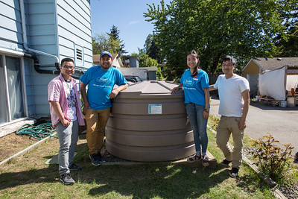
Learn from community
Plan or revise
Adjust grant agreement
Re-release
Photo: WEC

Slide 26
Next
Listen more, keep improving.
Replicate/Copy
GSI Minigrants can be expanded to any geography with a willing funder.
Stewardship Partners can administer, or share the model for others to administer.
A community-based outreach partner is required
Pierce Conservation District rolled out their own GSI minigrant program in 2021.

