Slide 1
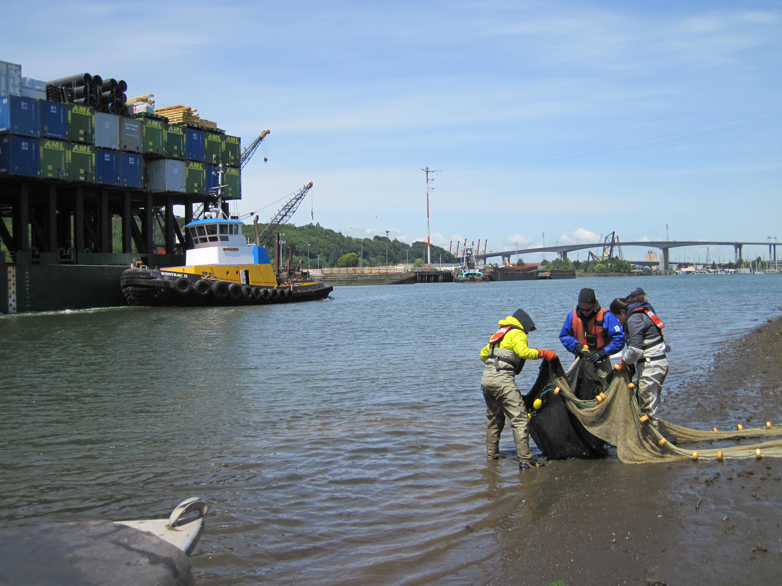
Juvenile Chinook salmon accumulate harmful levels of toxic contaminants during their seaward migration to Puget Sound
Andrea Carey, Sandra O’Neill, Louisa Harding, Robert Fisk, Mariko Langness, Danielle Nordstrom and James West
Toxics Biological Observation System (TBiOS)
Washington Department of Fish and Wildlife

Slide 2
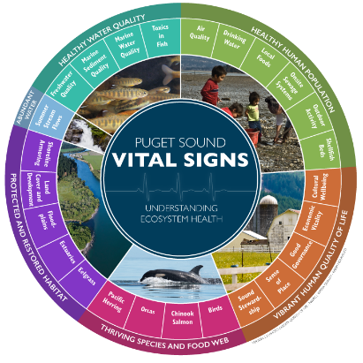
Monitoring Toxics in Juvenile Chinook Salmon (WDFW Toxics Biological Observation System)
Motivation
ESA-listed species
Prey of ESA-listed SRKWs
Culturally, ecologically and commercially important
Puget Sound ecosystem recovery
https://tinyurl.com/3stbredr
Contaminant exposure is a likely factor in the decline of Chinook salmon
and is likely preventing recovery.

Slide 3
Study Questions
Where are juvenile Chinook salmon accumulating contaminants?
River systems?
Estuary, nearshore, offshore?
Are the contaminant concentrations a concern for salmon health?
Results can be used to guide and prioritize management actions to reduce threats from contaminant exposure.

Slide 4
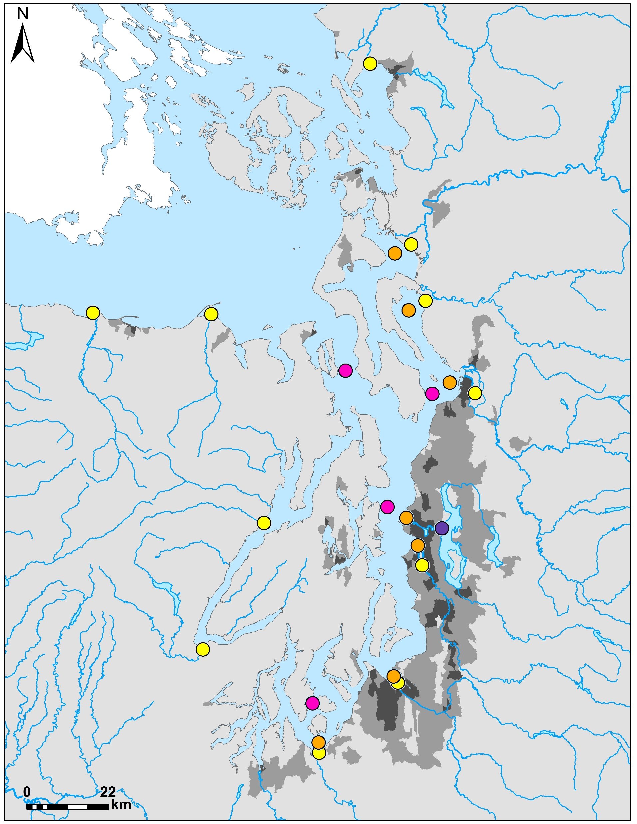
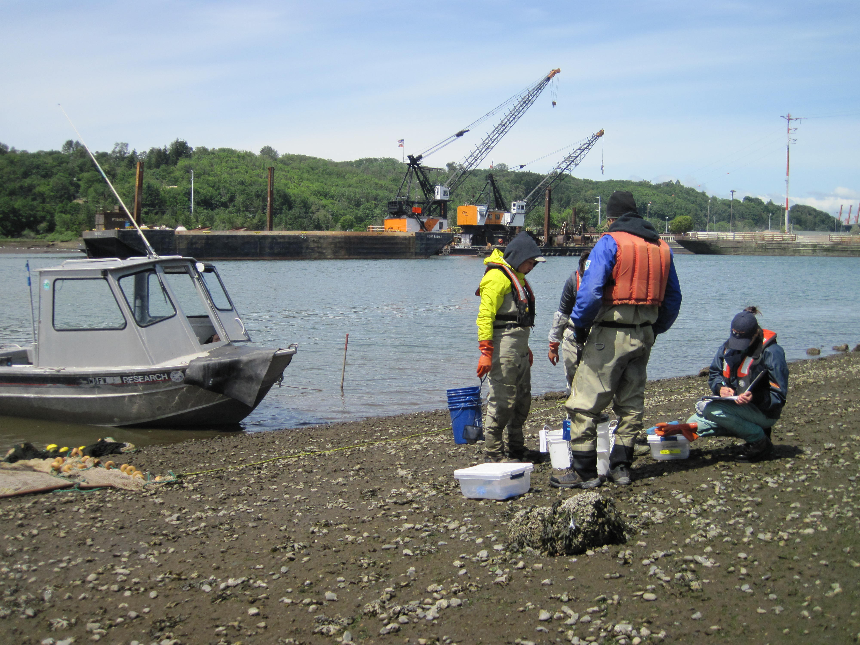
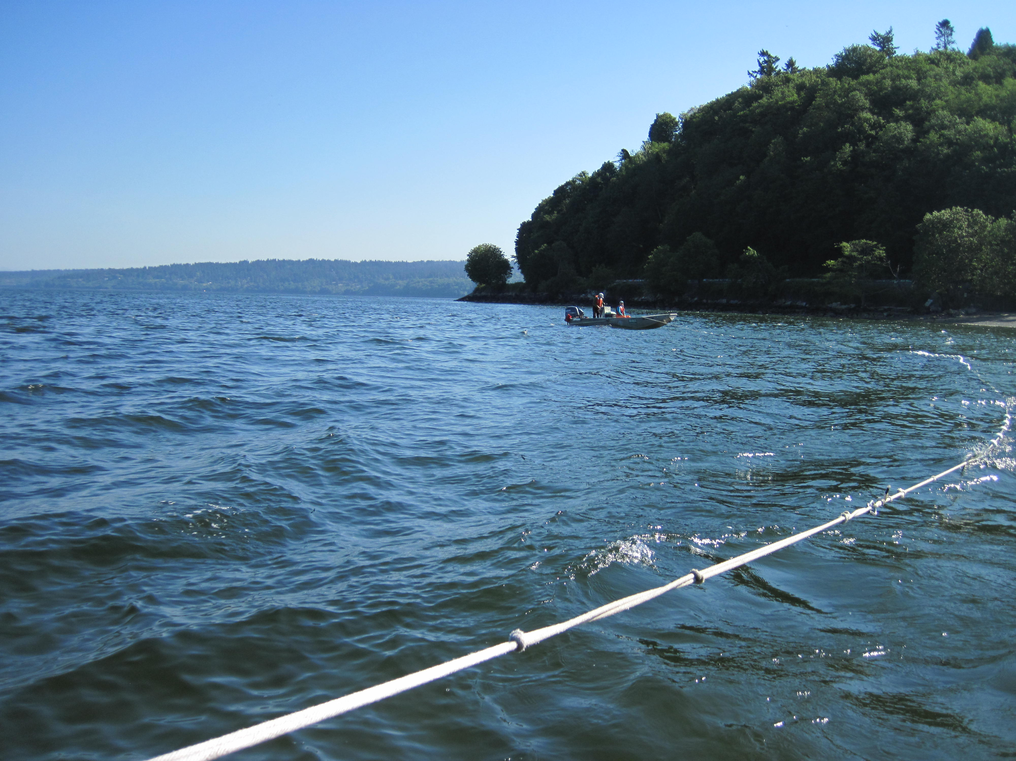
Methods
Toxics monitoring in juvenile Chinook salmon
Nooksack
Years sampled
2013, 2016 & 2018
Fish collected via beach or lampara seines & fyke nets
Habitats
Estuary
Lake*
Nearshore
Offshore
Skagit
Stillaguamish
Elwha
Dungeness
Snohomish
Duckabush
Sammamish/
Cedar*
Duwamish
Skokomish
Puyallup
Nisqually

Slide 5
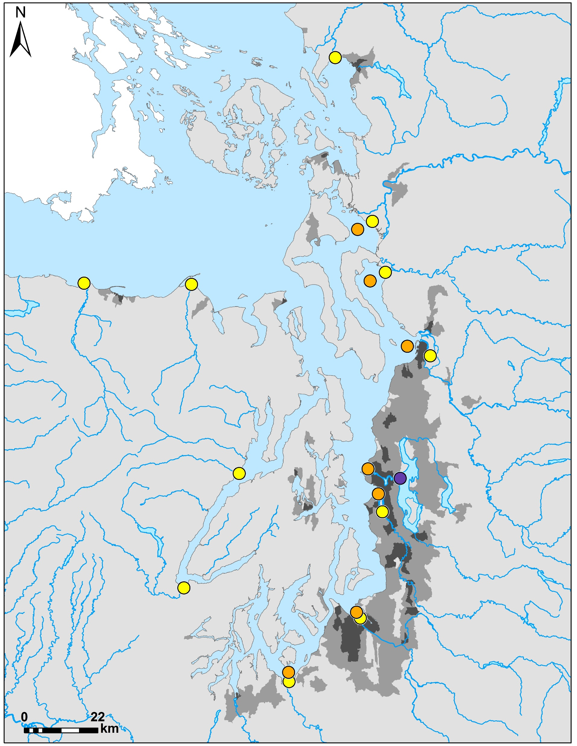
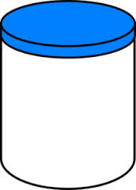
Methods
Toxics monitoring in juvenile Chinook salmon
Nooksack
Estuary
Lake*
Nearshore
1,596 Individual Chinook salmon collected
357 Whole-body samples created
286 composite samples
2-15 fish/composite
71 individual samples
Analyzed at NOAA NWFSC (Sloan et al. 2014)
Pooled the three years of data
Skagit
Stillaguamish
Elwha
Dungeness
Snohomish
Duckabush
Sammamish/
Cedar*
Duwamish
Skokomish
Puyallup
Nisqually

Slide 6
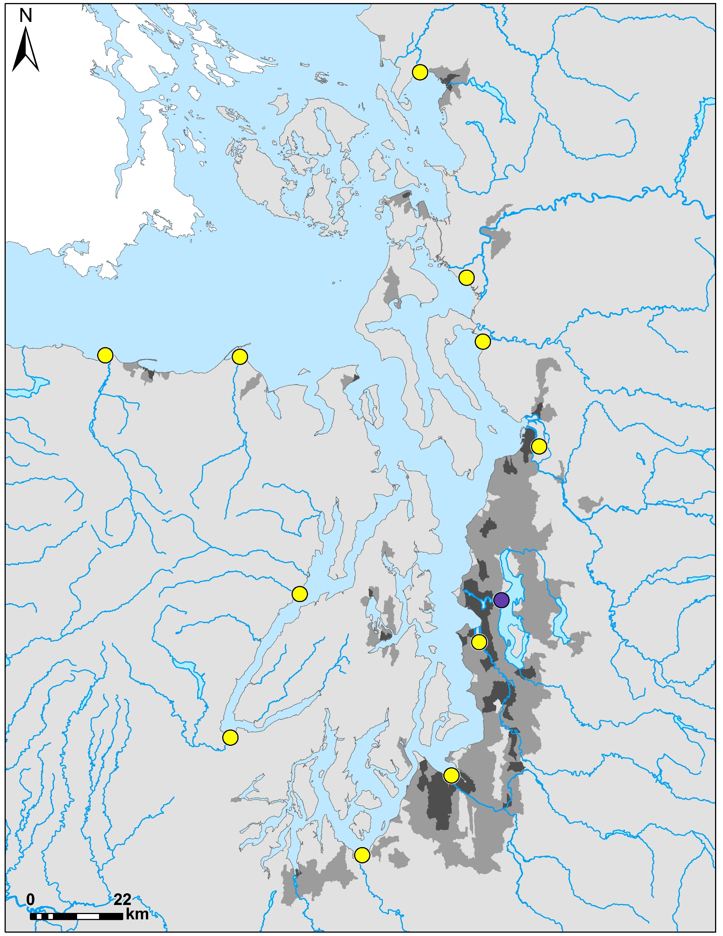
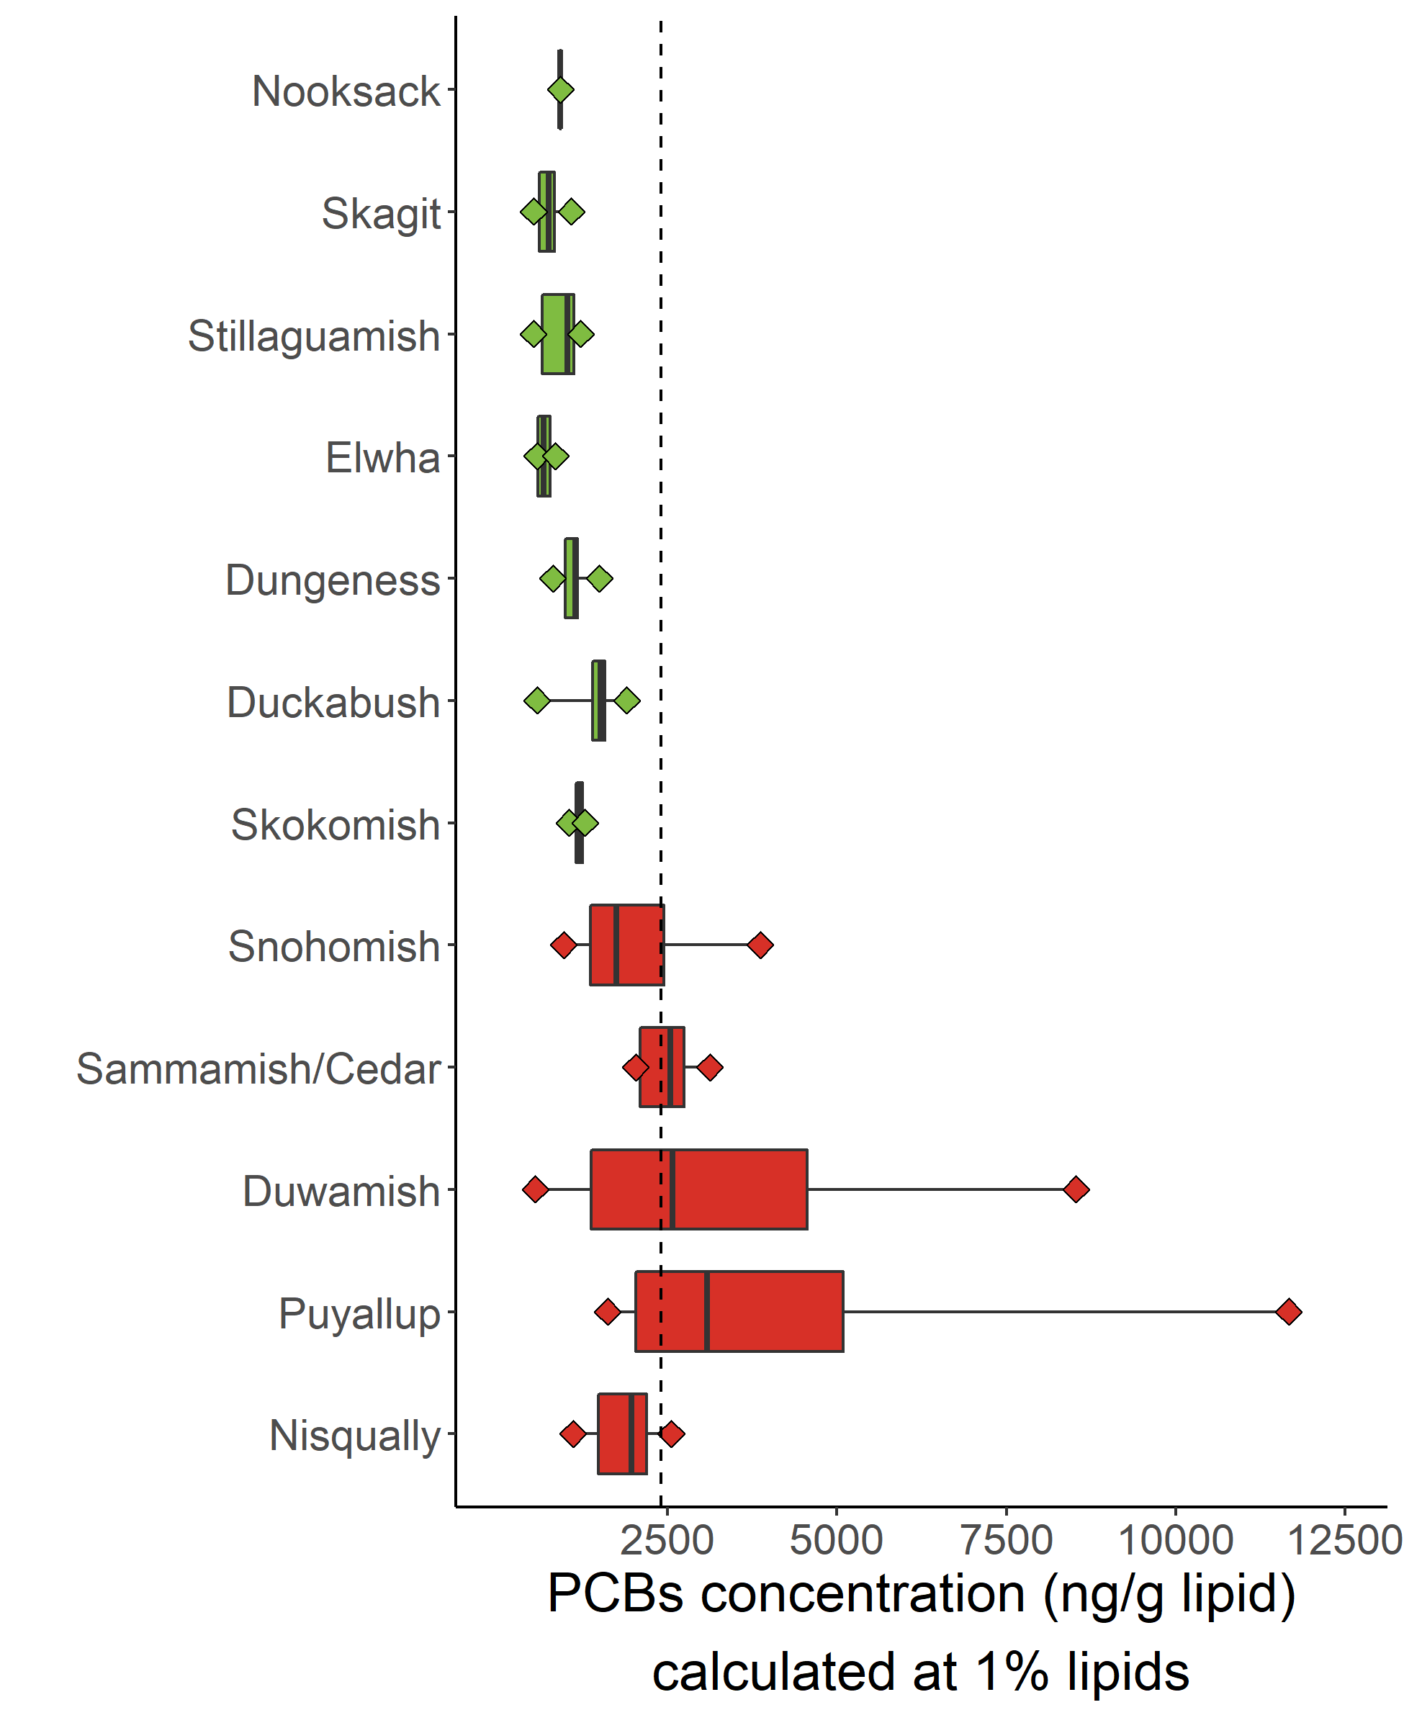
PCBs - Estuaries & Lake Washington
Nooksack
Estuary
Lake*
Skagit
PS Recovery Target
2,400 ng/g lipid
(Meador et al. 2002)
Stillaguamish
38% samples above recovery target
Elwha
Dungeness
Snohomish
Duckabush
Sammamish/
Cedar*
Duwamish
Skokomish
Puyallup
Nisqually

Slide 7
PCBs - Estuaries & Lake Washington
G
M
Nooksack
Fish Health Critical Tissue Levels (CTL)
(Berninger & Tillitt 2019)
Estuary
Lake*
43% samples above Growth CTL
> 9.2% samples predicted to
have growth effects
Skagit
Stillaguamish
13% samples above Mortality CTL
5% samples predicted to
die
Elwha
Dungeness
Snohomish
Duckabush
Sammamish/
Cedar*
Duwamish
Skokomish
Puyallup
Nisqually

Slide 8
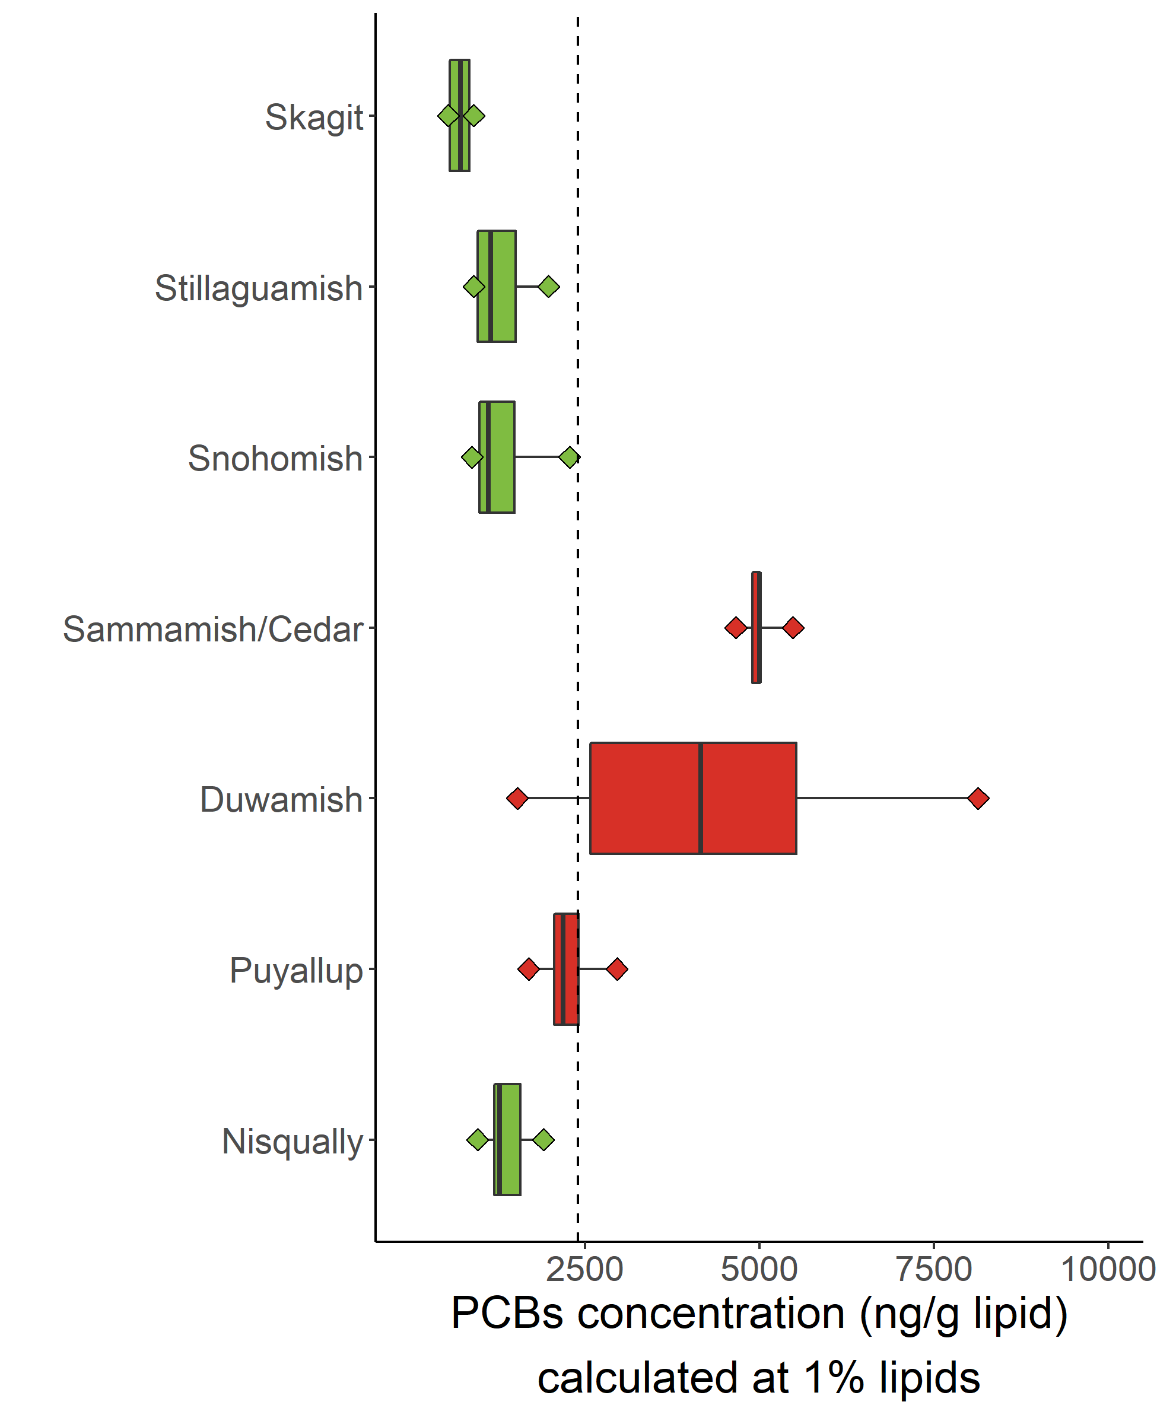
PCBs - Nearshore
Nearshore
PS Recovery Target
2,400 ng/g lipid
(Meador et al. 2002)
44% above recovery target
Skagit
Stillaguamish
Snohomish
Sammamish/
Cedar*
Duwamish
Puyallup
Nisqually

Slide 9
PCBs - Nearshore
G
M
Fish Health Critical Tissue Levels (CTL)
(Berninger & Tillitt 2019)
Nearshore
48% samples above Growth CTL
> 9.2% samples predicted to
have growth effects
Skagit
Stillaguamish
22% samples above Mortality CTL
5% samples predicted to
die
Snohomish
Sammamish/
Cedar*
Duwamish
Puyallup
Nisqually

Slide 10
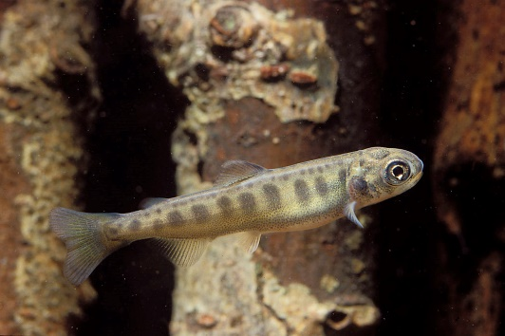
Where to prioritize actions for cleanups?
Photo by Richard Bell

Slide 11
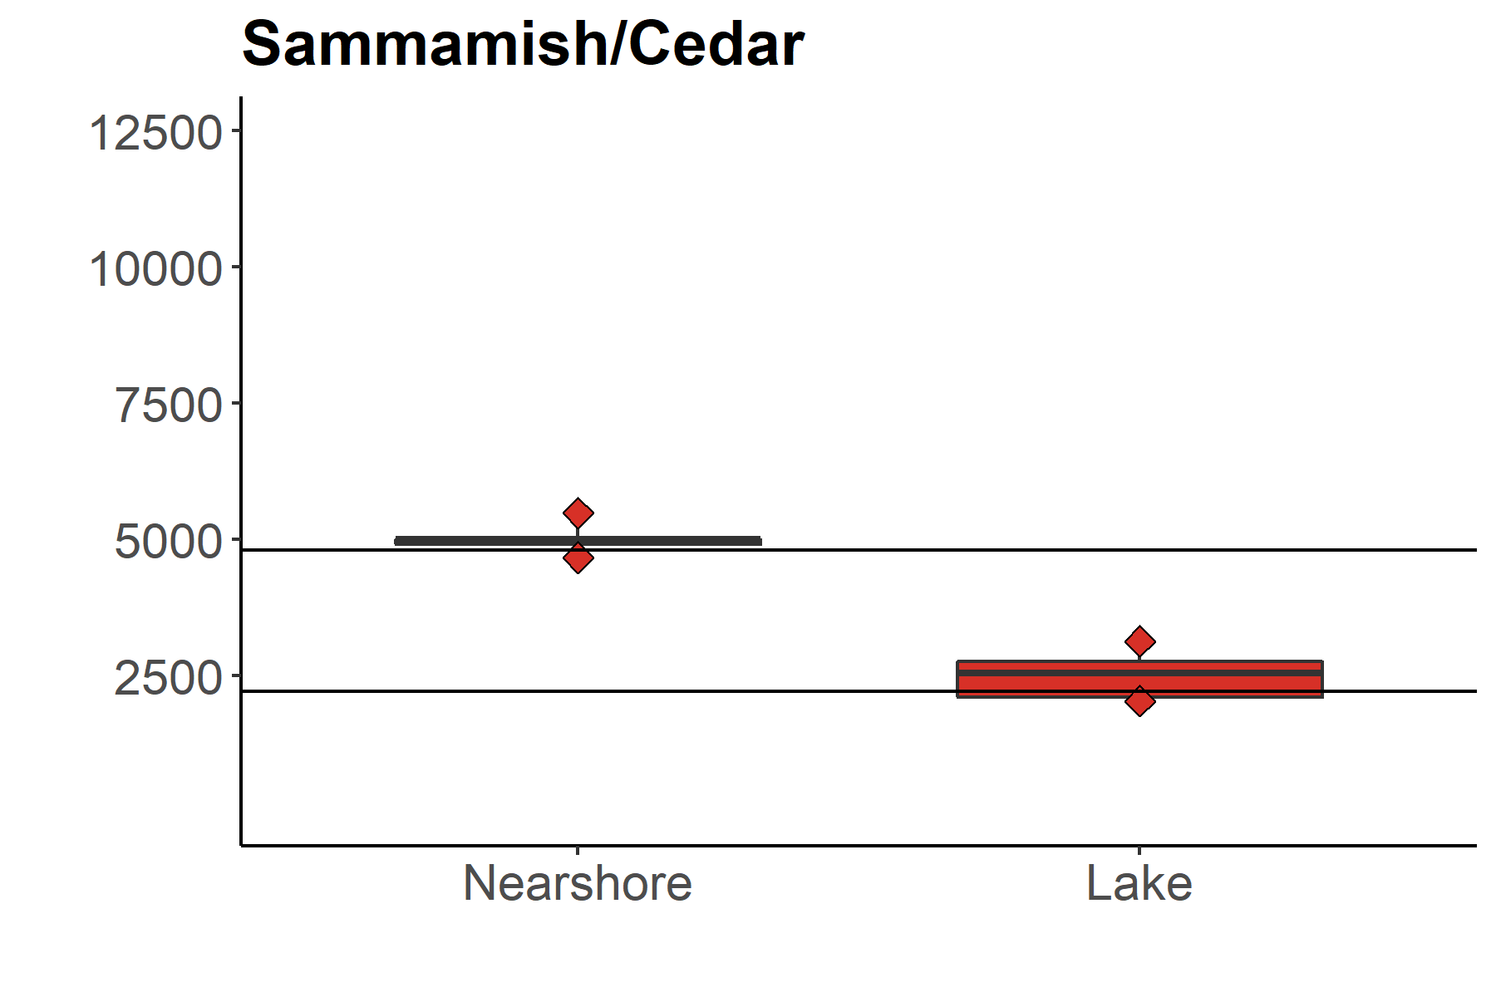
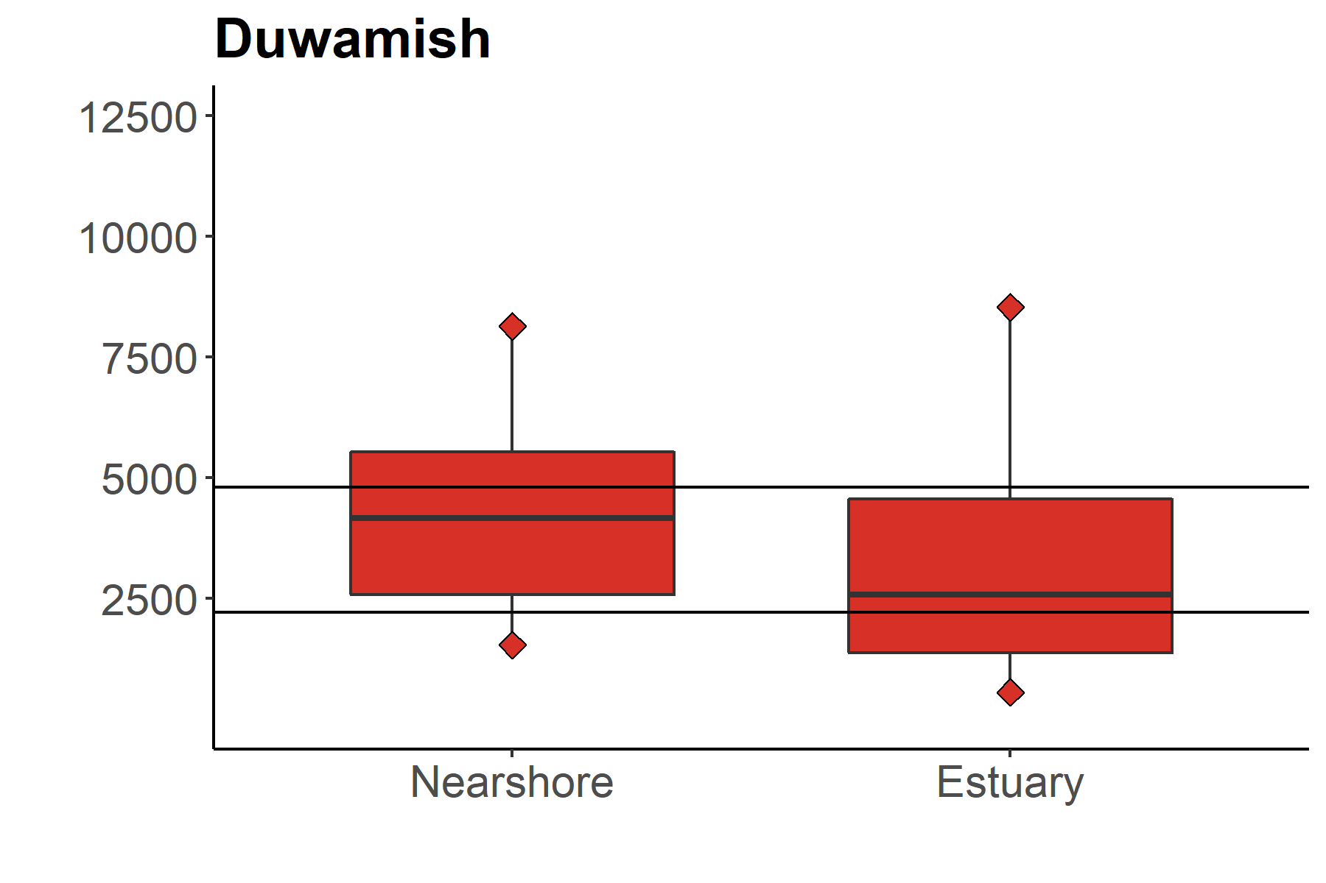
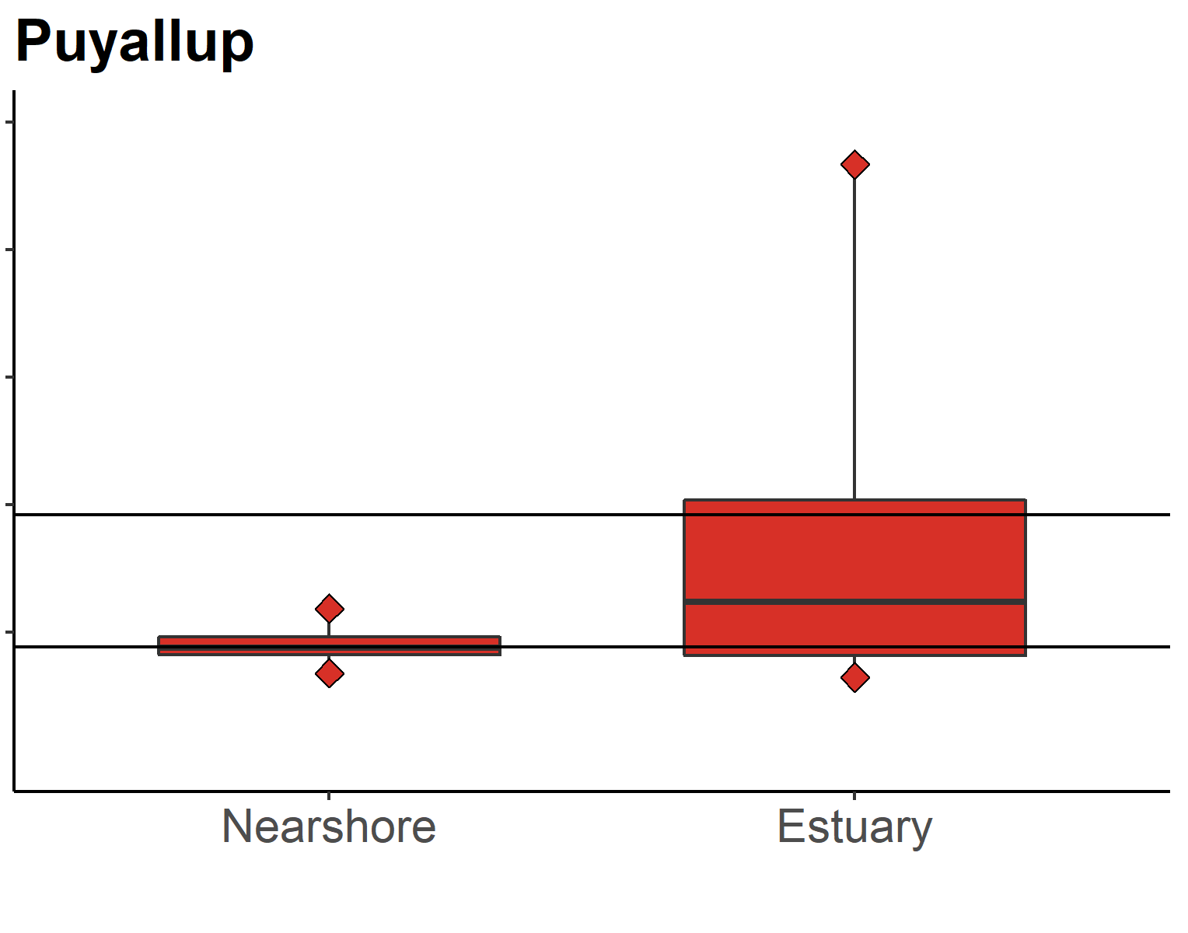
A comparison of estuary and nearshore
Estuary
Lake*
PCBs concentration (ng/g lipid) calculated at 1% lipids
Nearshore
Fish Health CTLs
Berninger & Tillitt 2019
M = mortality (4,800 ng/g lipid)
G = growth (2,200 (ng/g lipid)
Skagit
M > 80%
G > 100%
G > 63%
M
Stillaguamish
G
*
Snohomish
(5)
(8)
M > 27%
G > 67%
M > 41%
G > 81%
M > 22%
G > 57%
Sammamish/
Cedar*
Duwamish
G > 50%
M
M
G
G
Puyallup
(37)
(134)
(10)
(15)
Nisqually

Slide 12
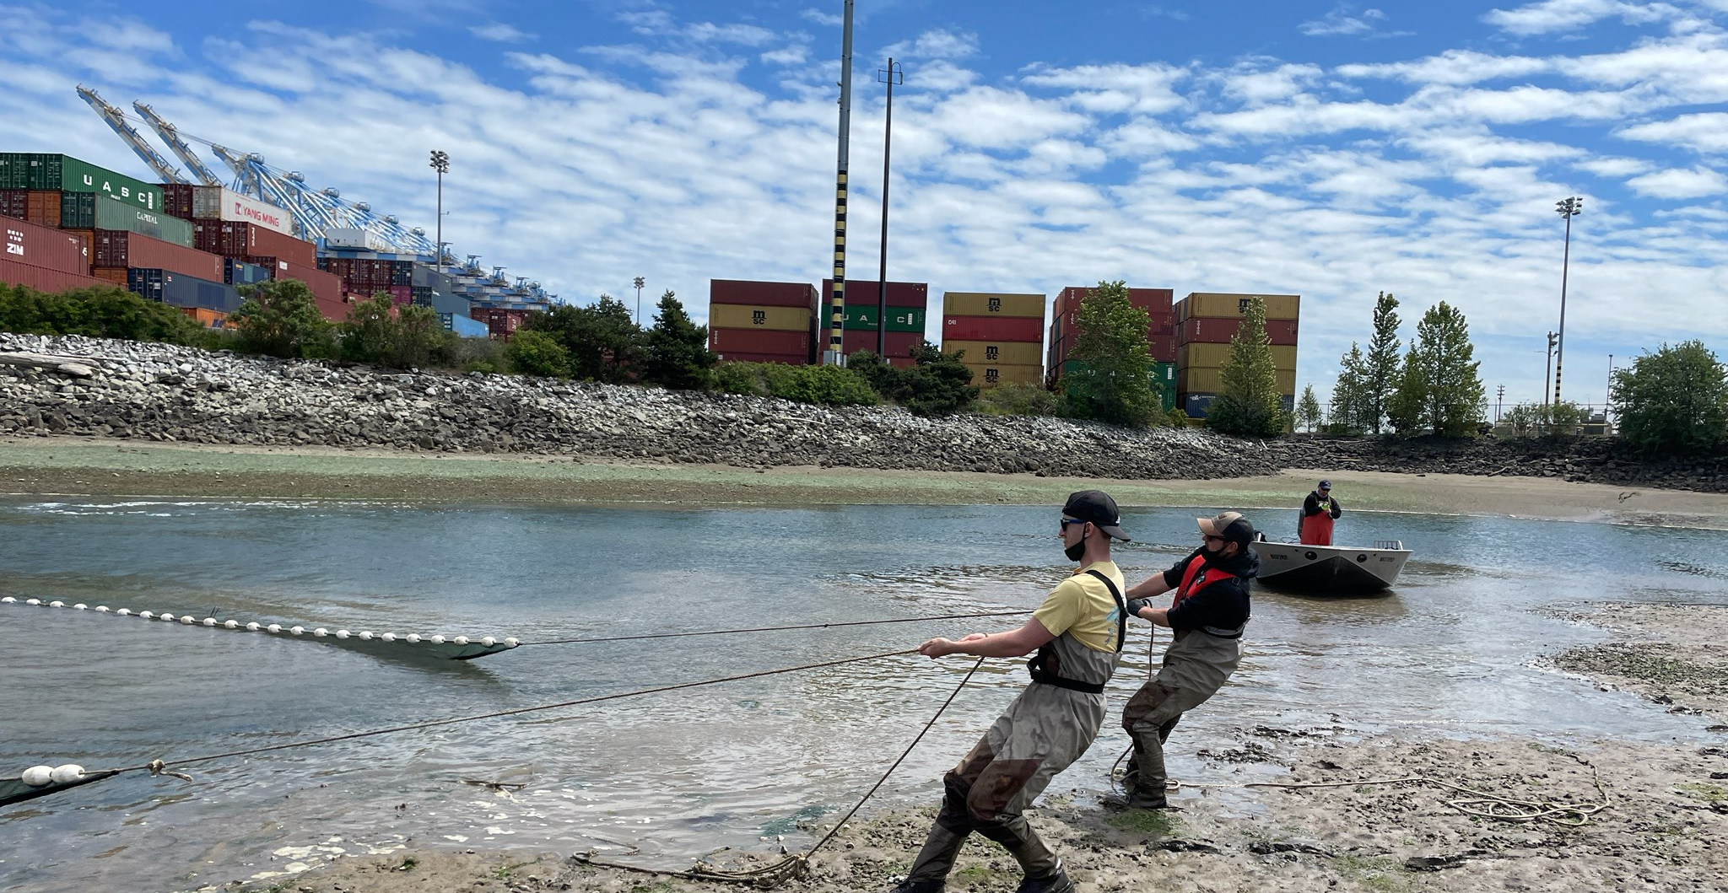
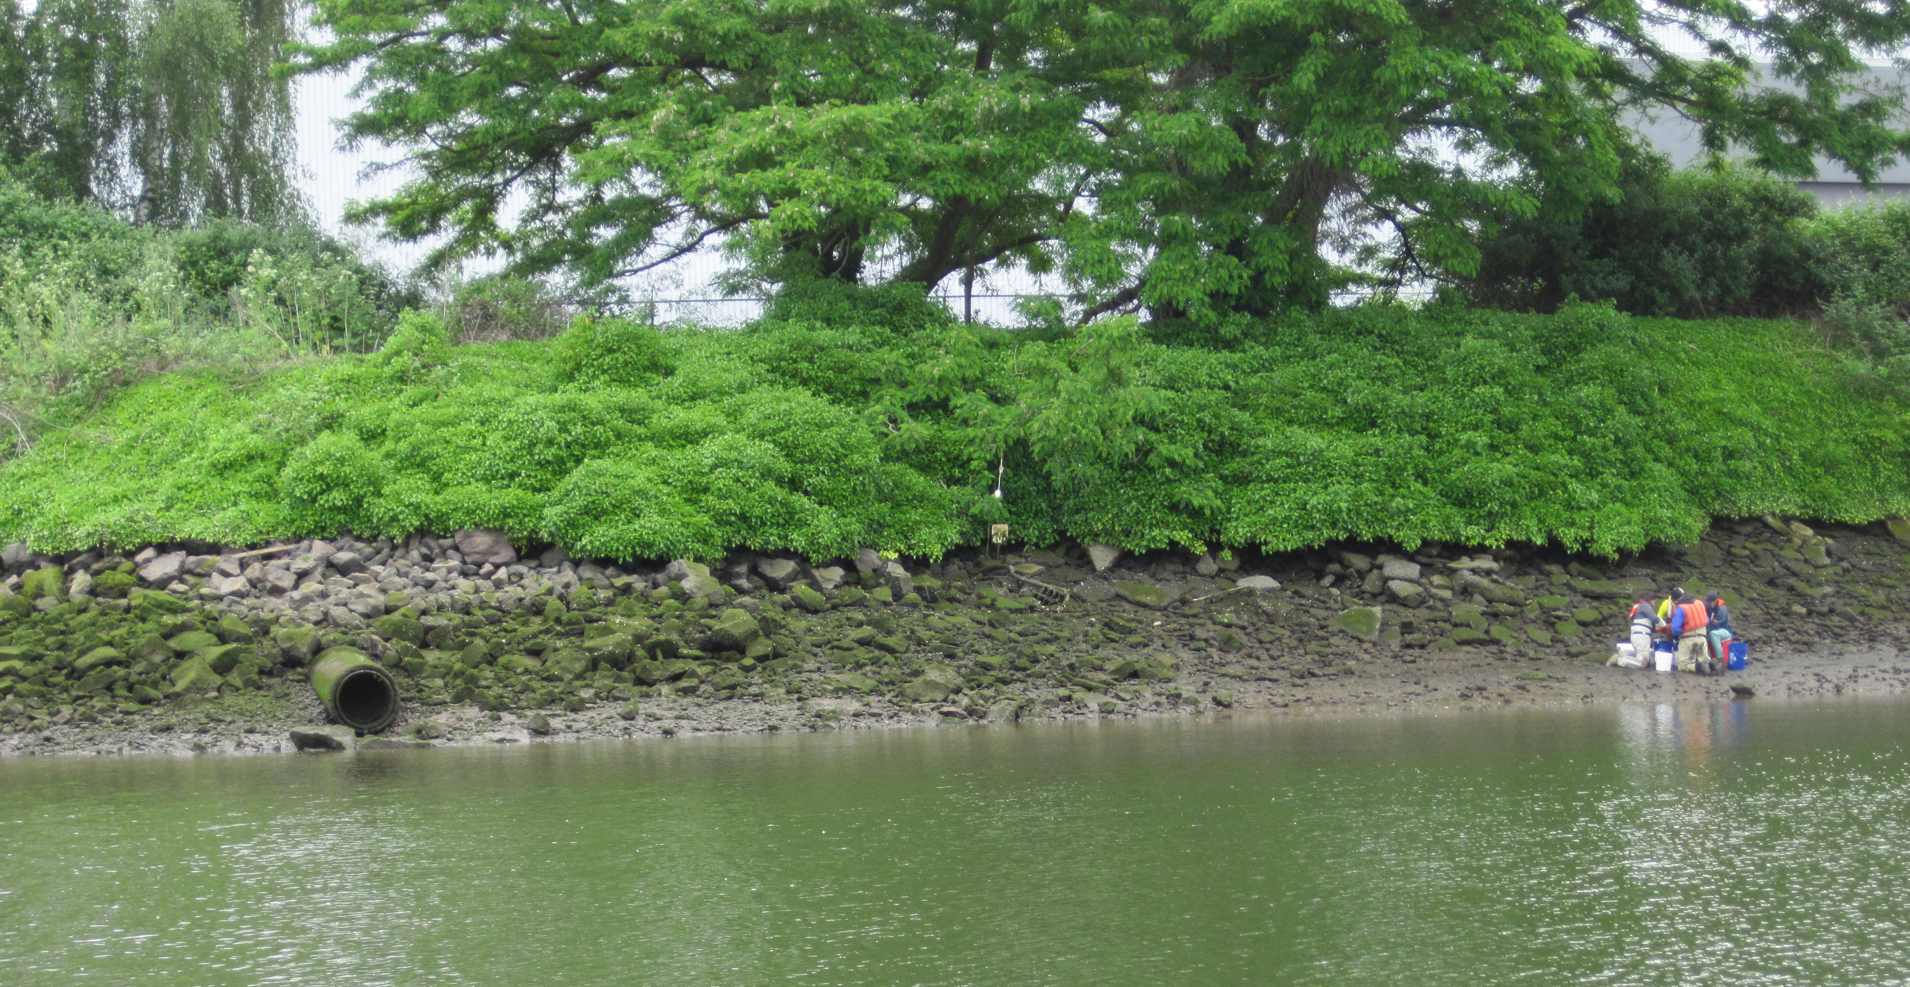
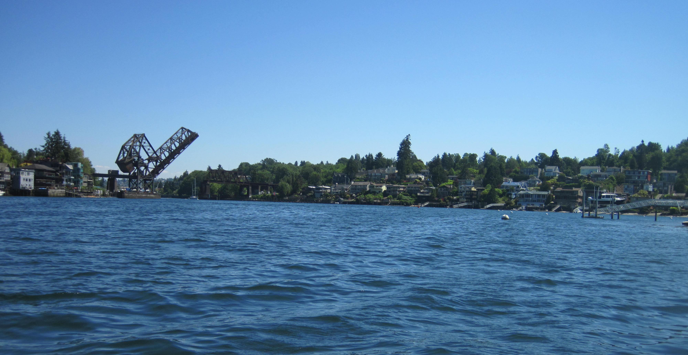
Conclusions
PCBs & PBDEs are predicted to impact fish health in 5/12 river systems
50 to 100% > PCB growth threshold (>9.2% growth effects)
22 to 80% > PCB mortality threshold (5-10% fish loss)
9.7 to 80% > PBDE disease susceptibility threshold
Health impacts to salmon are likely greater than indicated by individual thresholds because of combined effects from exposure to multiple contaminants.
CECs
PFAS
Decreases in salmon abundance caused by contaminant exposure:
Reduces SRKW’s food supply
Reduces fishing opportunities
Impacts cultural practices related to salmon
Data guide & prioritize management actions to reduce threats from contaminant exposure
e.g., Toxics in Aquatic Life Implementation Strategy
Puyallup Estuary
Andrew Berger (PTI)
Duwamish Estuary
Sammamish/Cedar Nearshore

Slide 13
Acknowledgements
Lummi Nation
Skagit River System Cooperative
Stillaguamish Tribe
Tulalip Tribe
Muckleshoot Tribe
Puyallup Tribe of Indians
Nisqually Tribe
Lower Elwha Klallam Tribe
Jamestown S’Klallam Tribe
Skokomish Tribe
Port Gamble Tribe
Snohomish County
King County
University of Washington
Long Live the Kings
NOAA NWFSC
USGS
WDFW

