Slide 1
Simultaneous determination of steroid hormones and pharmaceuticals and personal care products with LC–MS/MS in feces of killer whales (Orcinus orca)
Xiangjun Liao, Andrew Ross, Neil Dangerfield Institute of Ocean Sciences, Sidney
Tanya Brown, Katerina Colbourne, Peter Ross Pacific Science Enterprise Centre, West Vancouver

Slide 2
Outline
Introduction
Objective
Material used
Method
Results
Conclusion
Acknowledgement

Slide 3
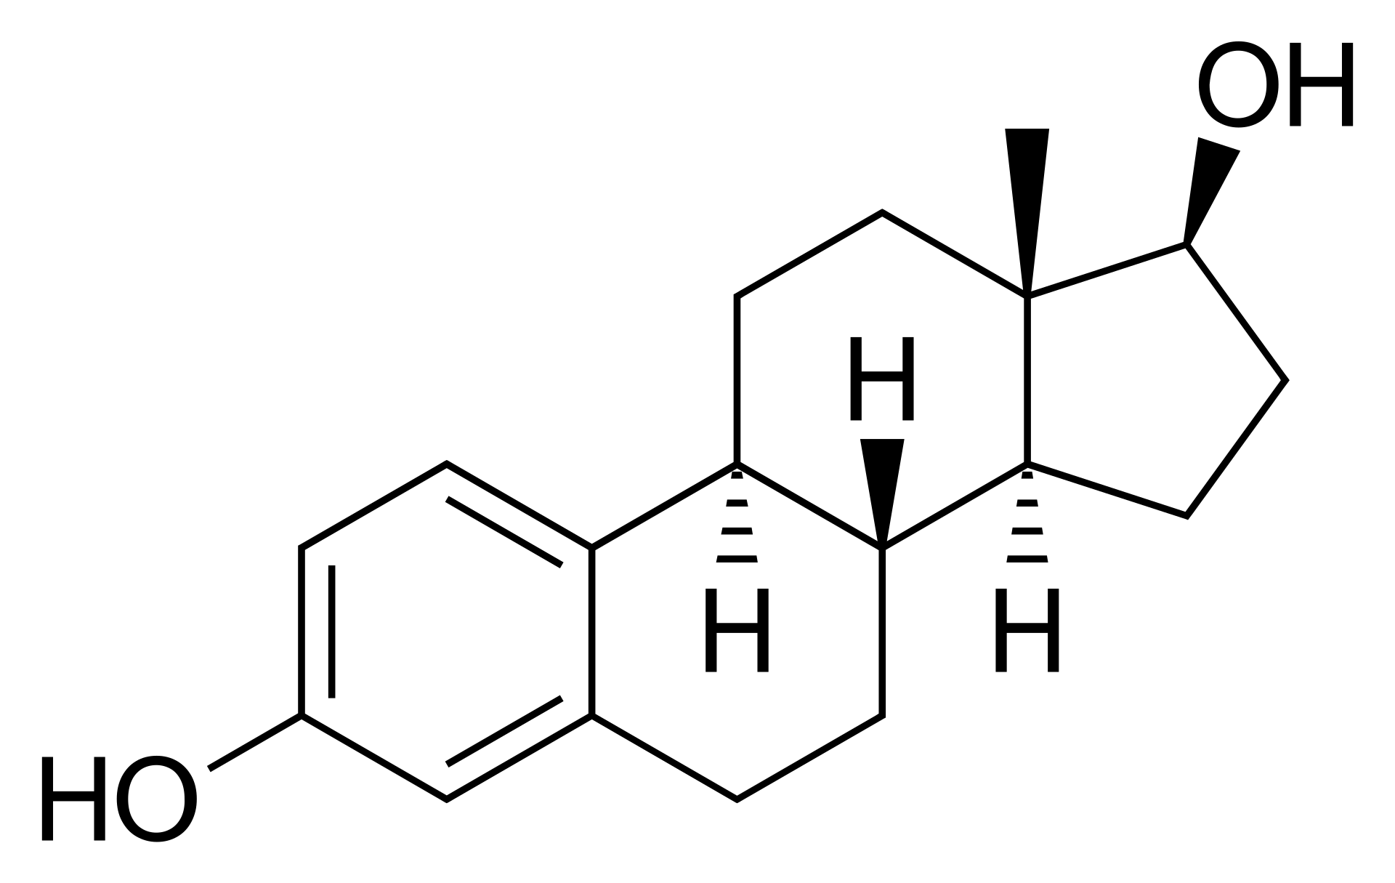
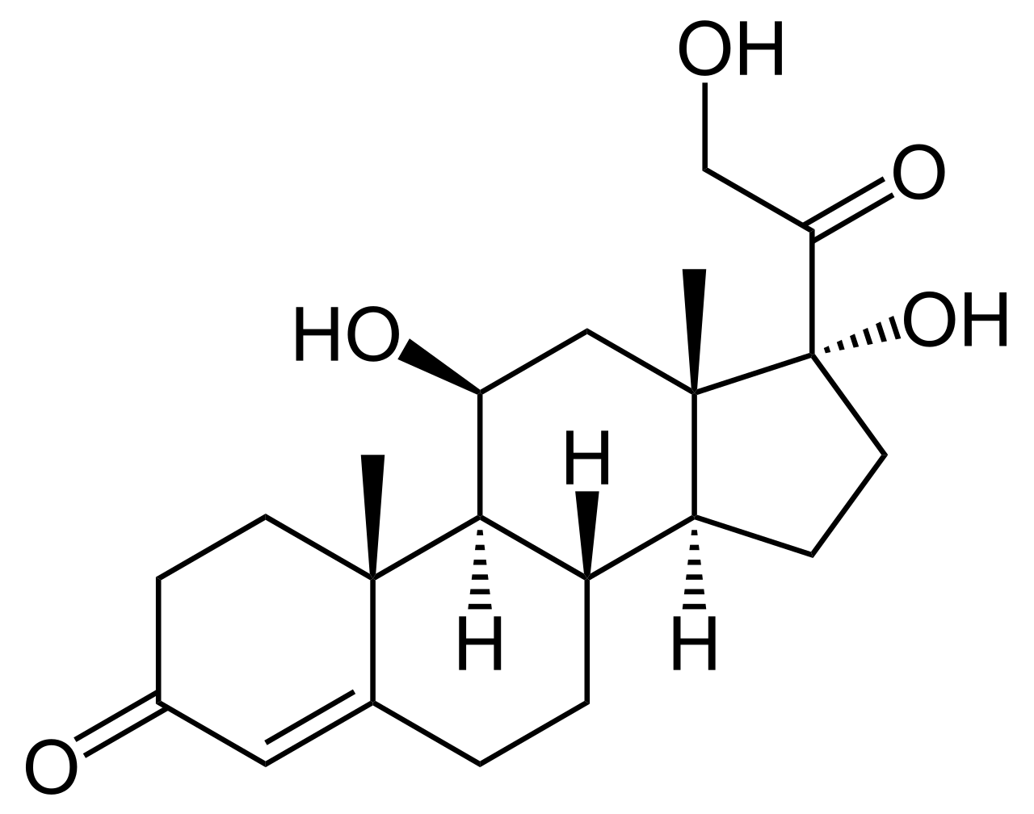
Introduction
Steroid hormones
Two classes: corticosteroids & sex steroids
Help control metabolism, inflammation, immune functions, salt and water balance, development of sexual characteristics
Indicate stress levels
Estradiol
Cortisol

Slide 4
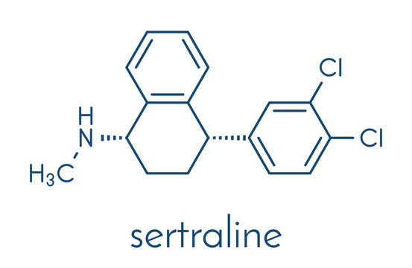
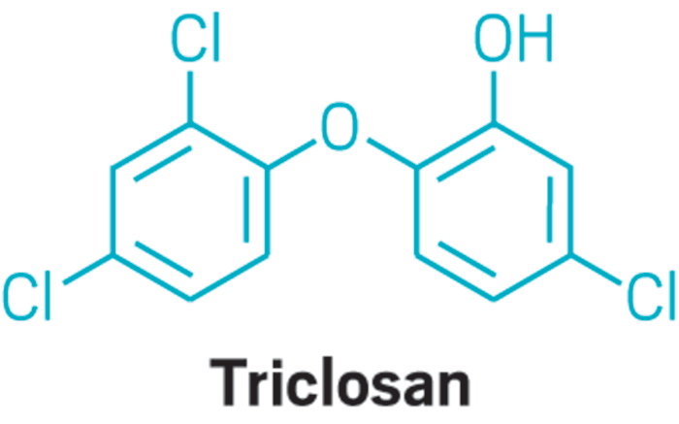
Introduction
Pharmaceuticals and personal care products
Emerging contaminants: prescription (such as antibiotics), non-prescription drugs (including ibuprofen), fragrances, detergents and others.
Sertraline has been observed and quantified in both fish liver and fillet tissue while fluoxetine in fish liver.
Triclosan and its transformation product methyl-triclosan were found in fish.

Slide 5
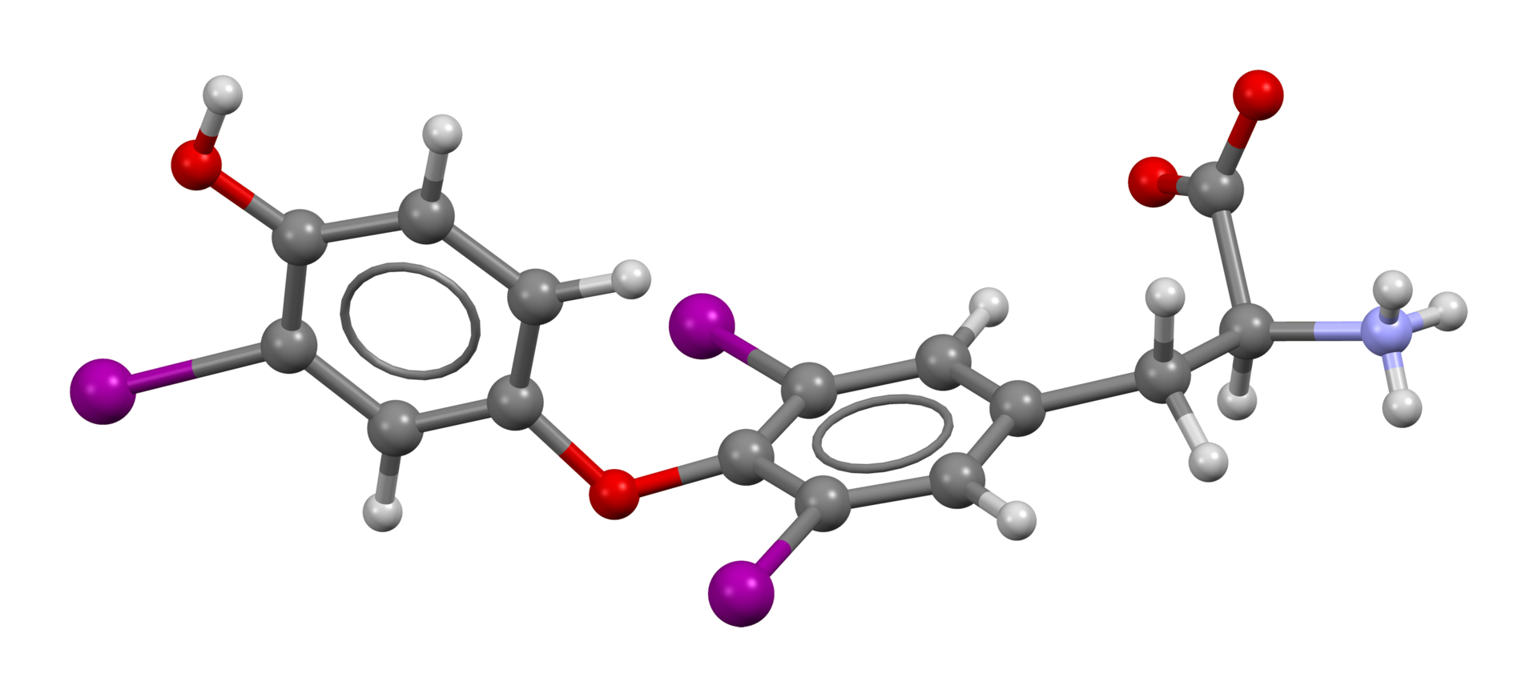
Introduction
Whale feces
Significant role in the ecology of the oceans
Rich in nutrients
Indicators of health and ecology
Diet composition-Prey
Contaminants
Population-
Psychological tension or starvation-Glucocorticoids
Nutritional stress-Thyroid hormones
Pregnancy- progesterone
Triiodothyronine
Cortisol

Slide 6
Objective
Be aware of the level of Steroid hormones and Pharmaceuticals and personal care products in whale feces
Develop a simultaneous determination of steroid hormones and pharmaceuticals and personal care products with LC–MS/MS in feces of killer whales (Orcinus orca)
Apply the developed method for analysis of those two groups of chemicals

Slide 7
Material used
Standards and Chemicals
20 + native chemicals and ~20 isotope labelled compounds
Solvents (methanol and acetonitrile)
Instrument /Equipment
Vortexer & Sonication Bath
Centrifuge & Auto SPE
LC Column & LC-MS/MS (API 5000)

Slide 8
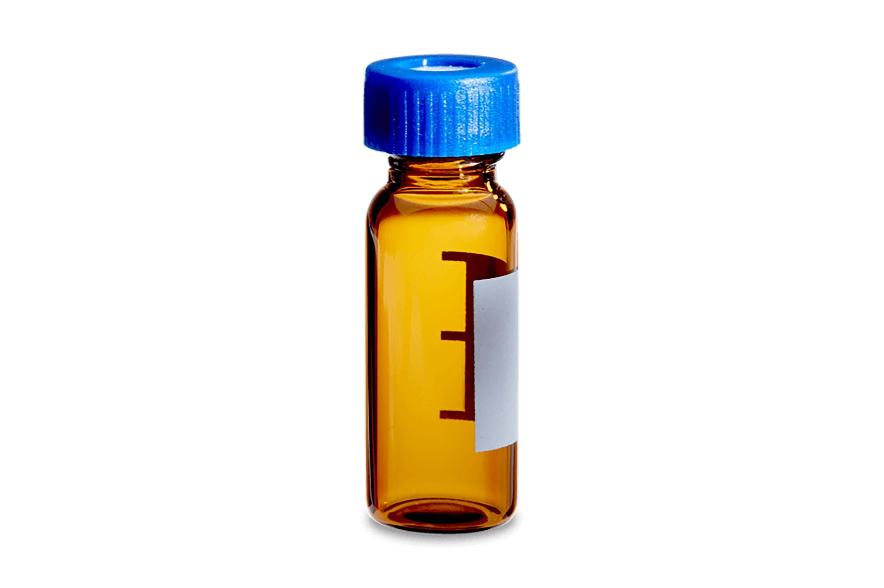
Sample preparation
Method
Residue
Wet whale fecal sample
Dried whale fecal sample
Liquid-solid extraction
Freeze dry
Centrifugation
Solution
Dry
Liquid-liquid extraction
Reconstitute
Dry
SPE
Reconstitute
Centrifugation
Lower
Upper
Dry
Reconstitute

Slide 9
Sample Analysis
Method
Reconstitute
Data & Results
Instrument conditions for target compounds analysis
LC condition | Mobile phase | A: 0.1% (v/v) formic acid in water | B: 0.1% (v/v) formic acid in methanol
 | Total flow | 0.2 mL min−1
 | Column | Xterra MS C18 column (100 mm × 2.1 mm, 3.5 µm)
MS condition | Ionization mode | ESI
 | IonSpray voltage | + / - 4500
 | Temperature (°C) | 400

Slide 10
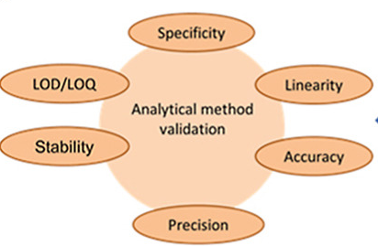

Slide 11
Results
Intraday and interday recoveries and R.S.D. of spiked freeze-dried feces of killer whales
Compound | Spiked level 1 (5.3 ng /g) |  |  |  | Spiked level 3 (133 ng/g)
 | Intraday |  | Interday |  | Intraday |  | Interday
 | RE (%) | RSD (%) | RE (%) | RSD (%) | RE (%) | RSD (%) | RE (%) | RSD (%)
Aldosterone | 116.2 | 0.6 | 104.5 | 7.2 | 84.5 | 1.7 | 89.6 | 5.5
Fluoxetine | 91.2 | 3.8 | 88.1 | 7.9 | 88.7 | 0.8 | 89.3 | 4.3
Cortisone | 120.4 | 8.6 | 122.3 | 4.4 | 130 | 0.7 | 130.3 | 4.2
Cortisol | 99 | 3.3 | 89.3 | 7.6 | 118.2 | 1.9 | 115.6 | 7.9
11-Ketotestosterone | 97.3 | 4 | 95 | 12.1 | 108.8 | 4.8 | 106.9 | 0.8
Corticosterone | 104.1 | 9.6 | 110.8 | 5.4 | 121.5 | 4.8 | 115.6 | 5.7
Estrone | 91.5 | 7.7 | 113.4 | 16.7 | 106.7 | 3 | 102.8 | 3.8
11-Deoxycorticosterone | 124.8 | 3 | 114.5 | 8.5 | 117.8 | 3.3 | 120.1 | 4.7
Testosterone | 102.1 | 2.4 | 107.2 | 2.7 | 96.4 | 1.9 | 96.1 | 1.9
Progesterone | 121.9 | 8.9 | 112.7 | 8.5 | 115.4 | 3.9 | 108.4 | 6.6
Androsterone | 110.6 | 3.7 | 105.9 | 3.5 | 112.7 | 0.7 | 105.2 | 6.6
RE: Recovery; RSD: Relative standard deviation

Slide 12
Results
Comparison of available method limit of detection (ng/g) of mammal feces
Compound | Method
 | Our method | Gesquiere et al | Weltring et al
Cortisone | 0.26 |  | 91.8
Cortisol | 0.65 |  | 18
Corticosterone | 1.52 |  | 99
Androstenedione | 0.37 | 0.25 | 47.4
Testosterone | 0.54 | 0.25 | 54.6
DHEA | 12.76 | 2.5
Progesterone | 1.32 |  | 50.4
Androsterone | 3.7 | 1.5 | 210.6
Estriol | 1.47 |  | 19.2
17b-E2 | 6.36 | 0.25 | 35.4
Estrone | 0.89 | 5 | 88.2

Slide 13
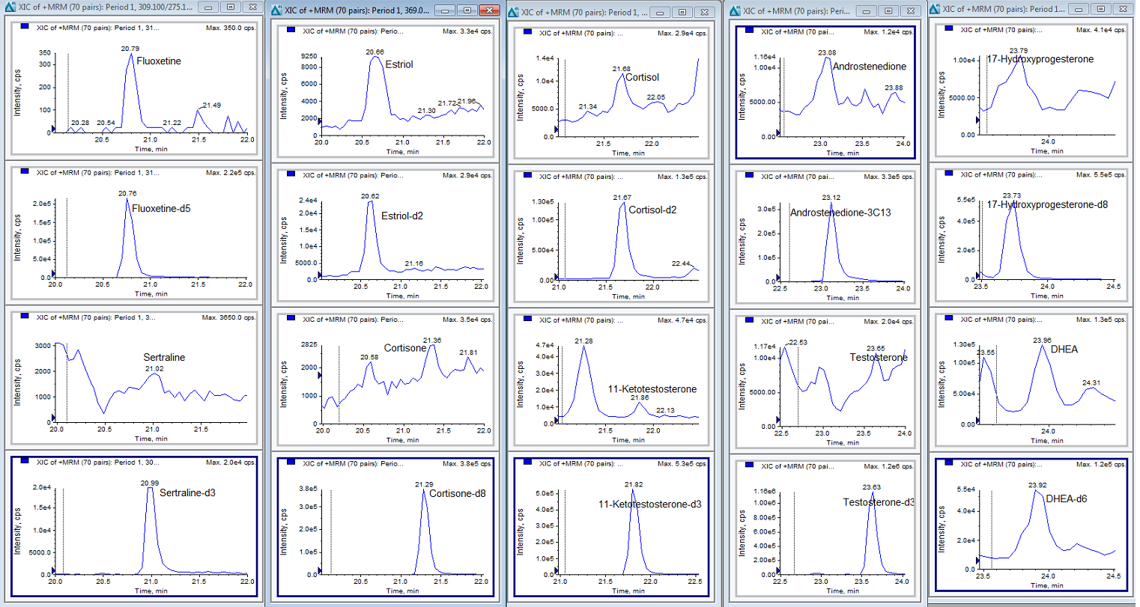
Results
Chromatograms of hormone and PPCPs in whale feces

Slide 14
Conclusion
The method for measuring 18 endogenous steroids and 3 pharmaceuticals and personal care products in freeze-dried feces of killer whales has been developed and validated
This method can be used as a reference in the validation of the existed and new immunoassays such as radioimmunoassay and enzyme immunoassay
Hormones such as 17-hydrogenprogesterone, Cortisol, Androstenedione, testosterone, and dehydroepiandrosterone sulfate (DHEAs ) are found and quantified in whale feces
PPCPs such as triclosan, sertraline and fluoxetine are found and quantified in whale feces
A non-invasive approach to characterizing contaminants and health endpoints for killer whales has been developed and validated

Slide 15
Acknowledgement
SeaWorld
Whales Initiative of Government of Canada

