Slide 1
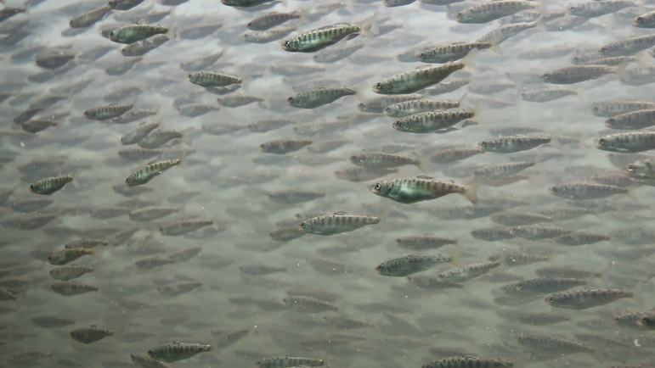
Hatchery Effectiveness Review
Andy Rosenberger, Sam James, Ravi Maharaj, Ben Fortini, Mark Giles, Isobel Pearsall, Jason Hwang, Brian Riddell

Slide 2
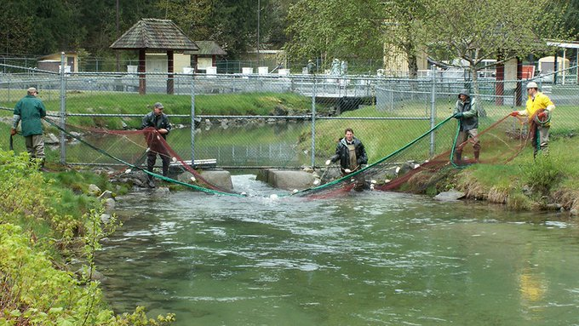
Outline
Project background
Project components
Highlights
Challenges and Limitations

Slide 3
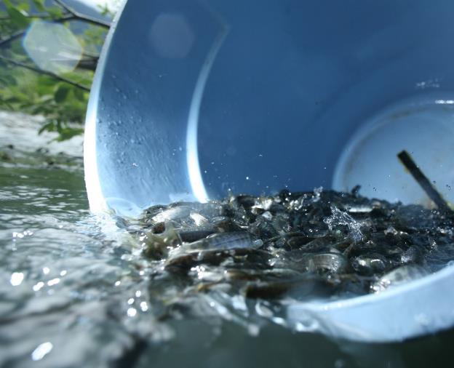
Project Background
Importance:
Growing concerns for declining salmon production
Increasing fishing restrictions
Climate change and changing ocean conditions
Broader ecological considerations (e.g., SRKW)
Several calls for assessment of enhancement
BCSRIF Funded (2019-2022)
3 Main Components
Perform a comprehensive review of hatchery effectiveness, including production for harvest and rebuilding, the role of community hatcheries, trends in biological traits, and hatchery-wild interactions
Notes:
Context: need for assessment, growing concerns for declining salmon populations, uncertainty around hatchery-wild interactions, increased restrictions for commercial and sport fisheries, implications for the broader ecosystem, incl SRKW, impacts of climate change

Slide 4
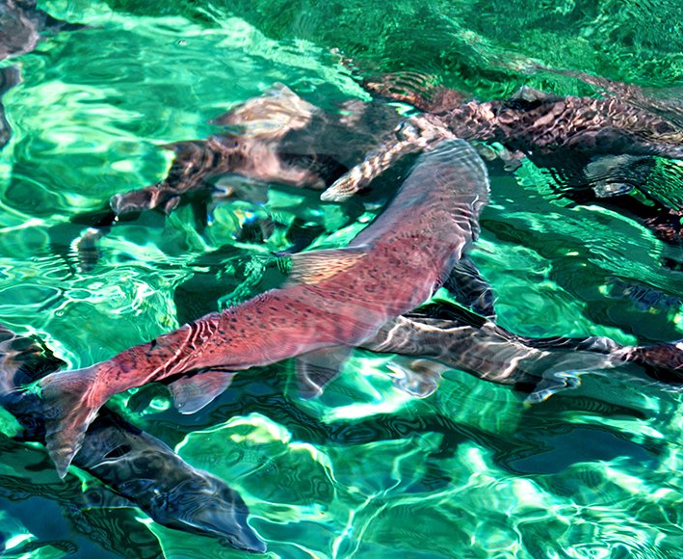
Comprehensive Review
Components
Literature Review
Role of community hatcheries
Trends in biological traits
Hatchery effectiveness
Hatchery-wild interactions
Notes:
Massive endeavour with many components
Projects in bold will be touched on today, just highlights.
Talk Timelines – preliminary analysis, currently wrapping things up with detailed reports in summer and through fall
Team: 5 staff
Details (not to present):
Molecular tools: scan of what genetic and molecular tools have been developed for other applications that could be used to improve hatchery effectiveness.
Release strategy review: takes a look at how hatcheries release their fish and the impacts on survival mostly, with some experiments looking at exploitation rates and return ages. Focus on CN and CO with CWTs
Literature Review: compile and summarise all relevant hatchery-wild interactions literature
Community hatcheries: Explore and take inventory of Community Involvement Program (CIP) hatchery practices and expert knowledge. Through interviews determine:
What is being done at the hatchery?
What are the objectives and how are they assessed?
What can be done to better support the hatchery?
Trends in biological traits: Declines in Chinook detected in stocks across PNW, but extent and causes of declines not well understood, especially in BC
Hatchery effectiveness:
How is the age/sex structure of BC salmon runs changing?
How is size changing across different ages classes of salmon?
How is size changing across sexes?
How do these differ between wild and hatchery salmon?
Hatchery effectiveness: Looking at Harvest and Rebuilding specifically: distribution of catch, efficiency, contributions to catch and escapement, trends in abundance/natural spawners
Hatchery-wild interactions: lit review, spatial analysis that looks at impacts of enhancement in one area on surrounding systems, and productivity modelling

Slide 5
Hatchery-Wild Interactions Literature Review
Goal
What is the current state of the literature concerning the effects of hatchery-origin salmon on wild salmon?
Preliminary findings
Most studied category, by far, is genetic effects
Competition the focus of 2nd most studies
Other categories include fish health and fishery mixing
Majority of studies find a negative effect on wild fish
Common recommendations:
Hatchery releases are a tool to be used sparingly, and as part of a larger enhancement or rebuilding strategy
Hatchery management must be adaptive, and ongoing evaluation of impacts on wild fish is essential

Slide 6
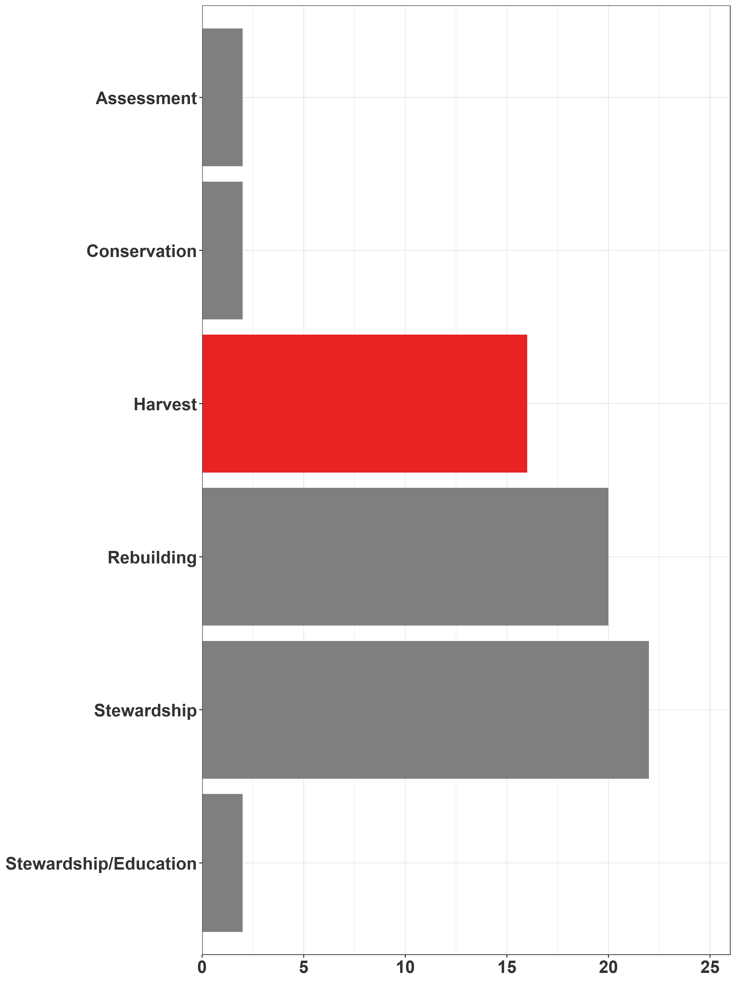
Community Hatcheries
Objectives
Summarize current practices and needs
Were goals achieved?
Provide recommendations for SEP to improve the CIP
Findings
Over half of CIP facilities have harvest as one of their objectives
Community hatcheries also have value outside of production (e.g., education and stewardship)
Majority say they lack operational funding
Notes:
Intro to slide Cas across BC approached to develop interview list, comprehensive interviews conducted over 3-4 months, results compiled and recommendations recorded
Findings additional speaking points
Difficult to assess how much these fish contribute to harvest
Funding
Often looking for extra revenue sources and partners
Some already involve local angler groups

Slide 7
Trends in Biological Traits
Widespread declines in size-at-age, age-at-maturity in Chinook
We looked more in depth at BC populations
Largely from enhanced populations, few wild systems
Used a large database of SEP and STAD individual fish records
Preliminary Findings
Declines in size-at-age evident in most populations for males and females of all ages
Likely declines in age-at-return as well
Changes in chum, coho, and sockeye should be explored

Slide 8
Hatchery Effectiveness-Questions
How effective is production for different objectives (i.e. harvest and rebuilding)?
Harvest Questions
What are enhanced contributions to harvest?
Where are enhanced fish caught?
Are some hatcheries more effective than others at producing catch?
Rebuilding Questions
Does enhancement increase TOTAL and/or NATURAL ORIGIN spawner abundance?
What happens when enhancement stops?
Are there differences in rebuilding production efficiency?
How is this different across regions and species?
Notes:
Obviously each one of these has detailed investigations, methodologies and unique challenges associated with them. Especially at the scope we are looking at. What we envisioned when starting out was to develop a standardized, scalable, analytical framework that would work across species and regions. Did we succeed? Probably not possible, but will talk about some of the challenges, limitations and recommendations that may inform and guide such an approach later on.

Slide 9
Hatchery Effectiveness-Findings
Production for Harvest
Enhanced contributions are variable, and depend on fishery, species and region
Hatchery fish provide significant contributions to many fisheries, but there are changes over time and areas
Production for Rebuilding
In systems that have rebuilding as an objective:
Total spawner abundance typically increases, but not natural origin
When enhancement stops, spawner abundance declines
Areas/systems have mixed responsiveness
No standardized assessment objectives

Slide 10
Hatchery-Wild Interactions
Many hatchery and wild interactions are identified in the literature
Questions
What influence do hatcheries have on wild salmon productivity in BC?
What effect does enhancement have on productivity in enhanced systems?
Can we use Stock-Recruit data and hatchery covariates to identify this?
Using single stock and hierarchical multi-stock models to explore
Are there more localized effects of hatchery enhancement on nearby wild systems?
→ In progress

Slide 11
Challenges and Limitations
Challenges
Quantity of data
Scope of review (all BC, coho, Chinook, chum, sockeye channels, etc.)
Few integrated precedents/methods to follow (although many specific papers etc.)
Limitations
Capacity within SEP and StAD
Data quality and accessibility (e.g., coho, chum, and wild stock biodata, stock specific information: ages, harvest, productivity, enhanced contributions)
Notes:
We are still encountering many challenges in working with vast amounts of data from various sources that don’t necessarily mesh together.
Quantity of data is an issue in terms of management and breaking it down for analysis
Scope is enormous
Lots of specific methods documents and summaries, but there are few if any studies to look at all the aspects we are
Limitations include capacity issues within DFO, lots of data quality and accessibility issues, stock specific information

Slide 12
In Summary
So what does all this mean?
Data compilation, management, and analysis at this scale is complicated
Assessment of effectiveness is hampered by data limitations
Recommendations
Recommendations will be focused around how to design assessment programs that support evaluation of objectives (e.g., harvest, rebuilding, interactions)
Enhancement activities must be properly planned with appropriate assessment
Any new enhancement must be considered in the context of the larger picture
Timelines and Reports
Reporting will be completed summer/fall 2022 – look for them on the PSF Website at www.marinescience.ca
Notes:
- Talk through points on slide.

Slide 13
For more information
Release strategies: Sam James sjames@psf.ca
Molecular tools: Aimee Lee-Houde ahoude@edynamics.com
Comprehensive review: Andy Rosenberger andy@coastlandresearch.com
Trends in Biological Traits: Ravi Maharaj futurefish88@gmail.com
Project lead: Isobel Pearsall pearsalli@psf.ca
PSF VP Salmon: Jason Hwang jhwang@psf.ca

