Slide 1
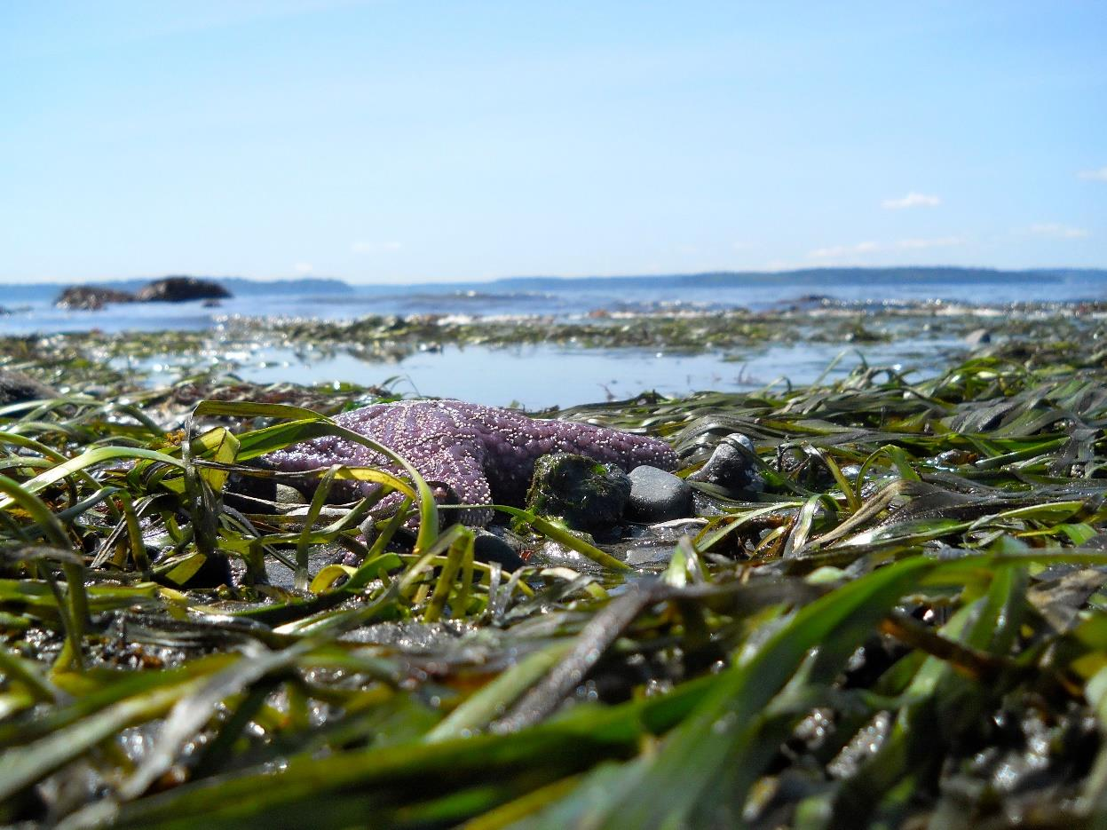
Pathogen Filtration: an untapped ecosystem service
Corinne Klohmann
Advisor: Dr. Jacqueline Padilla-Gamiño
University of Washington, School of Aquatic and Fisheries Sciences
Corinne Klohmann
Notes:
Fishery sciences, shift lower title over to the right
put twitter, at end and email, increase name font

Slide 2
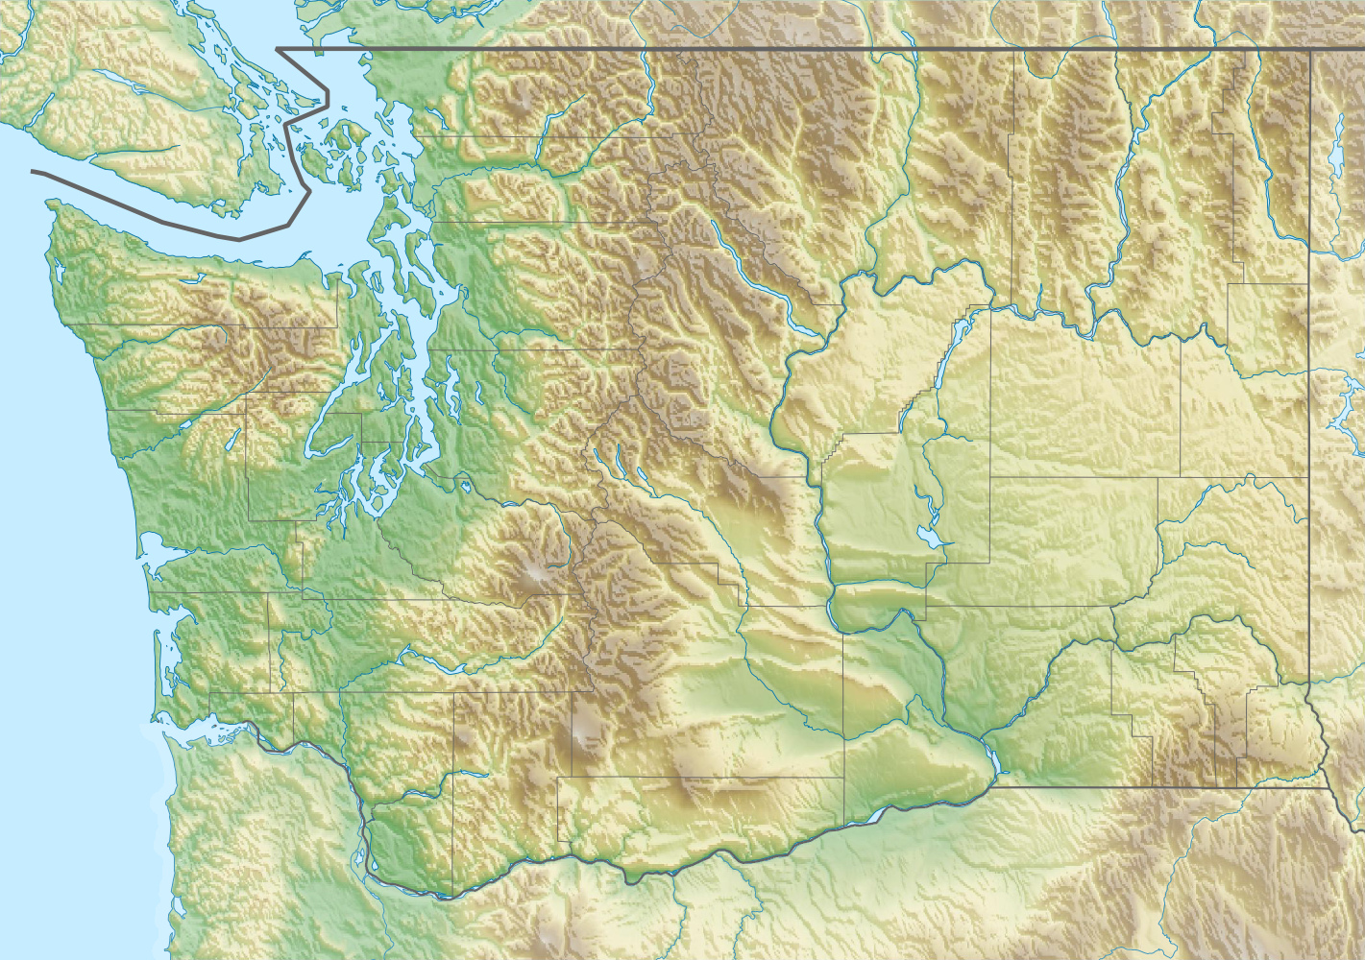
Roadmap
Bacterial pollution in Puget Sound
Z. marina as a solution
Methodology
Results
Next Steps
Notes:
Zoom in from salish Sea

Slide 3
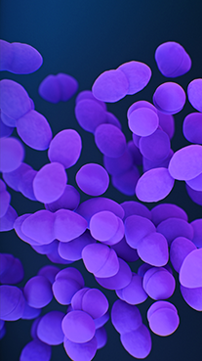

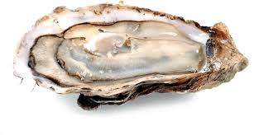
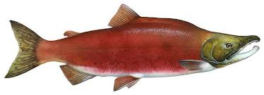
The Problem:
Bacteria in Puget Sound
“Too much bacterial pollution can close harvest of shellfish beds or make saltwater beaches unsafe for swimming.” - WA Dept. of Ecology
We all need clean water!
Notes:
fecal coliform bacteria that come from the digestive tract of warm-blooded animals
Bacteria can negatively affect the recreational and economic value of a water source. Pathogens can sicken humans and other animals in the water.

Slide 4
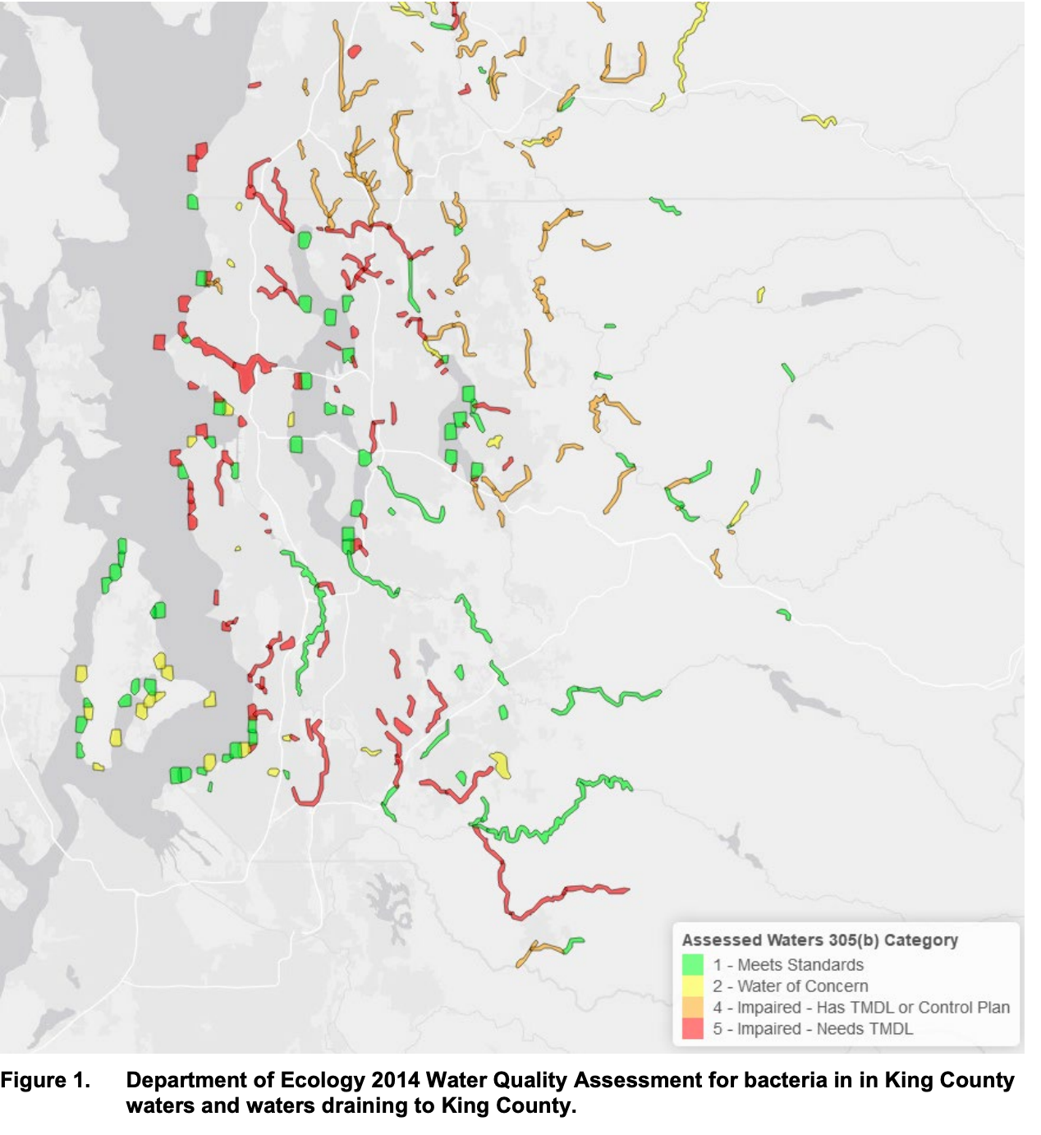

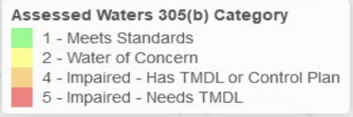
King County water quality assessment
172 bodies of water impaired by bacteria
        ⅓ (59) have a pollution control plan
(Clark, 2019)
Notes:
2014 report by DNR found that 172 bodies of water in king county were impaired by bacterial pollution. ⅓ have a pollution control plan in place
March 2019 - Puget Sound Naval Shipyard spills 4,000 gallons of sewage into Puget Sound. July 2019 -The West Point and Rentron Wastewater Treatment Plant discharged 4.5 million gallons of untreated sewage. July 2019 - Renton Wastewater Treatment Plant discharged 1.5 million gallons into Puget Sound.
Check if the report proportion of bodies of water
Orient people on map?
Maybe re-color
Play around with intro order

Slide 5

King County water quality assessment
172 bodies of water impaired by bacteria
        ⅓ (59) have a pollution control plan
4.5 million gallons of raw sewage spilled between March-July in 2019
(Clark, 2019)
Notes:
2014 report by DNR found that 172 bodies of water in king county were impaired by bacterial pollution. ⅓ have a pollution control plan in place
March 2019 - Puget Sound Naval Shipyard spills 4,000 gallons of sewage into Puget Sound. July 2019 -The West Point and Rentron Wastewater Treatment Plant discharged 4.5 million gallons of untreated sewage. July 2019 - Renton Wastewater Treatment Plant discharged 1.5 million gallons into Puget Sound.
Check if the report proportion of bodies of water
Orient people on map?
Maybe re-color
Play around with intro order

Slide 6
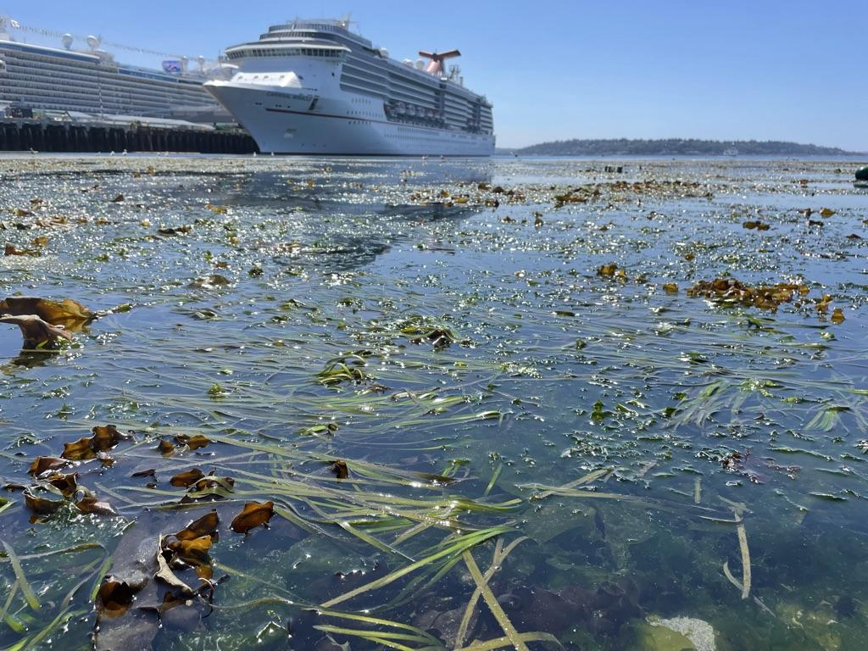
Proposed solution: Eelgrass (Zostera marina)
Notes:
change background color to white

Slide 7
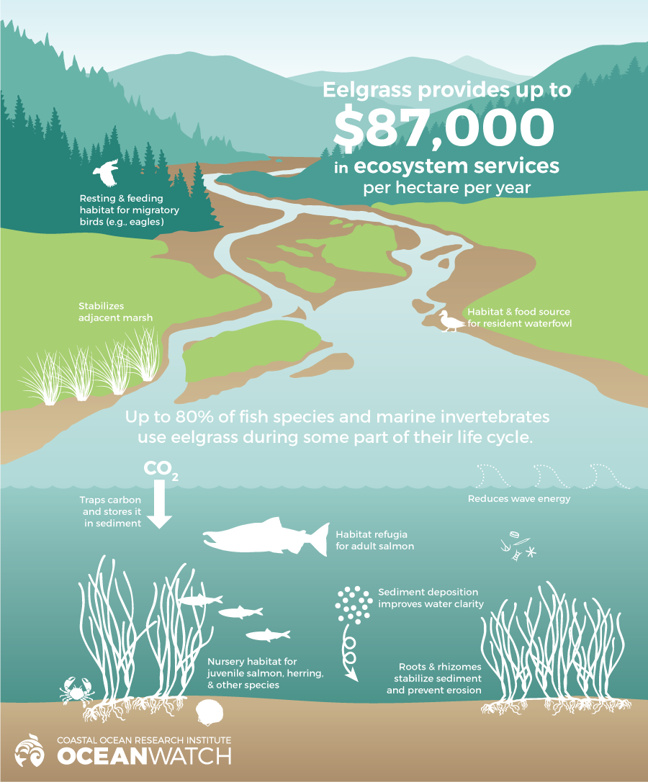
23,000 hectares in Puget Sound
$2,000,000,000 annually
Notes:
Challenges
23,000 hectares in PS = 2 billion dollars
Hypothesis: Bacterial counts are lower within an eelgrass bed
triple check US or Canada dollars

Slide 8
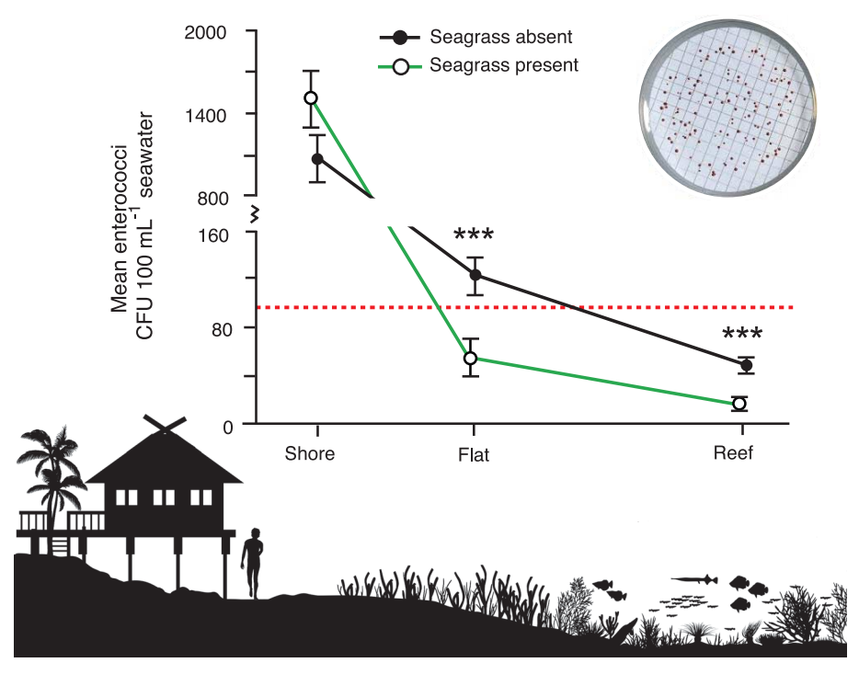
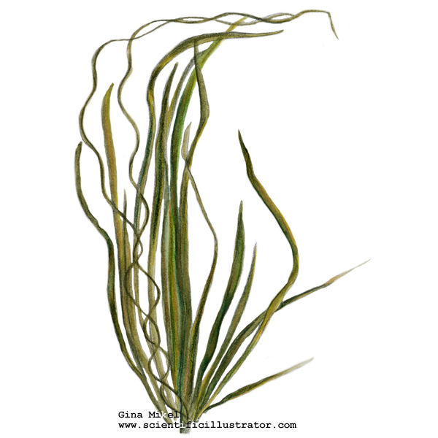
Shore
Flat
Reef .
(Lamb et al., 2017)

Slide 9
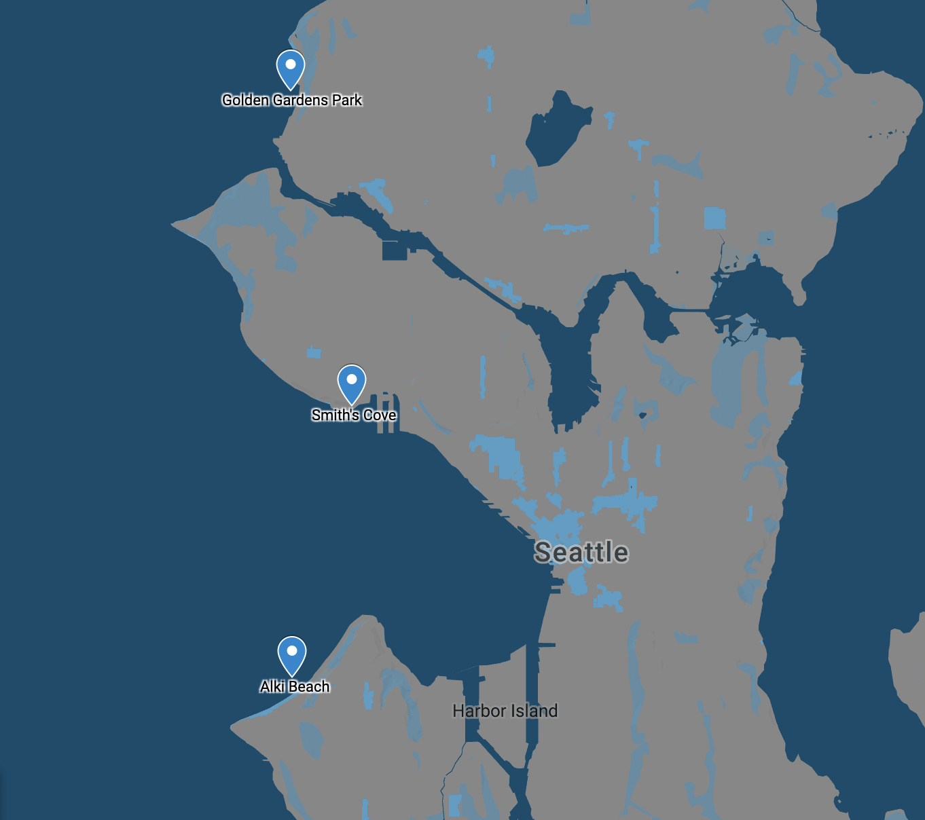
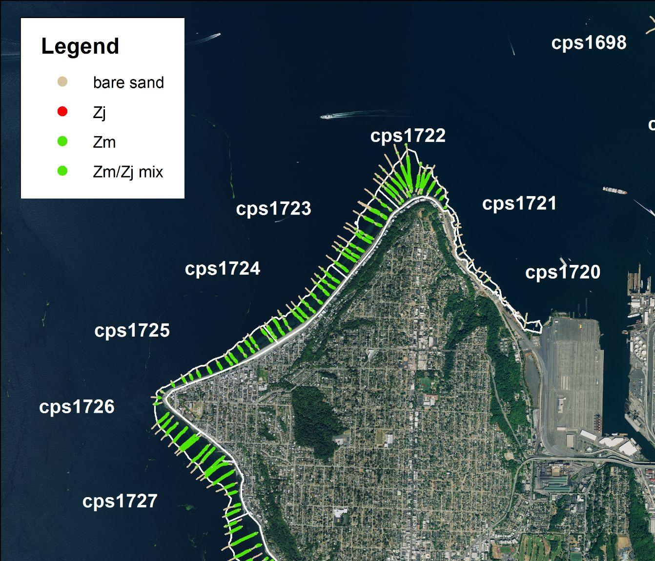
h djhv bjhabsdvjhbasdv
Golden Gardens
Smith’s Cove
WA Dept. of Natural Resources
Alki Beach
Notes:
collect data from 4 public parks in puget sound for 1-1.5 years, inside and outside the eelgrass bed
sample 3 sites for a year for Enterococcus (fecal indicator bacteria)

Slide 10

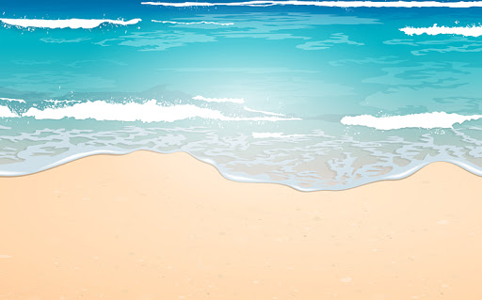
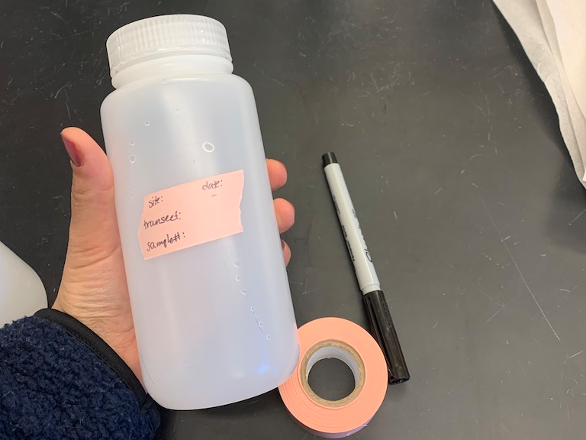
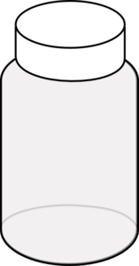

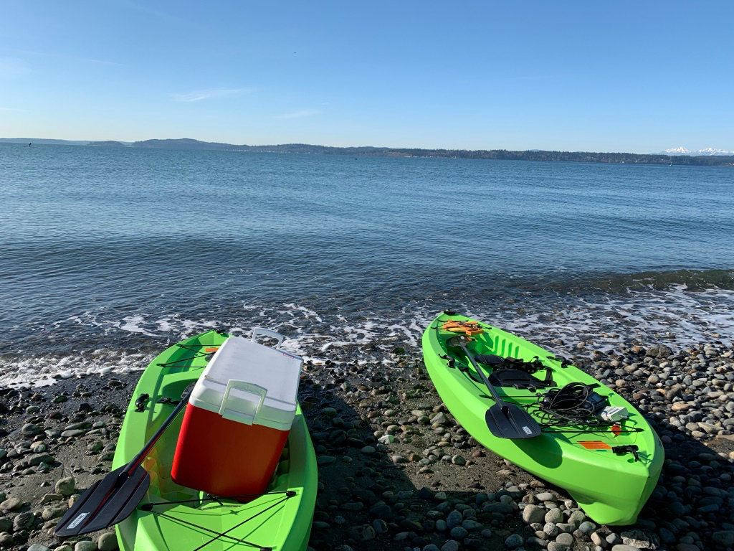
Field methods for Enterococcus detection
Notes:
Started in feb, sampled monthly until march 2021
Two transects perpendicular to shore, samples collected in triplicate
ISO - International Organization for Standardization
Standard methods from the US EPA and ISO
Enumeration = quantifiable method. Be able to count and list baacteria. Method always culture based in countries

Slide 11
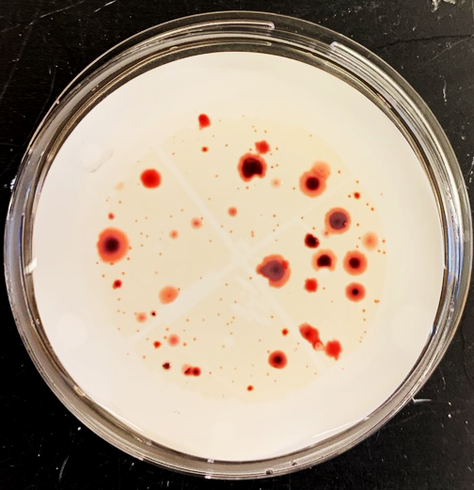
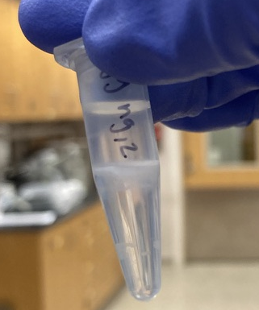
Laboratory methods for Enterococcus detection
Culture-based, CFUs/100ml
W.H.O. specific enterococcal enumeration method
Notes:
selective media,

Slide 12
Environmental field data
Notes:
emphasize points, general trends
add points to when eDNA sample were taken
Fix Smith's cove captialization
cow plot (theme under_basci )
increase titiel simplify
Consider changing to seasonal x-axis
Continue ot say site names and characterits
Change legend

Slide 13
Field survey data results
Notes:
high variability between sites, significant differences,
not significant differences between grass treatment
make lines thicker
make sites the same color
"animate" - add one site first, then add other sites

Slide 14
Field survey data results
Notes:
high variability between sites, significant differences,
not significant differences between grass treatment

Slide 15
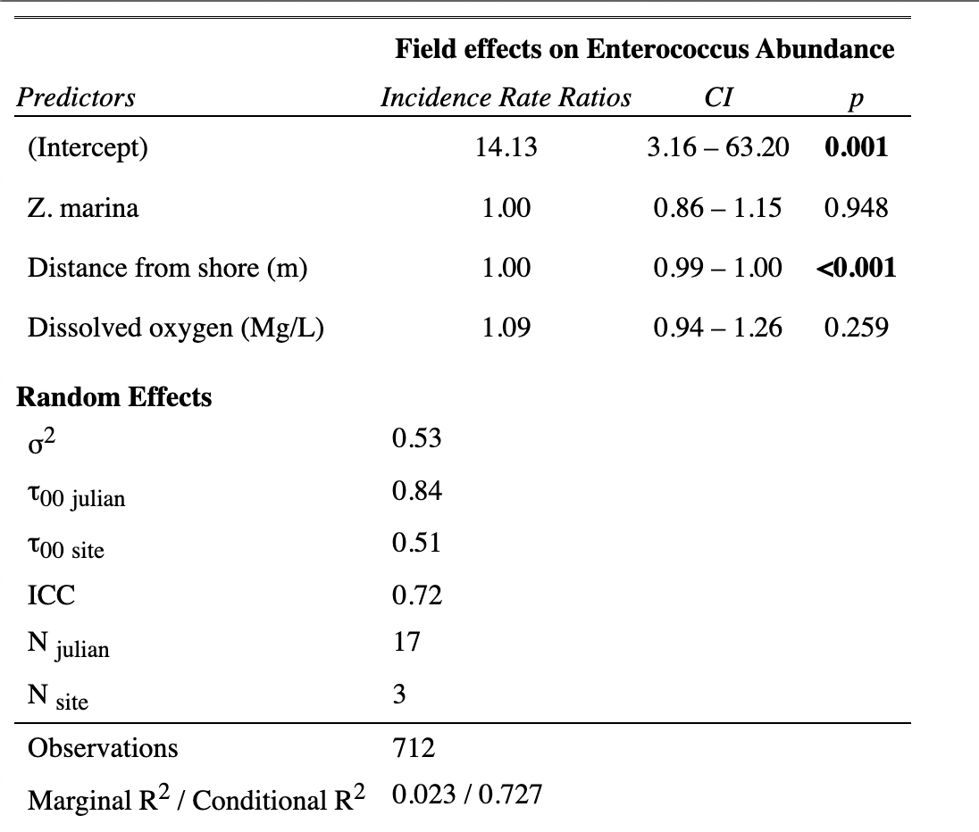
GLM with Negative Binomial Distribution
Notes:
GLM with negative binomial distribution
make eelgrass link more clear
say that it's not a clear pattern but it's true!
Maybe log transform the y-axis
Table back instead of full result table
Increase axis labels

Slide 16
Laboratory methods for Enterococcus detection
Collected environmental DNA (eDNA) samples
Phenol:chloroform:isoamyl alcohol extraction
16S rRNA sequencing using Illumina MiSeq
Samples from August and December (n =60)
Detected 287 genera including:
  Vibrio
  Rickettsia
  Pseudomonas
  Enterobacter
Notes:
initial OTU evaluation
will use CHIME pipeline to reevaluate microbial community using ASV’s
will characterize the microbial community by correlating abundance with environmental data

Slide 17
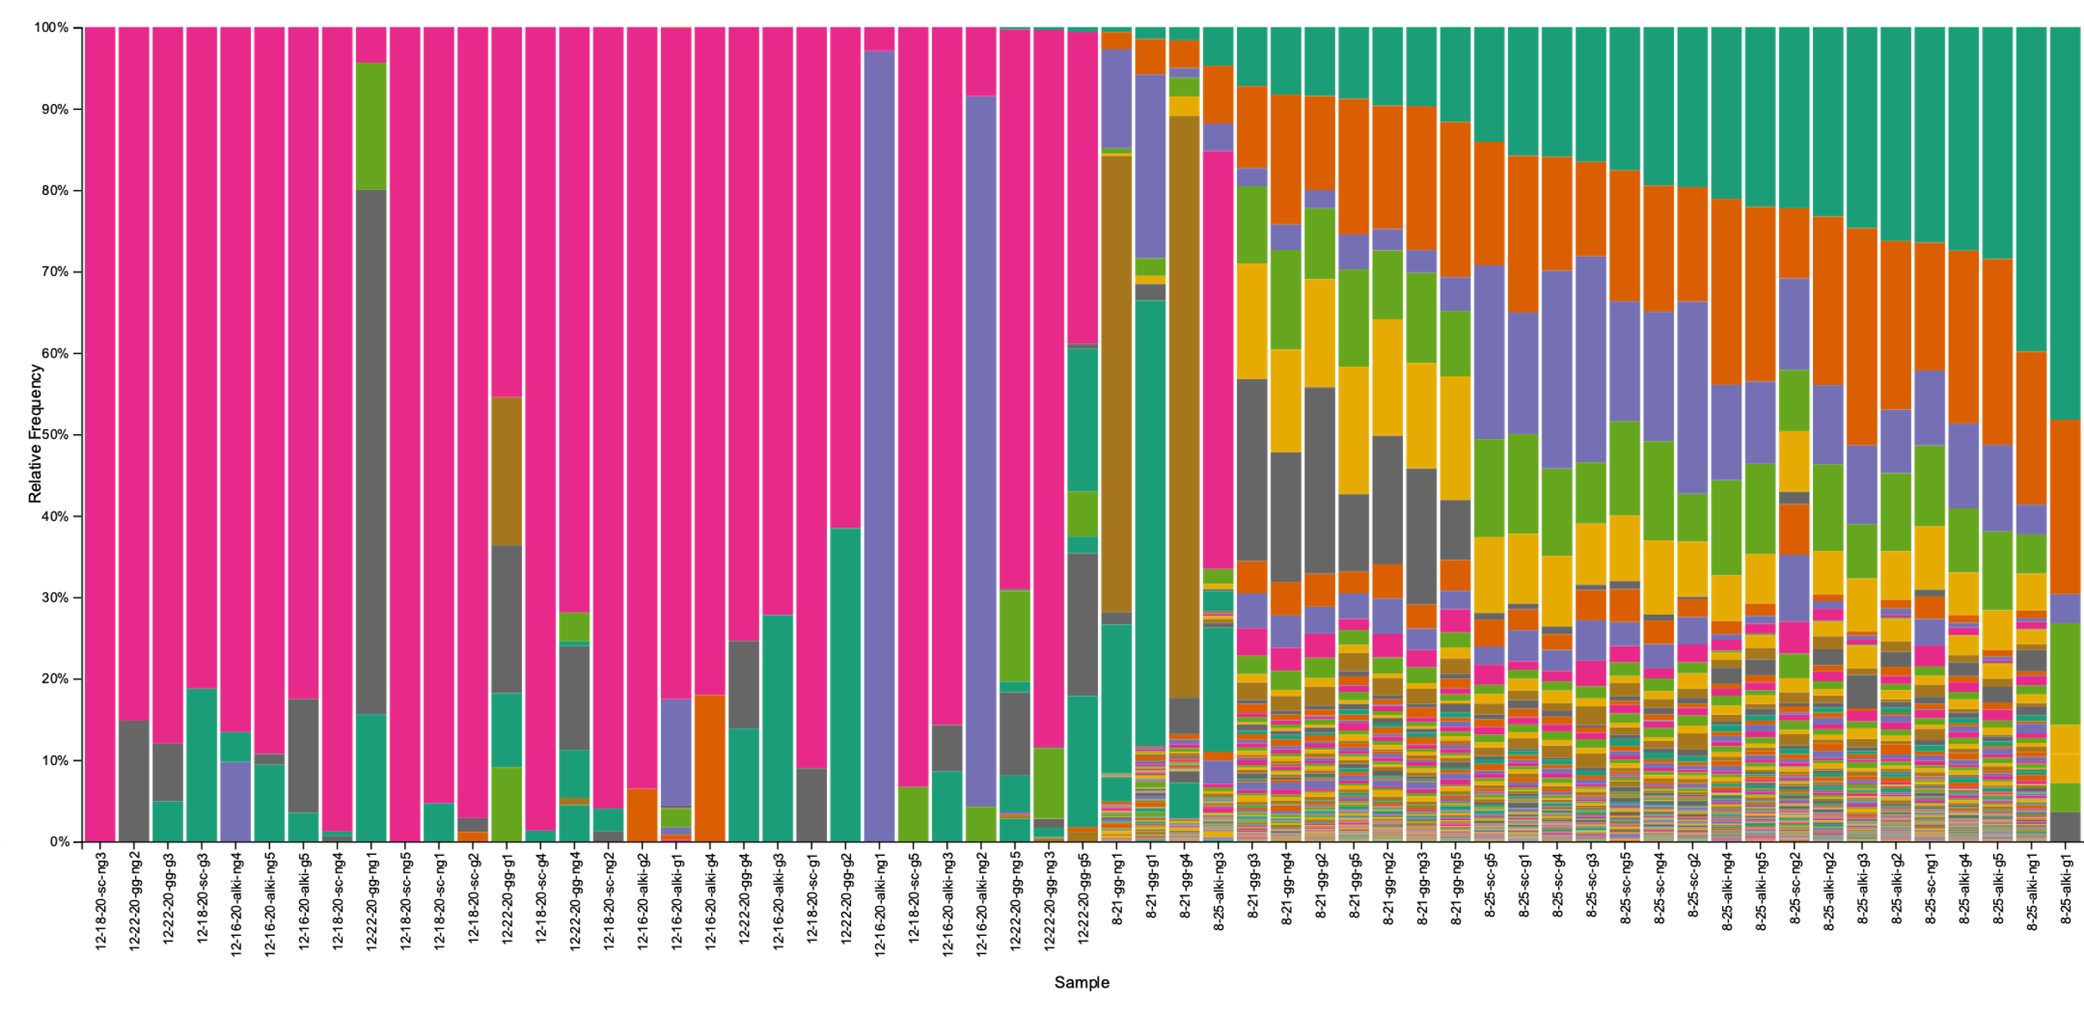
We did not find a filtration effect but found strong seasonal patterns of bacterial communities associated with Z. marina
Winter
Summer
Notes:
Level 6 (genera/genus)
Winter
Pink – Pseudomonas
Purple – Vibrio
Grey – Enterobacterales, Yersiniaceae, Serratia
Summer
Green - SAR11_clade of alphaproteobacterial
Orange – Rhodobacteria
Purple – cyanobacteria

Slide 18
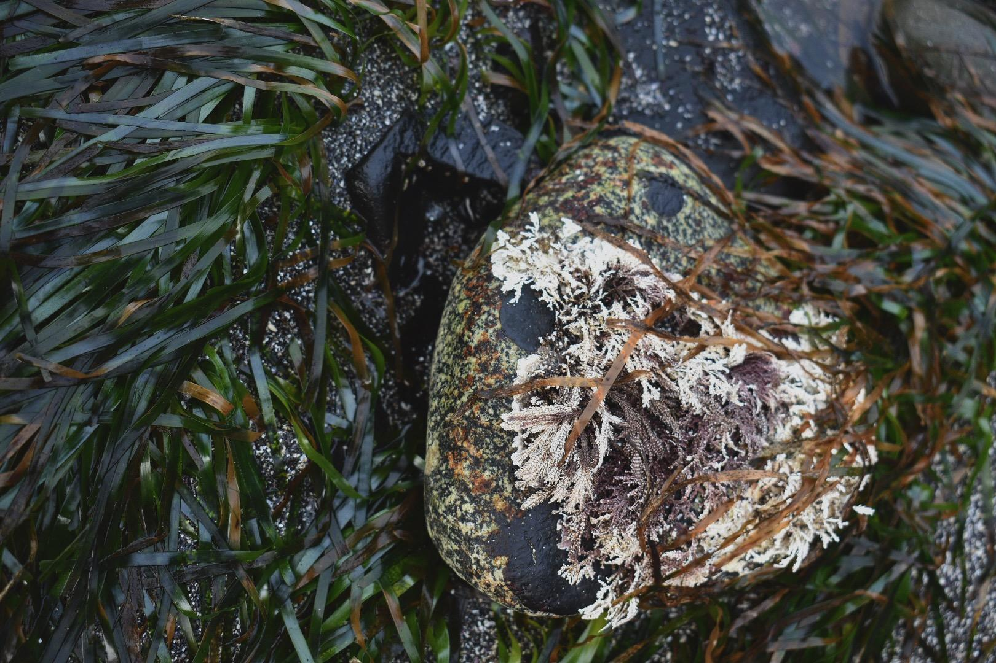
Next Steps
Sequence eDNA samples from Spring and Fall of 2020 (n = 144)
Explore which bacteria might be excluded from Z. marina beds
Notes:
using state of the art aquaria
future ocean conditions, see how it changes under future ocean conditions

Slide 19
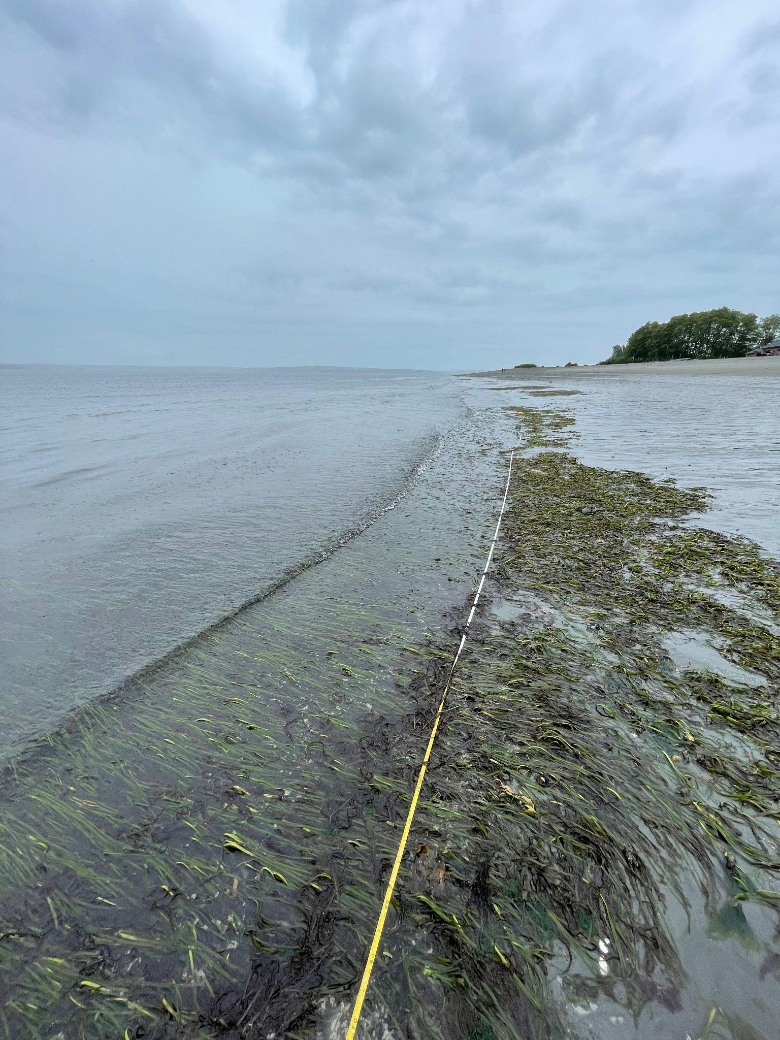
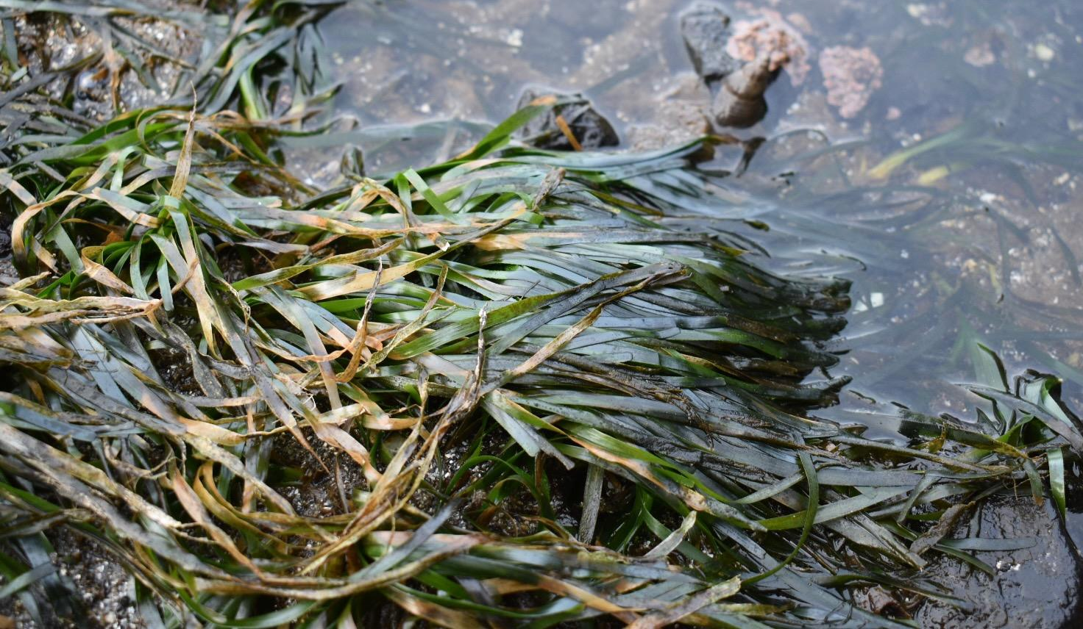
Summary
No Z. marina filtration effect
High geographic and seasonal variability
Potentially pathogenic microorganisms detected
Sequence additional eDNA samples

Slide 20
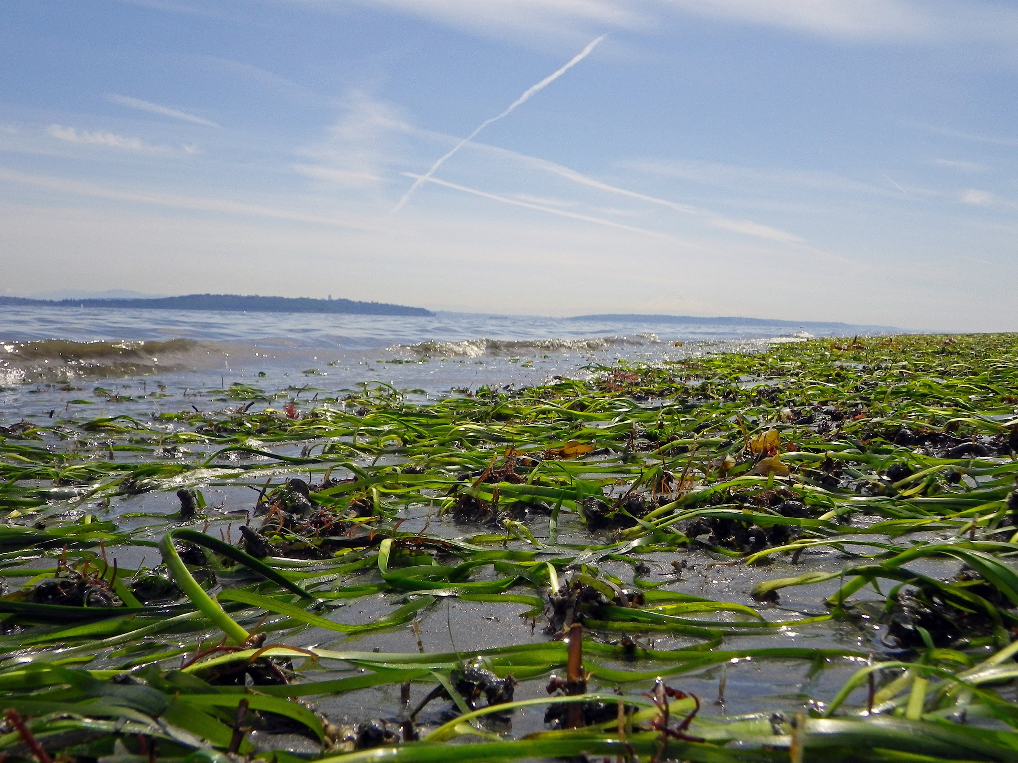




Thank you!
Questions?
Dr. Micah Horwith
Dr. Emily Jacobs-Palmer
Dr. Bart Christiaen
email: cak268@uw.edu
Twitter: @CorinneKlohmann
Notes:
Dr. Micah Horwith
Dr. Emily Jacobs-Palmer

