Slide 1
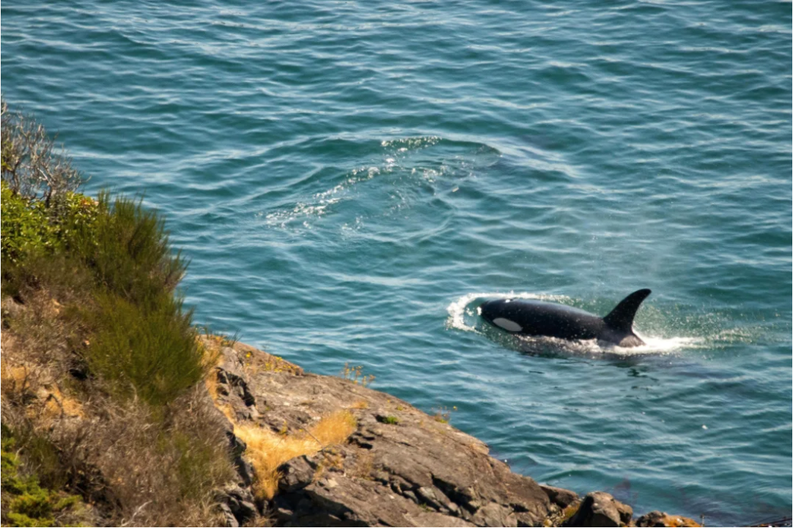
Environmental justice frameworks for large carnivore conservation:
Lessons from the shore
Alex McInturff
26 April 2022
Salish Sea Ecosystem Conference

Slide 2
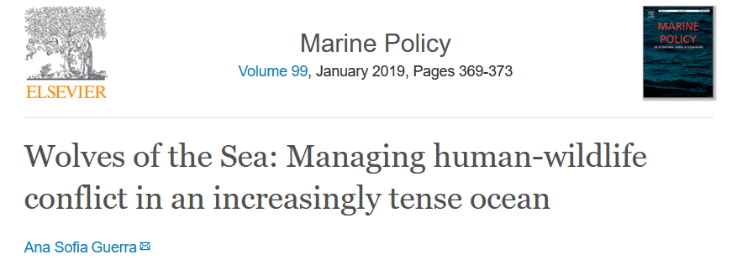

Slide 3
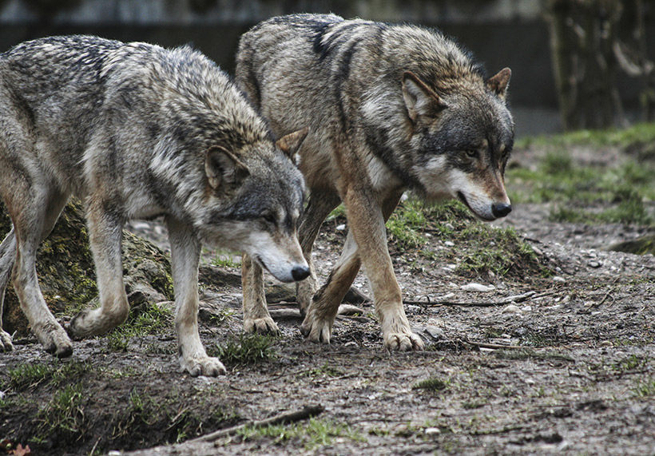
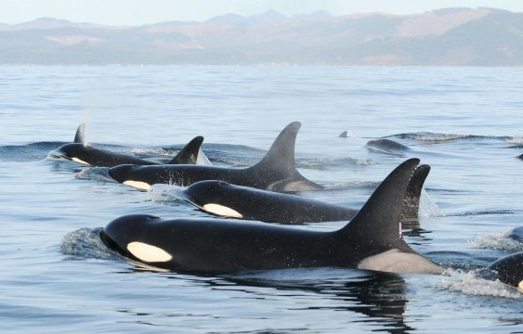
Can we “co-exist” with large carnivores?

Slide 4
Environmental justice (EJ) research seeks to document and redress the disproportionate environmental burdens and benefits associated with social inequalities
Chakraborty et al., 2016
Notes:
Luckily, we don’t have to start this research from scratch
We build on established research and theory in Environmental Justice, or EJ, which…
When it comes to wildlife, vulnerable, marginalized, and disempowered people are often among those living in closest proximity to wildlife,
especially in areas where restoration is occurring.
So this body of theory in environmental justice perfectly applies here, even though it has almost never been applied to wildlife issues

Slide 5
Distributive Justice – who is materially harmed?
Participatory Justice – who can participate?
Recognition Justice – whose worldviews are recognized?
Affective Justice – whose risk perceptions matter?
Notes:
Our research also identified two major roadblocks unique to questions of justice and wildlife
The first of these is familiar, and it is risk perceptions.
Our research showed that risk perceptions are so important to environmental justice, that they can warp the outcomes of these other approaches
With that in mind, we developed a new theory, called affective justice, which asks whose risk perceptions matter?
In this theory we show how histories of equating fear of predators with fear of black and brown people and immigrants in America and Europe has functionally linked programs of wildlife eradication and human marginalization
These overlooked links are not merely historical, and they continue to perpetuate colonial practices in conservation and management
By developing the theory of affective justice, our research has exposed an important site for future research and practice
And examining this further has rich potential for future graduate students
A second roadblock also involves the history of colonialism in conservation in management, especially as it relates to indigenous people

Slide 6
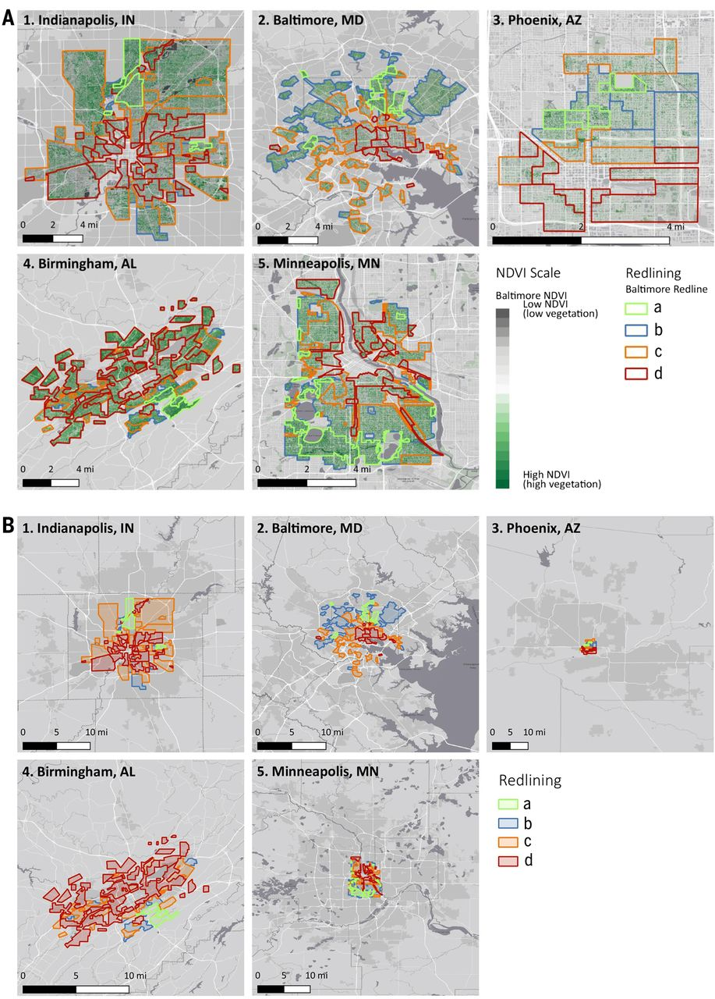
Distributive Justice – who is materially harmed?
Compensation programs
Resource access
Exposure to conflict
History and intersectionality
Measuring benefits
Schell et al., 2020

Slide 7
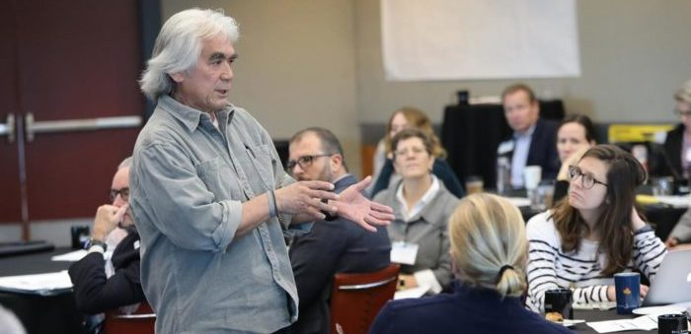
Participatory Justice – who can participate?
Stakeholder engagement
Identifying stakeholders
Access to participation
Scale and locality
Co-management and collaborative governance
Port of Seattle, 2019

Slide 8
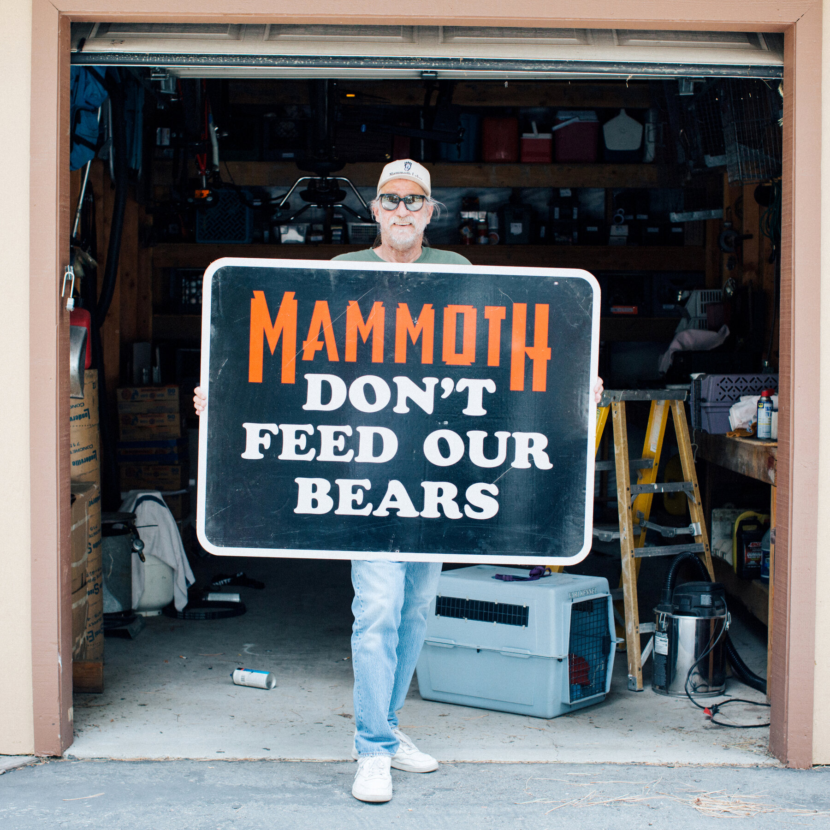
Recognition Justice – whose worldviews are recognized?
Identity
History
Ways of knowing
Ways of life
(Shared) values
Mammoth Lakes, CA

Slide 9
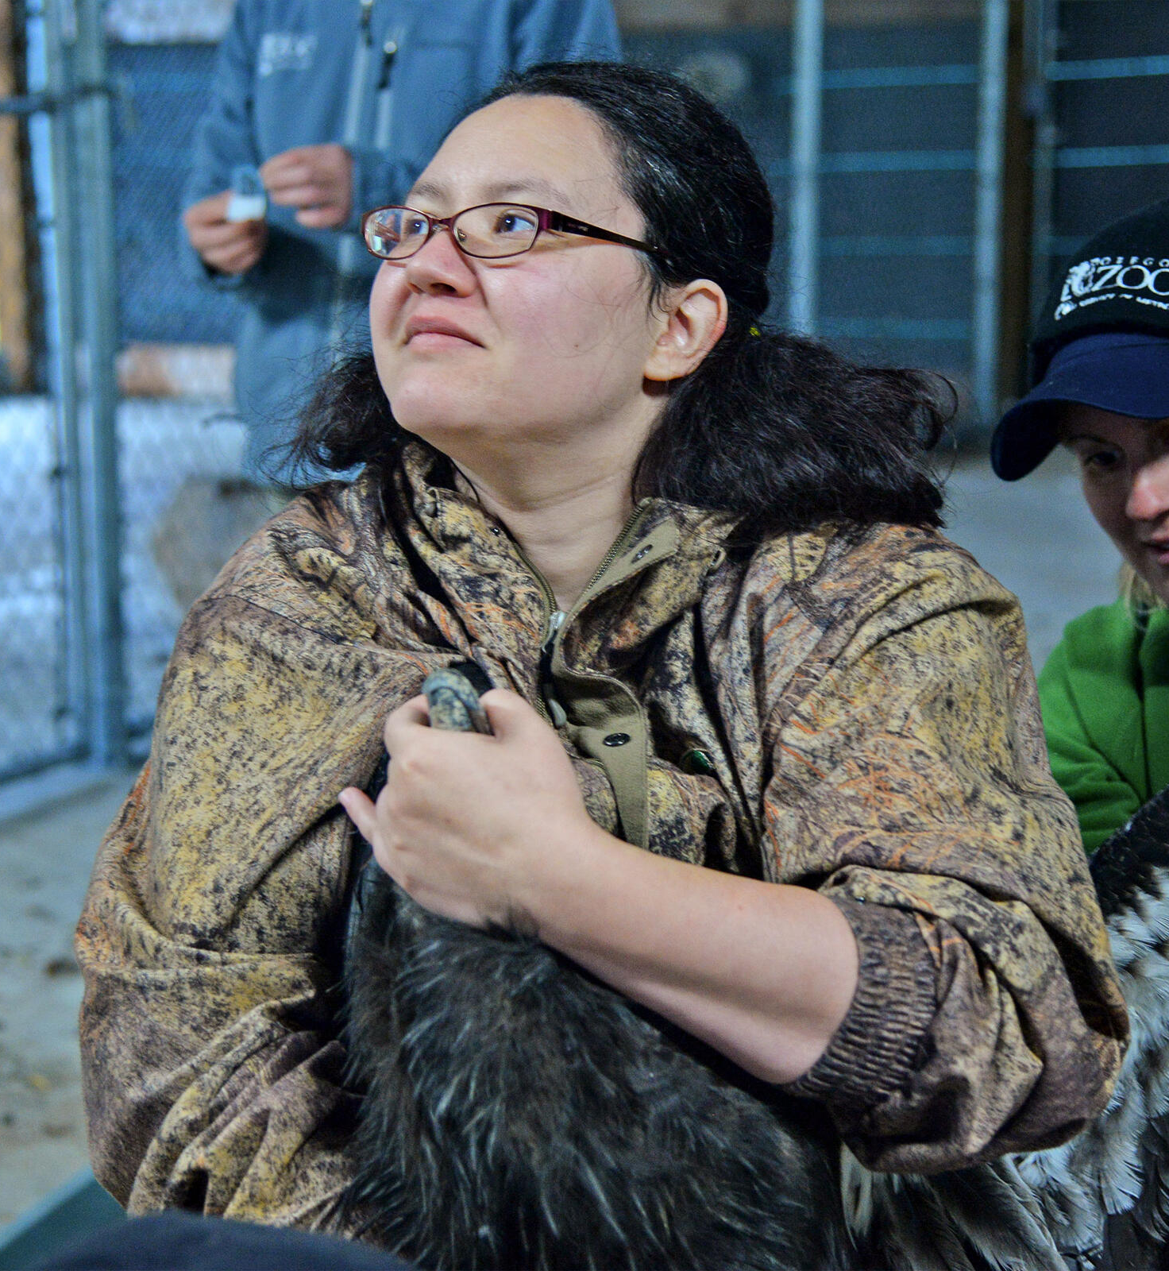
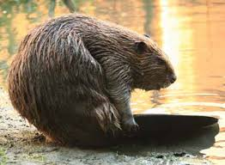
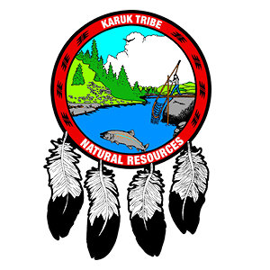
INDIGENOUS ENVIRONMENTAL JUSTICE
Kincentricity: life in any environment is viable only when humans view the life surrounding them as kin
Radical Relationality: restoring severed relationships between people, culture, and nonhuman beings
Martinez, McInturff, et al., in rev.
Notes:
I am working with indigenous people and indigenous scholars on a manuscript applying concepts that have emerged from indigenous EJ scholarship, including kincentricity and RR, to the management of cultural keystone species in California like beaver, elk, and condor
We’re also working on reseach that uses theories from Indigneous environmental justice to help improve intergovernmental coordination between the Karuk tribe and the Cal Dept. of Fish and Wildlife
With the co-op, I would be particularly interested in working with indigenous people in washington to extend these ideas to species like salmon
As well as to apply the lessons from this research to strengthen intergovernmental relations between tribal governments and wildlife agencies
This body of research is another where graduate student leadership can provide the new ideas and methods needed to understand these complex challenges

Slide 10
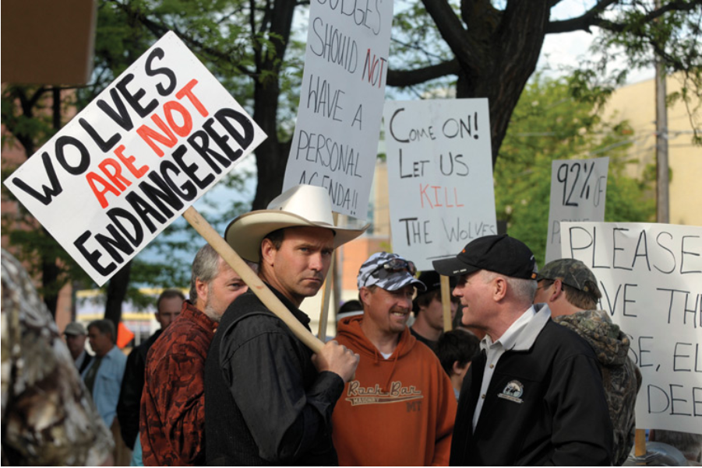
Affective Justice – whose risk perceptions matter?
Emotional impacts
Perceptions
Fear and oppression

