Slide 1
California’s Regulation of Motor Vehicle Tires Containing 6PPD
April 27, 2022
Anne-Cooper Doherty, PhD
Notes:
We are working to regulate 6PPD in motor vehicle tires. So want to go over a bit about how our process works, our justification for moving forward with 6PPD, and next steps.

Slide 2
The Safer Consumer Products Process
Create and maintain a menu of chemicals that we can choose from
Prioritize Product-Chemical combinations that may cause harm + Rulemaking
Manufacturer evaluation of alternatives
Wide range of possible actions
Notes:
Essentially regulate chemicals in consumer products.
Fairly lengthy process, on the order of years, but the goal is to avoid regrettable substitutes and encourage safer products.
Wide world of consumer products. Are excluded from regualting pesticides, prescription drugs, radioactive chemicals, natural toxins

Slide 3
SCP Process – Step 1
Menu of chemicals that we can choose from.
http://calsafer.dtsc.ca.gov
Notes:
Go to CalSAFER and show how can search for chemicals

Slide 4
SCP Process – Step 2
Prioritize Product-Chemical combinations that may cause harm + Rulemaking

Slide 5
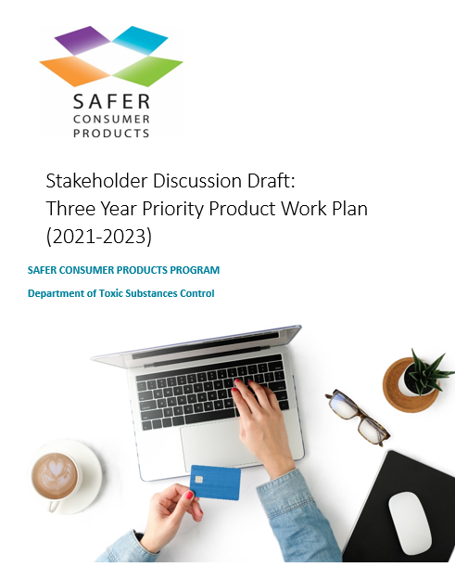
Scope of Products
Exclusions:
FIFRA pesticides
Prescription drugs
Radioactive chemicals
Natural toxins
Priority Product Work Plan = menu
of products
Released every 3 years
Work Plan website: https://dtsc.ca.gov/scp/priority-product-work-plan/
Notes:
PPWP – highlights categories that we will focus on for that three year period

Slide 6
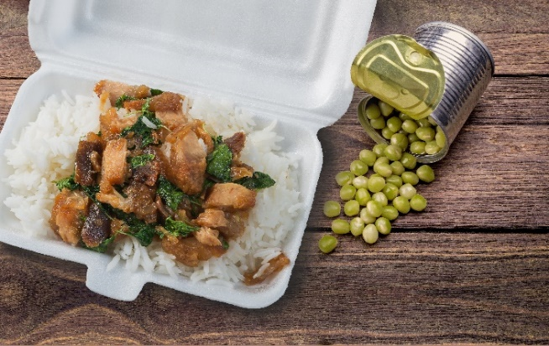
Priority Product Work Plan
Cleaning Products
Building Products and Materials Used in Construction and Renovation
Beauty, Personal Care, and Hygiene Products
Motor Vehicle Tires
Children’s Products
Food Packaging
Motor Vehicle Tires
Notes:
Identify product categories for next 3 years
Provide market signals
Engage stakeholders, gather data
Identify potential Priority Products
Continuing with BPCHP and CP because we’re still reviewing products, especially those with impacts to EJ communities.
We may research artificial turf, resources permitting.
Highlight children’s products category and why we decided to add it. (vulnerable developmental stage) – compelling, EJ issue; in our work we’ve kept finding products of especial concern due to exposure to children, hence we decided to add it; also, we now have also WA data. Different angle: gives us latitude and flexibility
Finally, we get the categories we propose including in the work plan.
Many of these are being carried over directly from the 2018-2020 Work Plan because of our ongoing work evaluating products in these categories.
We have proposed carrying over the Building Products and Materials Used in Construction and Renovation product category from the 2018-2020 Work Plan, and also expanding the scope of this category to include products or materials used in outdoor settings such as recreational fields, community centers, parks, playgrounds, stadiums, daycare centers, and schools. DTSC proposes expanding the scope of this category based on public comments we received regarding our proposed regulations to list Carpets and Rugs Containing Perfluoroalkyl or Polyfluoroalkyl Substances (PFASs) as a Priority Product. Many stakeholders have asked us to look specifically at artificial turf.
We also propose carrying over the Food Packaging category but we want to revise the definition slightly in order to provide further clarification to stakeholders regarding what products may be captured in this category.
We propose adding a new Children’s Product category. We propose adding this category because children below the age of twelve, and notably infants and toddlers, are especially susceptible to adverse impacts from exposures to hazardous chemicals.
We will also be adding a new Motor Vehicle Tires category. We are adding this category because we received a petition to add motor vehicle tires with zinc-containing tread to the Priority Products List. After evaluation of that petition we have decided to grant the petition. Therefore Motor Vehicle Tires is one of the product categories we will further evaluate to identify potential Priority Products during the 2021 – 2023 Work Plan cycle.

Slide 7
Priority Product Prioritization Process
Evaluate chemicals in the context of products.
Consider the potential for:
Exposure to the chemical from the product
Significant or widespread harm from that exposure
Narrative standard
Work Plan website: https://dtsc.ca.gov/scp/priority-product-work-plan/

Slide 8
The Product-Chemical Prioritization Process – 6PPD
Screening + Public Engagement
Profile Research + Writing
Pre-Rulemaking Workshop
Propose Priority Product
Refine Profile/ESPR
Initiate Rulemaking
Notes:
The Product-Chemical Prioritization process is actually a number of smaller steps, starting from initial screening and public engagement on a topic, through proposing a Priority Product, and finally the initiation of rulemaking.
For motor vehicle tires containing 6PPD, we have proposed a Priority Product and released our draft product-chemical profile. We are currently holding our pre-rulemaking workshop. After this workshop, the next steps will include external scientific peer review, and initiation of rulemaking.

Slide 9
Making the Case for motor vehicle tires containing 6PPD

Slide 10
Potential for Exposure to 6PPD, 6PPD-Quinone from Tires
Used in presumably all tires
High rates of release of tire wear particles containing 6PPD, 6PPD-quinone to the aquatic environment
End-of-life applications may further contribute
Detections of 6PPD-quinone in California runoff and waterways

Slide 11
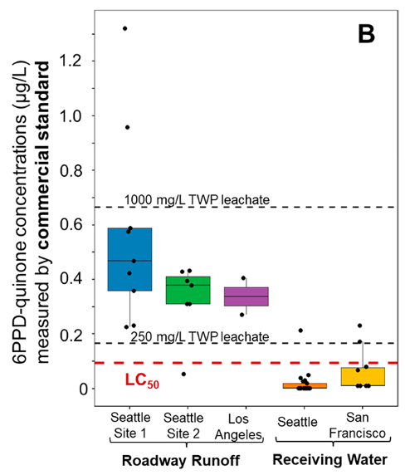
Potential for Significant Adverse Impacts
6PPD toxic at multiple trophic levels
6PPD-quinone acutely toxic to coho, an endangered species, at a variety of life stages
Environmental detections of 6PPD-quinone in California above the LC₅₀
Impacts to California’s Native American tribes
Tian et al. (2022)
Notes:
- Environmental detections of 6PPD-quinone in California are above the LC50, as evidenced by the box and whisker plot to the right, from Tian et al. The plots for roadway runoff from Los Angeles and receiving water from San Francisco are circled.
Interestingly, of the sites were there were detections of 6PPD-quinone in San Francisco, the highest detection was actually a creek whose watershed was 90% open space, but the sampling point was located near a heavily trafficked road.
Tribes:
Loss of core traditional food sources tied to loss of culture, increased physical and mental health issues, poverty
Tribal and state investment in retaining and replenishing coho populations

Slide 12
Next Steps: RULEMAKING
Timing:
Initiating process soon, begin public comment period
DTSC then finalizes regulations
Must be completed within 1 year
Anticipate regulations going into effect early 2023
Priority Product Notifications due 60 days after effective date
Preliminary AA due 180 days after effective date

Slide 13
Next Steps: Alternatives Analysis
A comparison of the Priority Product and alternatives
Drop-in replacements, product redesign, exposure reductions, etc.
Goal of the process is to avoid regrettable substitutions
Requires evaluation of ecological and life cycle impacts as well as economic impacts
Includes consideration of performance requirements

Slide 14
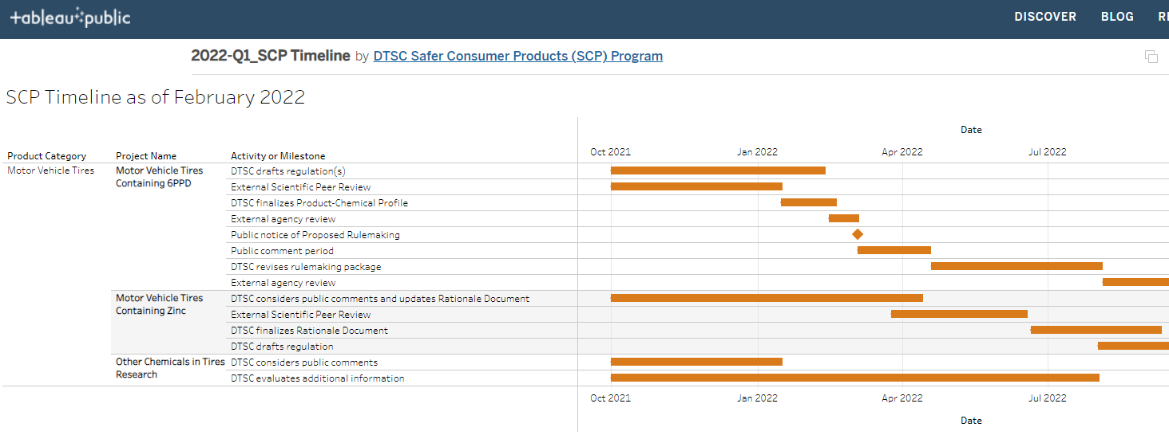
SCP Timeline
https://dtsc.ca.gov/scp

Slide 15
Thank you!
Anne-Cooper Doherty
AnneCooper.Doherty@dtsc.ca.gov

