Slide 1
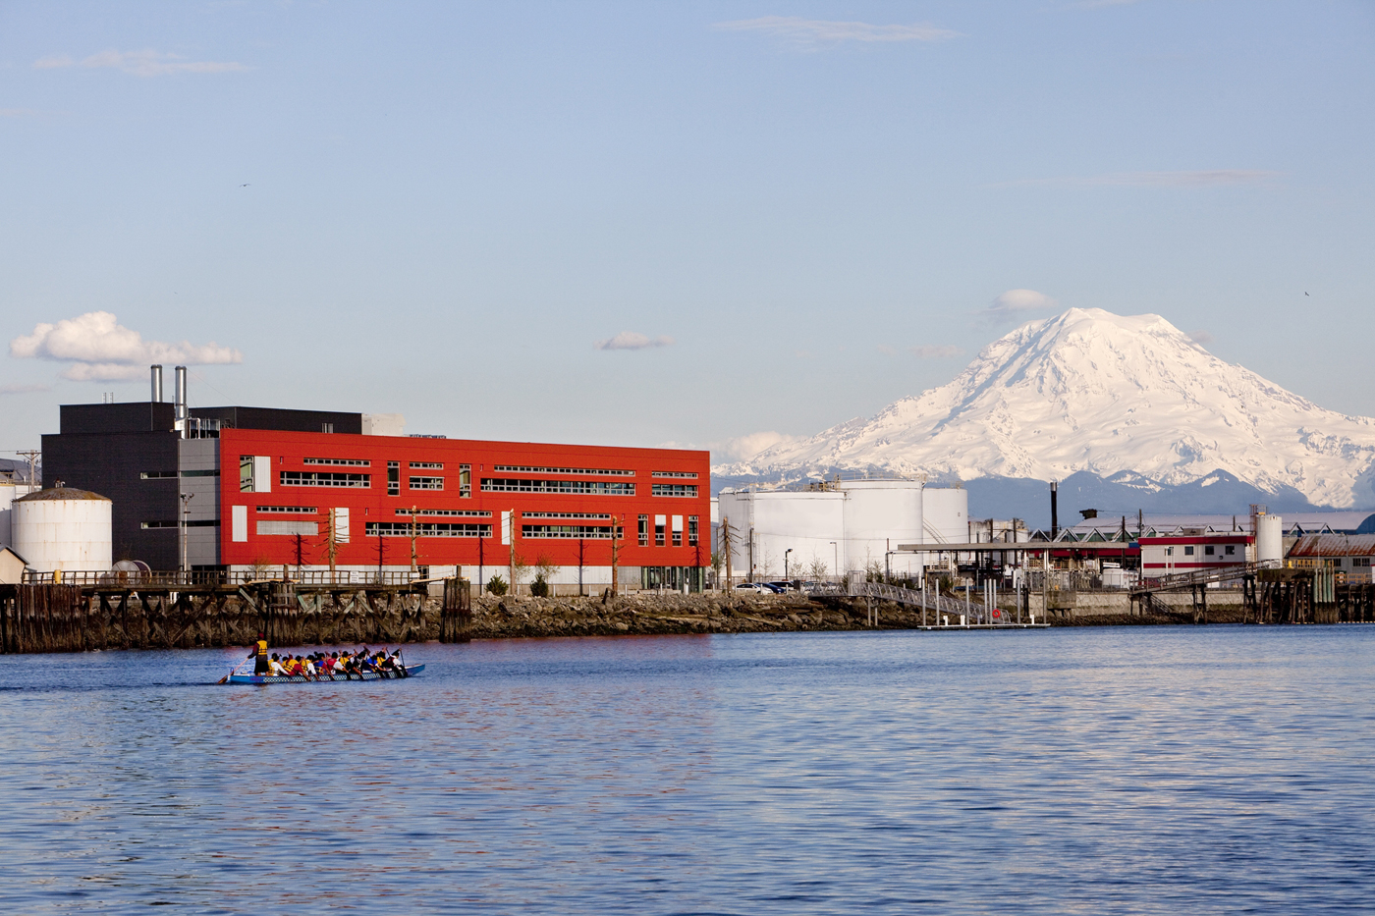


Occurrence and Fate of 6PPD-Quninone
in Urban Receiving Waters
Edward P. Kolodziej,
Center for Urban Waters Research Group,
and various awesome collaborators

Slide 2
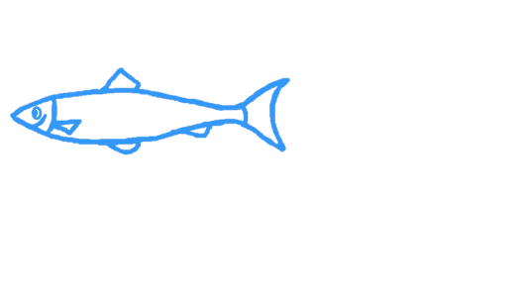
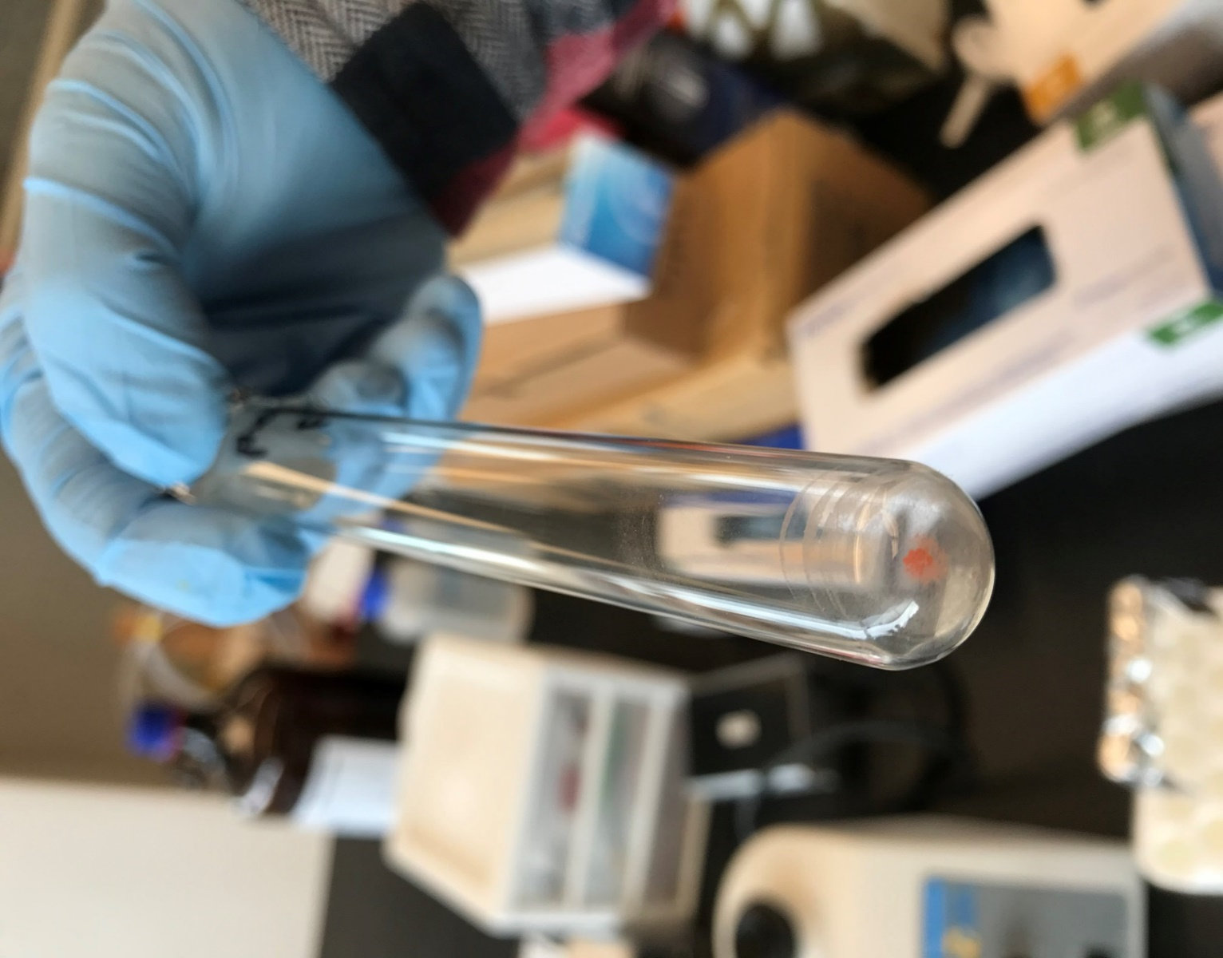
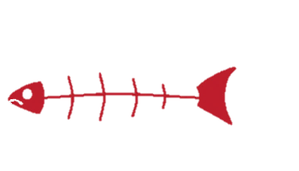



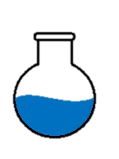

Finding a Toxic Chemical..
+Control: TWP leachate, 27 exposures, 135 coho, 98.5% mortality
-Control: Solvent and Exposure water blanks, 125 coho, 0% mortality
Safe
Lethal
TWP
leachate
Hex : DCM
H₂O : EtOH
H₂O
3:0
RT (min)
5-6
H₂O : EtOH
EtOH
2:1
.
.
RT (min)
H₂O : EtOH
UPLC-HRMS ESI+ Detections (#)
.
1:2
.
5-6
RT (min)
EA
10-11
.
.
.
5-6
0:3
.
.
.
.
.
.
CEX →
XAD-2
14-15
10-11
8-9
.
.
Silica gel
.
.
HPLC
C18
.
.
14-15
.
.
HPLC
PFP
14-15
(Tian et al. 2021 SCI)
HPLC Phenyl
Toxicant Fractionation Scheme

Slide 3
Tire leachate
6PPD ozonation
x10
5
C18 H22 N2 O2, ESI+
11.010
6
5
4
Abundance
3
11.004
2
1
0
1
2
3
4
5
6
7
8
9
10
11
12
13
14
15
16
17
18
19
20
21
22
Retention Time (min)
x10
3
1.6
1.4
1.2
1
0.8
0.6
0.4
0.2

Slide 4
Commercial 6PPDQ Standard Comparison
(Tian et al., 2022)
We lost mass in CUW in-house standard
Exact reason still unknown (redox or polymerization?)

Slide 5
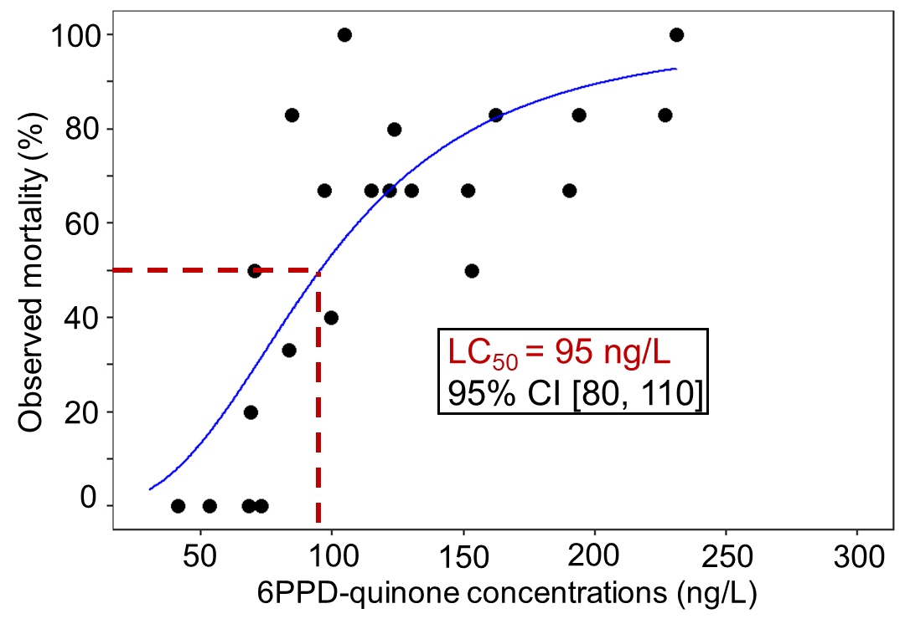
6PPD-Quinone Revised LC₅₀ Value
Tian et al., 2022
-Juvenile coho salmon, triplicate exposure, N=129
-Lower LC₅₀ with HPC standard: 95 ng/L VS 790 ng/L

Slide 6

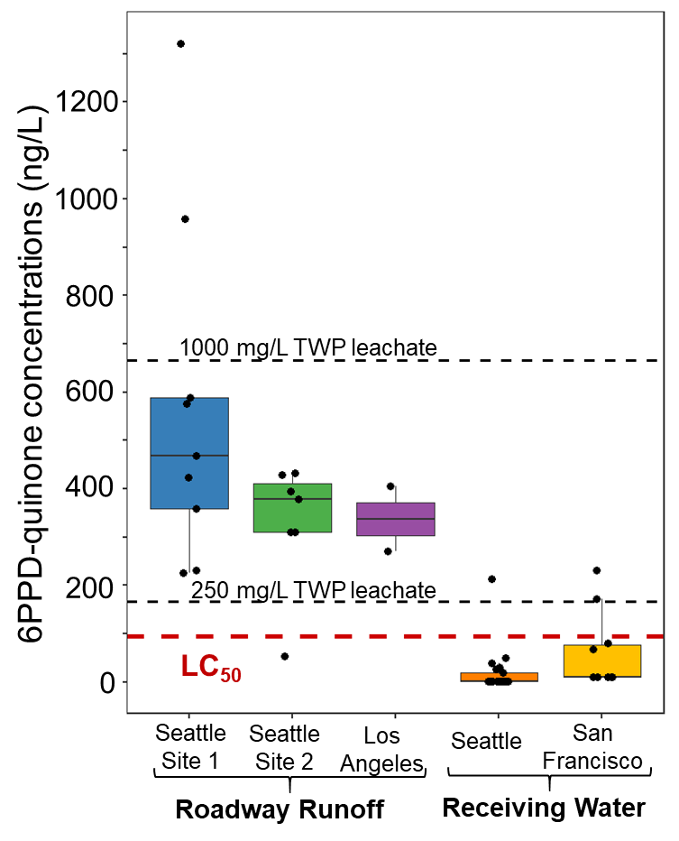
Environmental Relevance-Revised LC50
Detected in 18/18 road runoff, nearly all above LC₅₀ value
Detected in 6/7 creeks sampled during URMS events, concentrations near and above LC₅₀
Detected in Seattle, Los Angeles, San Francisco samples
(Tian et al. 2021/2022)

Slide 7
6PPD-Quinone Toxicity Estimates
Note some bad chemistry data here..
We have relatively little knowledge of quinones as pollutants
6PPDQ is especially toxic to salmonids
 |  |  | Non-lethal | LC50 (95% CL)
Common Name | Species | Time (h) | µg/L | µg/L | Reference
Coho | O. kisutch | 24 |  | 0.10 (0.08-0.11) | Tian et al. 2022
Brook trout | S. fontinalis | 24 |  | 0.59 (0.49-0.63) | Brinkmannet al. 2022
Rainbow trout | O. mykiss | 24 |  | 1.00 (0.95-1.05) | Brinkmannet al. 2022
Zebrafish | D. rerio | 24 |  | 308.7 (258.3-368.9) | Varshney et al. 2021
White sturgeon | A. transmontanus | 96 | >12.7 |  | Brinkmannet al. 2022
Artcic char | S. alpines | 96 | >12.7 |  | Brinkmannet al. 2022
Medaka | O. latipes | 96 | >34 |  | Hiki et al. 2021
Daphnia | D. magna | 48 | >46 |  | Hiki et al. 2021
Amphipod | H. azteca | 96 | >43 |  | Hiki et al. 2021
Zebrafish | D. rerio | 96 | >54 |  | Hiki et al. 2021
Notes:
In the past year additional species have been tested for acute toxicity from 6PPD-Q
Whereas many species tested did not have an acute lethal response, two more salmonid species were found to be acutely sensitive: brook trout and rainbow trout
Coho still most sensitive tested.

Slide 8
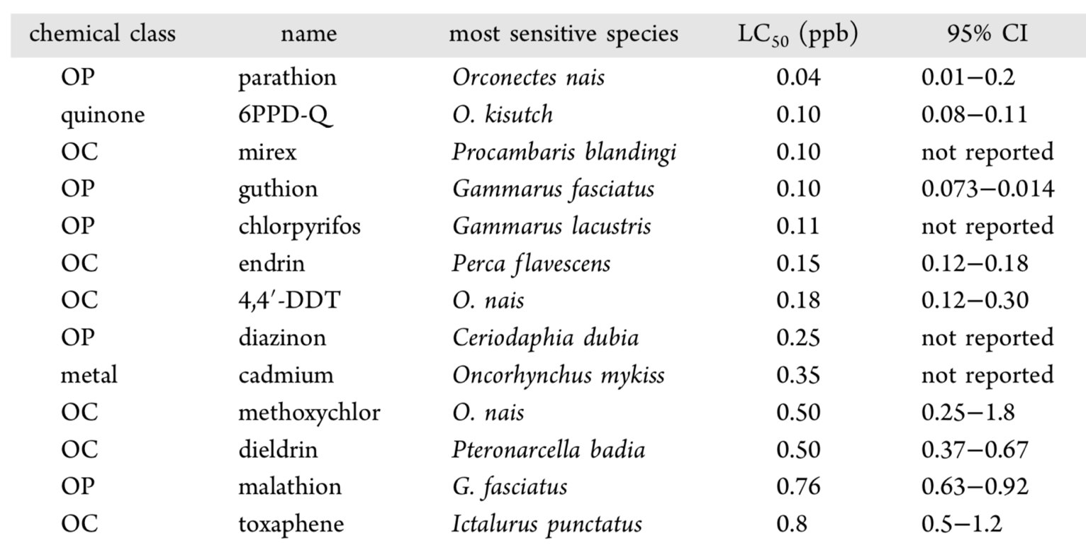
Relative 6PPD-Quinone Toxicity
6PPD-quinone is among the most toxic chemicals known for aquatic organisms (top 5-6 or so..)
(Tian et al. 2022 ES&T Letters)
Notes:
So 6PPD-quinone is very toxic to coho. How toxic is it relative to other toxic chemicals?
I went through the chemicals for which EPA has established aquatic life criteria - these are concentrations in water meant to protect aquatic species
These are usually based on the average LC50 for the 4 most sensitive species tested.
If coho end up being the most sensitive species for 6PPD-quinone, I wanted to compare them to the most sensitive species that was tested for other chemicals.
So I went to the data that was used to set the ALC and extracted the most sensitive species tested.
I’m showing data for chemicals with a LC50 < 1 ug/L, and here is our value for 6PPD-Q.
The other chemicals are nearly all organophosphate or organochlorine pesticides (neurotoxic mode of action).
And Q is among the most toxic chemicals that we know if for AL

Slide 9
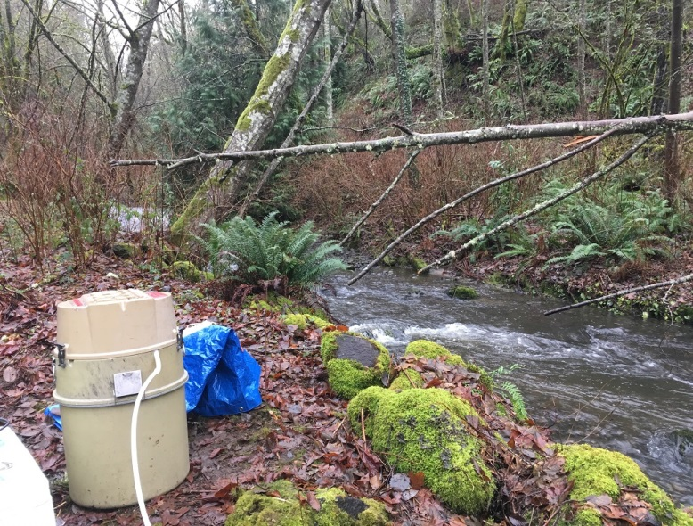
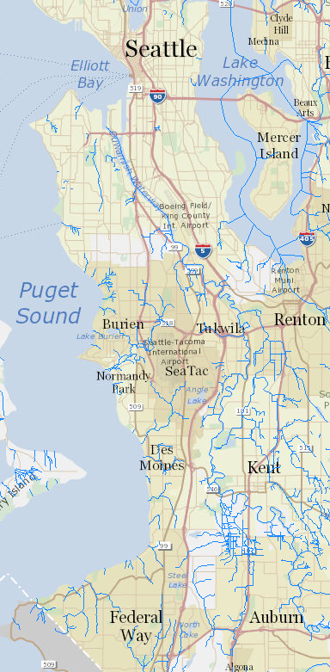
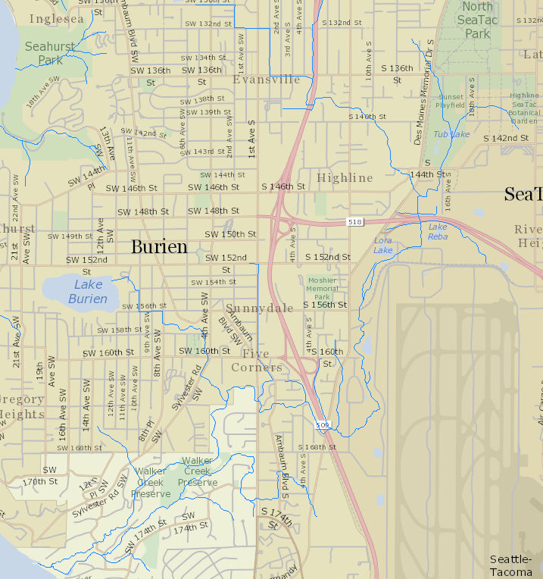
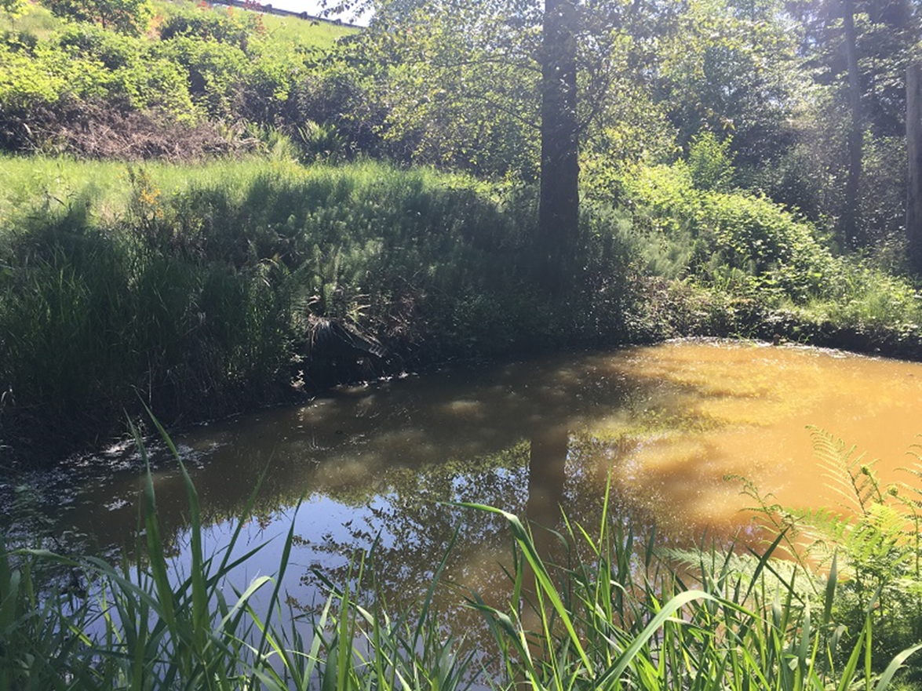
How Do We Protect Our Salmon??
Where are the hotspots
that need treatment??
1
2
42b
42h
42N
42M
4up; 4down
5
42AA
42j
7
6
3up
42a
3down
8mw; 8m
Sampling site
Active gauge
Miller Creek Watershed, Burien WA

Slide 10
When Do Peak Concentrations Occur??
-No significant difference between fall and spring
  (all concentrations, Wilcoxon rank-sum test, p = 0.36)
-Implication for spring rains: unnoticed impact?

Slide 11
When Do Peak Concentrations Occur??
Miller Creek, WA
Fall 2021
LC50
LC25
10/21/21
10/27/21
11/03/21
11/11/21
11/18/21
Most events would kill significant proportions of fish
Notes:
Peak concentrations of Q for each of those events, were near or above concentrations expected to kill coho – Here I have overlain the median lethal concentration (LC50) as well as the LC25 - expected to kill 25% of coho.
And we know from previous work that lethal concentrations don’t have to be exceeded for very long in order to result in mortality

Slide 12
6PPDQ Dynamics in Urban Creeks
Miller Creek, WA
Oct 21, 2021
Nov 18, 2021
6PPD
Discharge
LC50
Discharge
LC50
6PPDQ
6PPDQ
6PPDQ
6PPD
6PPDQ: lethal levels for a few hrs, long tails in 10s of ng/L
(6PPD concentration estimates are semi-quantitative)

Slide 13
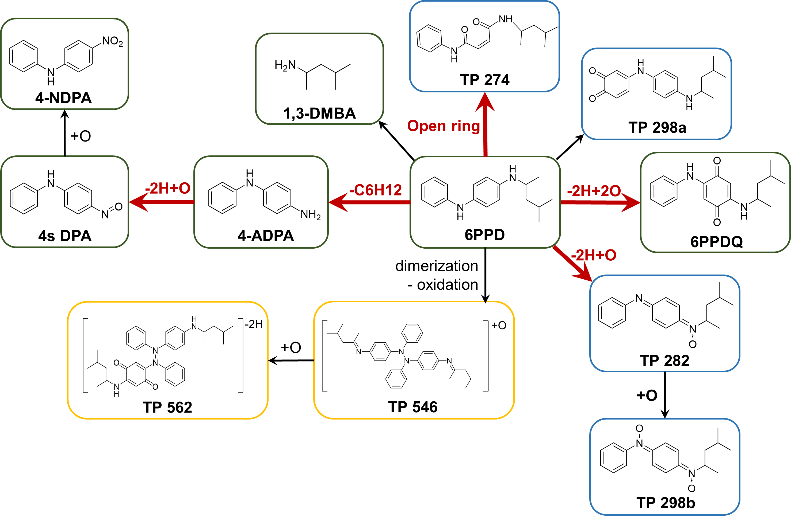
Other 6PPD Ozonation Products
Level 1
Level 2
Level 3
-25 TPs identified
-5 confirmed with standards, 4 with likely structures (level 2)
Zhao et al., in preparation

Slide 14
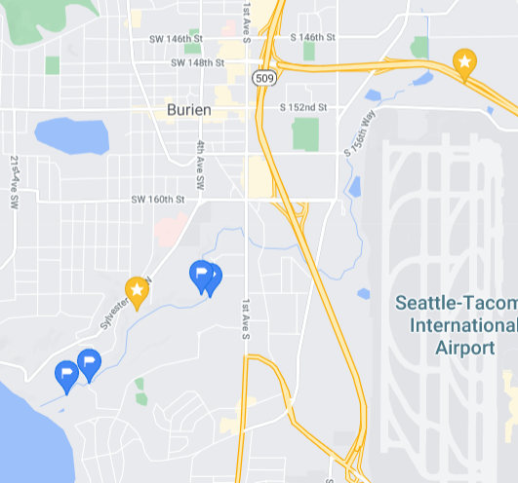
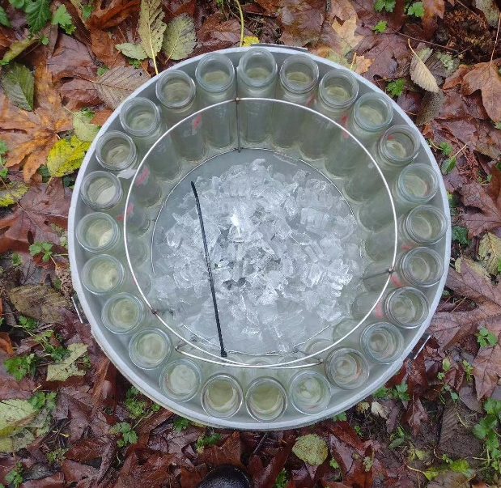
6PPD Ozonation Products in Urban Creeks
Miller Creek (URMS site)
Discharge
6PPDQ
Oct 21, 2021
24-hr ISCO sampling
1,3-DMBA
Discharge
4s DPA
Zhao et al., in preparation

Slide 15

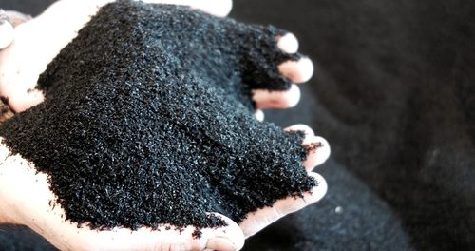
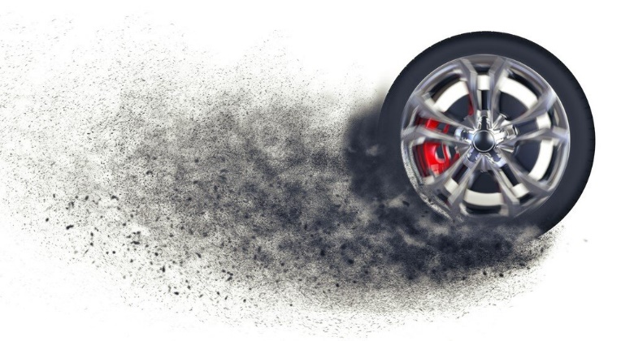
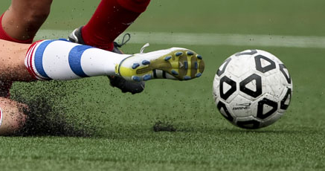
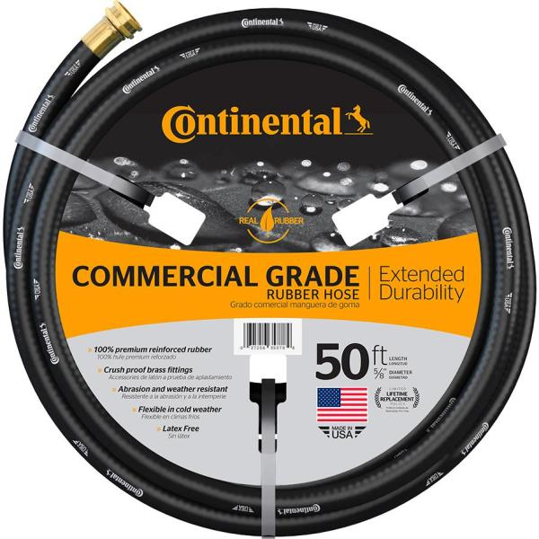
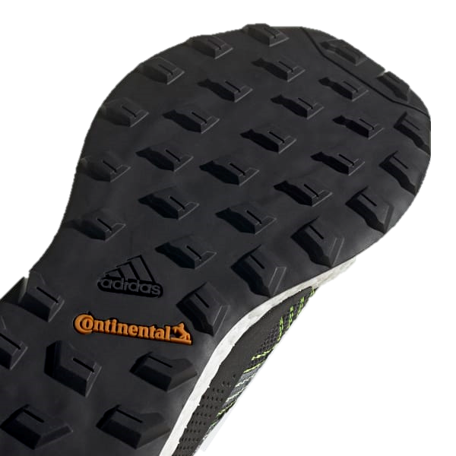
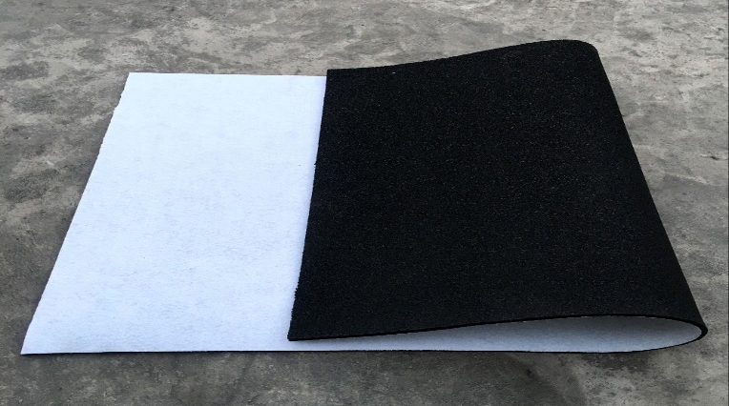
Other Rubber Products, Other PPD Antioxidants
6PPD
Occurrence of many PPD TPs and PPD quinones?

Slide 16
Recent References for Technical Details
Quantitative LC/MS/MS method, current 6PPDQ toxicity value
Tian et al. ES&T Letters 2022, 9 (2) 140-146.
6PPD mass balance, 6PPDQ yield, other 6PPD-ozone products
Hu et al. ES&T Letters 2022, Research ASAP

