Slide 1
Makah Tribe First Foods Climate Resilience Plan
Salish Sea Ecosystem Conference
April 28, 2022
John Reamer*, Natalie Lowell*, Haley Kennard, Carol Reamer, Morgan Goodrich, Janine Ledford, Rebekah Monette, Laura Nelson, Melissa Poe, Jenna Rolf, Isabell Ides, & Chazley Brown

Slide 2
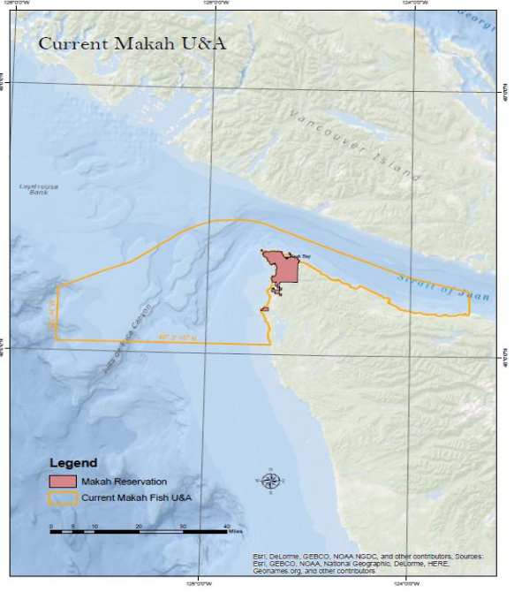
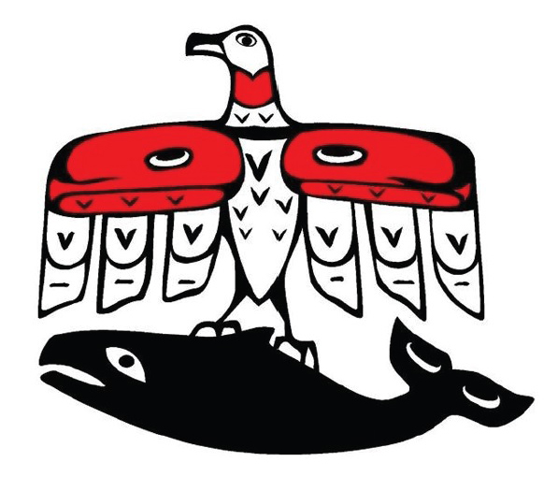
Makah Indian Tribe
Qᵂidicca?a’tx = “People of the Cape”
Nuu-Chah-Nulth
Inextricable dependence on ocean
1855 Treaty of Neah Bay
Reserved the right to retain our cultural identity based on our spiritual values
Ceded 300K acres of land for clearer treaty access to the ocean & it’s resources
Hunt, gather, fish, whale, seal within Usual and Accustomed areas

Slide 3
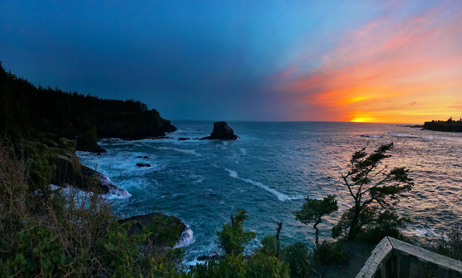
Project Goals
Develop First Foods Climate Resilience Plan rooted in knowledge of Makah community
Assess climate risk to First Foods
Gather community priorities in many ways, including conversations with community members and through a survey
Pilot strategies

Slide 4
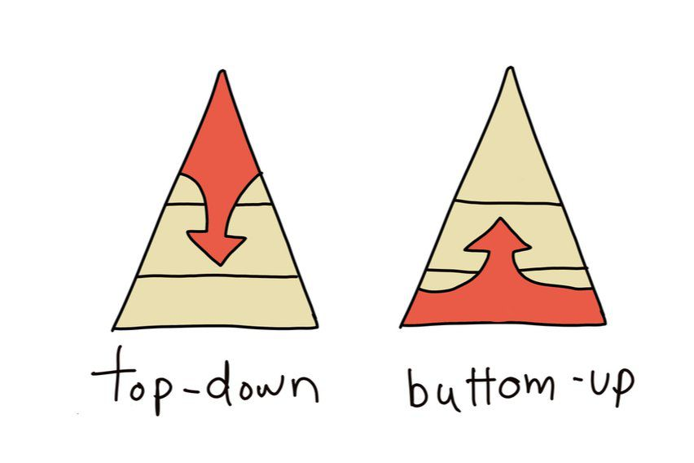
Community priorities
Top-down
Bottom-up
Community priorities are the starting point for our climate resilience work

Slide 5
Makah Climate Strategy
2015-2018
Makah community engagement & climate impacts assessment
2019
Makah climate resilience plan created
2021-Today
Climate resilience in food sovereignty
2018-Today
Vulnerability assessment to ocean change on Olympic Coast (WA Sea Grant)
2018-Today
Makah community engagement & equity in climate planning
2015
Today

Slide 6
Informal community engagement
We gathered feedback through
staff meetings held on food sovereignty
conversations with community members
piloting strategies and evaluating

Slide 7
Community survey: methods
Survey questions on
Use of First Foods
Accessibility of First Foods
Climate impacts to First Foods
Desired resilience strategies and programs
Survey data coded using First Foods framework
Data analyzed by individual team members then as group

Slide 8
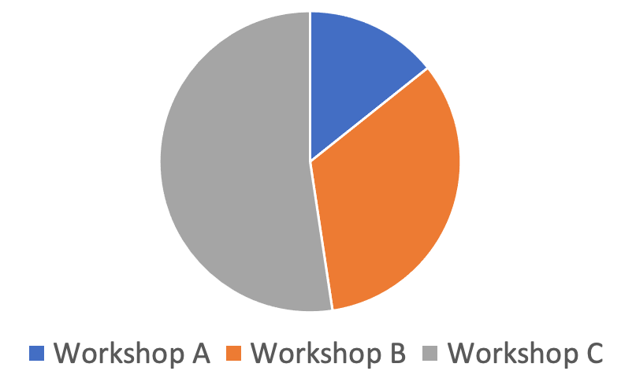
Community survey: preliminary results
From our results, we learned
What kinds of First Foods workshops the community wants
Demographics behind varying interests
Which First Foods harvest most affected by climate impacts
Context: pandemic & heat wave

Slide 9
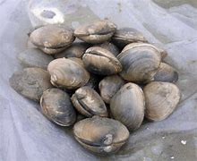
Community engagement through food sharing
Makah First Foods group hosted community clam chowder feed
Clams were locally harvested
Informational displays regarding foods of cultural and economical importance
Surveys given to gauge community interests

Slide 10
Ground truthing the strategies
Draft plan
Test strategies
Final plan
Test draft plan strategies
Gather community input and evaluate turnout and engagement
Refine strategies and finalize plan

Slide 11
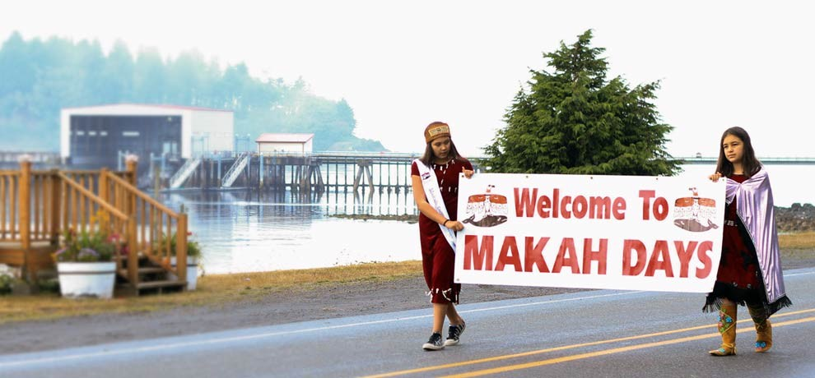
Thank you & acknowledgements
Makah community participants
Food Sovereignty Working Group
Makah Office of Marine Affairs
Sophie Trettevick Indian Health Center Makah Wellness Center
Makah Cultural & Research Center
Washington Sea Grant
Bureau of Indian Affairs

