Slide 1
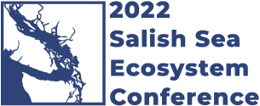

Boundary spanning in support of ecosystem-based management
Tessa Francis, PhD
Puget Sound Institute, UW Tacoma

Slide 2
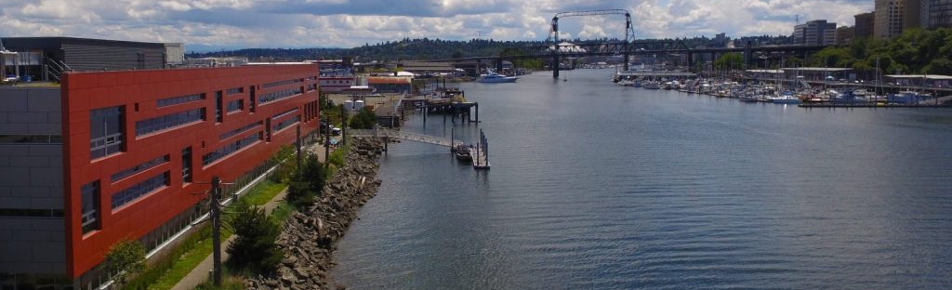
Thanks to my co-authors
Andy James
Joel Baker
Nick Georgiadis
Aimee Kinney
Caitlin Magel
Jeff Rice
Tanya Roberts
Christopher Wright

Slide 3

Linking science to management doesn’t happen by accident
Notes:
It also doesn’t happen simply because research is applied, with the “potential” to influence management. And it doesn’t happen either because the researchers gave gotten really really good at hashtag scicomm, though communicating science clearly is hugely helpful in the uptake of ideas and information and increasing literacy in the public and decision makers. But actually linking research to decisions, so that decisions are based on science & research, occurs through intentional, iterative, and in the best case scenario, facilitated engagement between decision makers and/or practitioners, and researchers or knowledge holders. And connecting these groups to actuate this engagement is boundary spanning. And groups who do this are boundary spanning organizations.

Slide 4
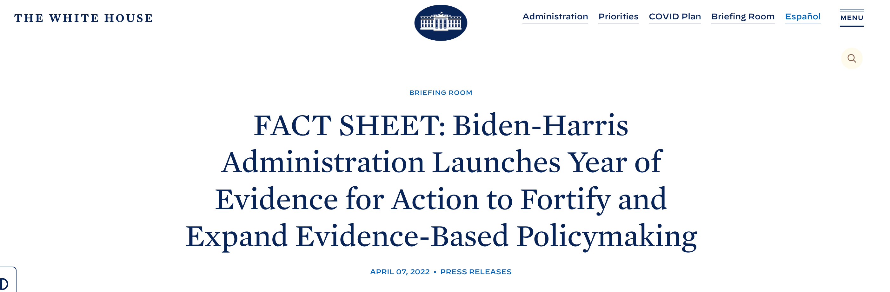
“Evidence for action” is trending
“YEA!”

Slide 5
Enabling the use of research
Increase efficiency by which research results are
tailored for decisions
Increase legitimacy and robustness of research results
Increase potential for durable decision processes
Capitalize on policy opportunities
Bednarek et al. 2018
Notes:
And it turns out that enabling the use of research is the specific function of boundary spanners, of boundary spanning organizations. And Angela Bednarek laid out 4 primary values that boundary spanners provide, and they are [LIST]
I’m here representing one specific BSO, the Puget Sound Institute (though I also help run the Ocean Modeling Forum, which is another BSO), and am going to offer a brief illustration of a BSO in action in the context of estuarine recovery.

Slide 6
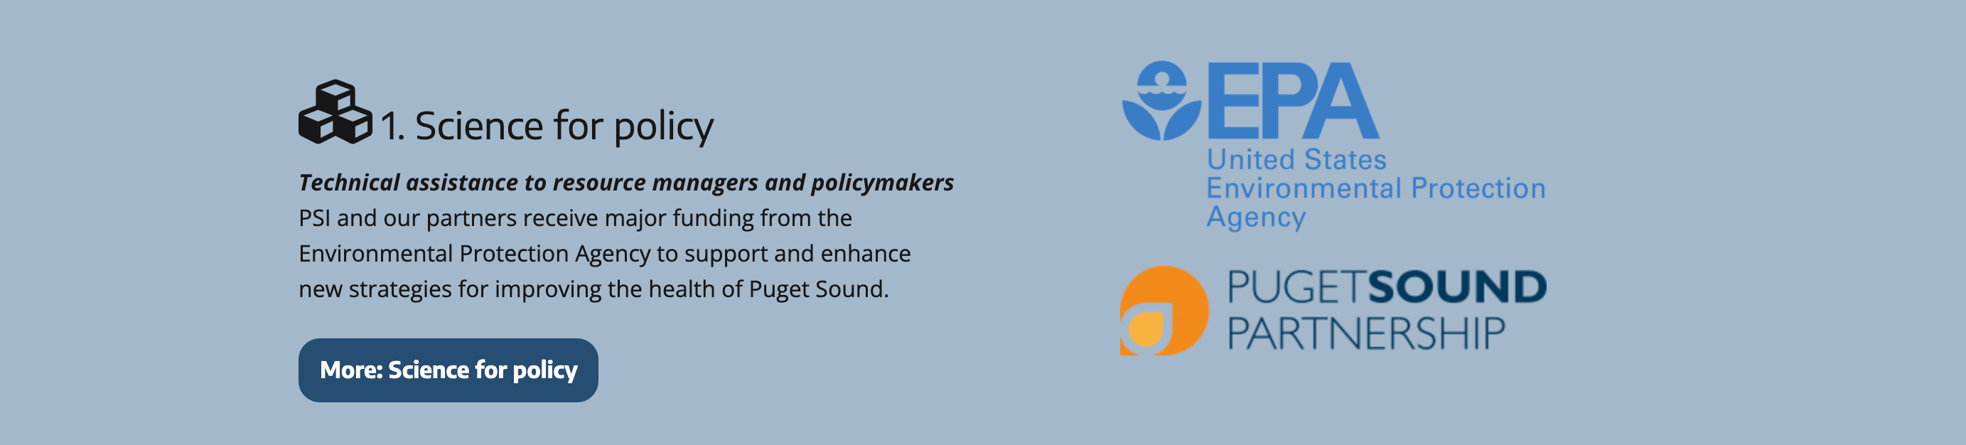
The Puget Sound Institute
Notes:
The Puget Sound Institute, or PSI, is housed at the UW Tacoma, and funded by EPA’s National Estuary Program which is coordinated by the PSP. One of our main activities is to help connect science to policy.
And I’m going to briefly illustrate that for you using the example of how PSI links research results to decision-making in the development of recovery strategies.

Slide 7
The Puget Sound Recovery Ecosystem
PSP
Science Panel
PSP
PSEMP
Communication
Implementation Strategies
Encyclopedia of Puget Sound
Salish Sea Currents
General Public
Implementing Organizations
Grant Program Syntheses
Technical Foundations
Research & Monitoring Priorities
Lawmakers
Funding & Planning Organizations
Researchers & Analysts
Boundary Object:
Tool to represent and transfer information across institutional and practical boundaries
Policy Development
Lawmakers
EPA National Estuary Program

Slide 8
Boundary object type 1: technical knowledge foundations at the interface between research & implementation/funding
Implementers
Researchers & Analysts
Grant Program Syntheses
Synthesis & analysis of past NEP grants
Recovery Strategy Technical Foundation
State of Knowledge
Base Program Analysis
Funders
Planners
Marine & Nearshore
Watersheds
Pathogens
Shoreline Armoring
BIBI
Toxics in Fish
Marine Water Quality
Boundary Object:
Tool to represent and transfer information across institutional and practical boundaries
Notes:
So the first example of an interface across which PSI has developed boundary objects to operate is the interface between Researchers/Analysts, i.e., science and technical information and the implementers, planners, and funders who are responsible for designing and implementing recovery strategies, or ISs.
And two types of BOs I’ll highlight are NEP Grant Program Syntheses, and Recovery Strategy Technical Foundations.
Syntheses are.. Examples include…
Technical foundations are… examples include…
Recall that a boundary object is…
OK so what value is being brought to this system by developing these boundary objects?

Slide 9
The value of boundary spanning
Increase efficiency by which research results are
tailored for decisions
Increase legitimacy and robustness of research results
Increase potential for durable decision processes
Capitalize on policy opportunities
Best practices identified in the Watershed Synthesis were adopted by the Strategic Initiative
New information was incorporated into the Shoreline Armoring Implementation Strategy
Notes:
And I’ll return to this list of values provided by boundary spanning activities

Slide 10
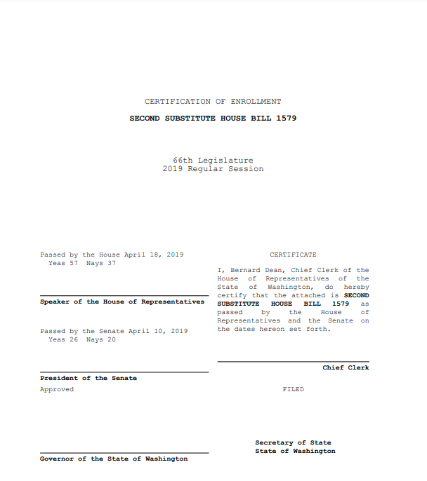
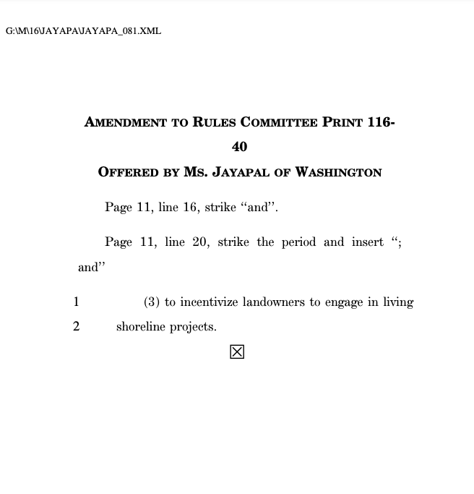
Boundary object type 2: technical knowledge foundations at the interface between research & lawmaking
Lawmakers
Researchers & Analysts
Grant Program Syntheses
Synthesis & analysis of past NEP grants
Recovery Strategy Technical Foundation
State of Knowledge
Base Program Analysis
Encyclopedia of Puget Sound
Salish Sea Currents
Marine & Nearshore grant program
Shoreline Armoring
Notes:
These boundary objects also operate at a second interface, between Researchers/Analysts and Lawmakers, during the process of policy development
Important to remember that these syntheses and analyses are conducted specifically to inform decisions going forward; that is their raison d’etre
OK so major finding of the Synthesis that subsequently was in the BPA was that there was a need for better enforcement of shoreline armor permits as a way to reduce armor this recommendation carried forward into bills passed in 2019 in the shadow of Tahlequah carrying her dead calf around for weeks, and resulted in additional agency funding for reinforcement.
A second recommendation to provide loans as incentives to remove armor was included in a Federal bill.

Slide 11
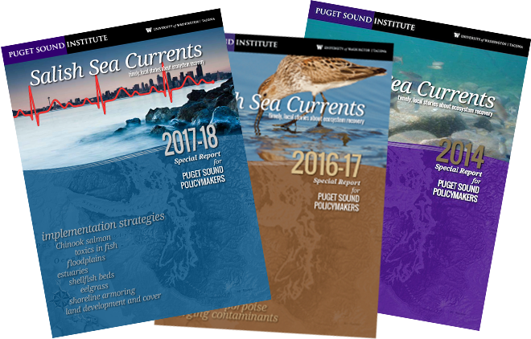
Boundary object type 3: communications at the interface between research and the general public/lawmakers
General Public
Grant Program Syntheses
Synthesis & analysis of past NEP grants
Recovery Strategy Technical Foundation
State of Knowledge
Base Program Analysis
Encyclopedia of Puget Sound
Salish Sea Currents
Lawmakers
Researchers & Analysts
Marine & Nearshore grant program
Shoreline Armoring
Notes:
And the final part of this story actually takes us to another interface and a third set of boundary objects
Through the EOPS and SS Currents, technical information is translated for a broad general audience, increasing accessibility and notice, bridging the gap between research/analysis on the one hand and the general public/lawmakers on the other. And so, for example, the recommendations contained in these technical documents were featured in stories and blog posts, and it was through these vehicles that the opportunity to incorporate those recommendations into federal legislation came.

Slide 12
The value of boundary spanning
Increase efficiency by which research results are
tailored for decisions
Increase legitimacy and robustness of research results
Increase potential for durable decision processes
Capitalize on policy opportunities
Best practices identified in the Watershed Synthesis were adopted by the Strategic Initiative
Research and monitoring priorities are co-produced with implementers, planners, funders.
New information was incorporated into the Shoreline Armoring Implementation Strategy
Action-ready recommendations in Base Program Analysis were used in legislation.

Slide 13
The Puget Sound Recovery Ecosystem
PSP
Science Panel
PSP
PSEMP
Communication
Implementation Strategies
General Public
Implementing Organizations
Lawmakers
Funding & Planning Organizations
Researchers & Analysts
Policy Development
Lawmakers
EPA National Estuary Program
Notes:
And I’ll just finish by returning to this slide to reflect on the fact that this is really an ecosystem of multiple communities engaged in multiple activities all moving towards the same goal, within this complex EBM system. This creates multiple interfaces and requires a suite of boundary objects to bridge the gaps between those communities. This is unique. Also unique is the framework or scaffolding upon which all these activities hang, which is the NEP and specifically the Implementation Strategy framework that brings together these different communities in these spheres of activity. This creates the space within which the Puget Sound Institute can work and be effective. That framework certainly is flawed and can be adapted and improved, but it also has its bright moments.
Thanks.

Slide 14
Thank you!
tessa@uw.edu
@tessafrancis

