Slide 1
Culturally-Inclusive Community Outreach Approaches
April 28th, 2022
Eunbi Lee
Public Health—Seattle & King County

Slide 2
Poverty Bay Shellfish Protection District
Notes:
What? Enhancing awareness of fecal pollution problem
Who? Korean community in Poverty Bay
Why? Water quality degradation

Slide 3
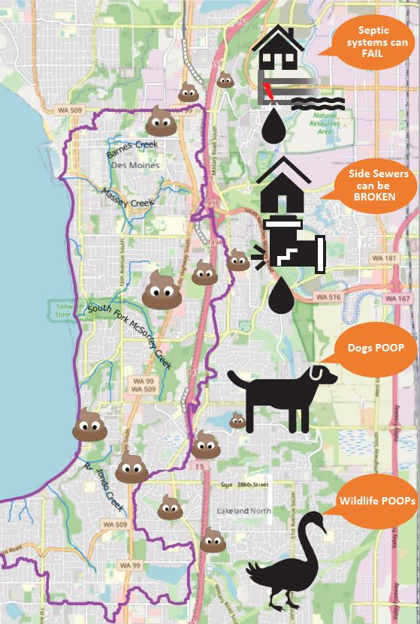
Pollution Identification and Correction (PIC) program
Problem
“conditionally approved”
Actions
Septic System maintenance
Scoop the Poop!
Notes:
In 2016, Department of Health downgraded the water quality status of 125 acres of Poverty Bay from Approved to Conditionally Approved for commercial shellfish harvesting. This meant that we needed to take an action to make sure pollution sources are identified and corrected, which culminated into the PIC program led by DNRP. Since then, we have monitored the water quality in five streams that flow into the shoreline, identified failing septic systems that may have adverse implication to the water quality, and various education and outreach programs to control pollution sources from various poop kinds.

Slide 4
Spanish-speaking population 10.0%
Korean-speaking population
7.4%
Vietnamese-speaking population
4.9%
Diverse Community
Census Tract, King County, 2006-2010, King County GIS Center
Notes:
Why focus on Korean community?
-one of the largest spots where Korean community is well developed with industry, social services, …

Slide 5
Steps of Culturally Inclusive Outreach
1. Know the culture
2. Plan diverse approaches
Create community value
3. Connect services

Slide 6
Step 1. Know the Korean culture
“Korean-speaking respondents were relatively more concerned about the health of the water in Poverty Bay rather than how it affects our use of water (e.g., recreational water use).”
Poverty Bay Community Survey, 2022
Notes:
More than 1 reasons, 0 responded “no concerns”.
Food is important!
The results of English-speaking respondents vary from Korean-speaking respondents since they were mostly concerned about the health of marine plants and animals as well as the safety of water recreational activities, and some people were not concerned about the polluted water in Poverty Bay (2%). Such difference in responses shows that some cultural groups, Korean-speaking respondents were relatively more concerned about the health of the water in Poverty Bay rather than how it affects our use of water (e.g., recreational water use). This indicates that there is a general understanding that clean water is important for a community’s health.

Slide 7
Step 2. Plan diverse approaches
Diversified communication
Translation
Physical connection
Youth, Family, Elderly

Slide 8
Translation vs Transcreation
Translation
Linguistic exchange
Written format
Direct transfer
Transcreation
Cultural consideration
Images, Events, “Being”
Soaking in
Notes:
Food
Family
Chuseok around Halloween, Thanksgiving

Slide 9
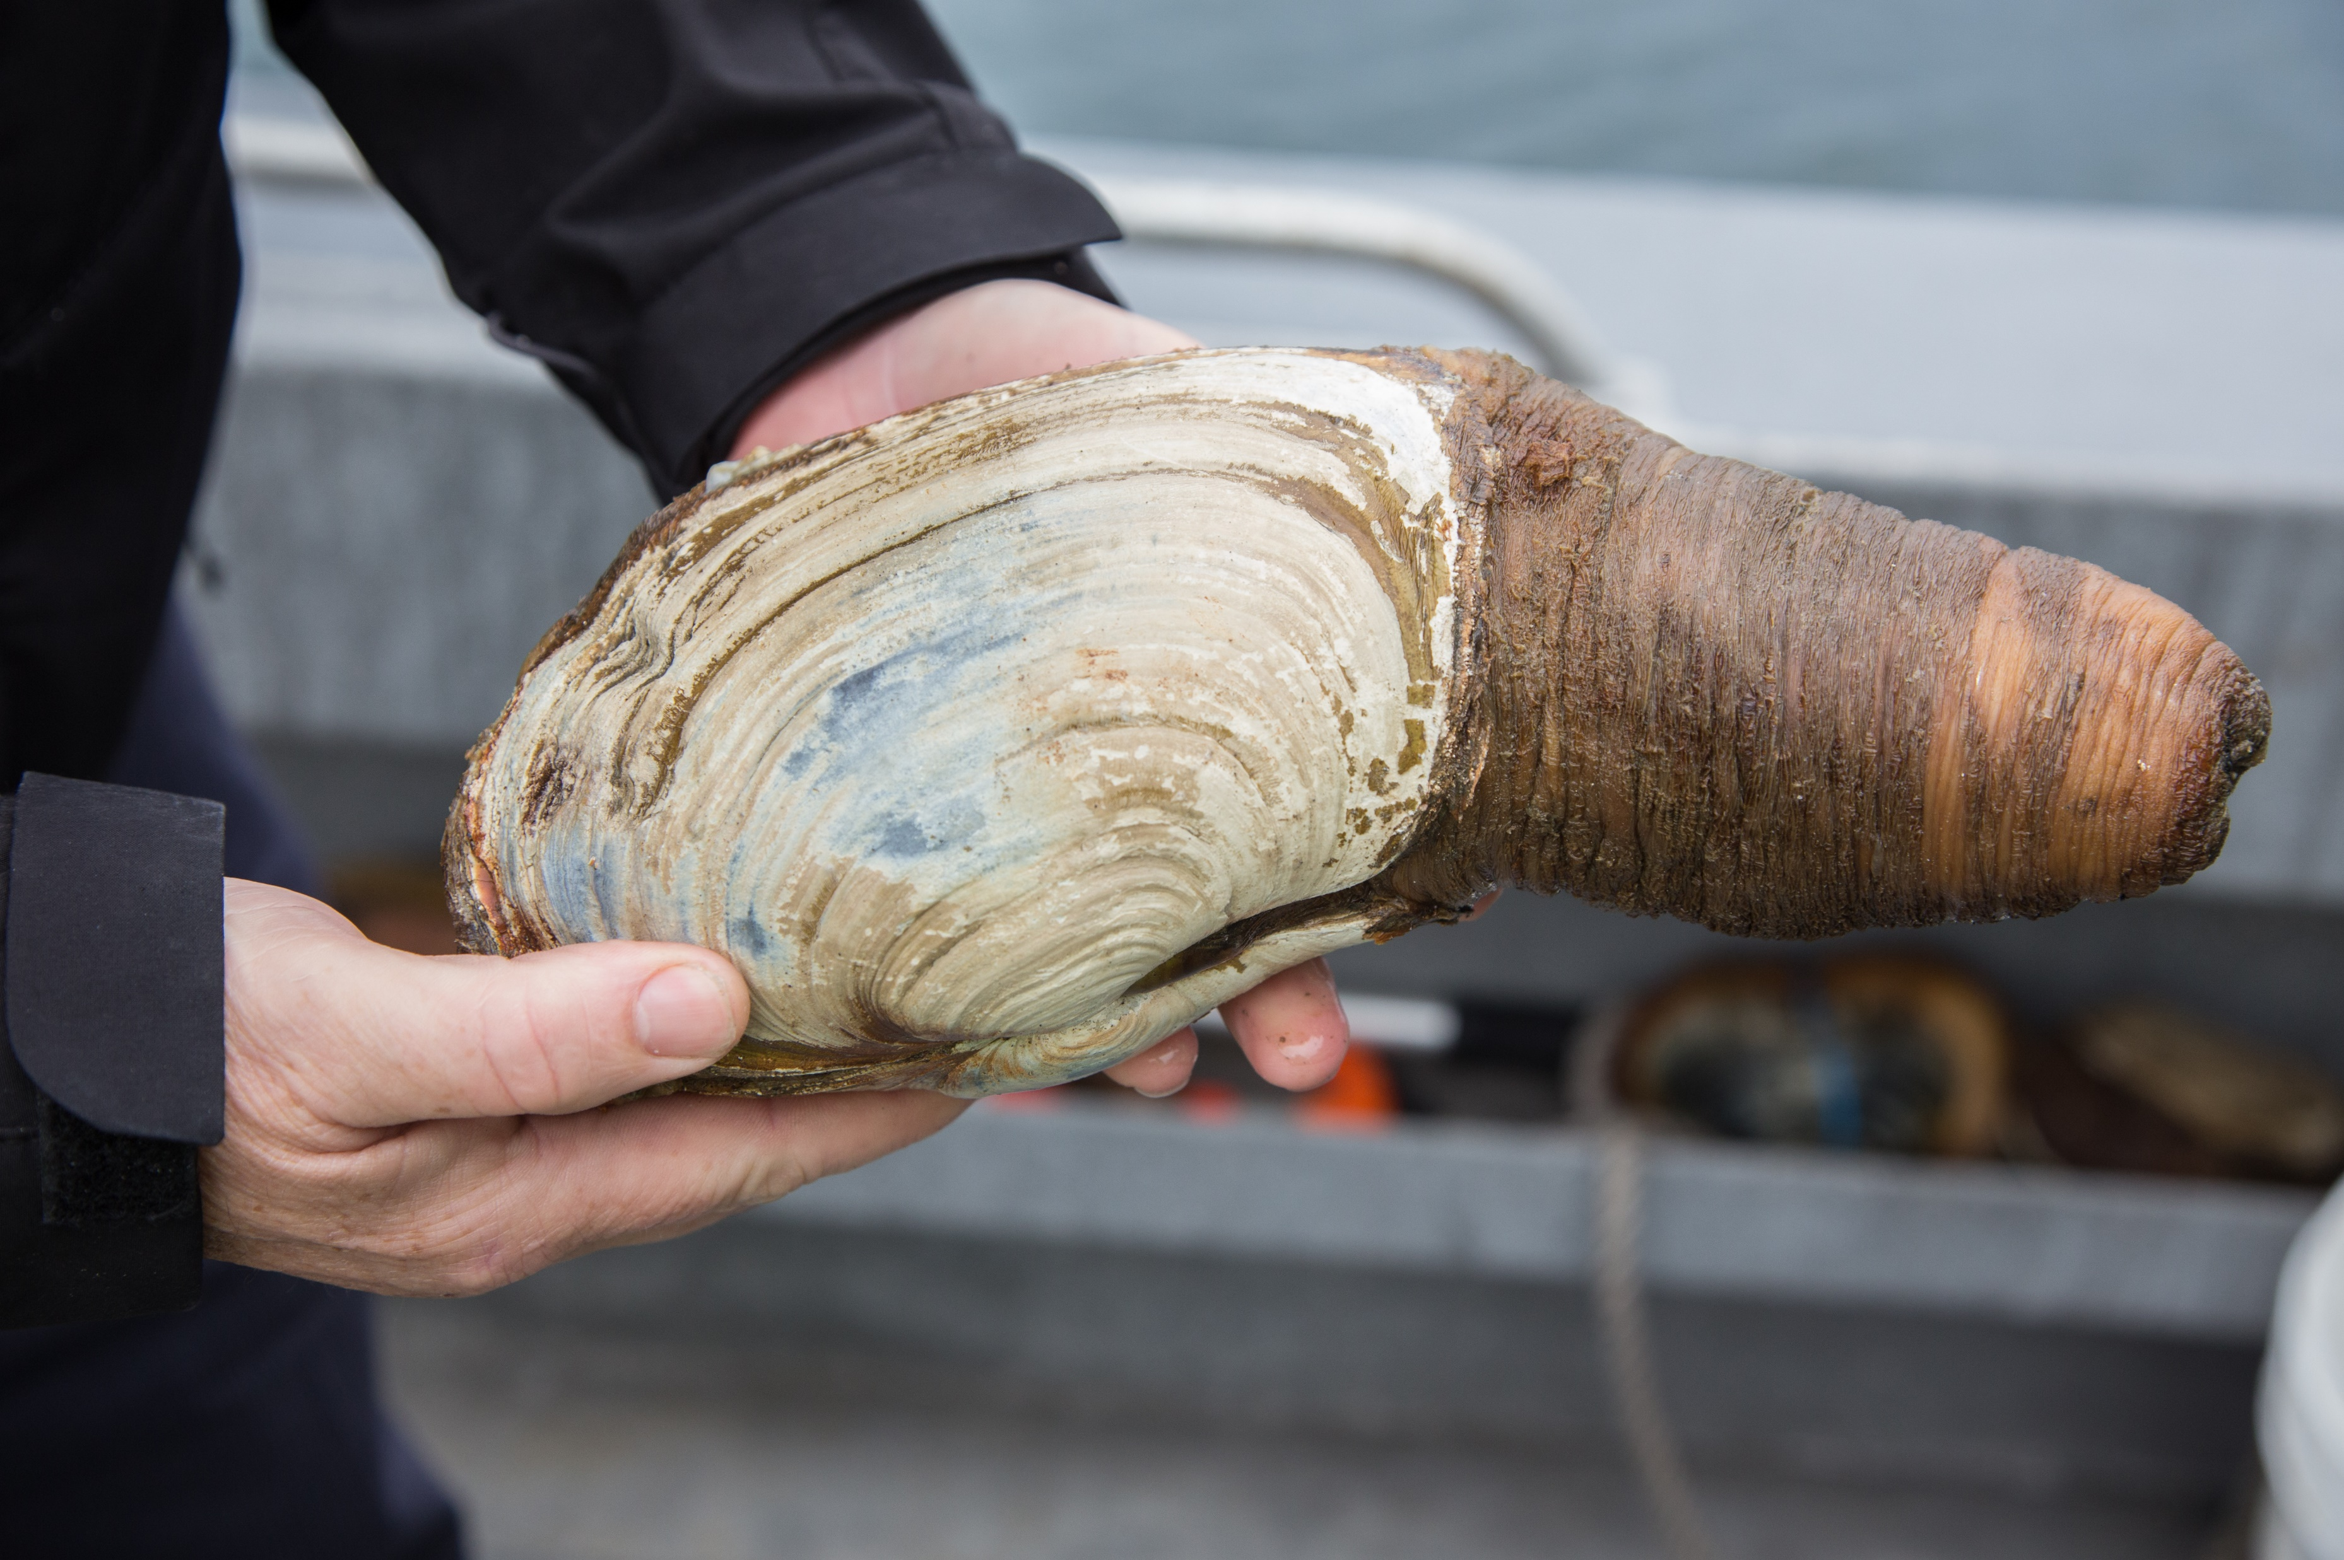
Transcreation aims to speak to the audience!
For Foodies? I can be attractive!
Poverty Bay, DNRP

Slide 10
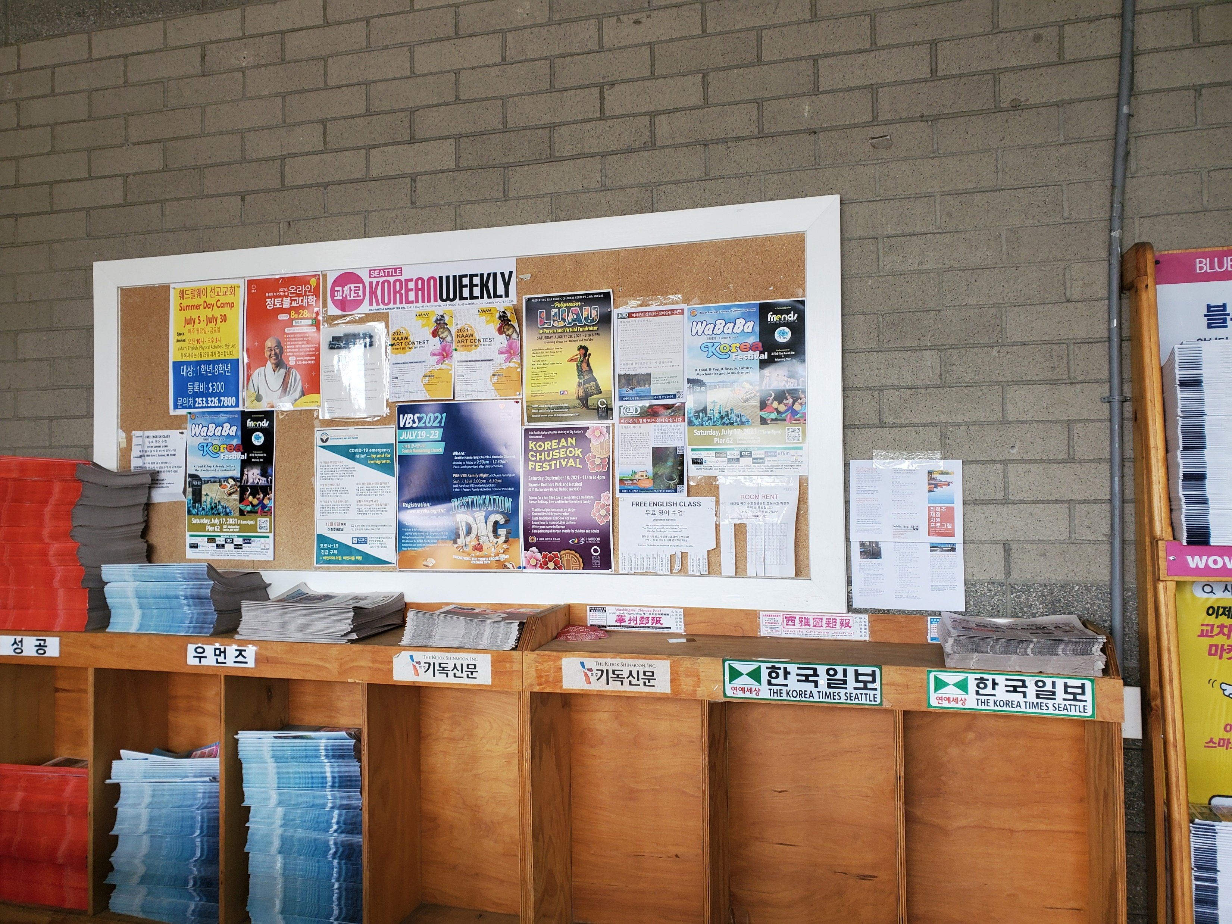
Build relationships by visiting
H-mart
Korean Women’s Association
Churches

Slide 11
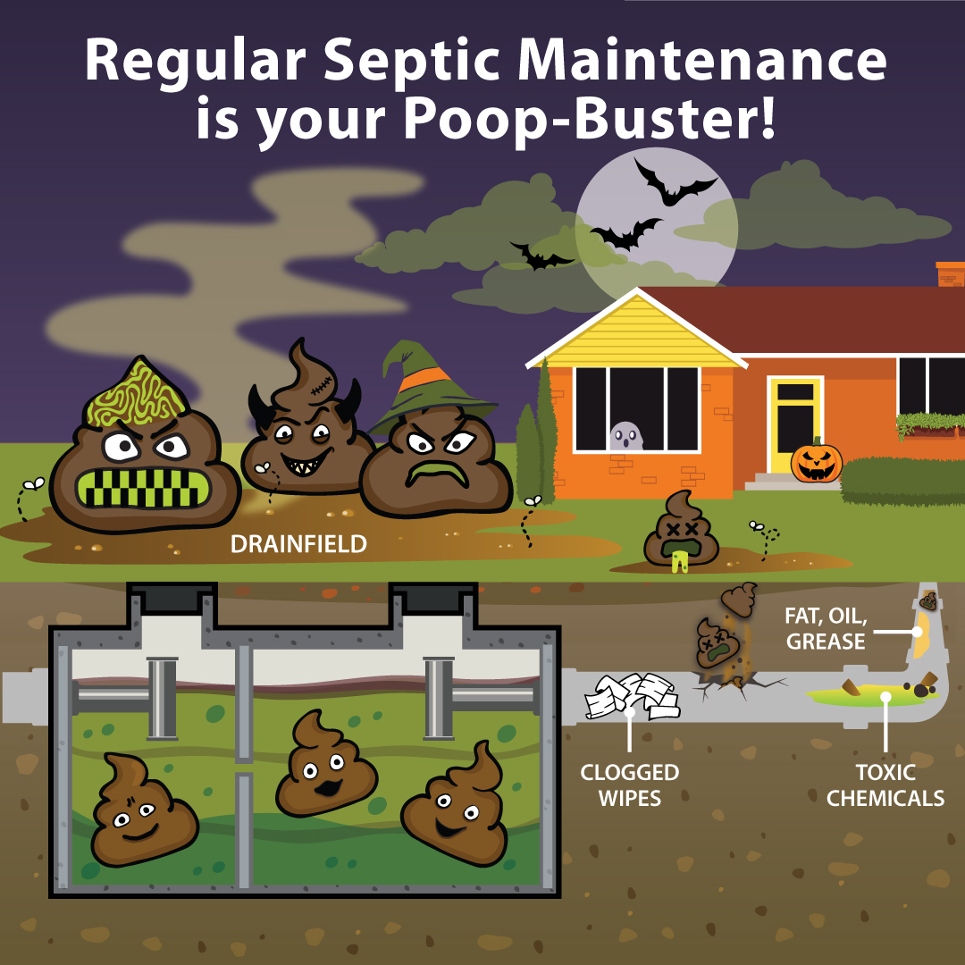
Message for youth, family, and elderly
“Halloween speaks to the Korean families and youth!”
-Interview with KWA staff
“My grandchild will like this because it is cute”
-During a small group discussion with a Japanese-speaking elderly, Federal Way Senior Center
Notes:
2021 Fall Septic Maintenance message includes this Halloween-themed graphic where angry poop from a failing septic system are ponding as raw sewage in our backyard, because of all the “flushable” wipes, toxic chemicals in the pipes as well as noncompliance to regular septic system inspection. People in Poverty Bay Shellfish Protection District qualify for a maintenance rebate, which is run by King Conservation District, and I was updated that there was a spike of 169 viewers on October 27th when this flyer went out via social media posting in Facebook, Instagram, twitter, and nextdoor. Given the average 5-15 daily views of the rebate application website visit, this shows the instant impact and the power of wordspreading through social media in this urban region. This was especially powerful as our posting connected wide range of government, jurisdiction agencies, as well as local non-profit organizations and community leaders who hold positions in different committees.
-fall messaging flyers developed with help of PIC group here for the idea and rigorous support from Mary Rabourn
-last sa
250 people received the flyer
-

Slide 12
Step 3. Connect services
Social Services (KWA)
Industry (H-mart)
Value in Water
Community Leader
Realtor
Information Center
Notes:
Realtor: septic owner
Information center: library
Community leader: senior center volunteer

Slide 13
Thank you!
Eunbi Lee
Educator Consultant
eulee@kingcounty.gov
This project has been funded wholly or in part by the United States Environmental Protection Agency under assistance agreement PC-01J18001 to the Washington State Department of Health. The contents of this document do not necessarily reflect the views and policies of the Environmental Protection Agency, nor does mention of trade names or commercial products constitute endorsement or recommendation for use.

