Slide 1
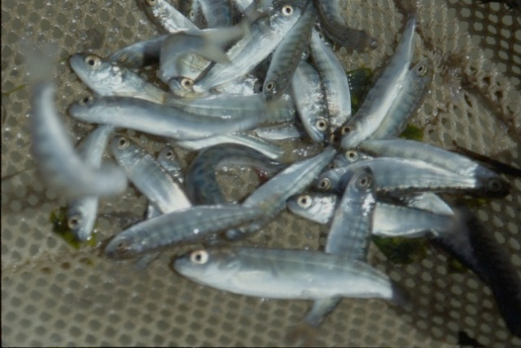
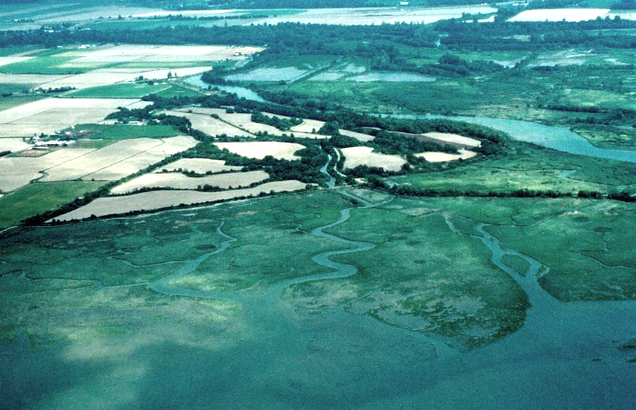
Density-dependent habitat limitations for juvenile Chinook salmon in large river deltas of Puget Sound
Correigh Greene and Joshua Chamberlin
Eric Beamer and W. Gregory Hood (Skagit River System Cooperative)
Joseph Anderson (Washington Department of Fish and Wildlife)
Chris Ellings and Sayre Hodgson (Nisqually Tribe)
Matthew Pouley and Todd Zackey (Tulalip Tribes)
Notes:
I’d like to follow Mike’s talk with a broader perspective on density dependence in Puget Sound, and it’s a collaborative effort of biologists from the Science Center, WDFW, and several Puget Sound tribes.
I’d like to thank my coauthors….

Slide 2
Acknowledgements
Funding
Estuary and Salmon Restoration Program (ESRP)
Salish Sea Marine Survival Project
City of Bellingham
Department of Ecology: Skagit IMW
Technical review
ESRP, Skagit River System Cooperative, Upper Skagit Tribe, Tulalip Tribes, Nisqually Tribe, NW Indian Fisheries Commission, WDFW, USGS
Notes:
As well as a number of funding agencies that made this work possible
In addition, a whole bunch of people helped review this document, which will shortly be available on ESRP’s website.

Slide 3
Chinook salmon and estuary restoration
Tidal wetland loss > 70-99% in Puget Sound
Many large restoration efforts
Key assumption for restoring Chinook salmon: restoration is increasing capacity
Are large river deltas actually surpassing capacity?

Slide 4
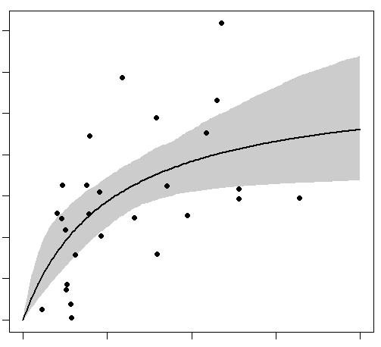
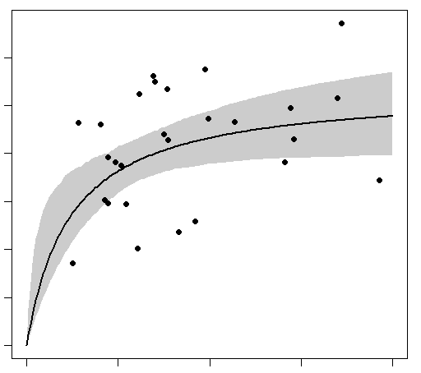
Evidence for density-dependent limitations: Skagit River delta
Cumulative fry in delta (1000s/ha)
0 10 20 30
0 200 400 600
Adult returns (1000s)
0 2 4 6 8
0 2 4 6 8
Migrant fry (millions)
Subyearling migrants (millions)
(Fry + parr)

Slide 5
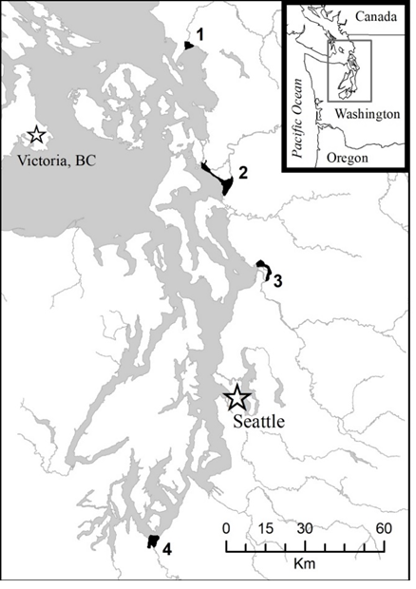
General questions
Are there systematic density-dependent patterns in abundance in the four deltas?
Under what conditions are high densities observed?
What are the applications to salmon restoration and recovery?

Slide 6
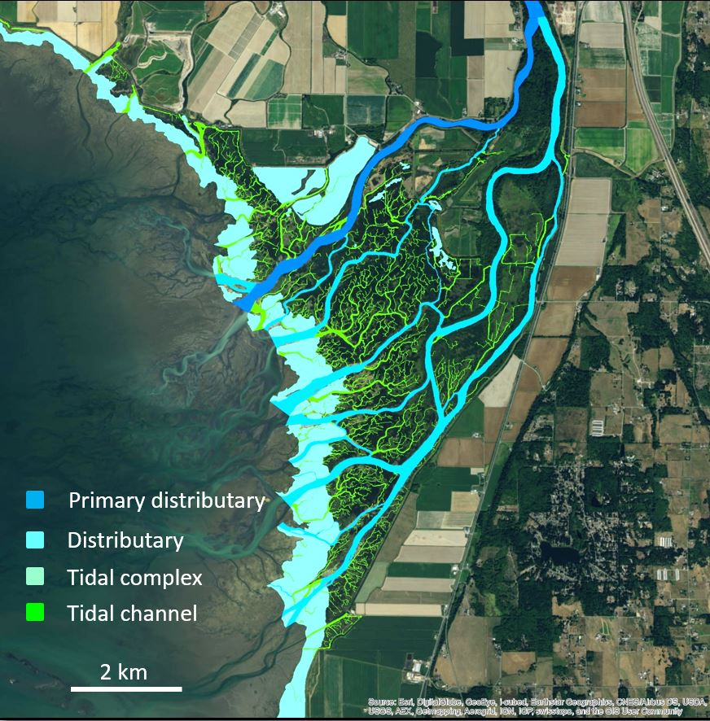
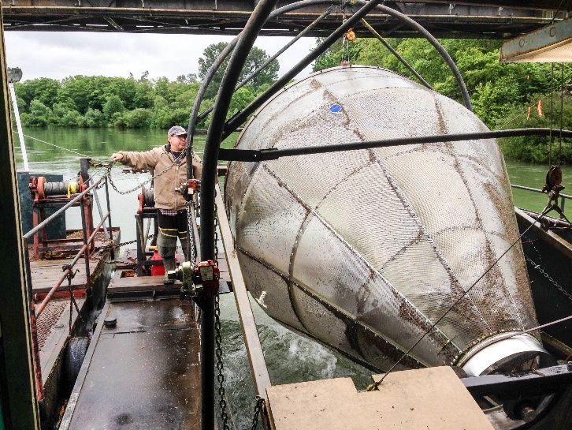
Building a stock-recruit curve with data from 4 systems
NOr subyearlings/ha in delta
Individual observations
Across all habitat types, years
Curve estimation
Assumed Beverton-Holt relationship
Tested against density-indep. model
Density-independent
Recruits
Beverton-Holt
E. Beamer
Stock
NOr outmigrants/ha of delta channel
All subyearling outmigrants
Individual observations by week
Use wetted channel area estimates for each delta
(corrects for habitat availability differences among systems)
Encyclopedia of Puget Sound

Slide 7
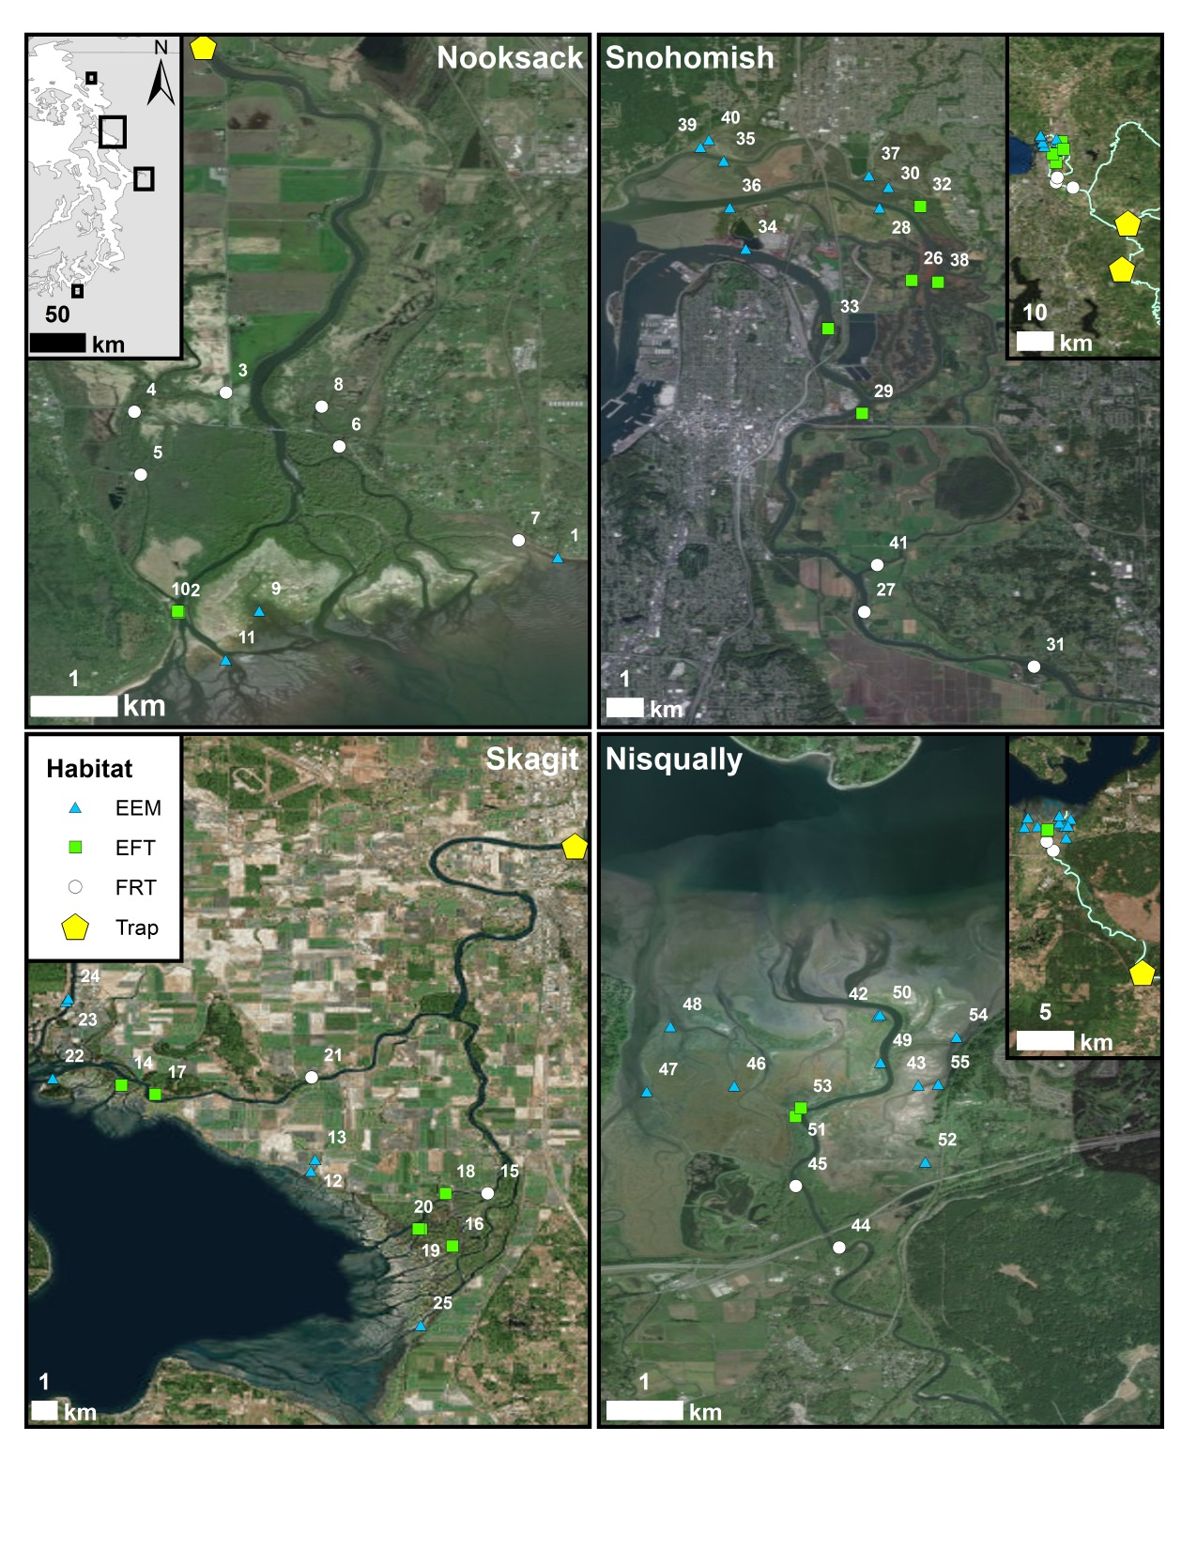
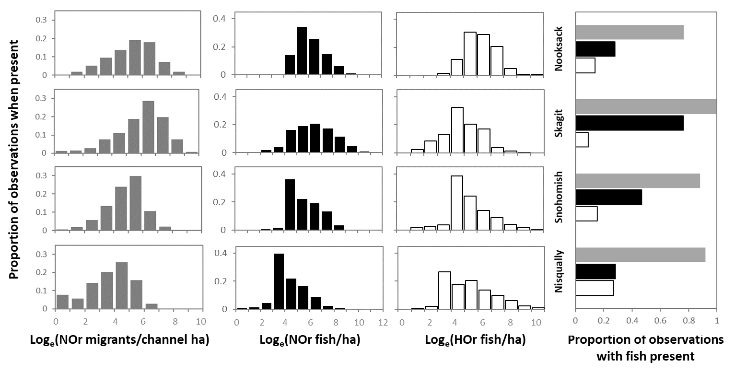
Evidence for habitat limitations
in four Puget Sound deltas
Nooksack
Snohomish
7,228 observations of fish:
4 deltas, 19 years, 26 weeks, 57 sites
Skagit
Nisqually
Notes:
4 systems
7K observations
Histograms show a large range in density within and across systems
Also show abundance of HOr varies
Probability of catching fish in the delta also varies by system

Slide 8
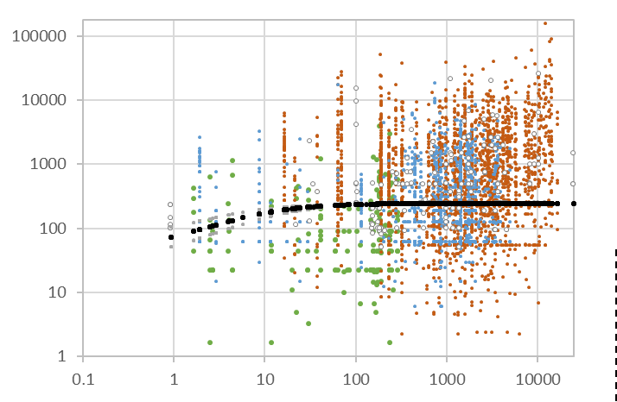
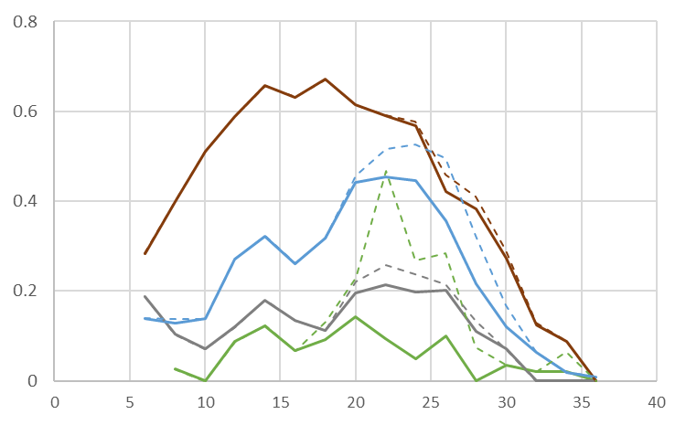
Evidence for habitat limitations in multiple Puget Sound estuaries
0.8
0.4
0
95 % of Capacity
Skagit
NOr migrants
NOr + HOr
fish/ha in delta
Growth
Proportion of observations
surpassing 95% capacity
240
Prey
selectivity
Snohomish
116
Nooksack
Nisqually
Outmigrants/ha channel area
0 10 20 30 40
Management week
Recruitment rate
(Fish in delta/outmigrants)
Big differences among systems
Strong seasonal patterns in capacity exceedance
HOr migrants increased the likelihood to surpass capacity
Outmigrants/ha channel area

Slide 9
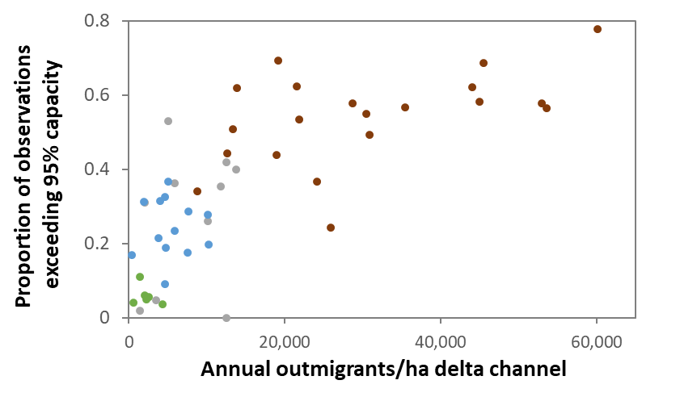
Evidence for habitat limitations in multiple Puget Sound estuaries
fish/ha in delta
Recruitment rate
(Fish in delta/outmigrants)
Big differences among systems
Capacity exceeded in each system for some portion of almost every year
Inflection point evident between 10-20,000 outmigrants/ha
Outmigrants/ha channel area

Slide 10
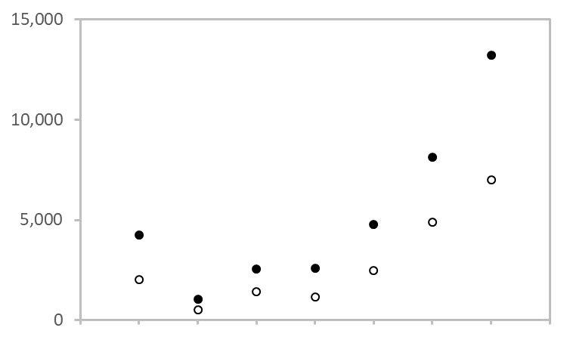
How about those “high” densities?
95th percentile
Forested riverine tidal (FRT)
Estuarine
forest
transition (EFT)
Estuarine emergent
marsh (EEM)
fish/ha in delta
Distributary
NOr Density (fish/ha)
Blind channel
90th
All
types
EEM
EFT
FRT
EEM
EFT
FRT
Recruitment rate
(Fish in delta/outmigrants)
Distributary
Blind channel
Many observations at odds with theoretical capacity by orders of magnitude
90th or 95th percentiles varied with habitat type
Higher in blind channels & fresher wetland types
Outmigrants/ha channel area

Slide 11
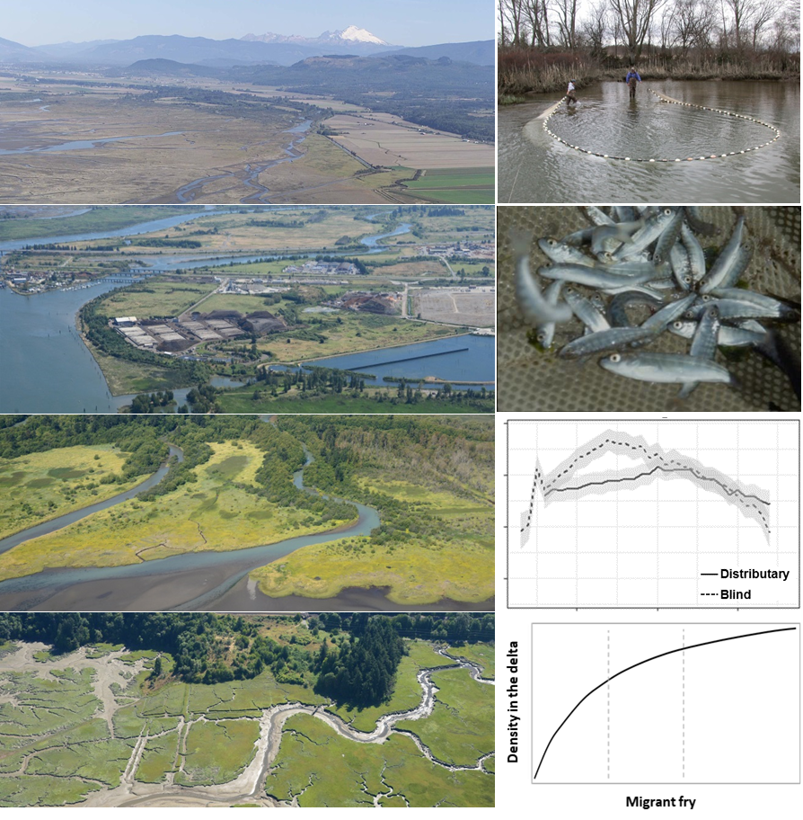
Do deltas completely “fill” at high outmigration densities?
Pr (presence)
Outmigrants
Nooksack
Snohomish
Proportion of observations with fish
Nisqually
Skagit
Log (outmigrants/ha delta channel)

Slide 12
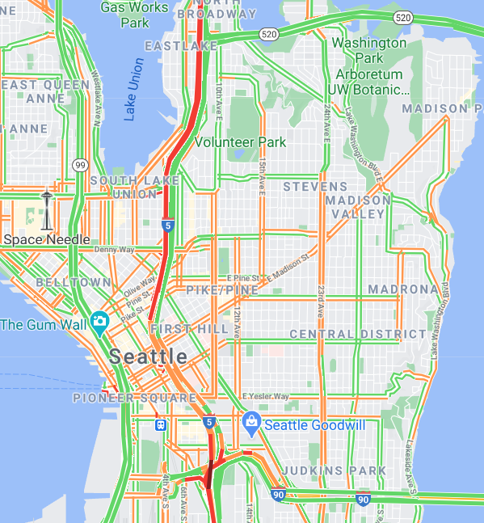
Rethinking habitat capacity in large river deltas
Old metaphors
New metaphors
Seatac
Airport

Slide 13
Summary
Four systems:
Capacity exceeded in all systems in certain weeks and years
Hatchery releases can increase likelihood of exceeding capacity
“High” values of density: fresher, connected, safer habitats
Data can be used:
to estimate exceedance of capacity in other systems
to improve predicted benefits of estuary restoration
For more information:
Report and webinar available on Salish Sea Wiki

Slide 14
Thanks

