Slide 1
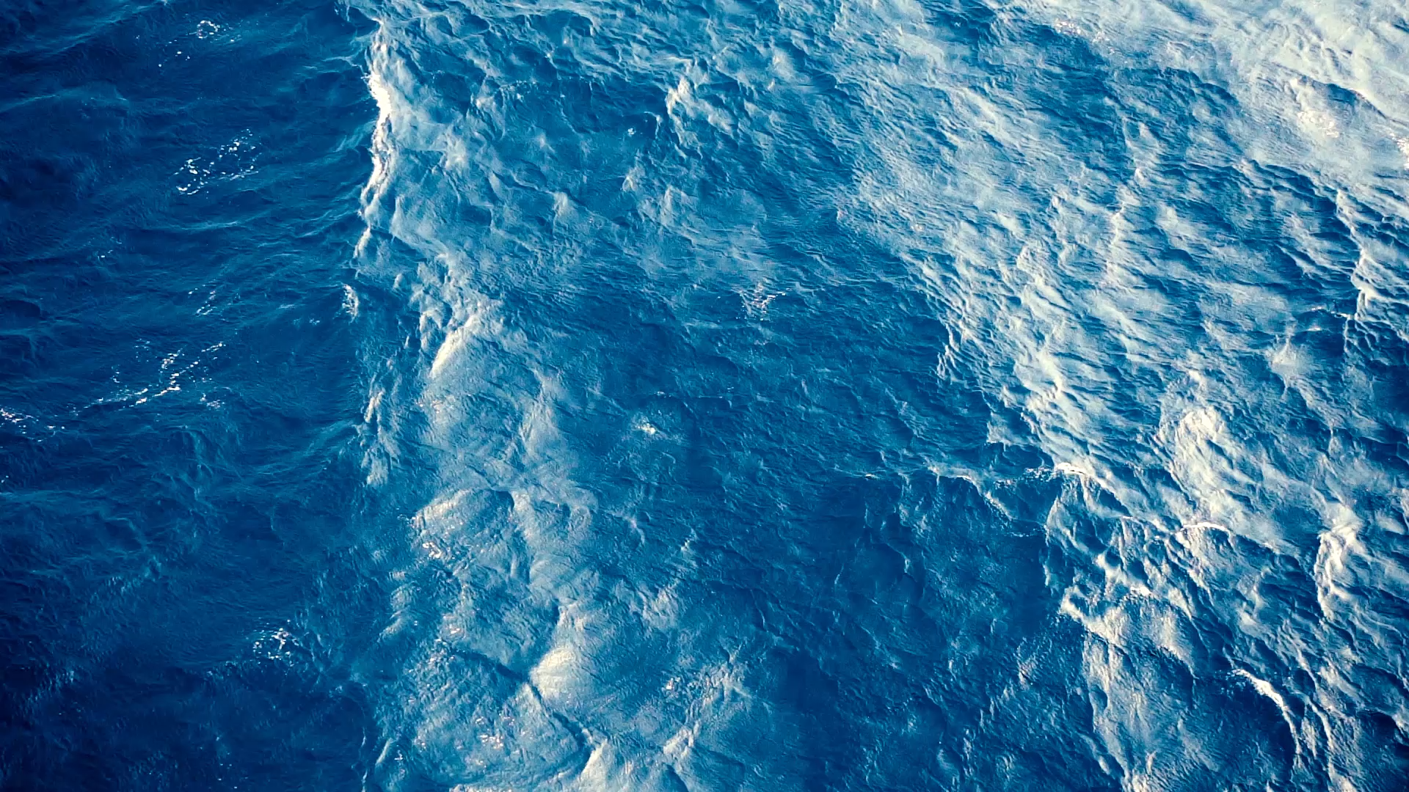
From Site to Sea:
Protecting Habitat Through an Integrated Response to the Invasive European Green Crab across the Salish Sea

Slide 2
Panel Outline
European green crab in the Salish Sea
  Emily Grason | Washington Sea Grant
Remarks from T’Sou-ke First Nation and Lummi Nation
  Chief Gordon Planes | T’Sou-ke First Nation
  Councilwoman Lisa Wilson | Lummi Indian Business Council
Settler Management Agency Perspective
  Renny Talbot | Fisheries and Oceans Canada
  Allen Pleus | Washington Department of Fish and Wildlife
Local Removal Trapping Vignettes
  Sooke Basin, BC: Crysta Stubbs | Coastal Restoration Society
  Lummi Tidelands, WA: Bobbie Buzzell | Lummi Natural Resources
  Drayton Harbor, WA: Allie Simpson | Northwest Straits Commission
Moderated Discussion and Q&A

Slide 3
European Green Crab in the Salish Sea
Emily Grason, PhD (she/hers)
Marine Ecologist | Crab Team Program Lead
Washington Sea Grant

Slide 4
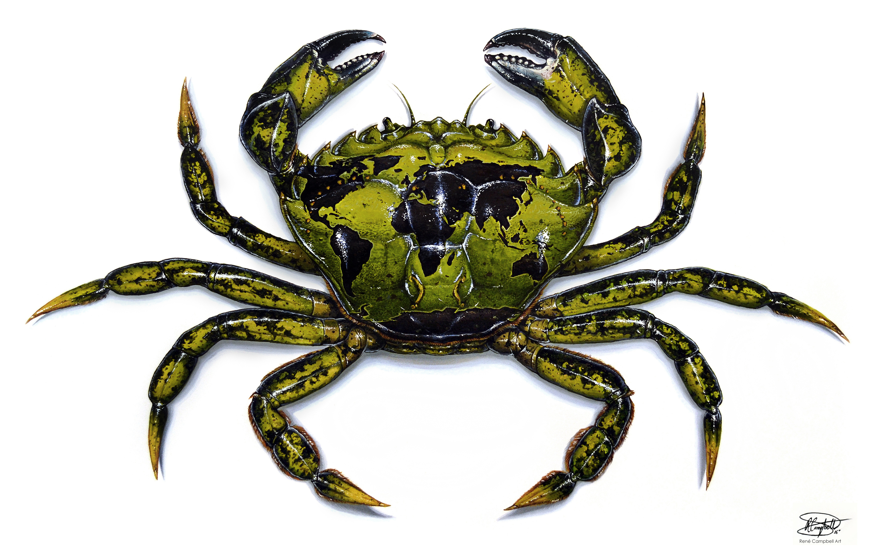
European green crab
Carcinus maenas
Global Invader
Local Impacts
Artwork reproduced with permission of artist: by Rene Campbell www.renecampbellart.com

Slide 5
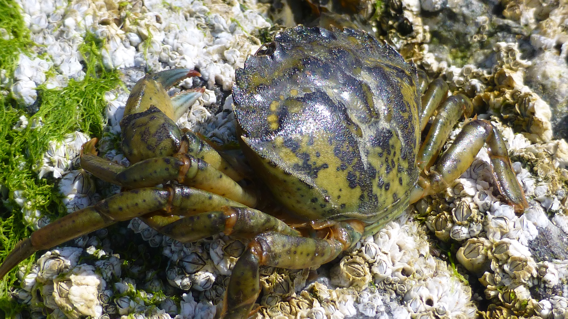

Slide 6
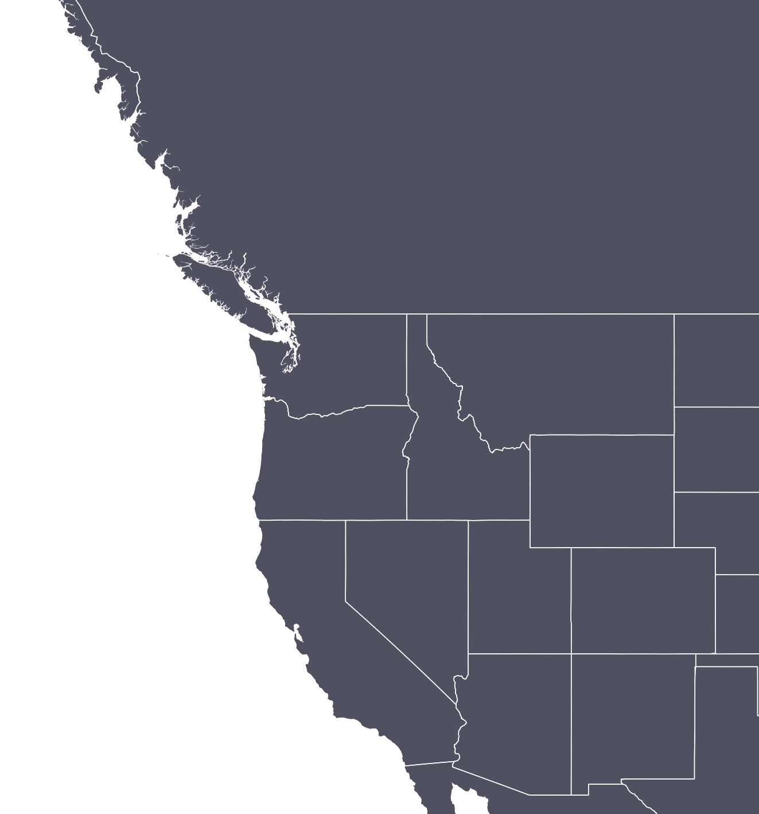
West Coast Invasion History
Transported by humans from eastern US
Regional spread by larvae, facilitated by warm climatic events (ENSO, “Blob”)
2010
1997-98
Salish Sea initially protected from invasion
1990s
1989

Slide 7
Salish Sea
Invasion History
Drayton Harbor
Lummi Sea Pond
Lummi & Drayton
Sooke Basin
Inland Washington
Sooke Basin
Notes:
As more sites were invaded the complexity of management increased, with each new site, one or more new jurisdictions became involved. And need for increased technical capacity and cooperation to effectively respond
Sooke was the spur for action to develop transboundary, but it turns out it wasn’t exactly ground zero.

Slide 8
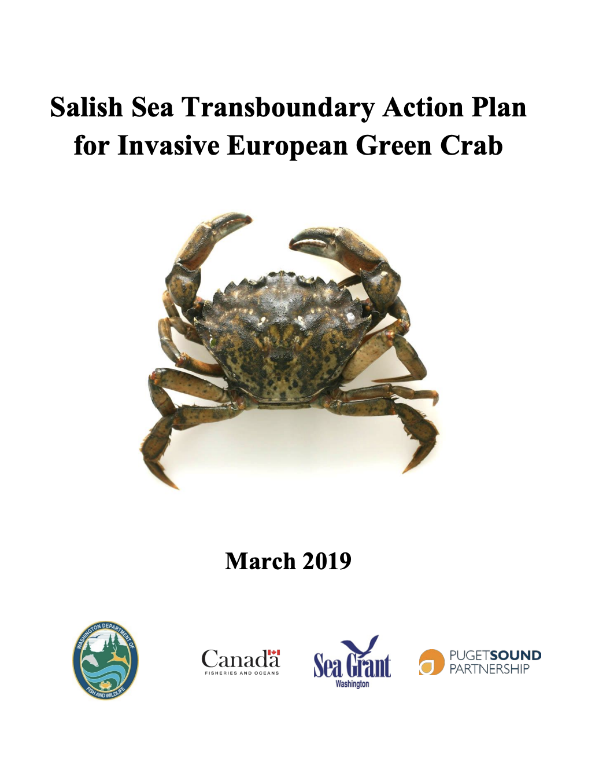
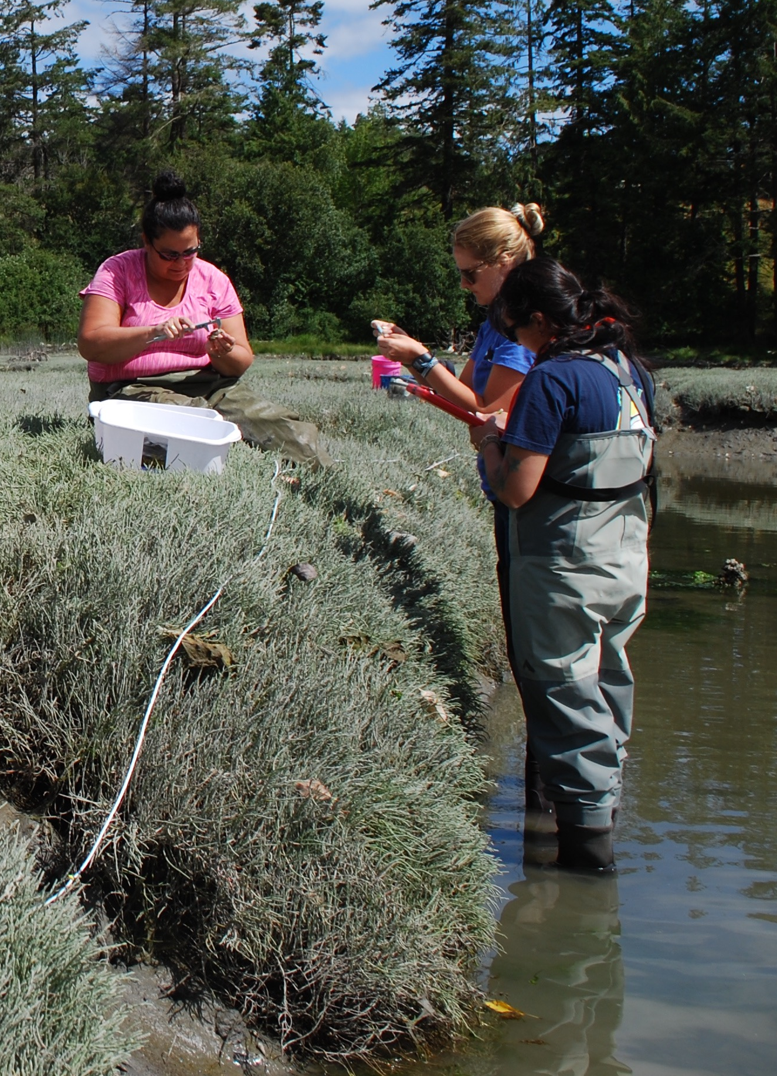
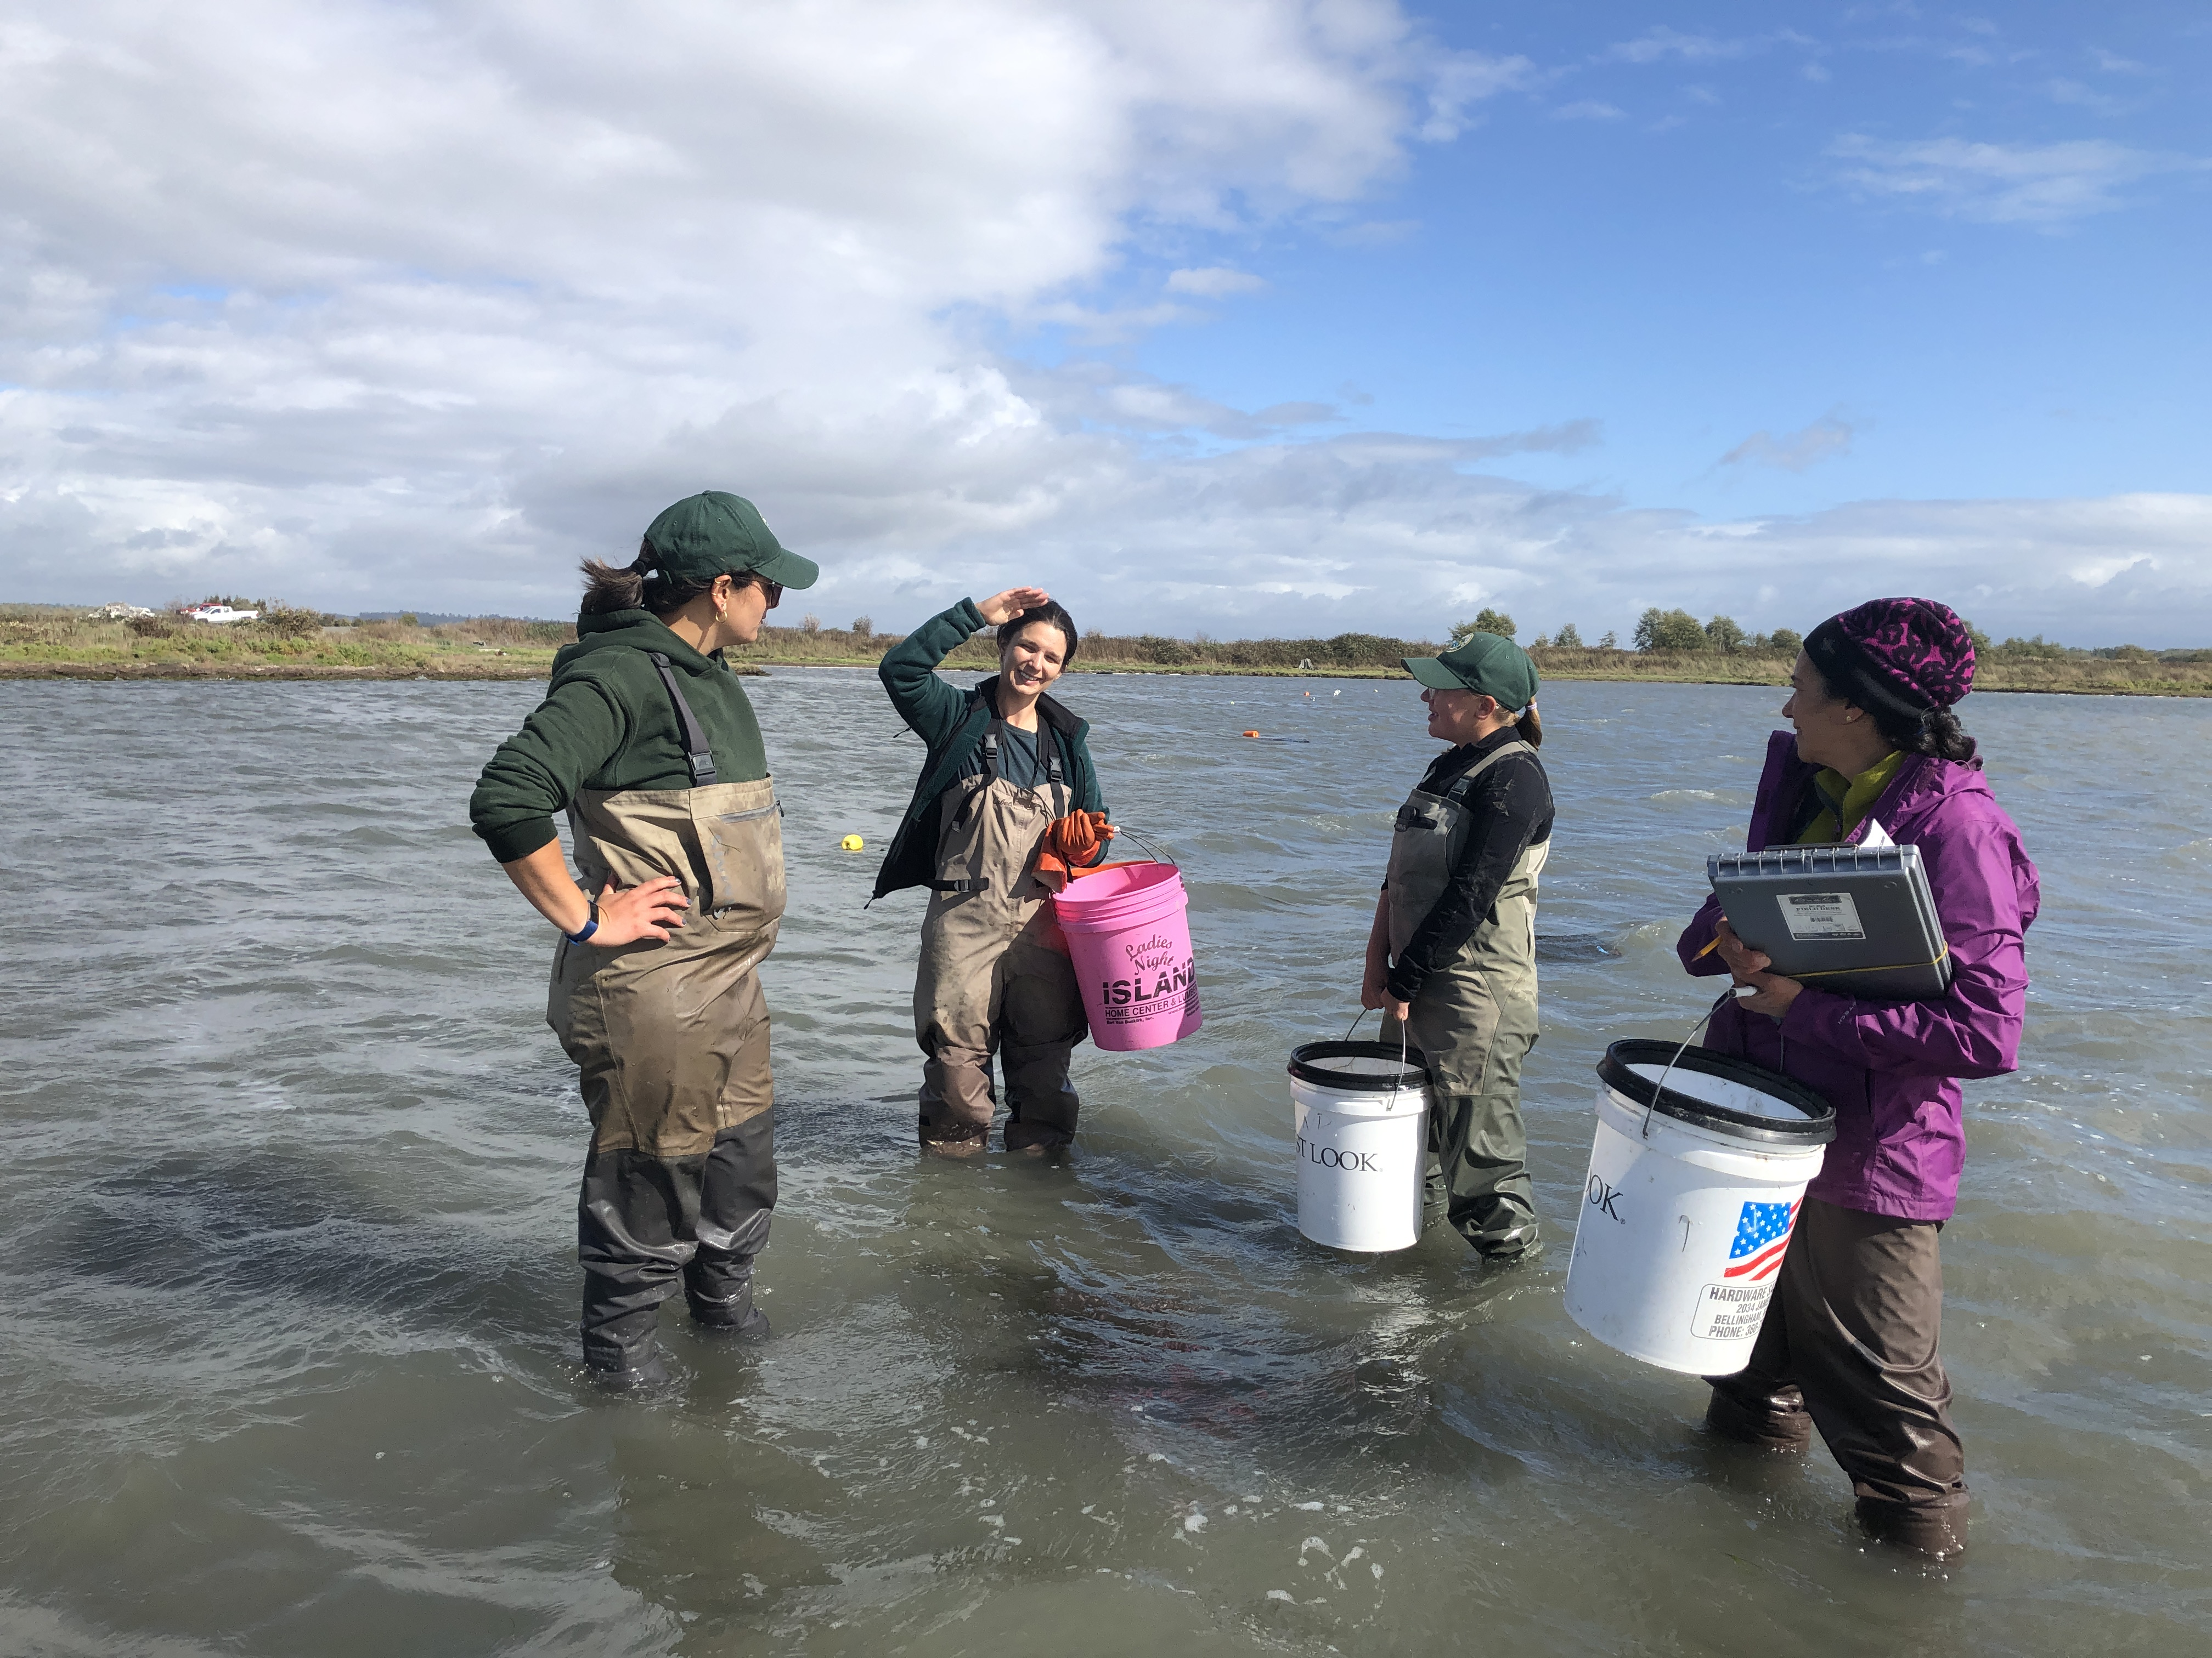
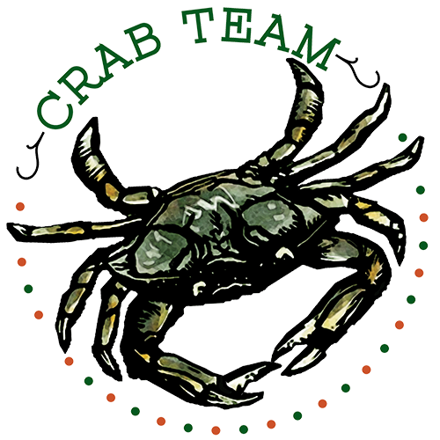
Great Moments in collaborative green crab management
WDFW & WSG launch Crab Team
Interagency response trapping in WA
Salish Sea Transboundary Action Plan
WA, WDFW, DFO cross training
WDFW & Lummi initiate co-management
CRS engages partners to plan removal
WDFW, WSG, NWSC Drayton Management plan
Sooke Basin
2012
2013
2014
2015
2016
2017
2018
2019
2020
2021
Notes:
SSTAP
Transboundary Workshop

Slide 9
Salish Sea
Invasion Status
Salish Sea is an early and unfolding invasion.
Control actions localized but matter on a regional scale.
Information sharing:
  Builds trust & collective knowledge
  Maximizes efficiency
  Works both ways
  Takes resources
2021 Trapping Rates
Crabs per 100 trap sets
0
0.1
11,000
Notes:
Green crab is a problem that transcends both political and, biogeographical boundaries
Folks working in this area have always understood that a green crab anywhere in the salish sea represents a threat to everywhere in the salish sea.
Today’s panel will feature speakers that work on green crab management at local and regional scales, we’re particularly interested in the transfer of information and communication information both horizontally, across groups doing work in a single water body, and vertically, from groups working in the mud to groups working at the 30,000’ level, and back again. It’s easy for each of these dot s to become siloed, for the work to occur in a vacuum, and it’s easy for folks working at the broad scale to become out of touch with what things really look like on the ground ( I say this from personal experience), So what are the strategies that each of these groups have used to collaborate and avoid these challenges, and where do we have opportunities to do even better.

Slide 10
Removal Trapping: Sooke Basin, BC
Crysta Stubbs, BSc, BIT
Lead Biologist
Coastal Restoration Society

Slide 11
Geography & Approach
Management Site:
Sooke Basin, BC
Coordinating group:
Coastal Restoration Society
10 square km of tidelands (4 target sites)
First green crab detection: 2012
Removal trapping began: November 2021
60,013 green crabs captured in since Nov. 2021
Personnel
  4 Full Time
  3 Part Time

Slide 12
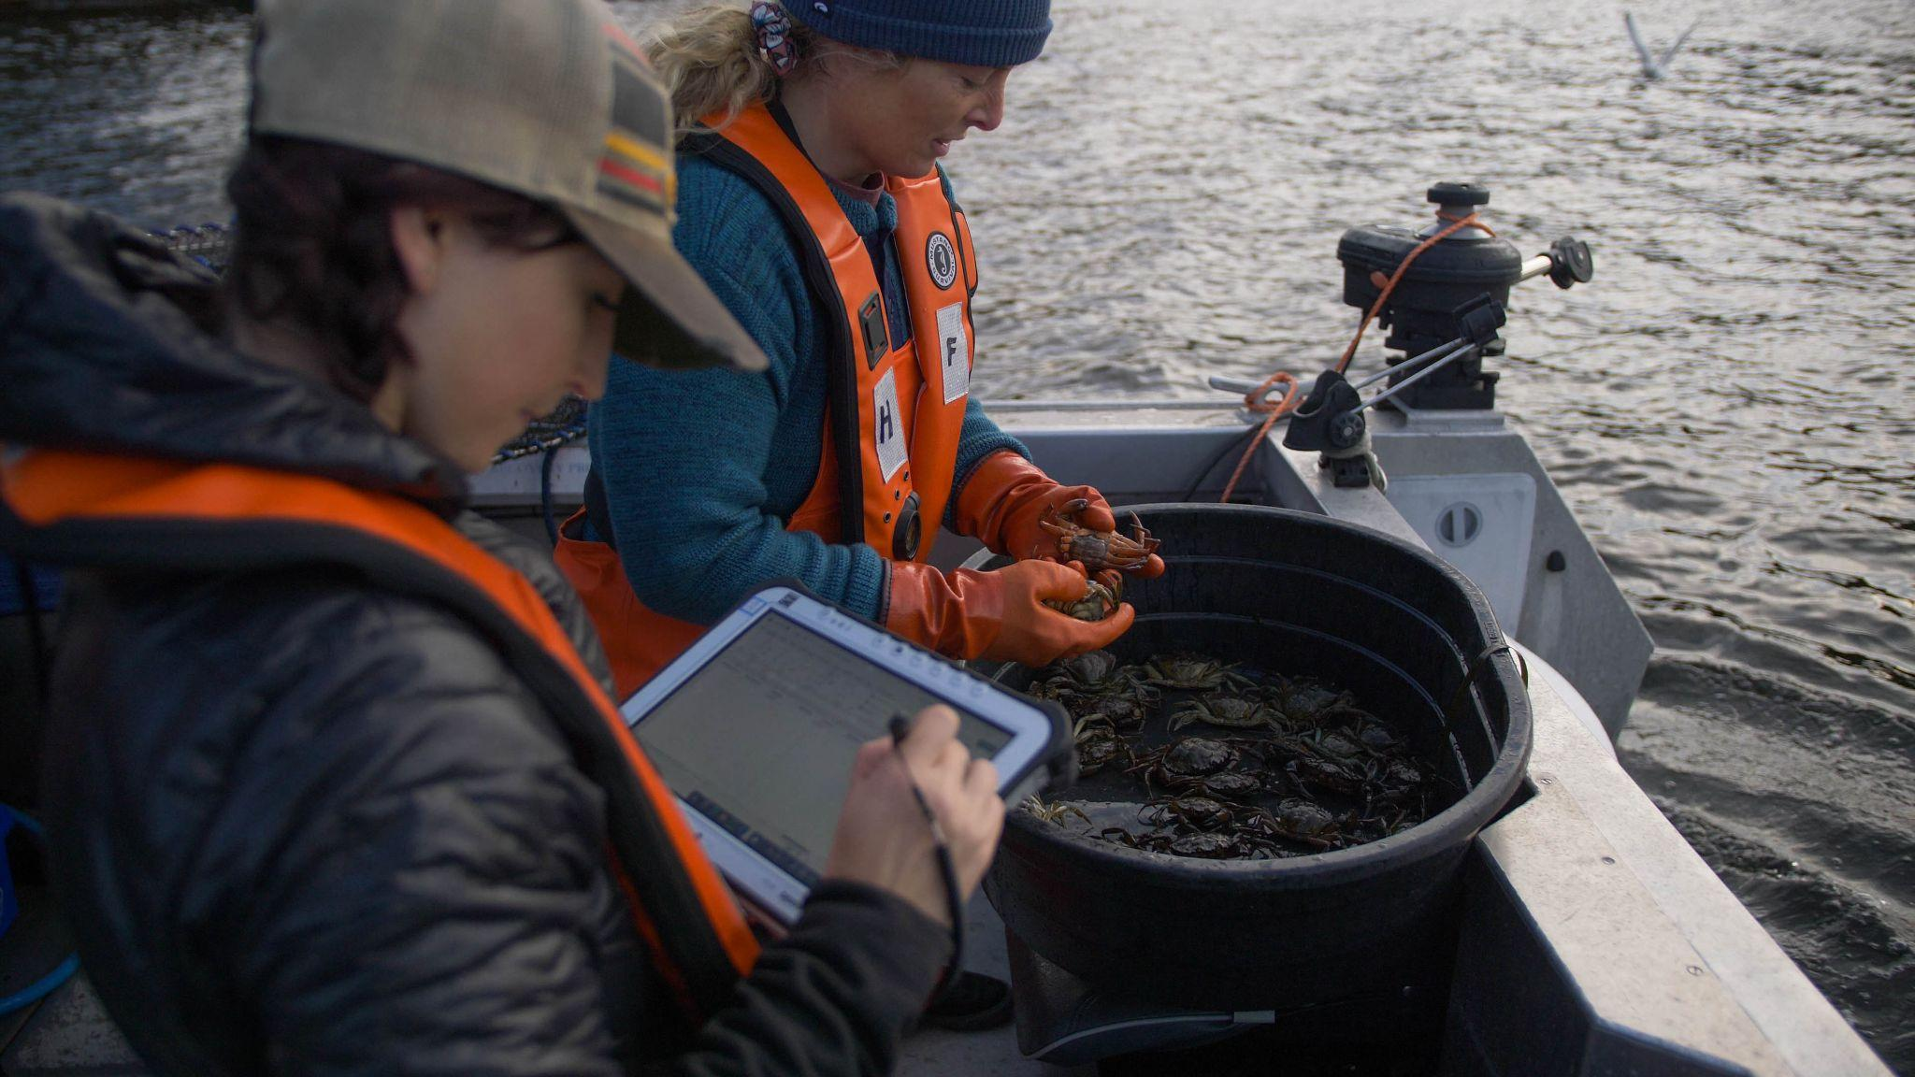
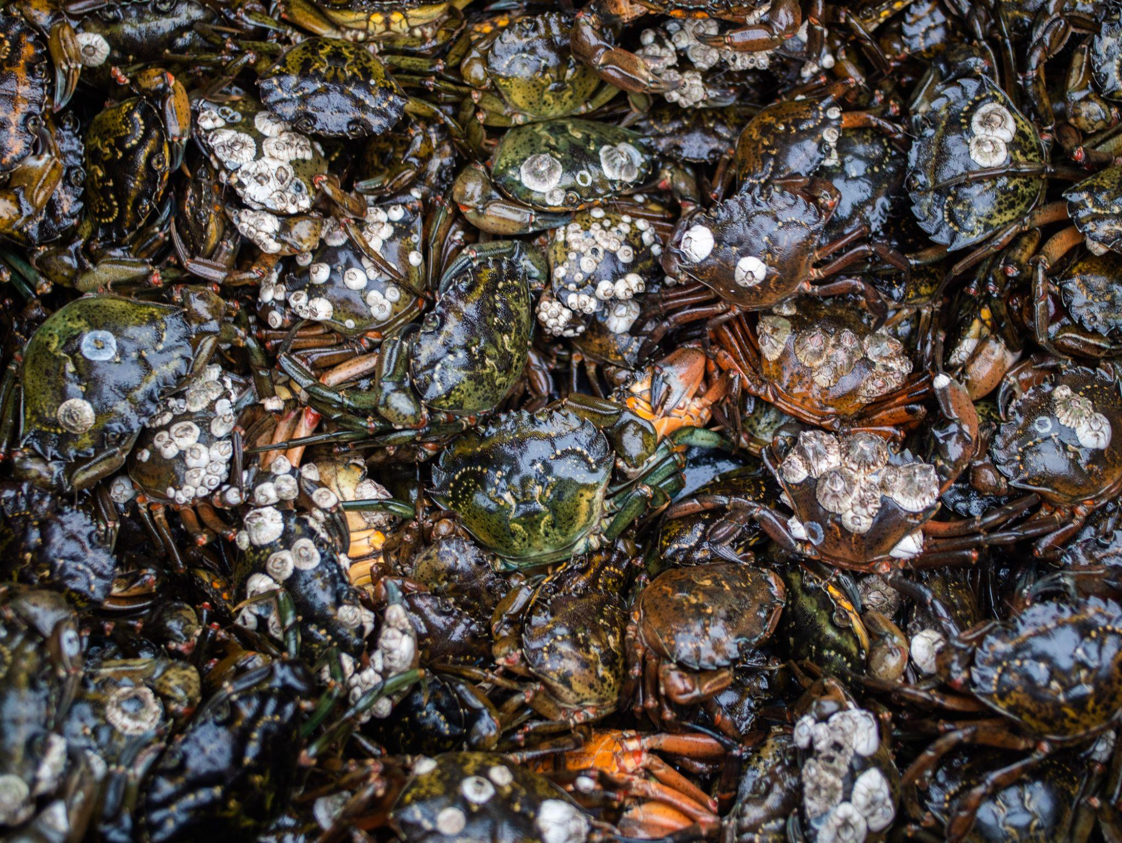

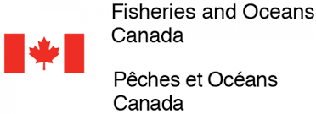



Collaborations & Partners: Sooke Basin, BC
For planning:
T’Sou-ke First Nation
Coastal Restoration Society
Department of Fisheries and Oceans Canada
For funding:
British Columbia Salmon Restoration and Innovation Fund
For personnel:
Coastal Restoration Society
T’Sou-ke First Nation
For information/advisement:
Department of Fisheries and Oceans Canada
T’Sou-ke First Nation

Slide 13
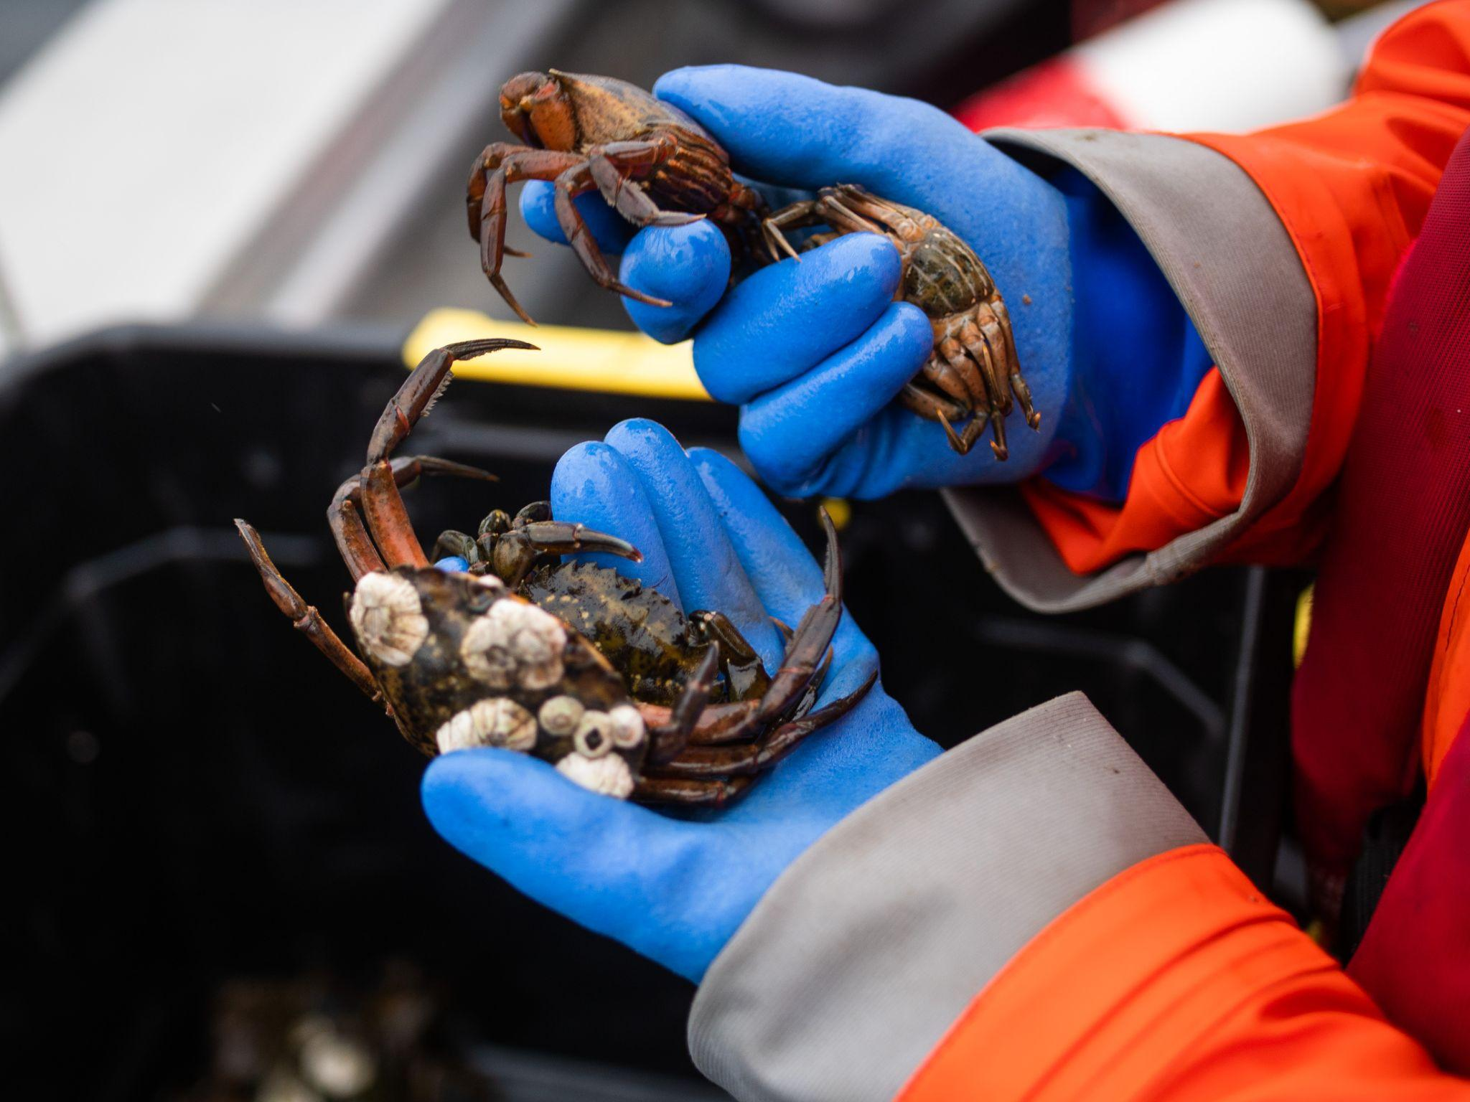
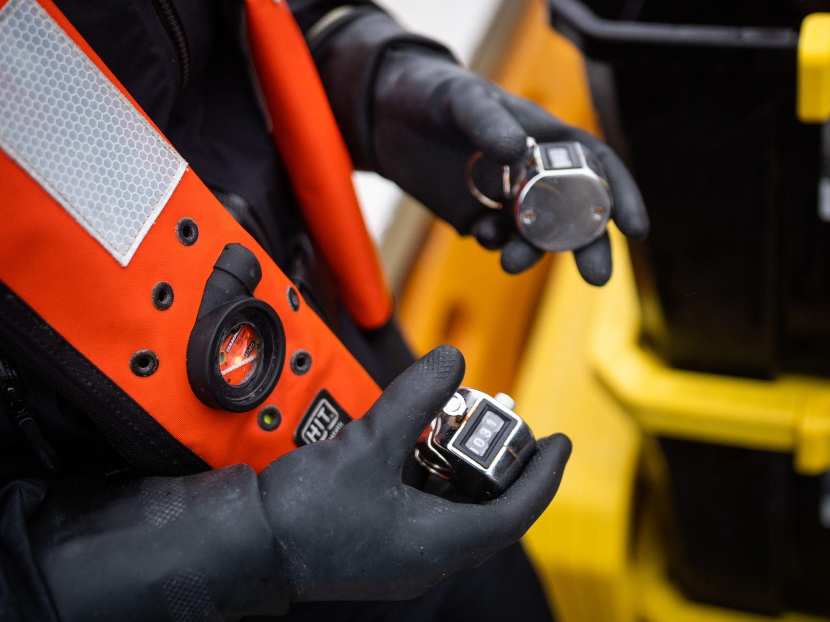
Lessons Learned: Sooke Basin, BC
Successes | Lessons learned | Ongoing challenges
Expanded EGC network Development and implementation of Sooke Basin EGC Management Plan | Evolving methodology Enhanced understanding of EGC and management for all partners | COVID-19 Capacity limitations
Notes:
What are components to sharing information/resources and collaborating across groups that have been key to being able to do your removal trapping?(as they relate to collaboration/information sharing needed for removal trapping success). What worked for your group from the outset, what has been improved since you started, and what do you hope to improve moving forward (what barriers remain).
Keep to a max of 4 or so take homes
Feel free to add image/visual as helpful.

Slide 14


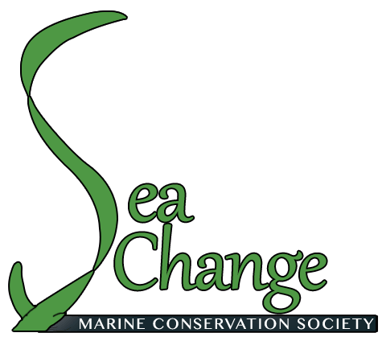
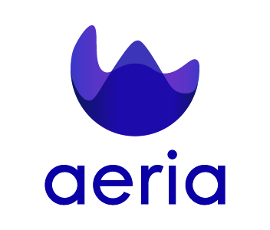
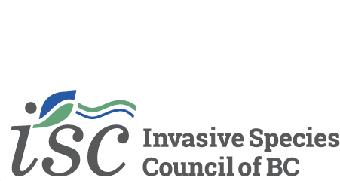
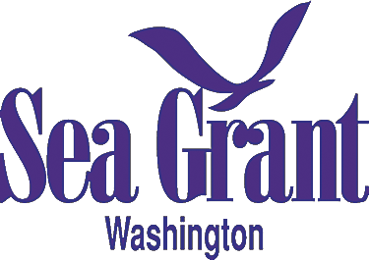

Acknowledgments: Sooke Basin, BC
Notes:
CRS has benefited from additional support from the following organizations.

Slide 15
Removal Trapping: Lummi Tidelands, WA
Bobbie Buzzell MSc
Green Crab Biologist
Lummi Natural Resources Department

Slide 16
Geography & Approach
Management Site:
Lummi Nation Tidelands, WA
Coordinating group:
Lummi Natural Resources (LNR)
20 square miles of tidelands
First detection: 2019
Removal trapping began: 2020
85,792 green crabs captured in 2021
Personnel
  7 LNR, 1 WSG, 1 UW
  6 Washington Department of Fish and Wildlife (WDFW),
  2 Northwest Straits Commission (NWSC)
Notes:
Overview of Lummi Nation Tidelands managed by Lummi Natural Resources
Tidelands consist of roughly 20 square miles, vas intertidal sand/mud flats, marsh habitat in two estuarine zones (Lummi and Nooksack River), Portage Island and it’s adjacent bay.
In addition, salt water intrusion can occur as far as 2-3 miles up Lummi River, reaching 5 ppt during periods of low precipitation (e.g. summer months).
Removal trapping on tidelands began in October 2019. Several locations were trapped in Lummi Bay and River, and on Portage Island. Only 2 locations contained trapped
Personnel reflective of current, LNR have doubled our staff since last year

Slide 17
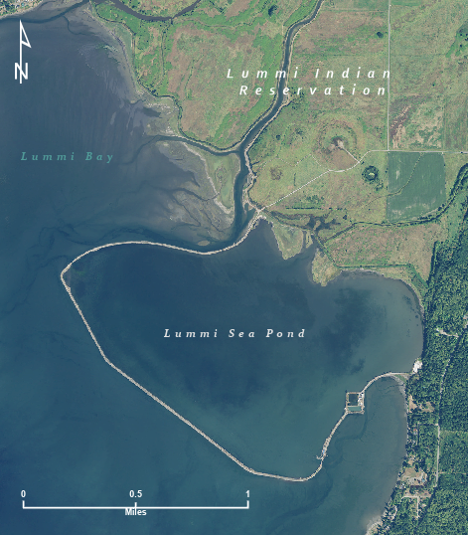
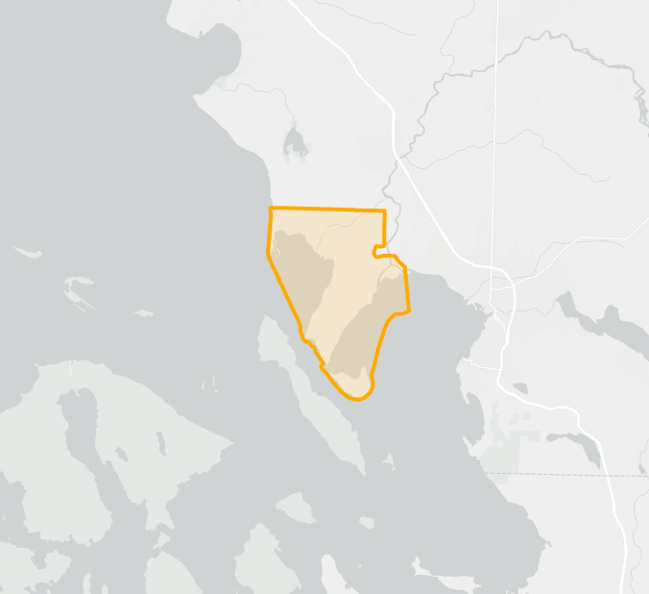
Geography & Approach

Slide 18
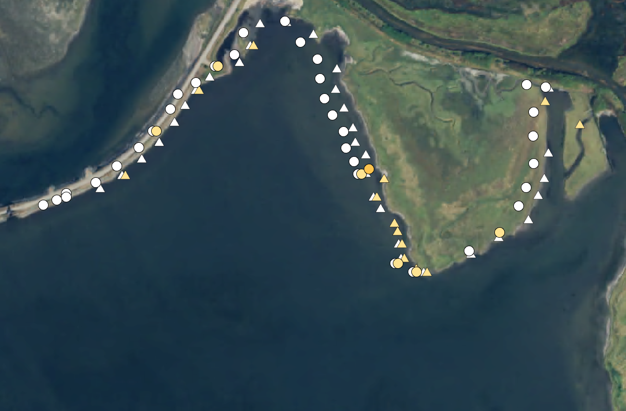
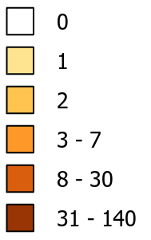
Count of EGC
Trap Type
Shrimp
Lummi Sea Pond
Fukui
Week of July 13th
Minnow
Notes:
# of traps checked 171
# of EGC 72

Slide 19
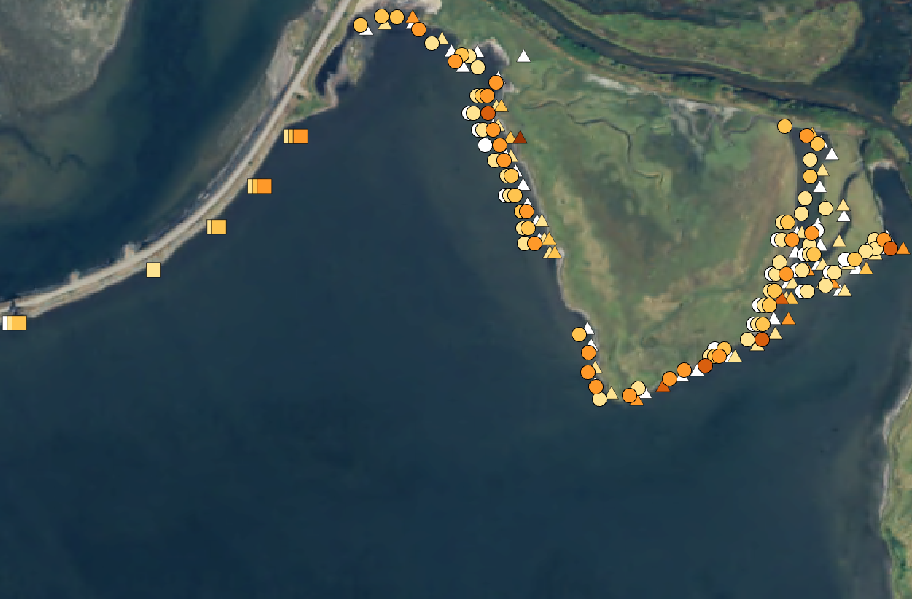
Count of EGC
Trap Type
Shrimp
Lummi Sea Pond
Fukui
Week of August 22nd
Minnow
Notes:
538 traps checked
1342 EGC captured
Tripled effort, 10x the crab

Slide 20
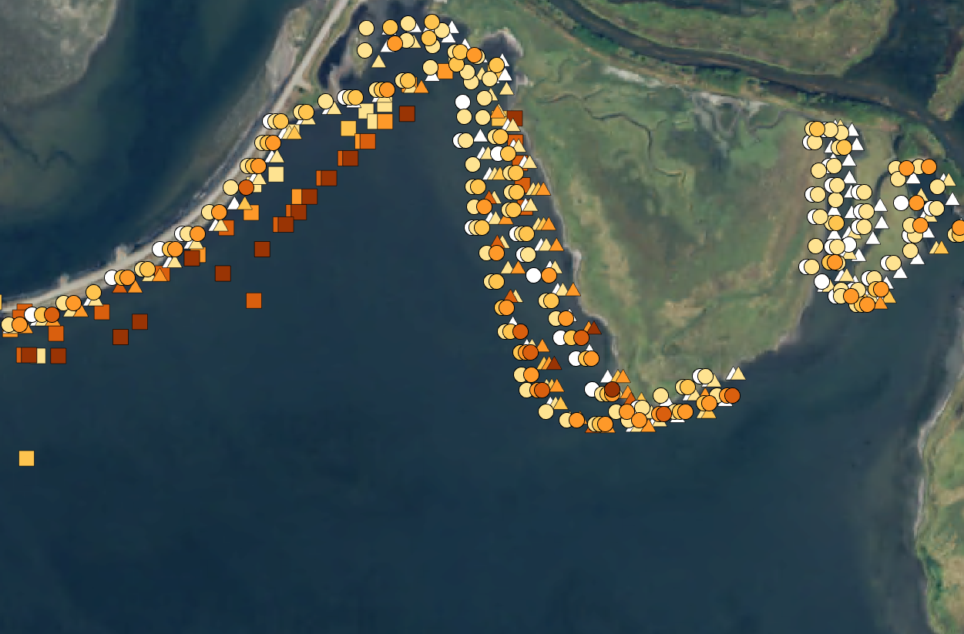
Week of September 23rd
Count of EGC
Trap Type
Shrimp
Lummi Sea Pond
Fukui
Minnow
Notes:
1451 traps checked
11,049 EGC captured

Slide 21

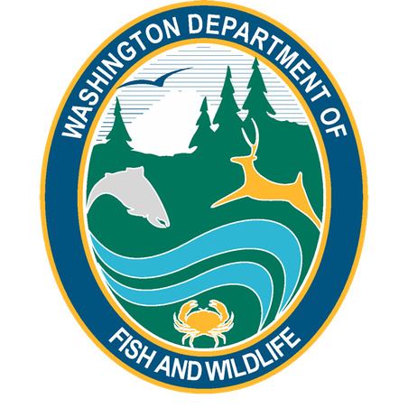
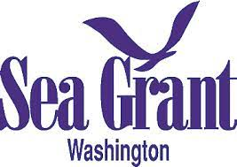
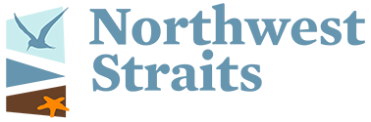



Collaborations & Partners: Lummi Tidelands, WA
Information/Advisement
Planning
Personnel
Funding
Notes:
Outline who supports and participates in your removal trapping efforts, whether solely managed internally or also facilitated with external partners or entities, who helps plan, make decisions, or provide authority for management, who funds and actively participates in on the ground work, and who do you reach out to for social license or expertise when needed.
Feel free to add photo or other visuals
LNR and our partner organizations “wear many hats”

Slide 22
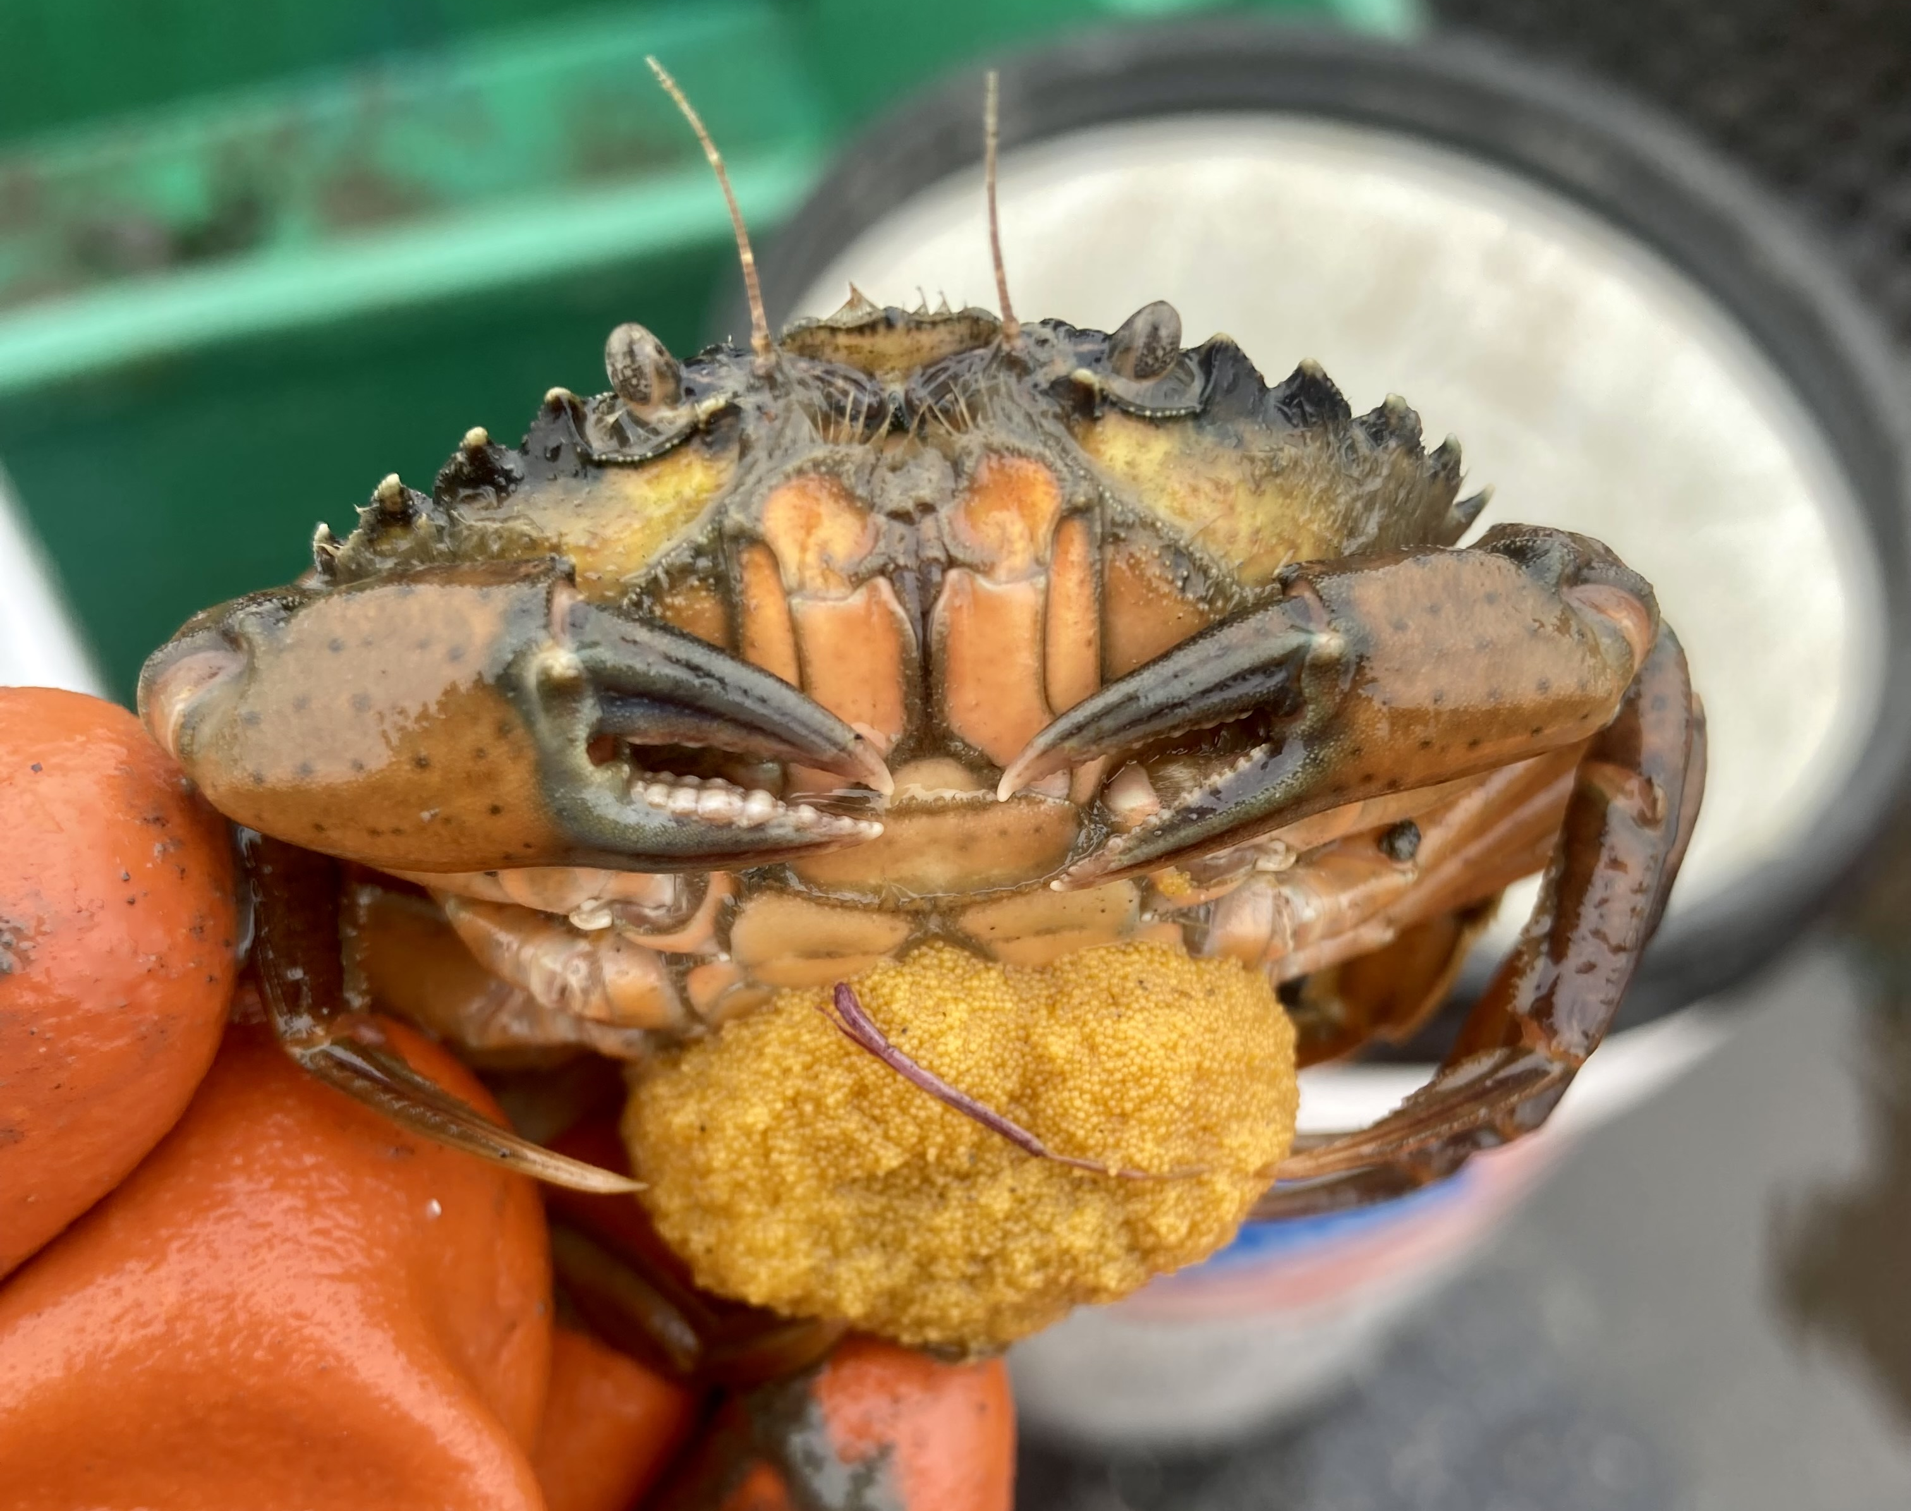
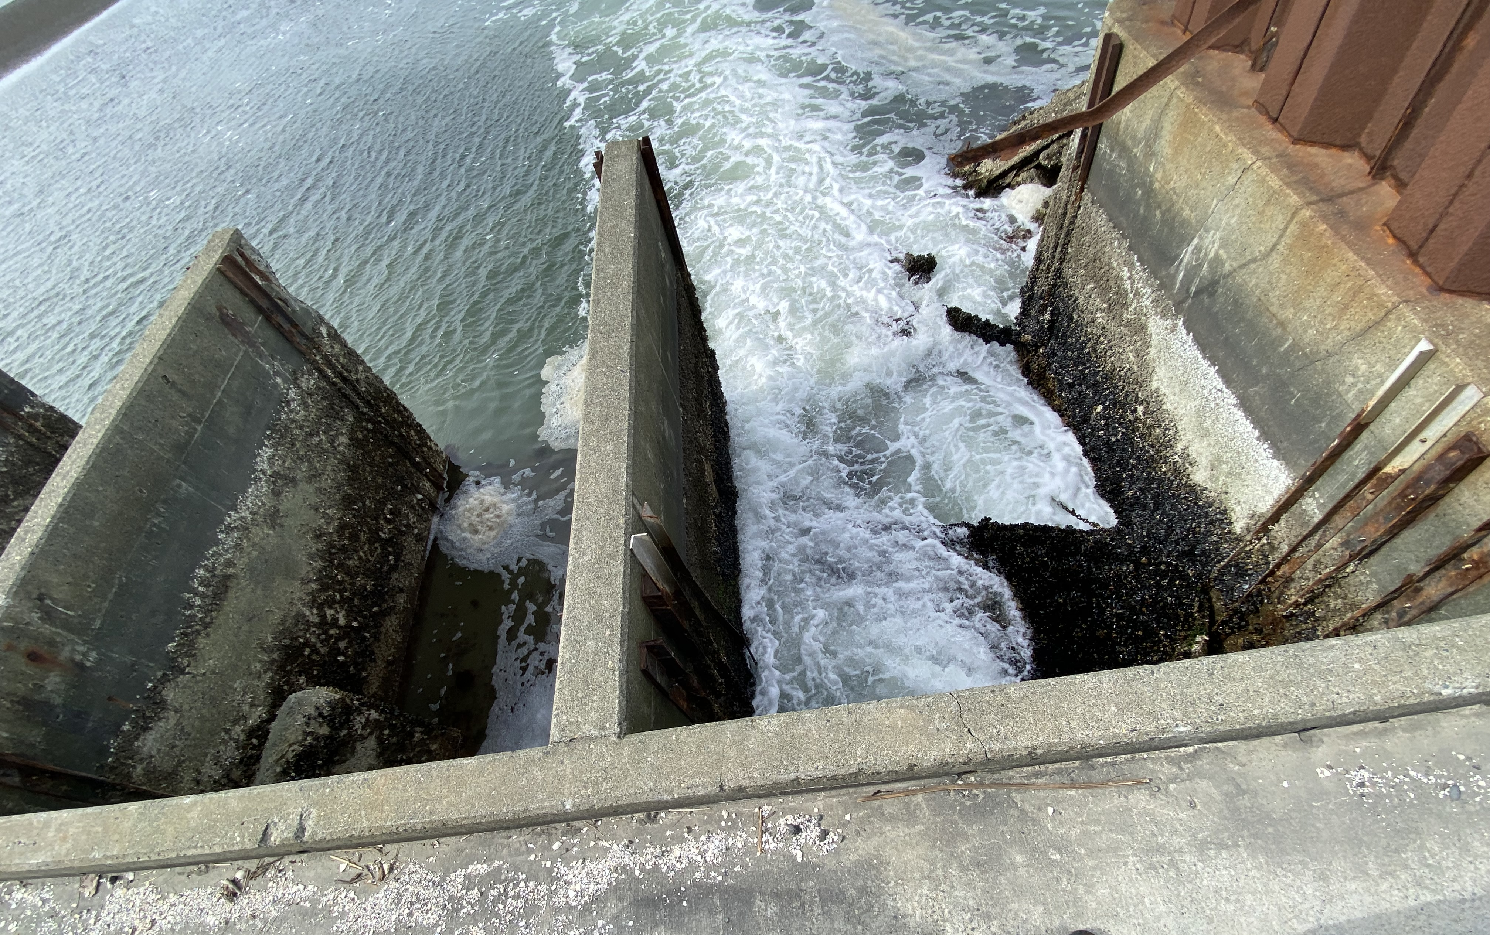
Lessons Learned: Lummi Tidelands, WA
Successes
With the support of partner organizations, LNR more than tripled trapping effort and launched one of the largest collaborative EGC trapping efforts along the U.S. West Coast
Lessons learned
Do not underestimate the reproductive potential of green crab
Building positive collaborations is essential for successful response
Ongoing challenges
How to sustain long-term EGC response, management, and funding
Notes:
Successes
With the support of partner organizations, LNR was able to more than triple effort and launch one of the largest collaborative EGC trapping efforts in Washington State
Lessons learned
Do not underestimate reproductive potential of green crab
Building positive collaborations early on are essential for successful response
Ongoing challenges
Complacency and response burnout
“Early and often” engaging the tribes in management issues.
Long-term EGC management and funding
-Trapping is a short-term solution for the sea pond
-EGC in LSP will most likely seed and establish neighboring EGC population
At this particular location only 1 of 6 tide gates are functioning, integrity of tide gates questionable. Restoring the tide gates will allow full control of water levels in sea pond, and treatment options-controlling the environment within the sea pond.
-can’t drain in its current state
-source water system for hatcheries, must maintain ~5 ft to be able to draw water from sea pond. Breaking the dependence will be a challenge.

Slide 23
Removal Trapping: Drayton Harbor, WA
Alexandra Simpson
Ecosystem Project Coordinator
Northwest Straits Commission

Slide 24
Geography & Approach
Management Site:
Drayton Harbor, WA
Coordinating group:
Northwest Straits Commission
10 square km (3 core sites)
First detection: 2019
Removal trapping began: 2020
146 green crabs captured in 5,400 traps in 2021
Personnel
  2 WDFW
  2 Veterans Conservation Corps
  2 NWSC
  WCC Crew

Slide 25
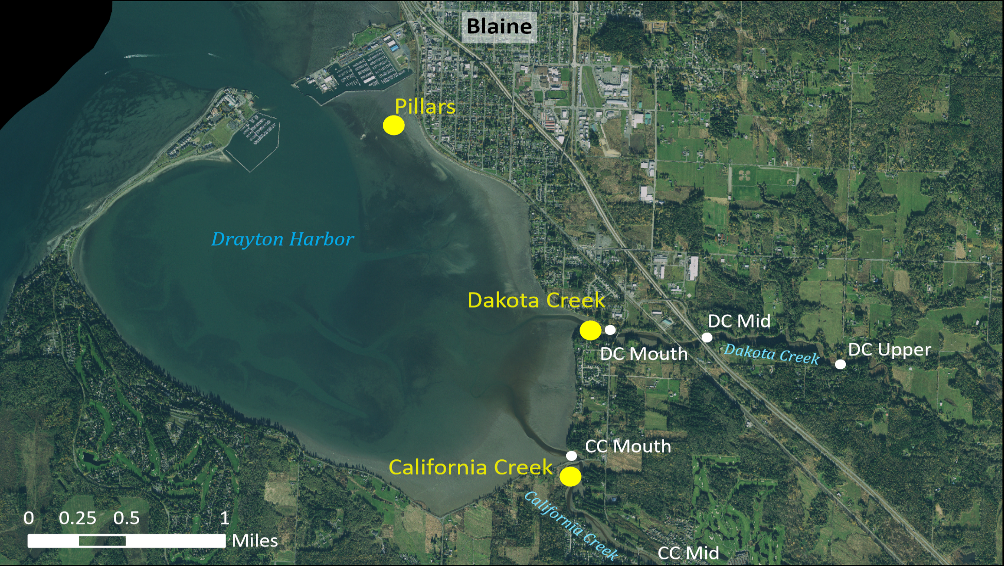
Core Sites:
Goal – Dedicated intensive green crab removal efforts
Traps set systematically in “hotspots” as often as possible
Index Sites:
Goal – Understand green crabs use of creek systems
Traps set for one night at lowest tide of the month
Notes:
Core site trapping: Traps set for multiple nights and checked daily, 2-3 weeks trapped each month
Index site trapping: Traps set for one night at lowest tide of the month
Prospecting Pillars, California Creek, Dakota Creek, and others with various trap types (opportunistic)
Overview map of all sites trapped during 2021. Something as simple as a screen shot of a Google map will work. Add site names that will be used throughout presentation. No need for details on captures, or effort at this point. Can also add site photos, if they are informative.
Purpose: show others where you trapped and familiarize people who may not be as tuned in to your geography.

Slide 26
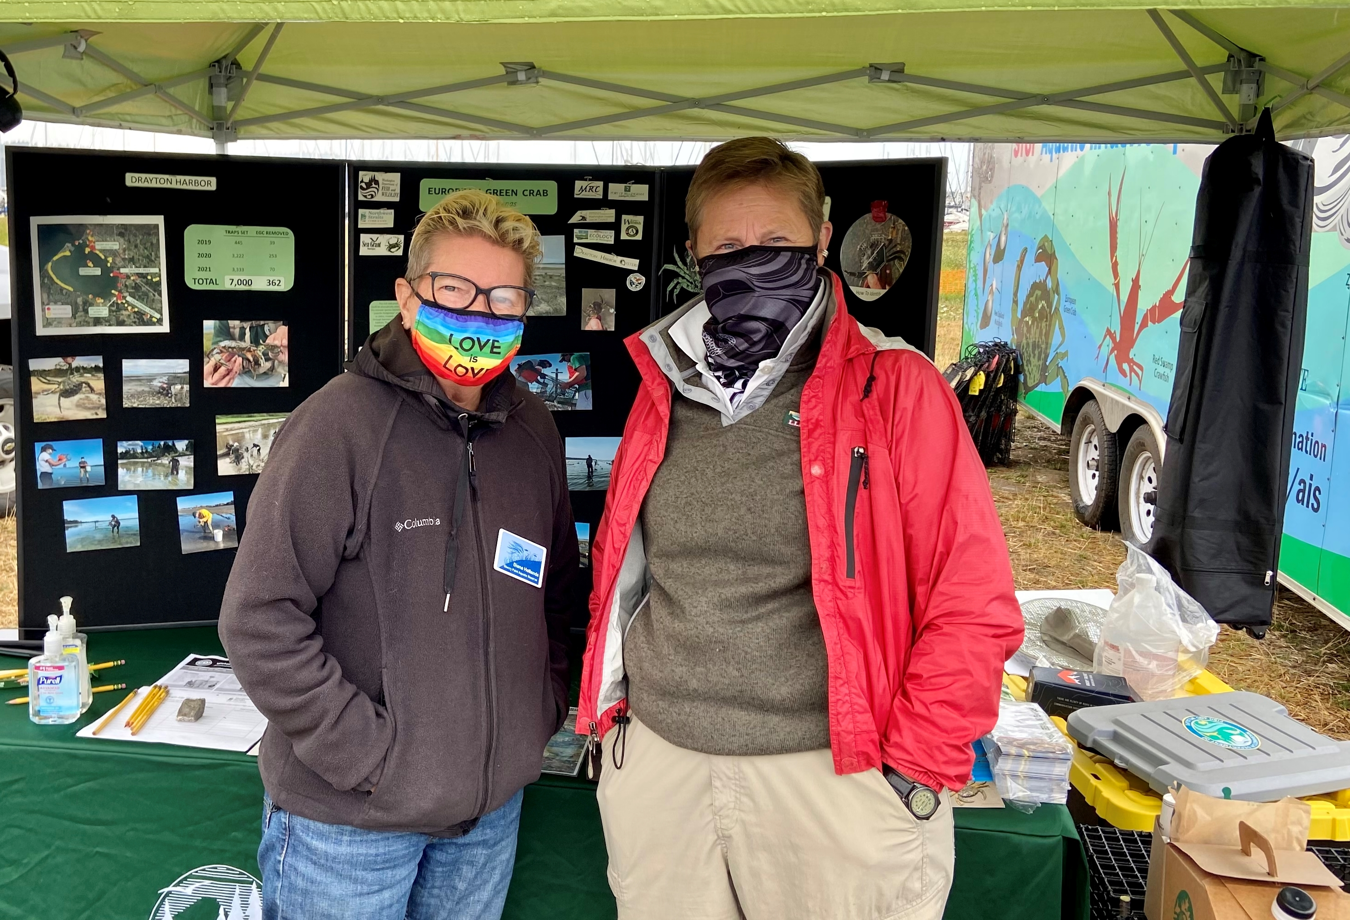
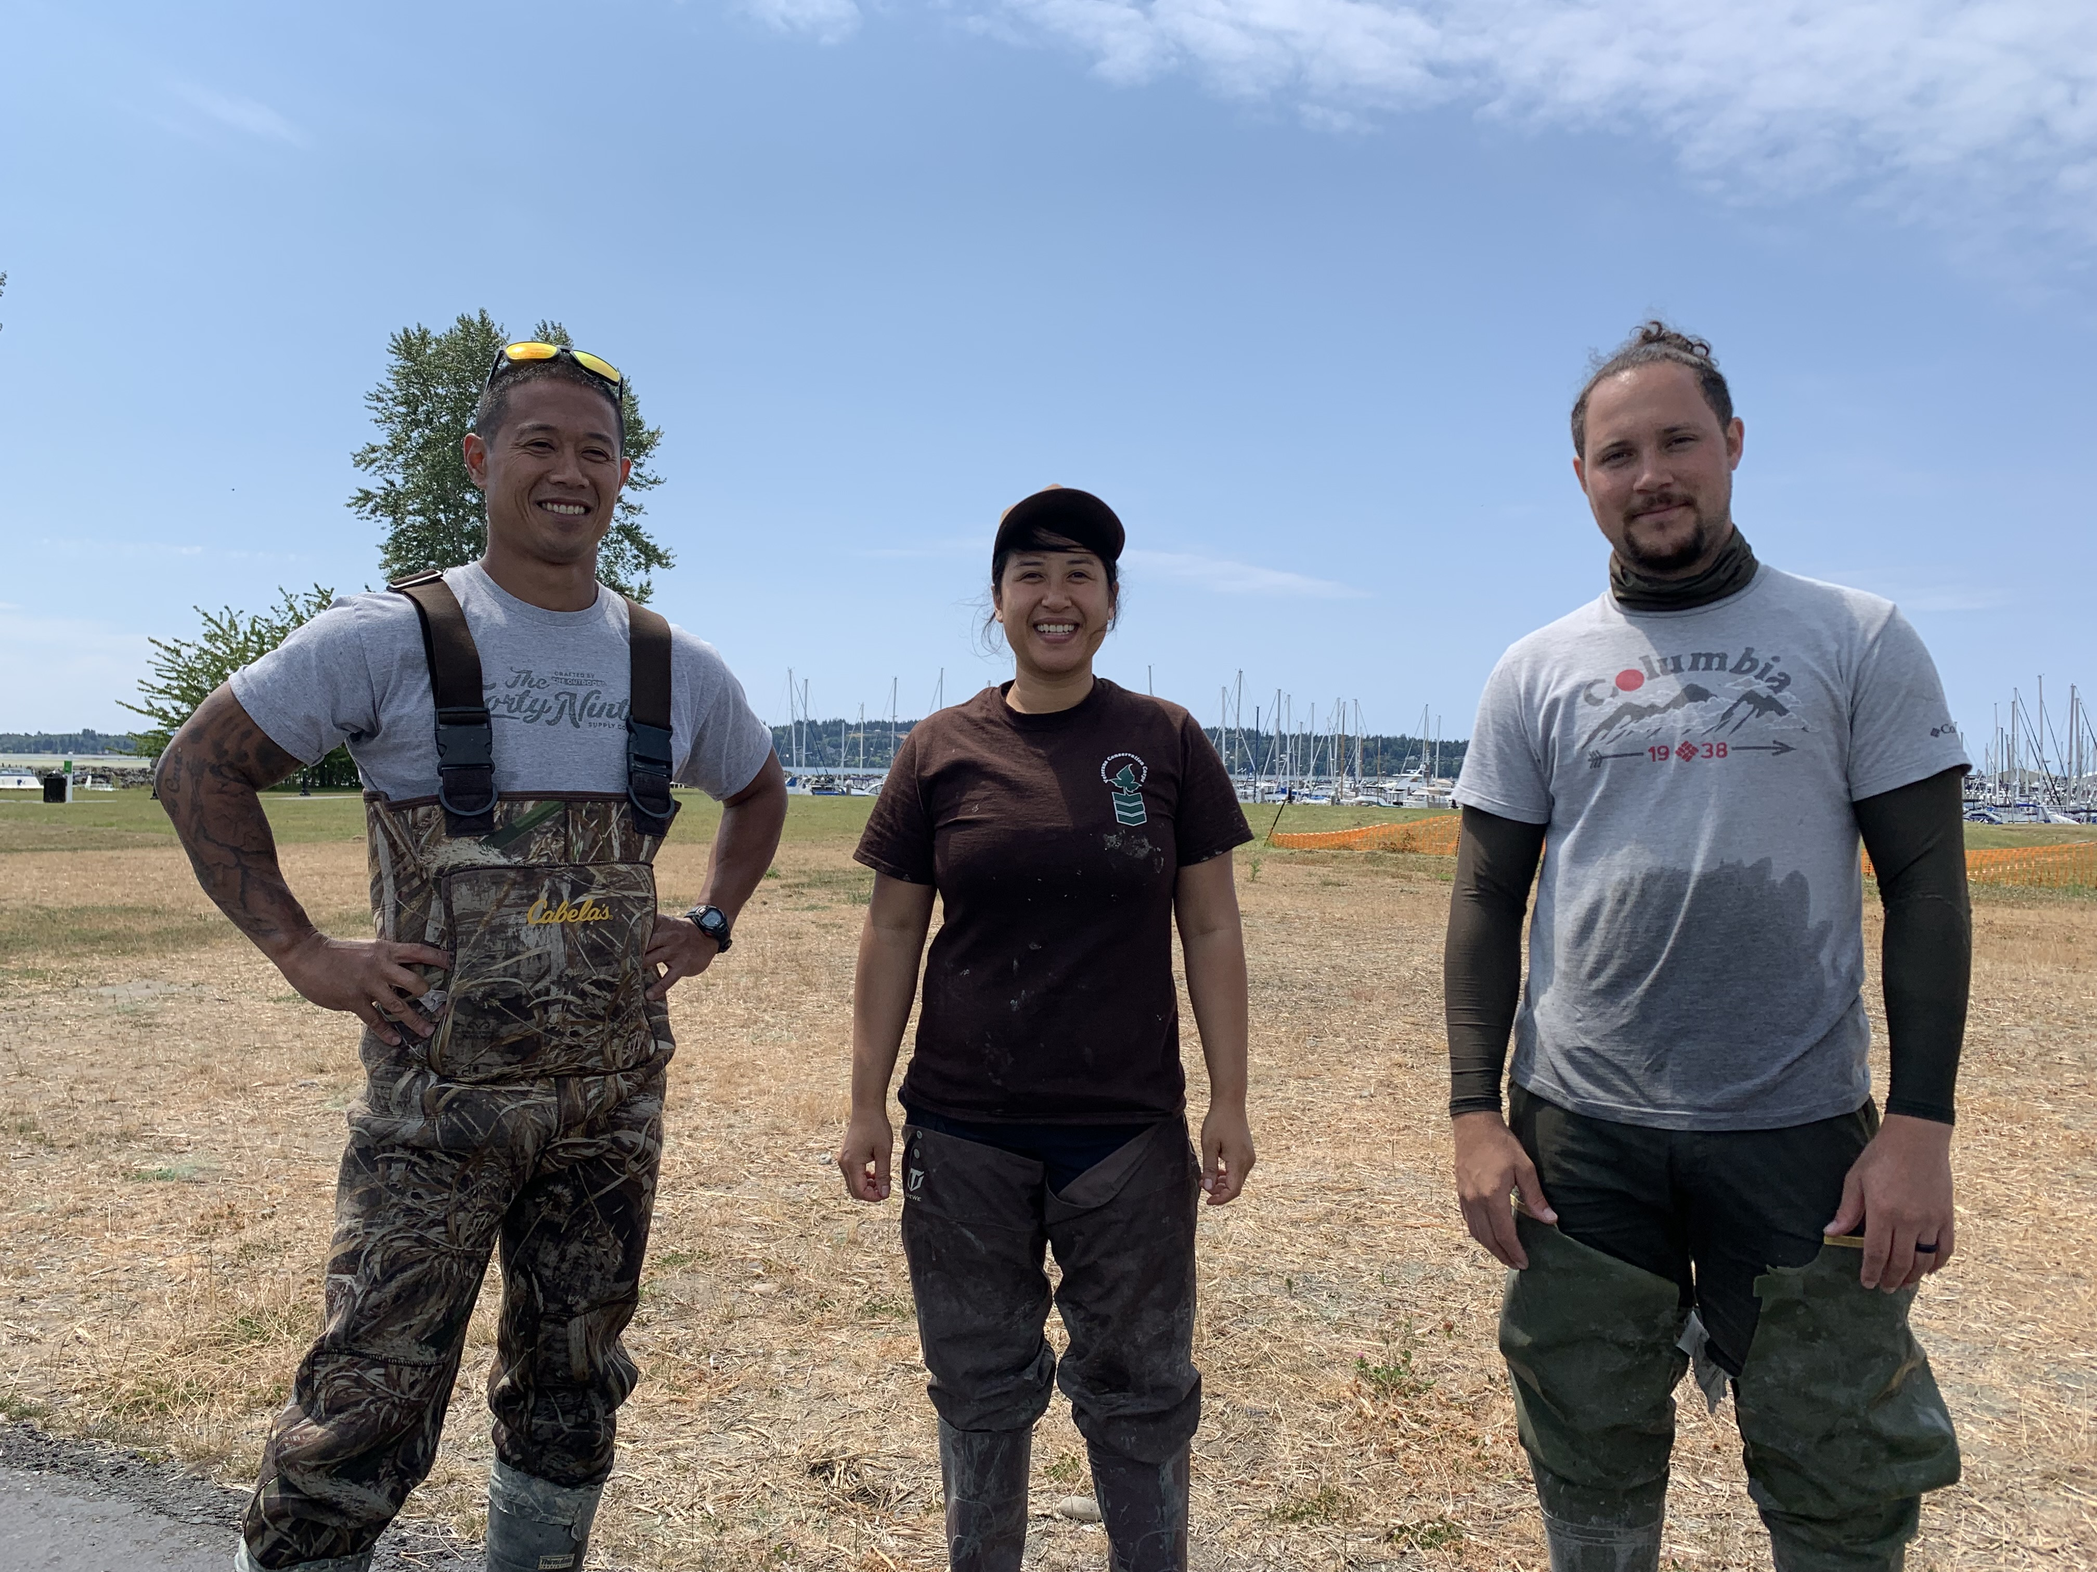

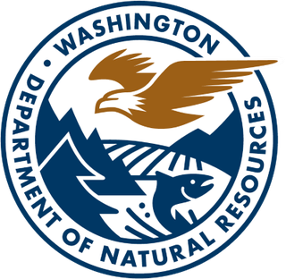
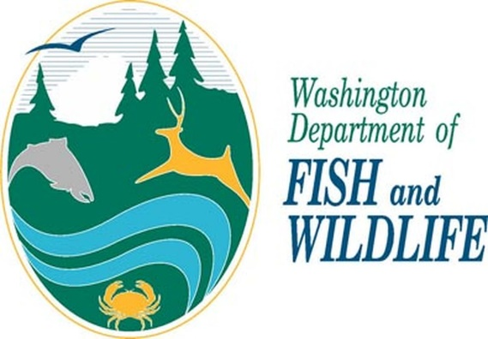



Collaborations & Partners: Drayton Harbor, WA
For planning:
Washington Department of Fish and Wildlife
Washington Sea Grant
For funding:
US Environmental Protection Agency/Puget Sound Partnership
WA Legislature (via WDFW)
For personnel:
Northwest Straits Commission
Veterans Conservation Corps
Washington Conservation Corps & Puget Sound Corps (WA DNR)
Whatcom Marine Resources Committee (volunteer)
For information/advisement:
Washington Department of Fish and Wildlife
Washington Sea Grant

Slide 27
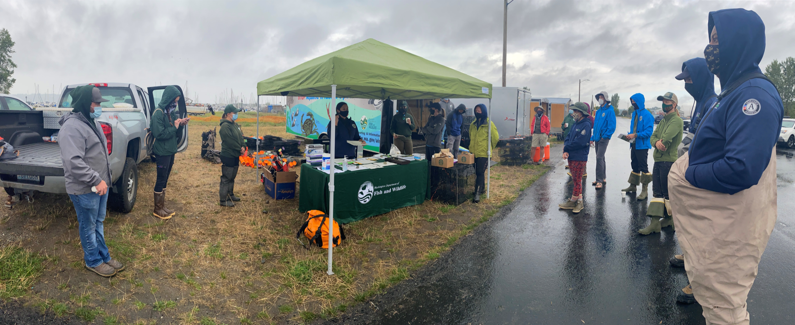
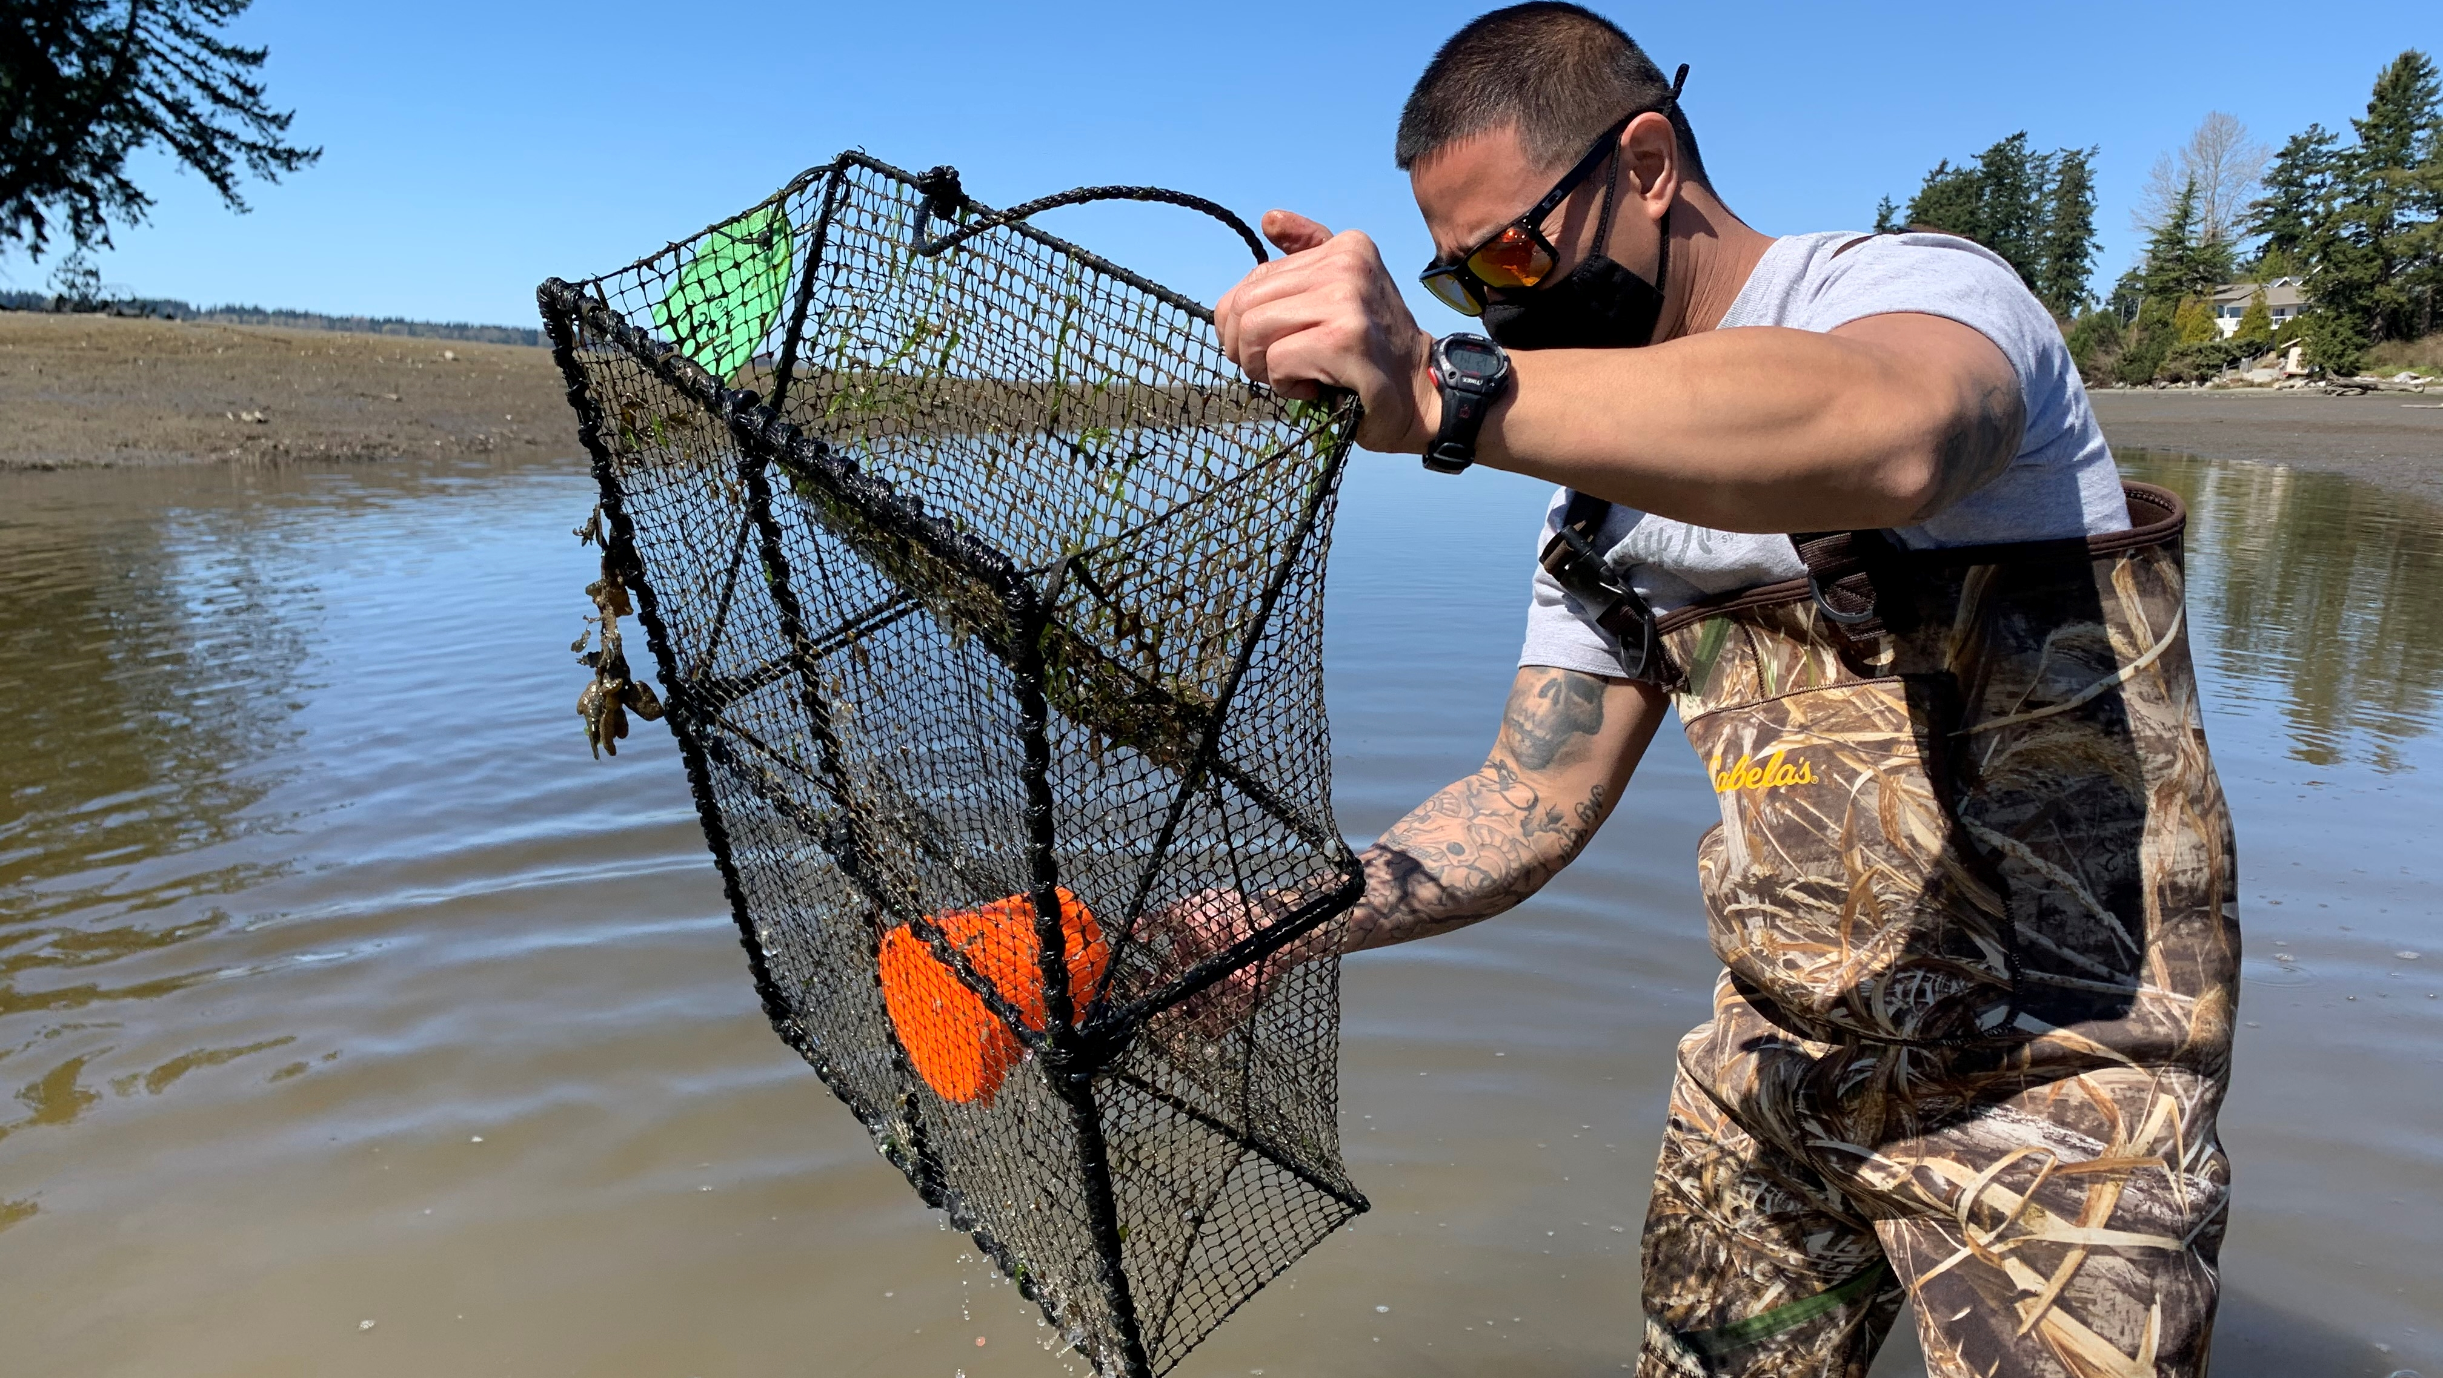
Lessons Learned: Drayton Harbor, WA
Successes
With the help of WDFW we conducted a harbor-wide grid survey that included 31 individuals across 7 organizations!
Lessons learned
Public outreach and education is essential for removal efforts in places with complicated land ownership.
Collaboration is key! Trapping could not have happened without in-the-mud help from multiple organizations.
Ongoing challenges
How to best include volunteers for dedicated removal efforts.

