Slide 1
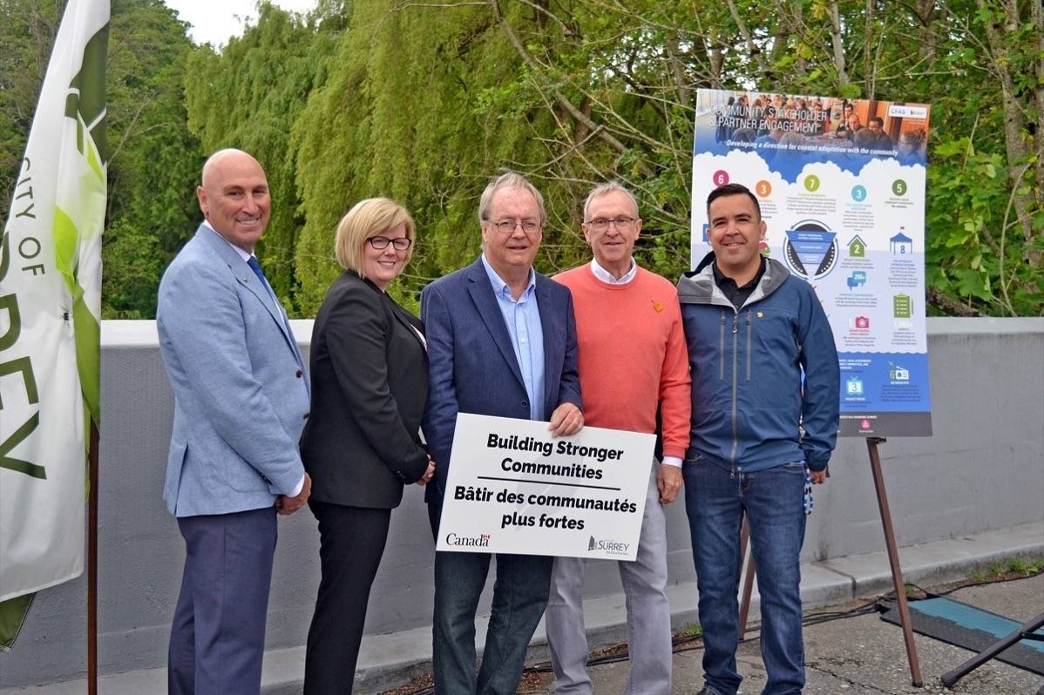
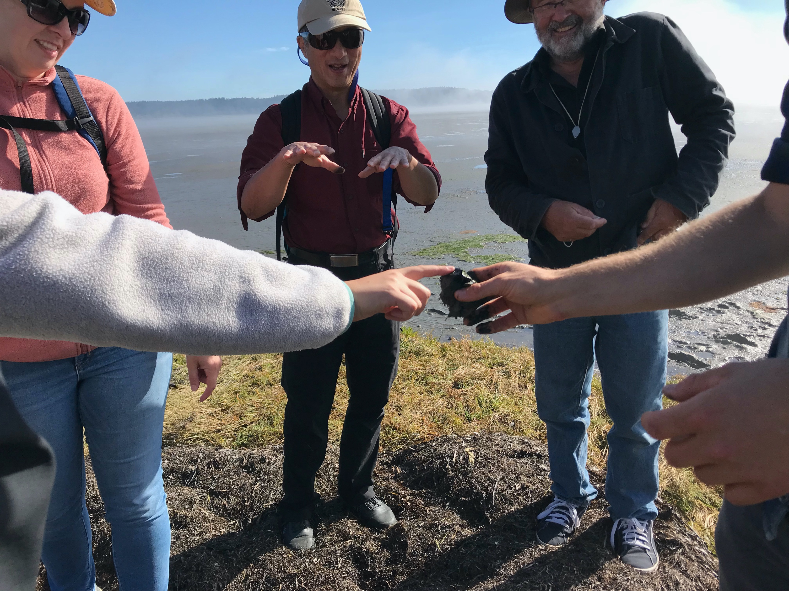
Relationship building for nature-based flood management Chief Harley Chappell, Semiahmoo First Nation; Matt Osler, City of Surrey; Erin Clement, City of Delta; Eric Balke, Province of BC (Moderators: Gillian Fuss, Emergency Planning Secretariat; Deborah Carlson, West Coast Environmental Law) Salish Sea Ecosystem Conference April 26, 2022
Gord McKenna

