Slide 1
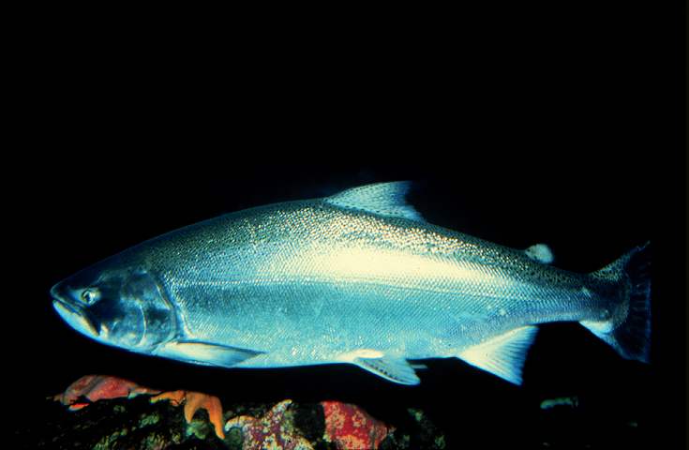
Contaminants reveal spatial segregation of Chinook salmon in Puget Sound: implications for the health of salmon, and the people and whales that eat them
Photo by Andrew Henry
Sandra O’Neill, Andrea Carey. Louisa Harding, Robert Fisk, Mariko Langness, Danielle Nordstrom, and James West
Washington Department of Fish and Wildlife
Toxics Biological Observation System (TBiOS)
Notes:
Chinook salmon are a favorite food for both people and resident killer whales. However, some Chinook population from Puget Sound are exposed to and accumulate contaminants, at concentrations that are high enough to affect the health of the salmon. Many of the contaminants that Chinook salmon are exposed to are poorly metabolized, persist in the environment and bioaccumulate and biomagnify
in the food web. Those toxic contaminants that persistentant and bio-accumulative are also a concern for people and whales that eat these salmon.

Slide 2
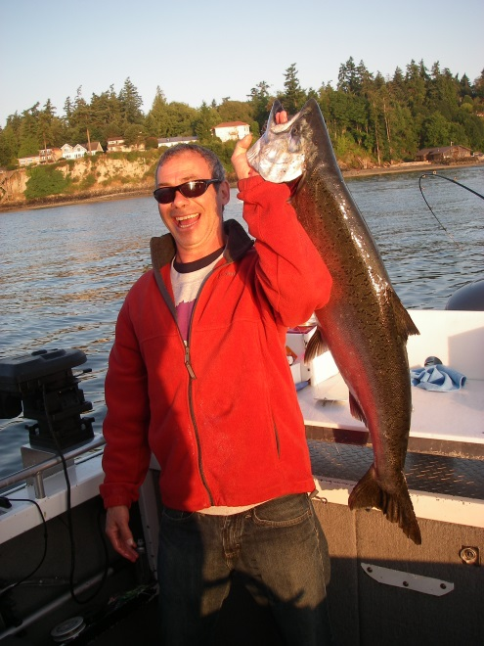
Resident Chinook Salmon: Study Motivation
Puget Sound Chinook salmon are threatened
Puget Sound population 3 - 5 times more contaminated than other West Coast populations
~1/3 feed within Puget Sound rather than the Pacific Ocean
Residency hypothesized to increase contaminant exposure
O’Neill & West 2009, TAFS 138:616 - 632
Chamberlin et al. 2011, TAFS 140:1398 - 1408 WDFW unpub. data)

Slide 3
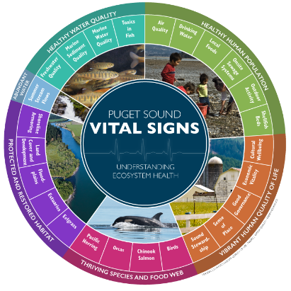
Resident Chinook Salmon: Study Questions
How contaminated are resident Chinook salmon?
Do contaminant levels of residents vary by region?
What are the implications of contaminant exposure
for salmon health?
for people?
for southern resident killer whales?
https://tinyurl.com/2p9c8dsb

Slide 4
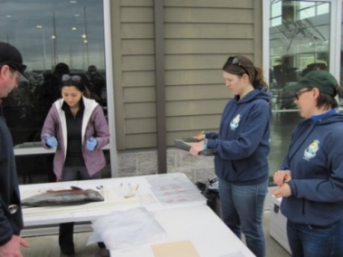
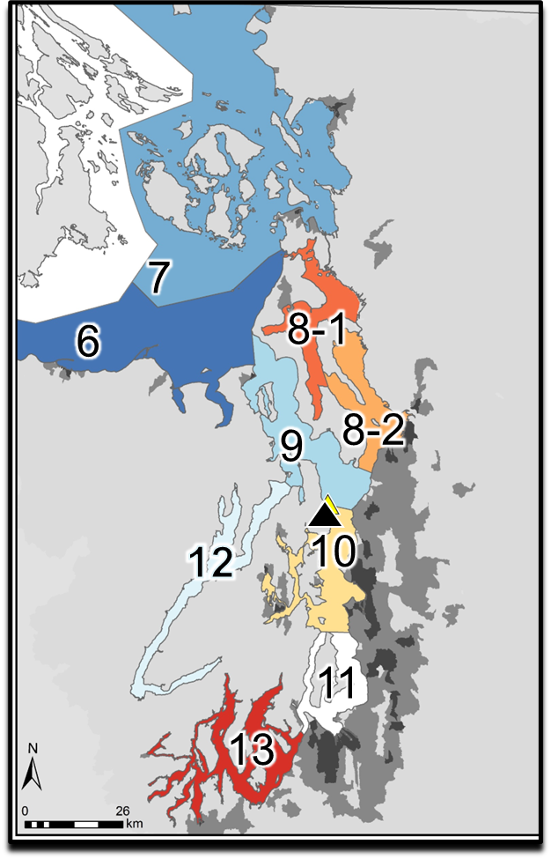
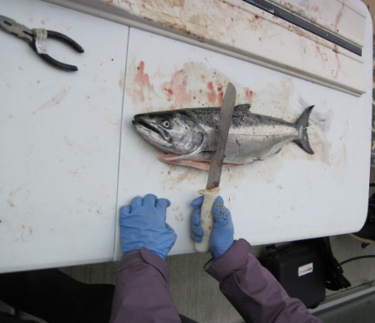
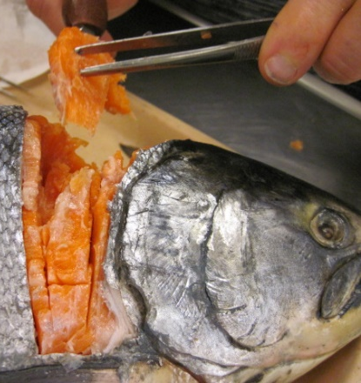
Methods
8 Marine Areas (MA)
114 fish collected in 2016 and 2017 from
winter sport fisheries, and
commercial test fishery ( )
muscle tissue analyzed for contaminants
PCBs, PBDEs, DDTs,
HCB, dieldrin, & chlordanes,
PFAS, CEC & Hg (subset)
Notes:
Fish were collected from 8 Marine Areas, roughly representative of marine oceanographic basins

Slide 5
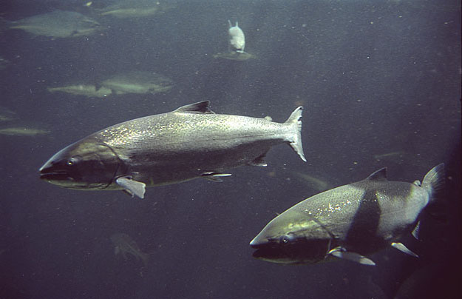
Results: Contaminant Concentrations & Patterns
Richard Bell photo

Slide 6
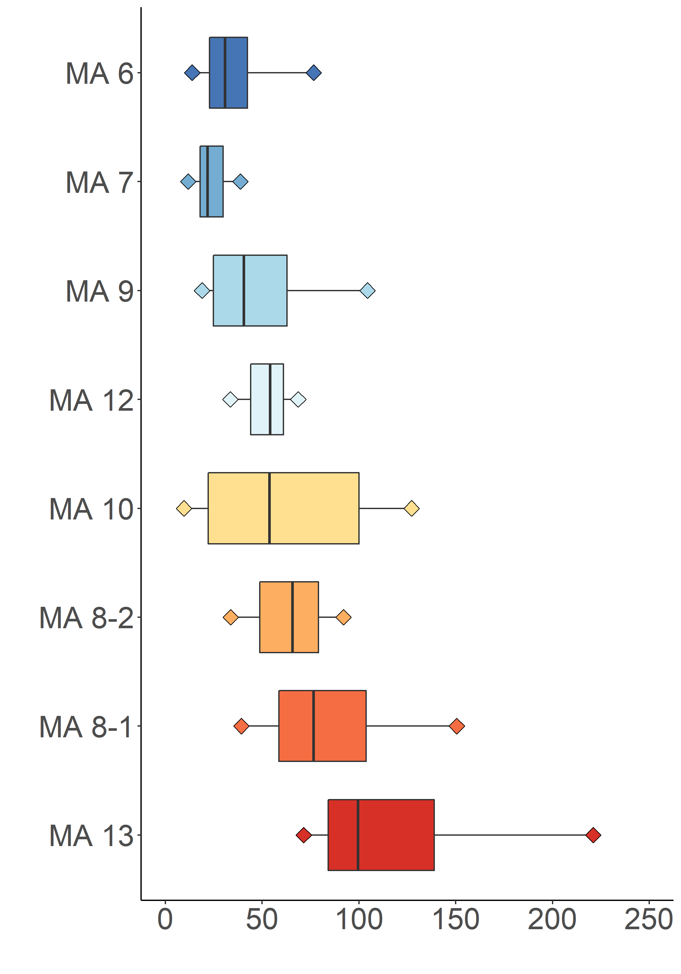
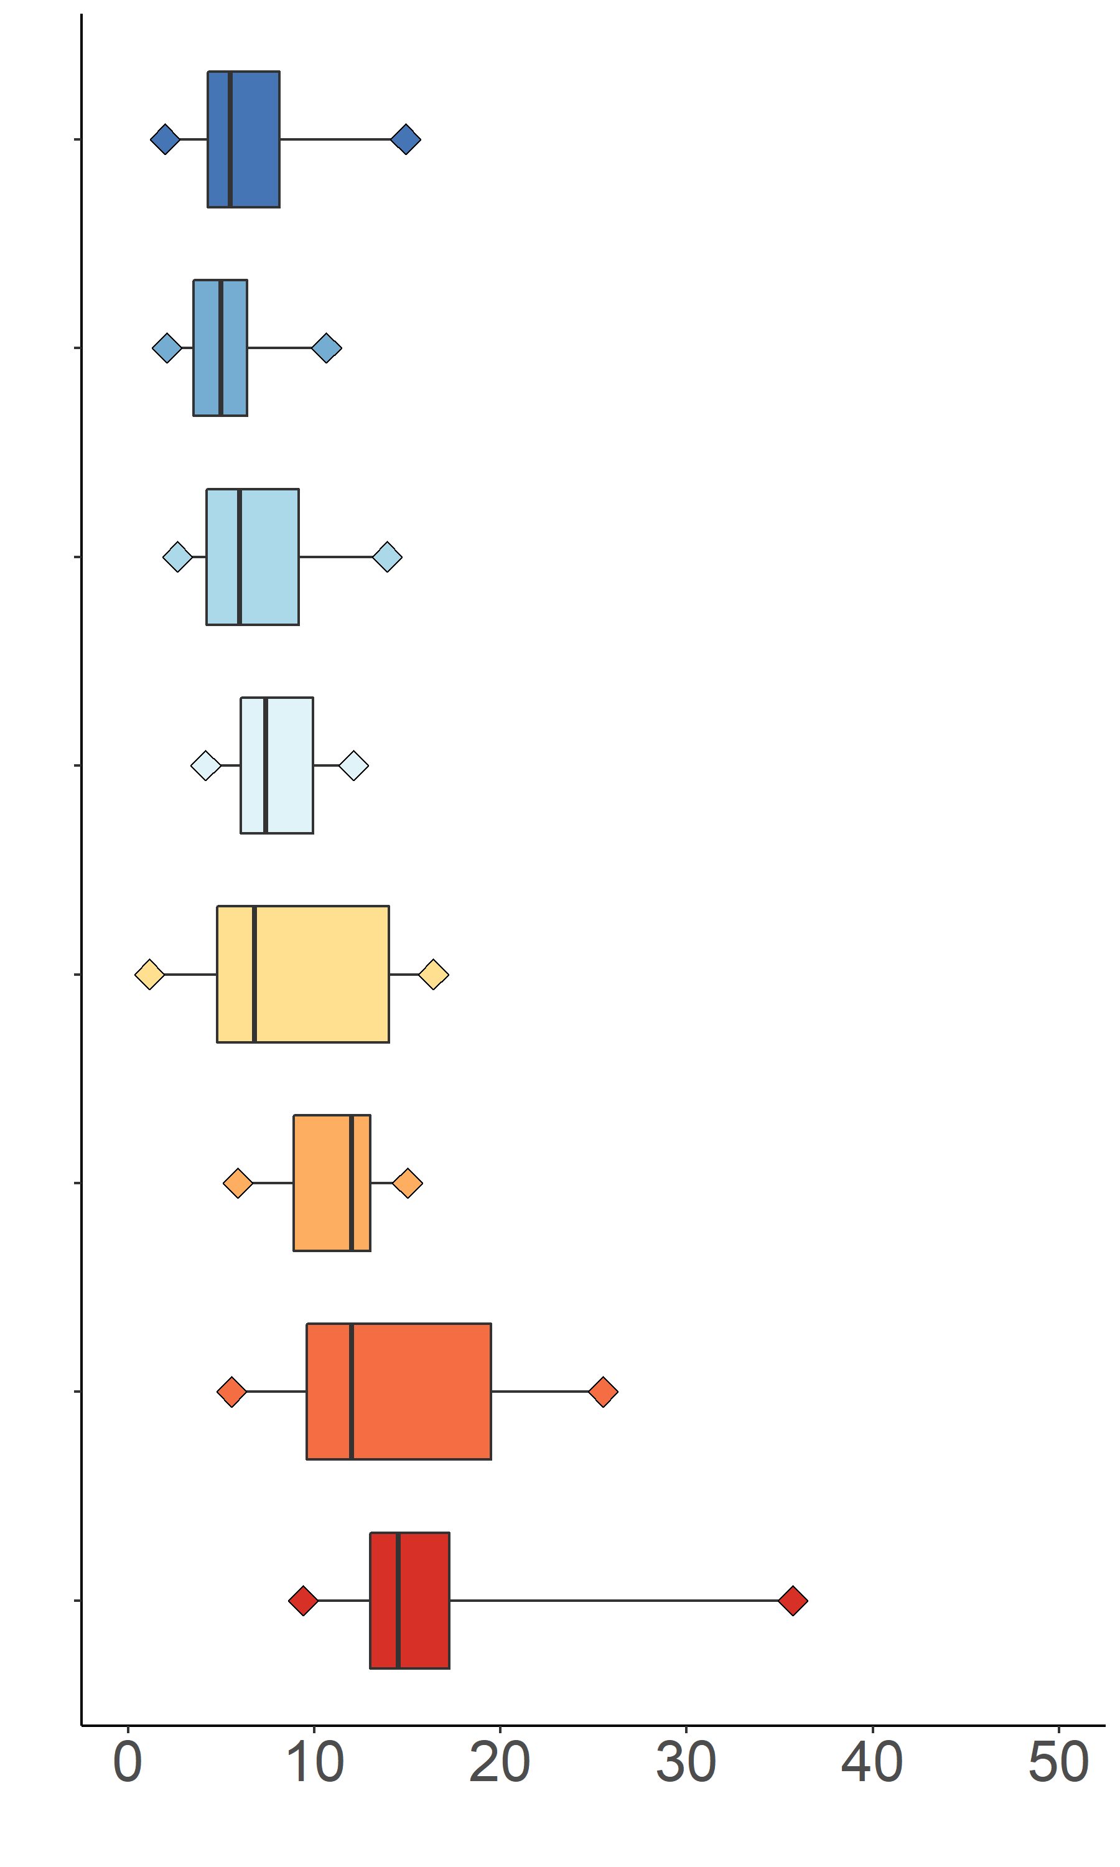
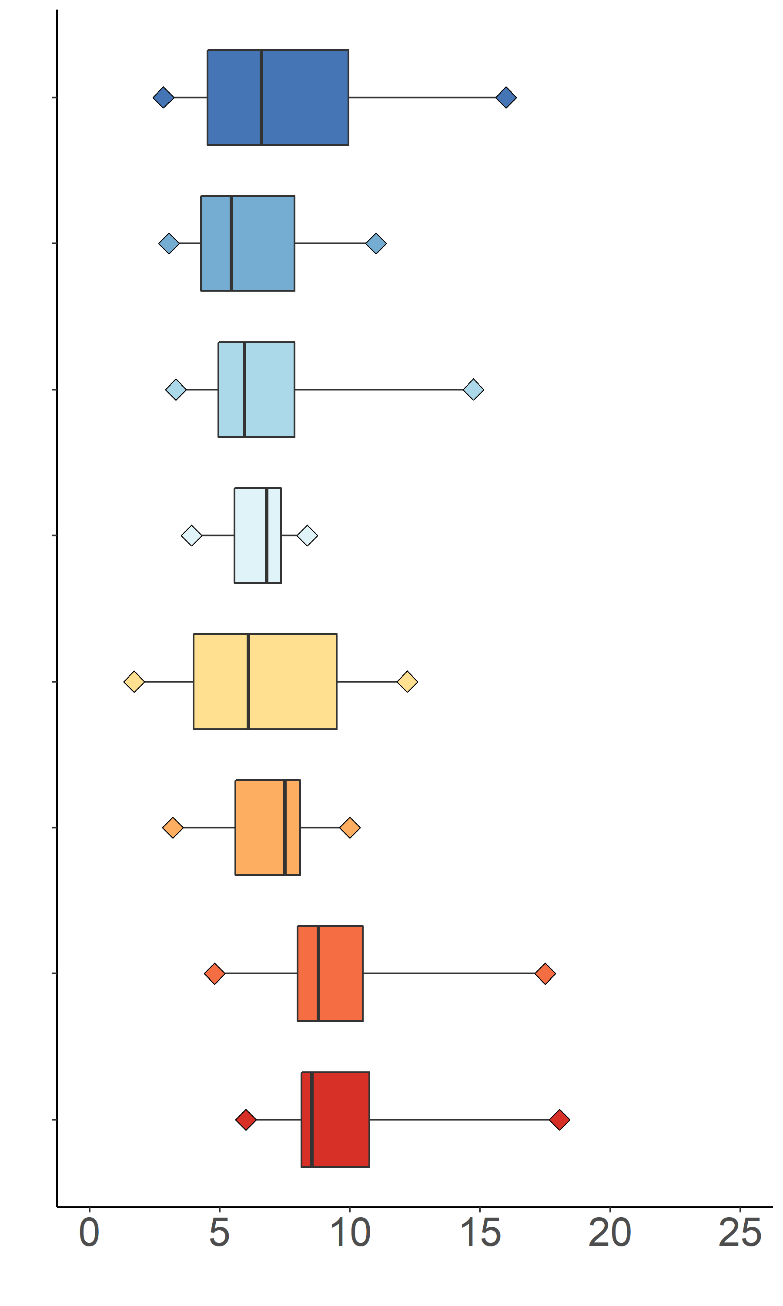
POPs in Resident Chinook salmon
PCBs
PBDEs
DDTs
Concentrations lower in outer Puget Sound
Distance from Pacific Ocean
5X higher average concentration
3X higher average concentration
Fillet Concentration (ng/g ww)
Notes:
Note: Box plots are based on 2*17 PCBs, Sum11 PBDEs, and Sum5DDTs;

Slide 7
Spatial Patterns in Concentrations
Elevated PCBs & PBDEs in Chinook salmon caught in inner Puget Sound, compared to outer Puget Sound, suggesting:
higher inputs to inner Puget Sound
estimated loading 11 x greater compared to Hood Canal and Admiralty Inlet (Osterberg and Pelletier 2015).
limited movement of resident salmon between inner and outer Puget Sound
Strait of Georgia
San Juan
Islands
Strait of
Juan de Fuca
Whidbey
Basin
Admiralty
Inlet
Hood Canal
Central
Basin
South
Basin

Slide 8
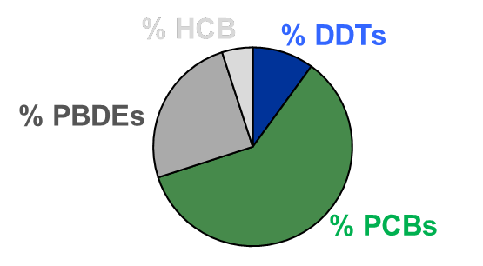
POP contaminant pattern (i.e., fingerprints) can be used to infer salmon movement patterns among Marine Areas
?
Evaluation of relative proportion of POP classes rather than absolute concentrations
Richard Bell photo
Notes:
The relative abundance of four POP classes in Chinook salmon populations revealed unique chemical fingerprints consistent with their known marine distribution, confirming that POP patterns can be used as chemical tracers that reflect time spent foraging in specific marine regions. We observed higher levels of DDTs compared to other POPs in Chinook populations originating from California that migrate northward and feed off the coast of California and Oregon (Weitkamp 2010), reflecting greater historical use of DDT in California. Likewise, higher concentrations of PCBs and PBDEs were observed in salmon that reside in Puget Sound, where the pelagic food web has elevated concentrations of these contaminants relative to the other regions of the west coast (West et al. 2008, O’Neill et al. 2009).

Slide 9
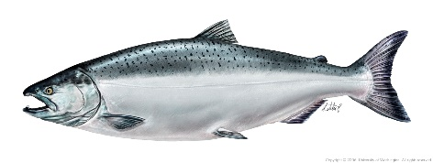
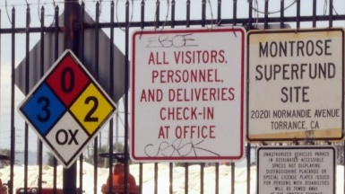
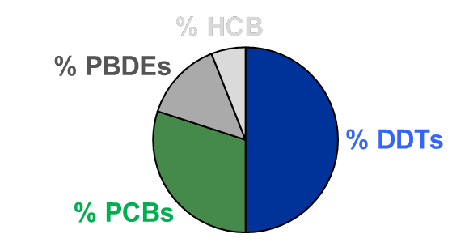
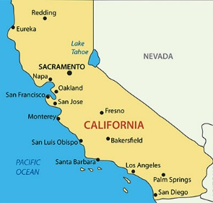
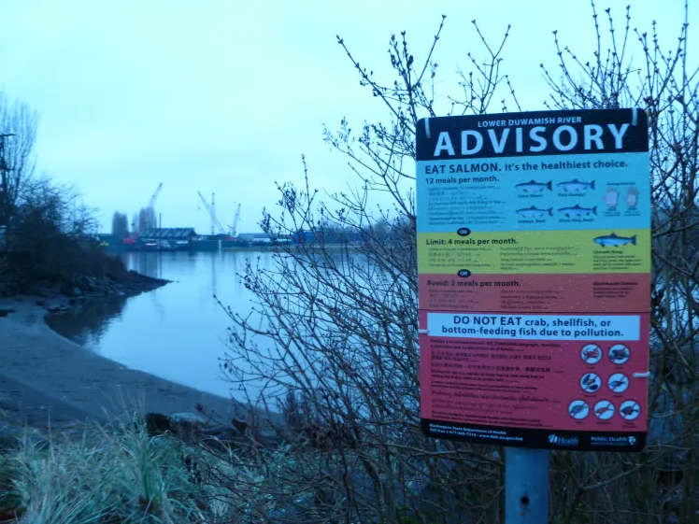
Do contaminant fingerprints indicate limited movements of resident salmon?
Regions have distinct POP patterns based on historical inputs & environmental attributes
Biota accumulate POPs in proportion to their availability in foraging habitats
DDTs
PCBs
Notes:
First, we used source identification thru contaminant fingerprints.
Just like fingerprints are unique to an individual, contaminant fingerprints are unique to a specific location and can identify where a fish is foraging
Aquatic environments have distinct patterns of contaminants based on historic inputs and unique environmental characteristics
FOR EXAMPLE
Montrose Superfund Site - DDT inputs to CA coastal waters
Elevated PCB/PBDE in Puget Sound central basin, multiple inputs
Biota foraging for extended time periods in regions with distinct contaminant patterns will accumulate specific contaminants proportional to their availability in the environment
Therefore, concentrations of contaminants can reflect time foraging in regions with distinct chemical inputs
The example here is over a large area – It can also be used in smaller geographic areas
For the resident Chinook salmon, we’re looking to see if salmon from the contaminant fingerprint along the migration pathway of these fish

Slide 10
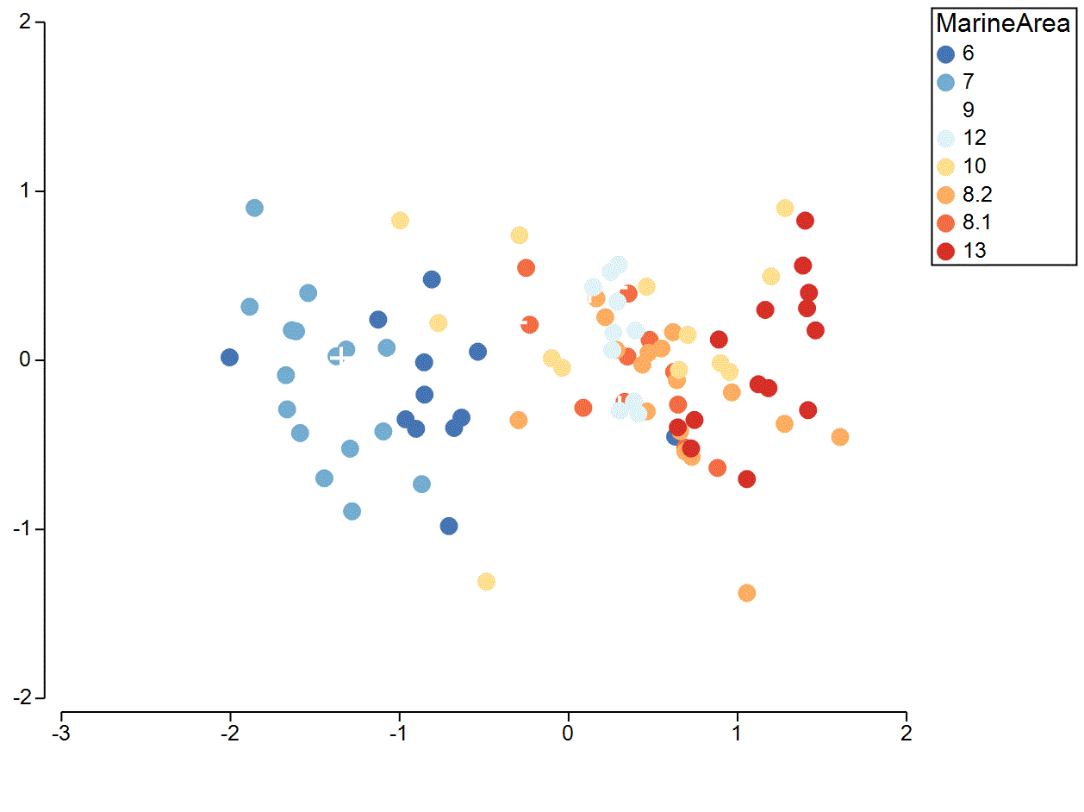
POP Fingerprints Reveal Segregation of Resident Chinook
Strait Juan de Fuca
Hood Canal
Inner Puget Sound
San Juan Islands
Tagging studies documented limited movements between resident Chinook caught in the Strait of Juan de Fuca & the San Juan Islands with those residing in the Central Basin (Arostegui et al. 2017; Kagley et al. 2017).
PC2 (explains 16.8% variation)
Increasing % DDT, HCB
Increasing % PCB
PC1 (explains 74.1% variation)
Tagging studies documented limited movements between resident Chinook caught in the Strait of Juan de Fuca & the San Juan Islands with those residing in the Central Basin (Arostegui et al. 2017; Kagley et al. 2017).
Notes:
salmon caught in in the San Juan Islands (MA 7) and the Strait of Juan de Fuca (MA 6) with those in the rest of Puget Sound, indicating limited overlap in their marine distribution (data not shown), consistent with
previous salmon tagging studies that documented limited movements between resident Chinook salmon caught in the Strait of Juan de Fuca and the San Juan Islands with those residing in the Central Puget Sound basin (Arostegui et al. 2017; Kagley et al. 2017).

Slide 11
Implication of Spatial Segregation of Resident Chinook
How does spatial segregation of resident Chinook salmon affect
salmon health?
people?
whales?
Richard Bell photo
Richard Bell photo

Slide 12
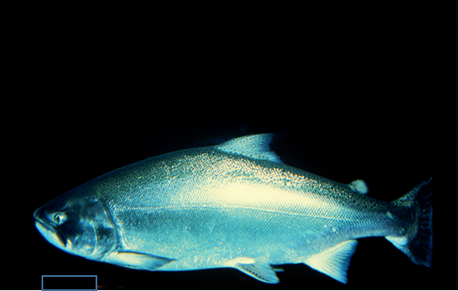
Implications for Salmon
PCBs & PBDEs likely impair salmon health
15% samples > reproduction, growth, disease susceptibility thresholds
54 – 69% > in MA 13
1% samples > mortality threshold
15% in MA 13
Percent of fish impaired is likely higher
Concentrations will be > in mature salmon as they will spend another 5 – 24 months feeding in Puget Sound prior to spawning
Combined effects of exposure to multiple contaminants will be greater
Richard Bell photo
Photo by Richard Bell
Andrew Henry photo
Photo by Andrew Hendry

Slide 13
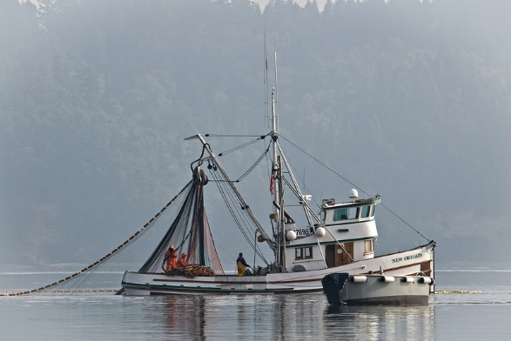
Implications for People
99% sample of resident Chinook salmon have PCB levels high enough to affect their health
< 2 meals/month resident Chinook for average consumers.
< 4 meals/month Chinook for average consumers
fewer meals for subsistence consumers
Elevated PCBs and PCBs reduces salmon viability
decreases recreational, commercial, tribal ceremonial and subsistence fishing opportunities.
https://tinyurl.com/2p9c8dsb

Slide 14
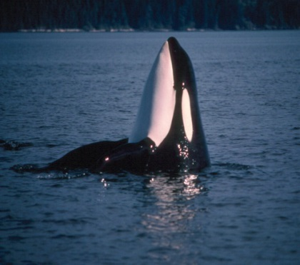
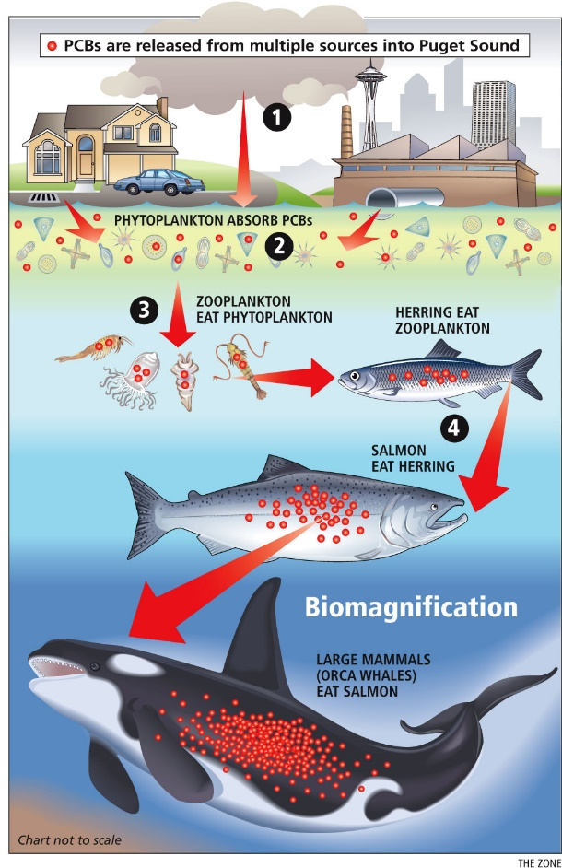
Implications for Whales
Photo by Graeme Ellis
PCBs and PBDEs in Puget Sound Chinook salmon bio-magnify to SRKWs, especially for J-pod, to levels high enough to reduce their immunity to disease and cause reproductive disruption
(Mongillo et al. 2012, Hickie et al. 2007).
PCBs and PBDEs are likely a contributing factor to low survival of juvenile and adult Chinook salmon in Puget Sound, thereby reducing the availability of prey to whales.
Notes:
The high levels of POPs in the Southern Residents have health implications that are influenced by interactions with other stressors, including the abundance of their prey. Reduced prey availability can cause a whale to draw on lipid reserves stored in its blubber, mobilizing POPs into circulation, where they have the potential to cause a toxic response. Therefore, nutritional stress from reduced Chinook salmon populations may act synergistically with high POP levels in Southern Residents and result in deleterious health effects.
The high levels of POPs in the Southern Residents have health implications that are influenced by interactions with other stressors, including the abundance of their prey. Reduced prey availability can cause a whale to draw on lipid reserves stored in its blubber, mobilizing POPs into circulation, where they have the potential to cause a toxic response. Therefore, nutritional stress from reduced Chinook salmon populations may act synergistically with high POP levels in Southern Residents and result in deleterious health effects.

Slide 15
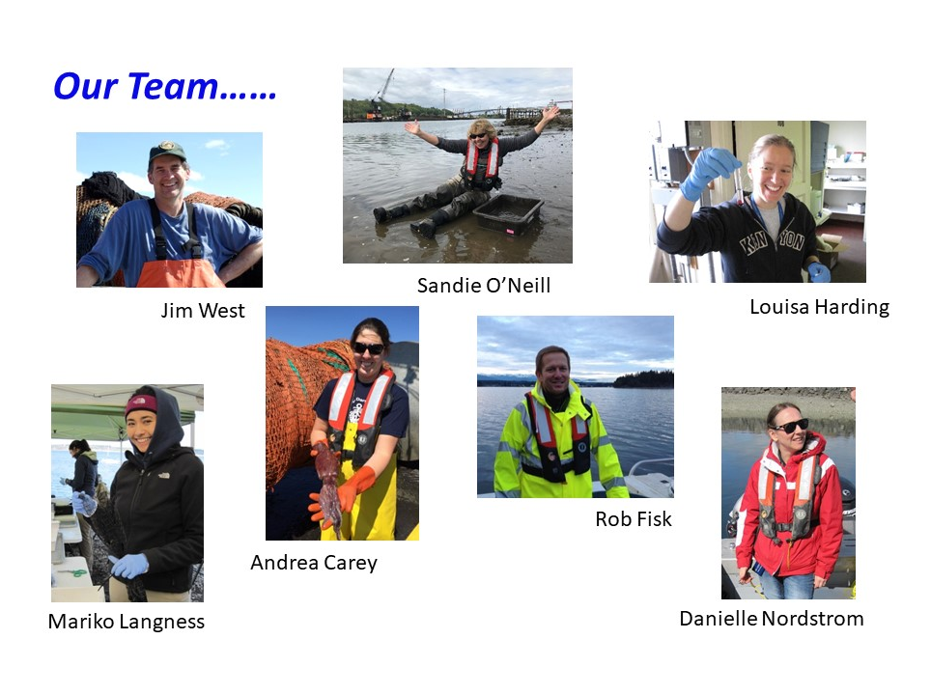

Slide 16
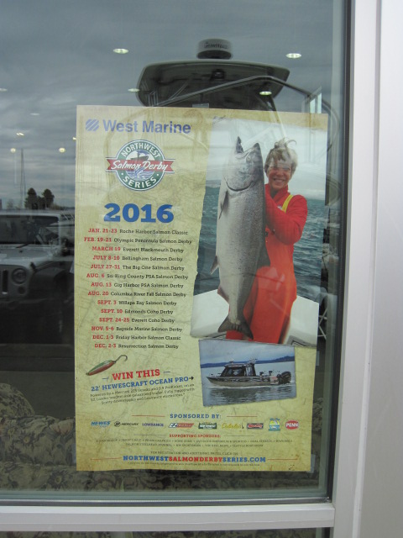
Acknowledgements
2016 NW Salmon Derby Series
Derby Organizers
Anglers
Pete Topping (WDFW)
Dept of Ecology – Keith Seiders Lab
NOAA NWFSC

